Slide 1
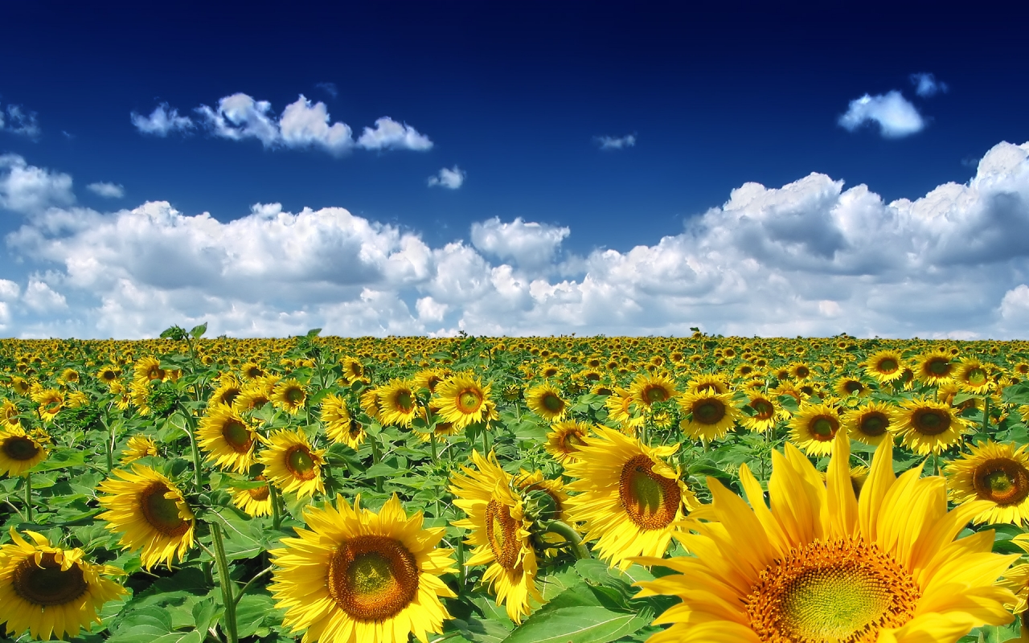
UKRAINE- LAND OF CONTRASTS

Slide 2
Цей слогАН

Slide 3
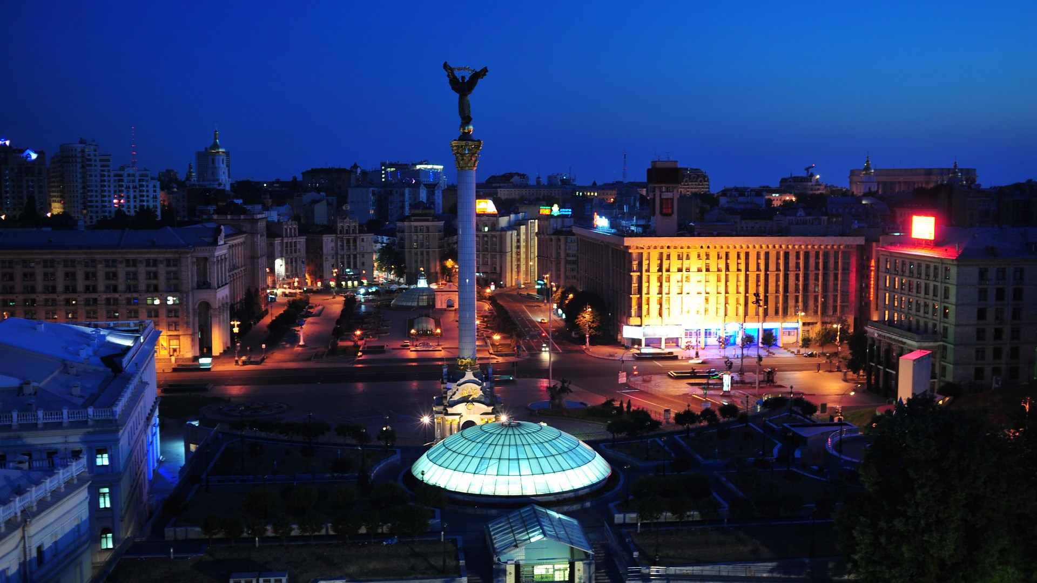
KYIV- THE CAPITAL OF UKRAINE

Slide 4
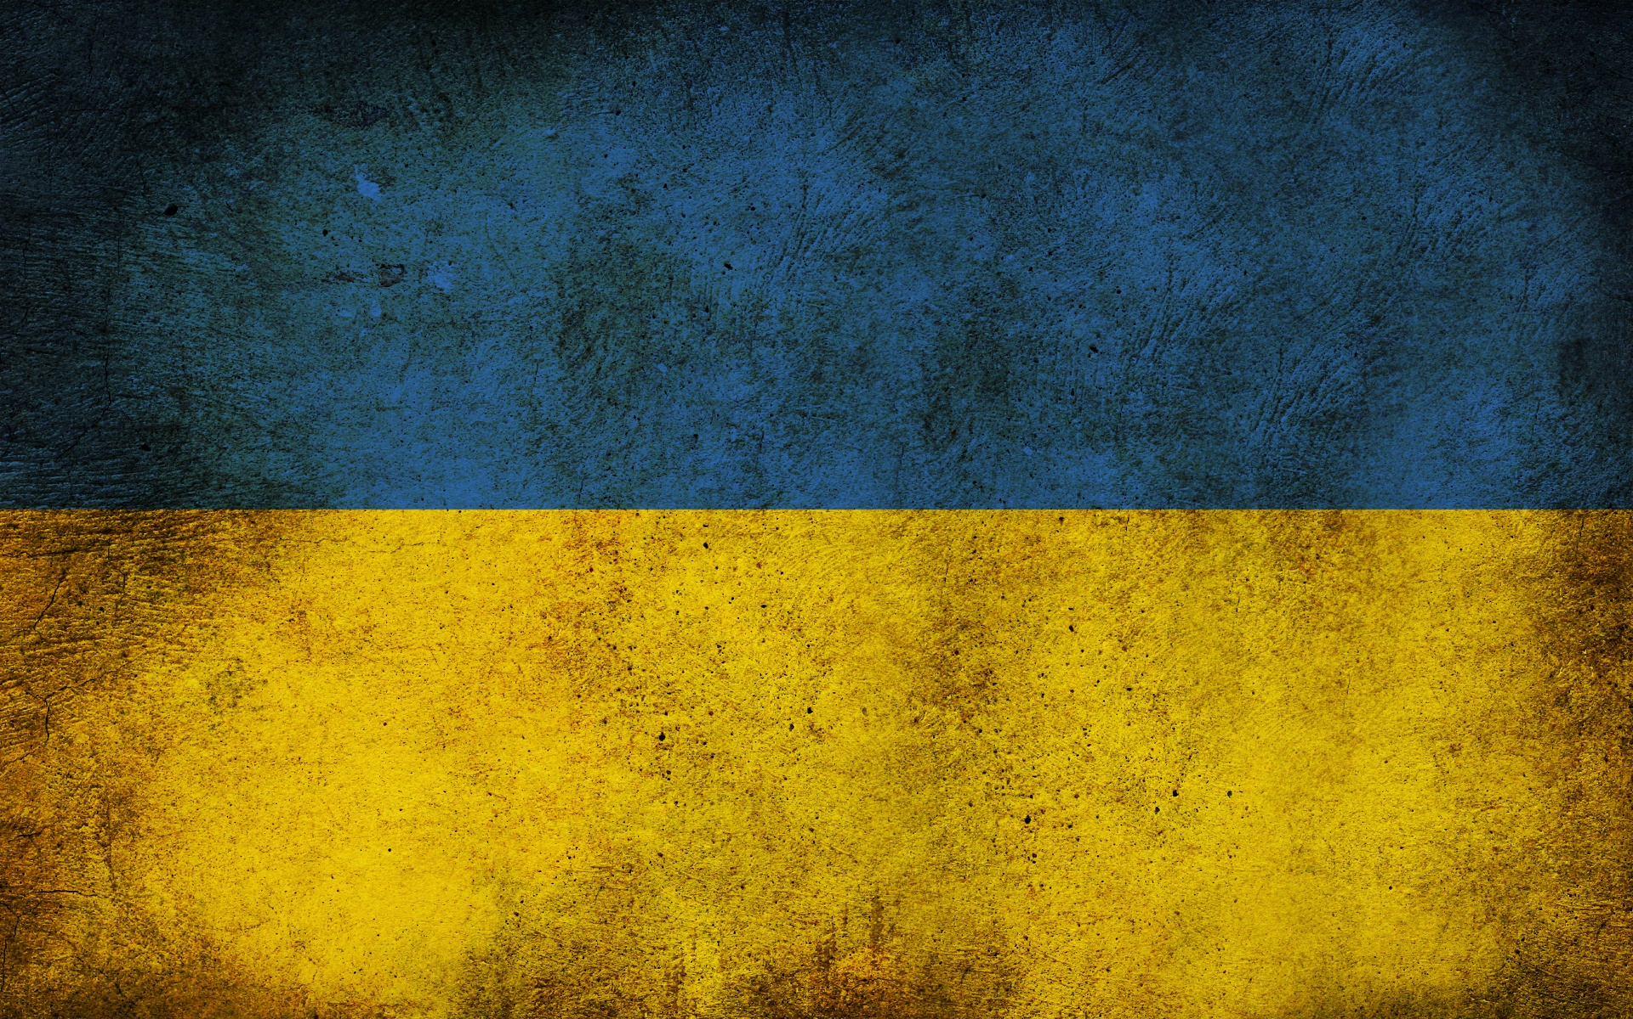
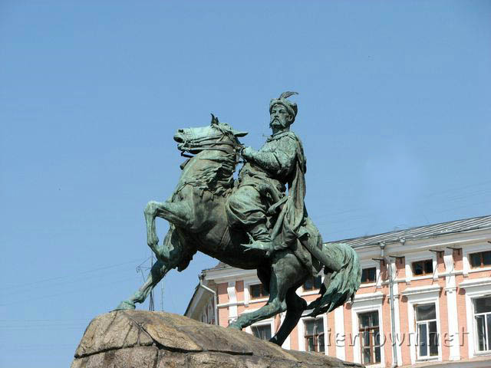
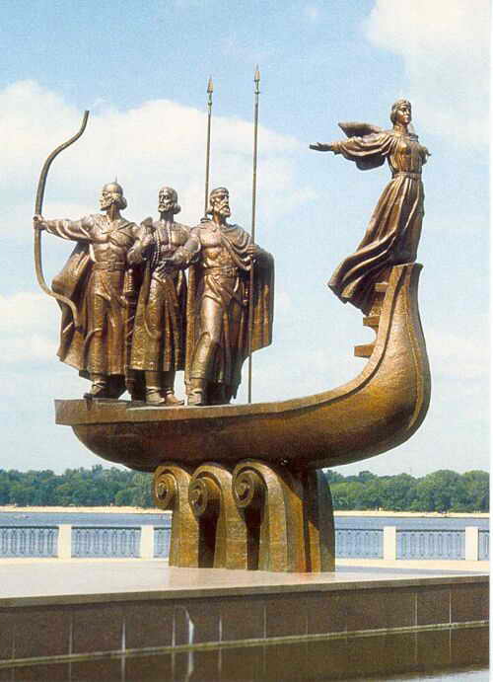
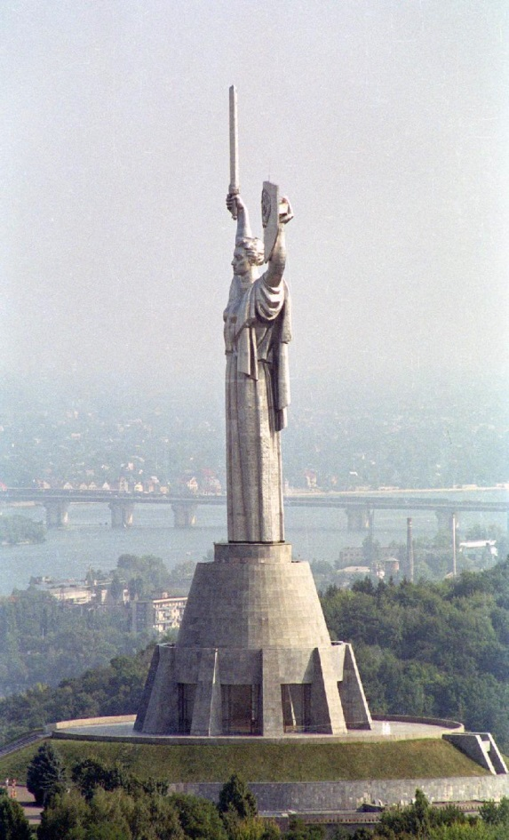
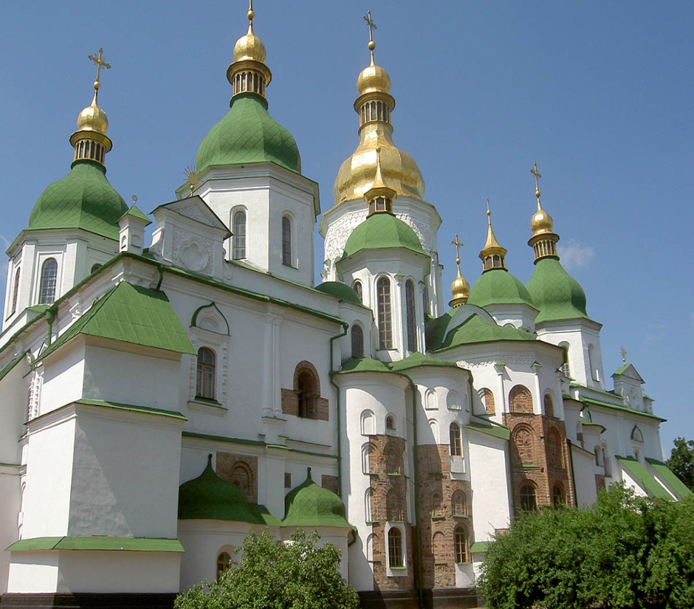
Also known as:
the Mother of all Rus cities
the Majestic the City of Gardens
Founded over 1.5 millennia ago
Come to see :
UNESCO World Heritage sites
Millennia-old monasteries
Medieval fortifications

Slide 5
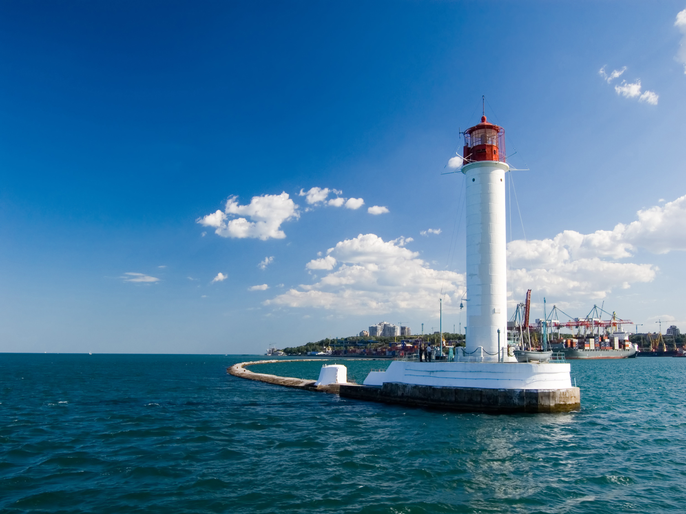
ODESSA- Pearl of the Black Sea

Slide 6
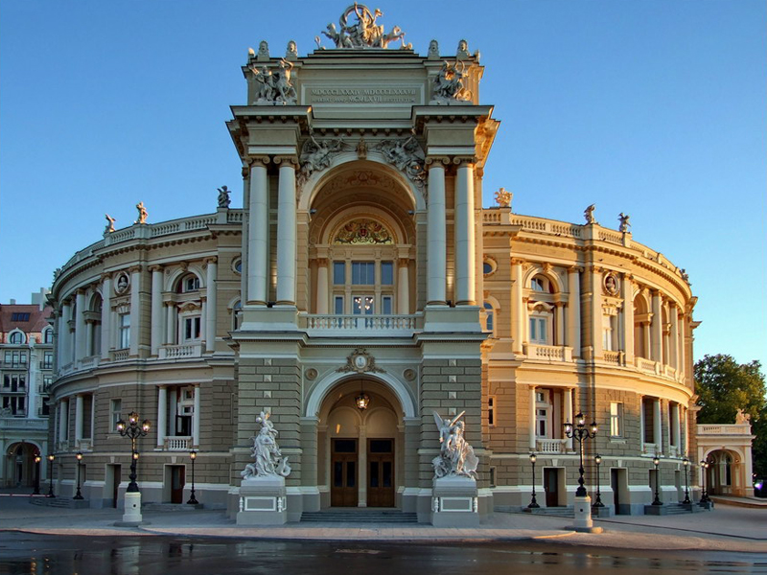
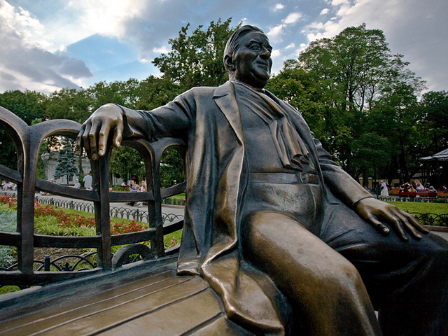
The largest city along the Black Sea. Odesa's mild climate, warm waters and sunlit beaches attract hundreds of thousands of people year around. Odesa's history left the city with some splendid architecture from the 18th and 19th centuries and irrepressible spirit.

Slide 7
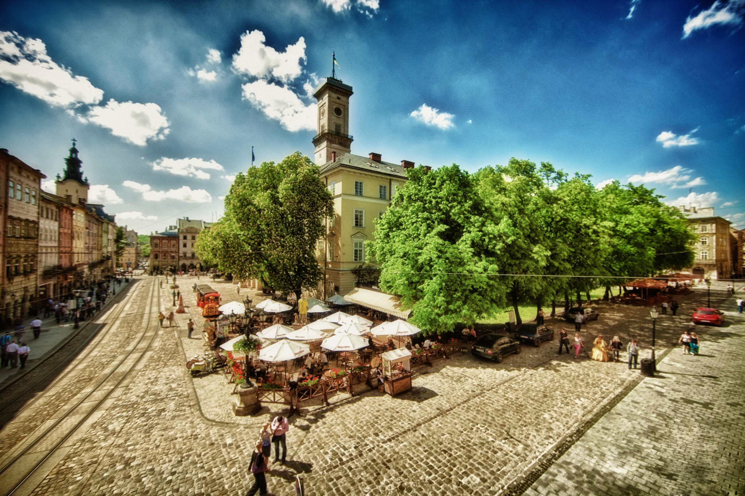
LYIV- HISTORICAL CITY

Slide 8
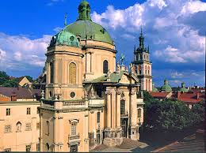
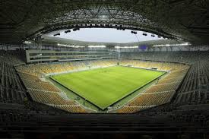
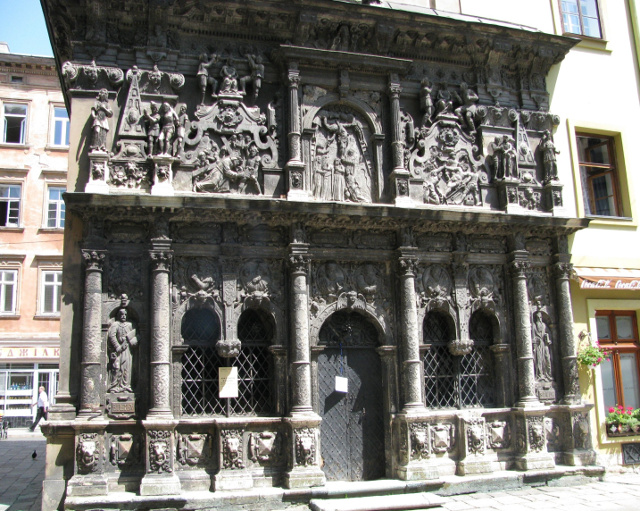
А beautiful city in the west of Ukraine, was founded by Prince Danylo Halytsky. The city was first mentioned in 1256. Today Lviv has an area of 155 square km. Its core is the city of the 14th—18th centuries. Lviv is the only city in Ukraine that still has some original Renaissance architecture.

Slide 9
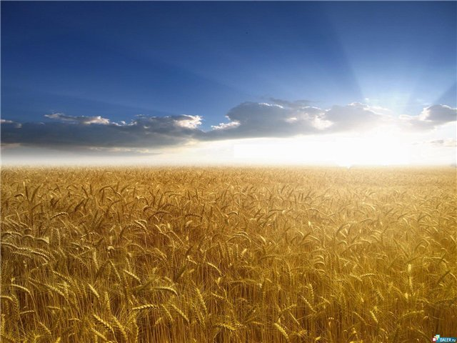
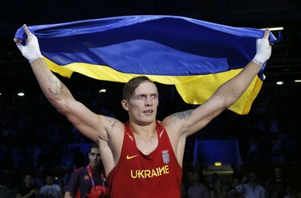
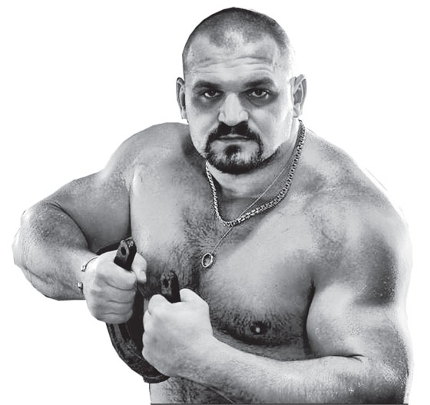
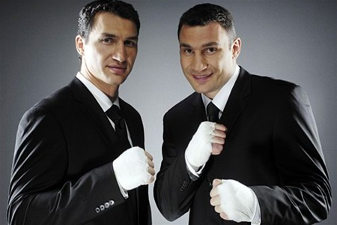
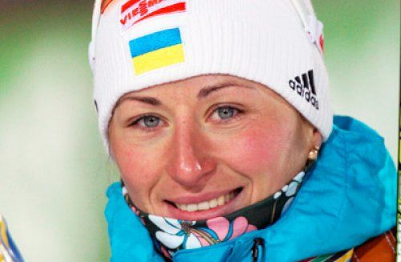

Slide 10
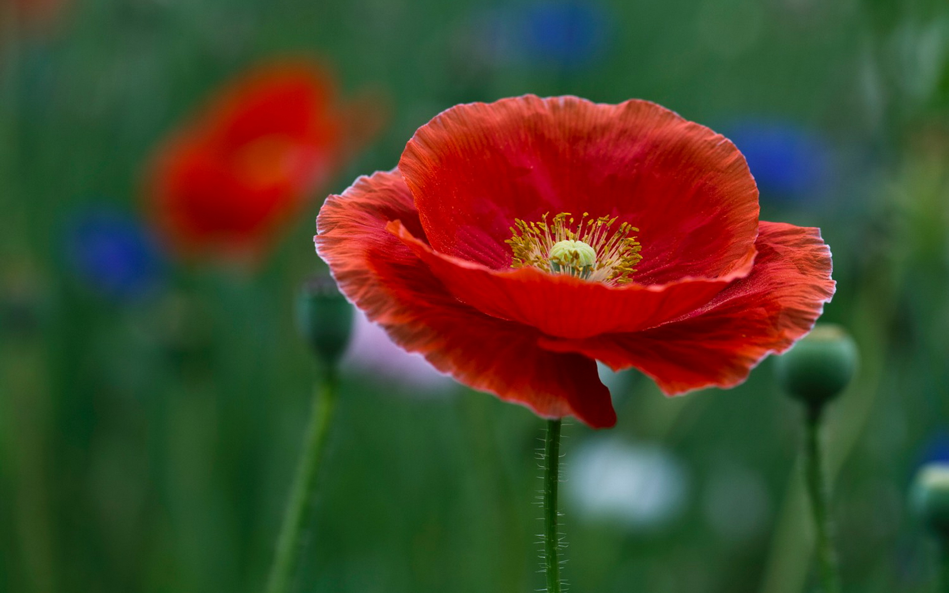
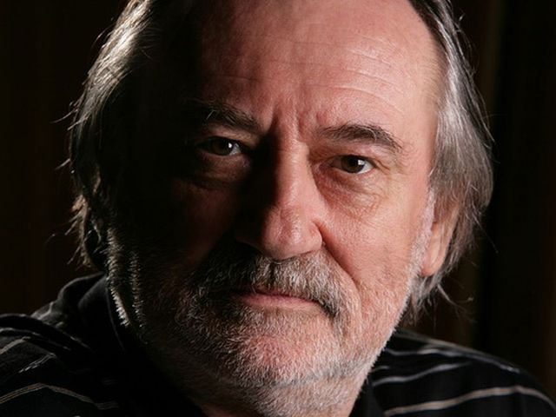

Slide 11
