Slide 1
BIG BEN

Slide 2
Big Ben - the bell tower in London, the part of the architectural complex of the Palace of Westminster.
The official name - "Clock Tower of Westminster Palace“, also called “the Tower of St. Stephen. "

Slide 3
The tower was built in 1858, the clock tower was set on foot 21 May 1859.

Slide 4
Big Ben - is not the name of the tower, but the name of the 13-ton bell that rings inside.

Slide 5
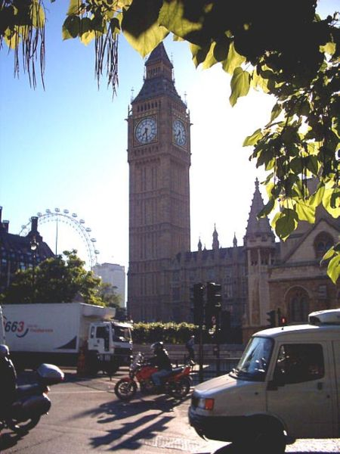
In 1844 by the decision of the Parliament there was established a commission for the construction of the clock tower. The following requirements for clock were: the first hit of the bell should correspond to hour up to a second.

Slide 6
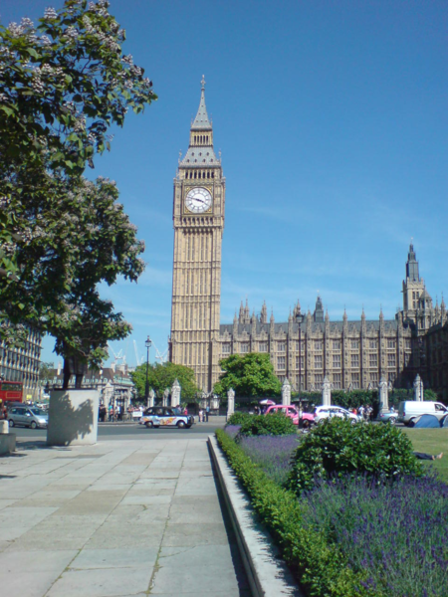
But by 1851, there was found a designer who decided to such a step - Edmund Beckett Denison, who decided to break the record of weight of the bell in York ("Peter the Great") in 10 tons and cast a bell weighing 16 tons.

Slide 7
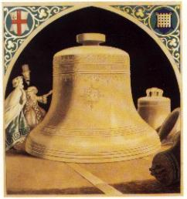
Casting was engaged by George Mears.
During the week the bell was melting
and then 20 days were spent on the fact that the metal cooled down and took shape. It happened on April 10, 1858
And after testing May 31, 1859 the bell
was taken to the building of the Parliament with the enthusiastic cheers of the crowd.

Slide 8
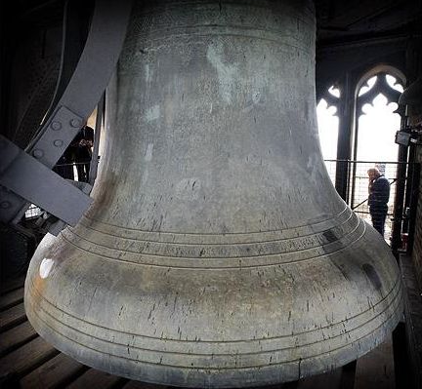
However, after 2 months the bell cracked to a huge upset of Denison. Weight of the hammer which beat the bell, was twice as heavy as the maximum possible weight of the hammer defined by George Mears.
During 3 years the bell was inactive, and instead beat off hours bell, responsible for a quarter of an hour.
Later there was made easier bolt , but the crack is still making its presence felt in the world famous chimes.

Slide 9
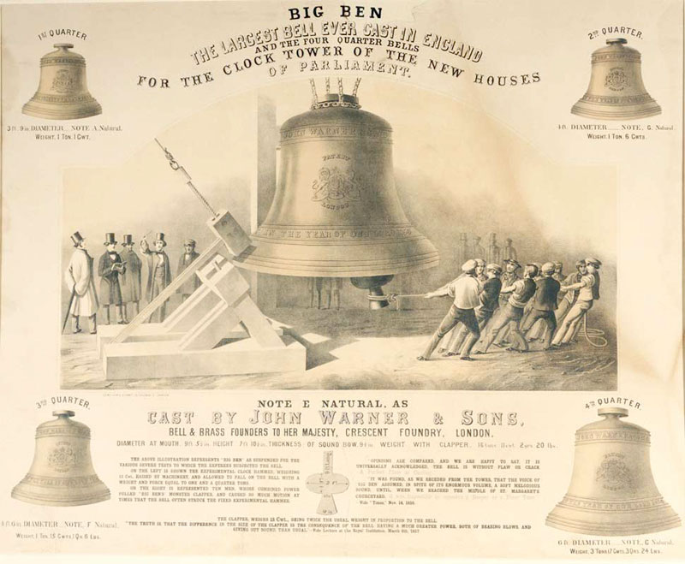
Iron arrows were poured from a lighter alloy. Clock was opened May 31, 1859. Up to 1912 clock was covered by gas jets, which were later replaced by electric lamps. And on the radio for the first time chimes sounded December 31, 1923.

Slide 10
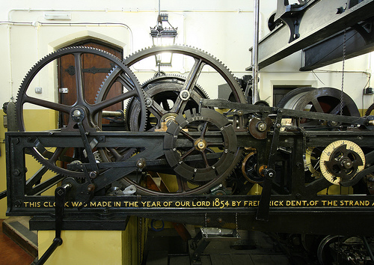
The mechanism that activates the hammer of the bell of Big Ben.

Slide 11
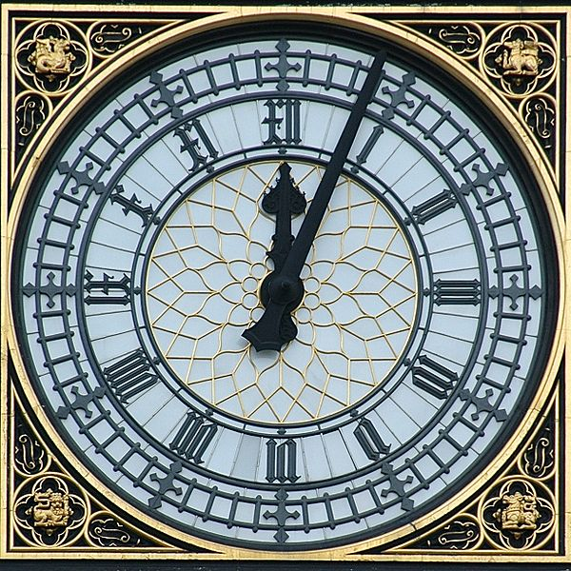
The tower is 61 meters (not counting the spire) clock is at a height of 55 m above the ground. With a diameter of the dial in 7 meters and a length of the arrows in the 2.7 and 4.2 meters, height of each figure - just 61 centimeters. Clock was long considered the largest in the world.

Slide 12
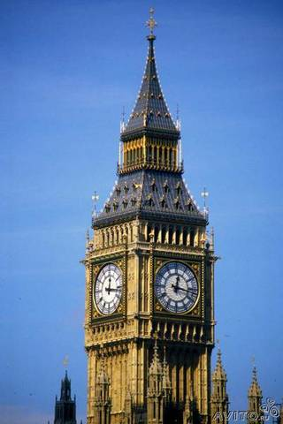
The name Big Ben is surrounded by interesting stories. The official version: the bell is named after the chief of construction sulfur Benjamin Hall. For its impressive size foreman was given the nickname Big Ben. Another version - the bell got its name from the athlete and boxer of times of Queen Victoria.

Slide 13
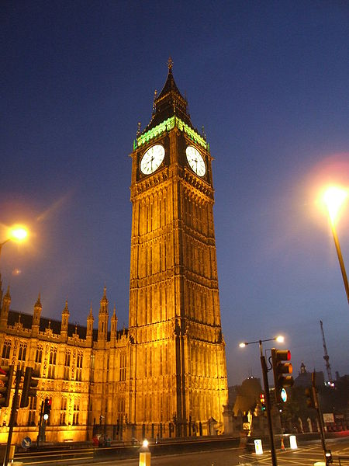
On the perimeter of the tower on the right and left of the clock there is inscribed the phrase in Latin:
«Laus Deo» («Thank God" or "Glory to God")

Slide 14
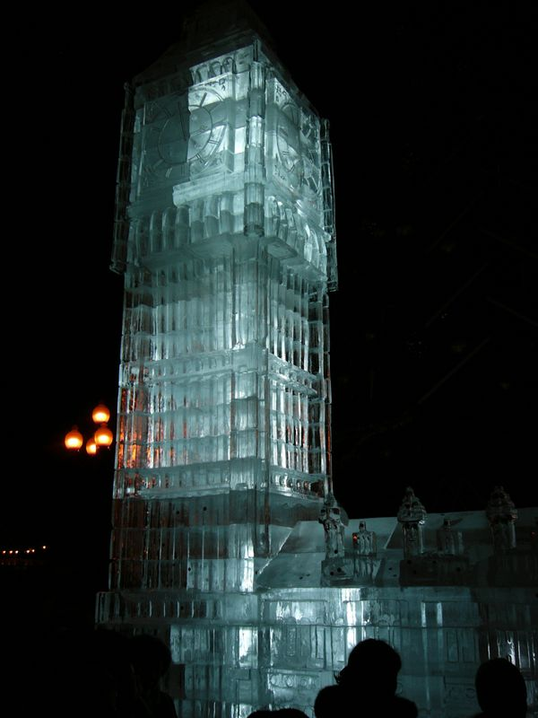
There are also many different copies of the famous Big Ben.

Slide 15
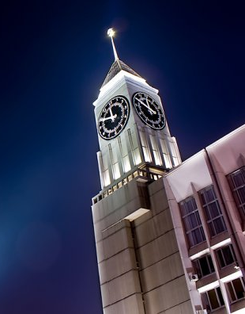
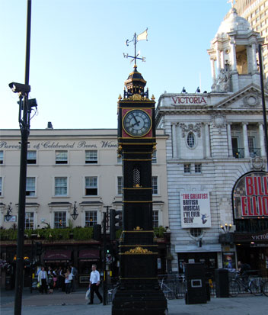

Slide 16
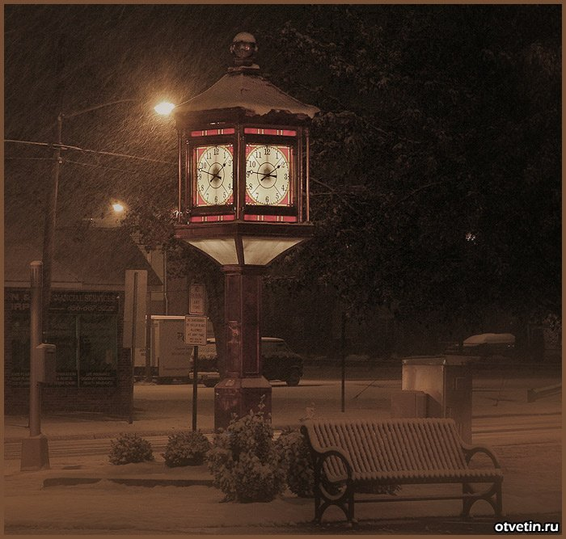
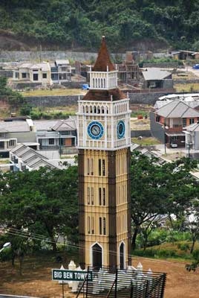

Slide 17
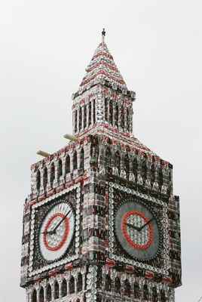
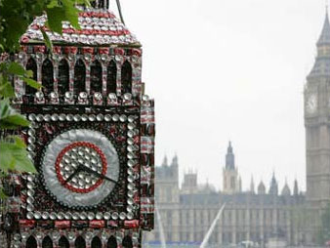

Slide 18
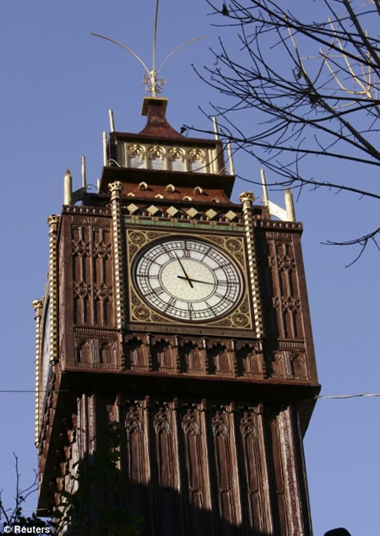

Slide 19
