Slide 1
Michelangelo Merisi da Caravaggio
(28 September 1571 – 18 July 1610)

Slide 2
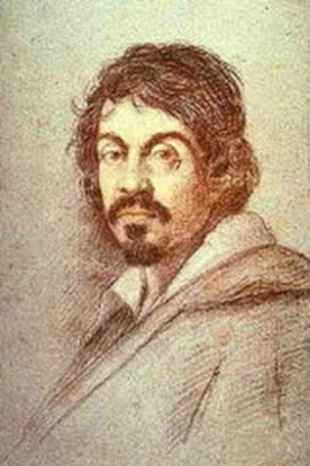
Was an Italian artist active in Rome, Naples, Malta, and Sicily between 1593 and 1610. His paintings, which combine a realistic observation of the human state, both physical and emotional, with a dramatic use of lighting, had a formative influence on the Baroque school of painting.

Slide 3
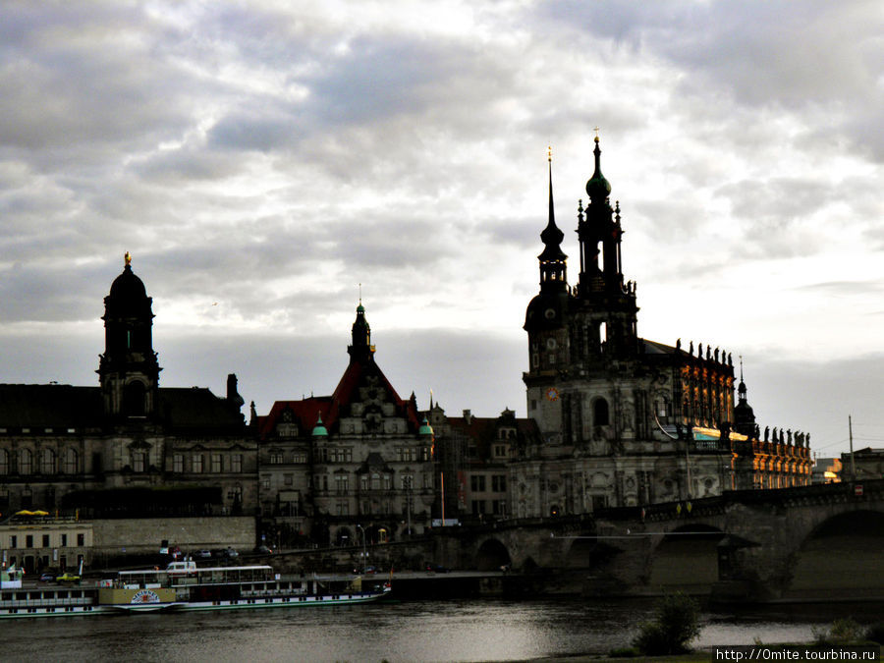
Caravaggio trained as a painter in Milan under Simone Peterzano who had himself trained under Titian. In his early twenties Caravaggio moved to Rome where, during the late 16th and early 17th centuries, many huge new churches and palazzi were being built and paintings were needed to fill them.

Slide 4
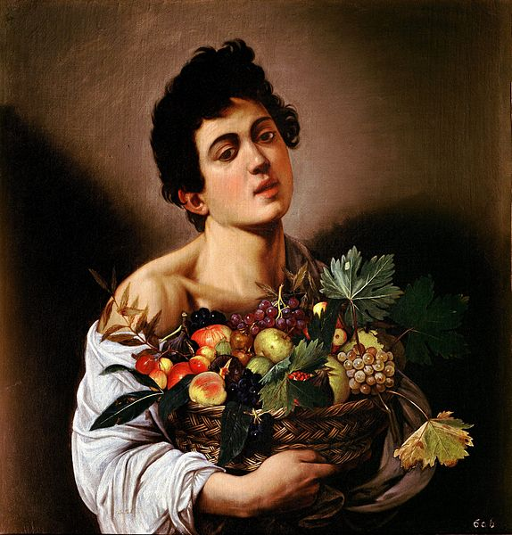
Caravaggio's novelty was a radical naturalism that combined close physical observation with a dramatic, even theatrical, use of chiaroscuro. This came to be known as Tenebrism, the shift from light to dark with little intermediate value. He burst upon the Rome art scene in 1600.
Boy with a Basket of Fruit

Slide 5
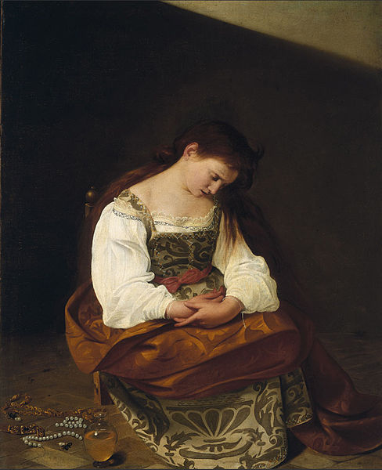
In 1606 he killed a young man in a brawl and fled from Rome with a price on his head. He was involved in a brawl in Malta in 1608, and another in Naples in 1609, possibly a deliberate attempt on his life by unidentified enemies. This encounter left him severely injured. A year later, at the age of 38, he died under mysterious circumstances in Porto Ercole, reportedly from a fever while on his way to Rome to receive a pardon.
Maria Magdalene

Slide 6
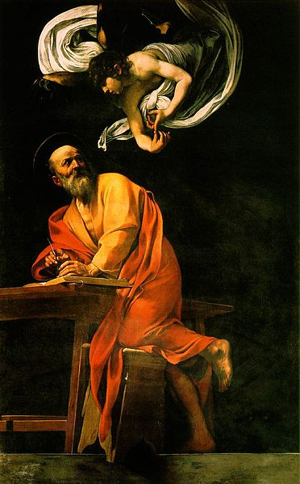
Famous while he lived, Caravaggio was forgotten almost immediately after his death, and it was only in the 20th century that his importance to the development of Western art was rediscovered.
The Inspiration of Saint Matthew

Slide 7
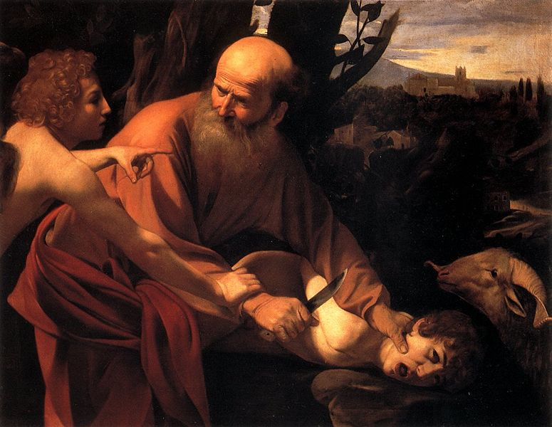
The Sacrifice of Isaac
The Inspiration of Saint Matthew

Slide 8
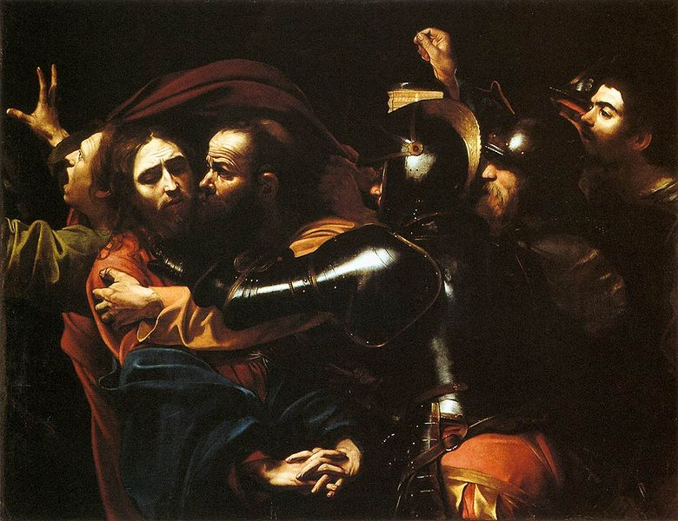
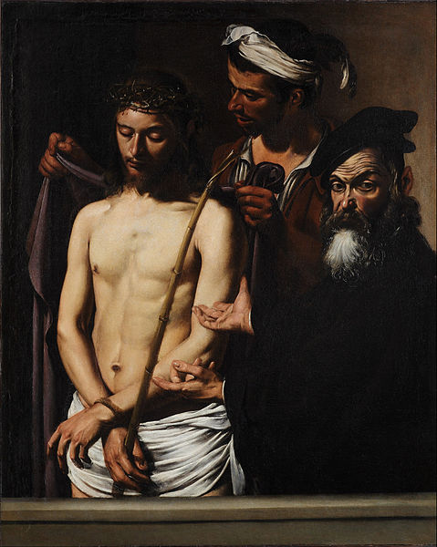
Taking of Christ
Ecce Homo

Slide 9
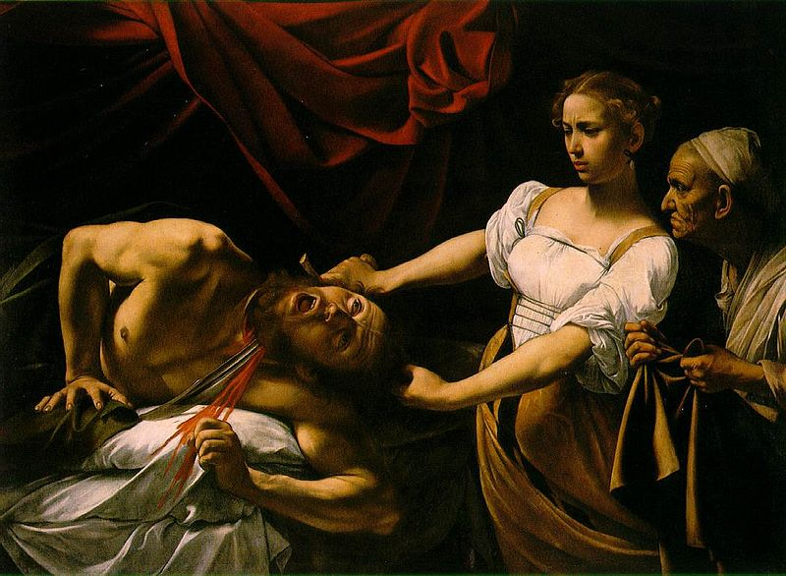
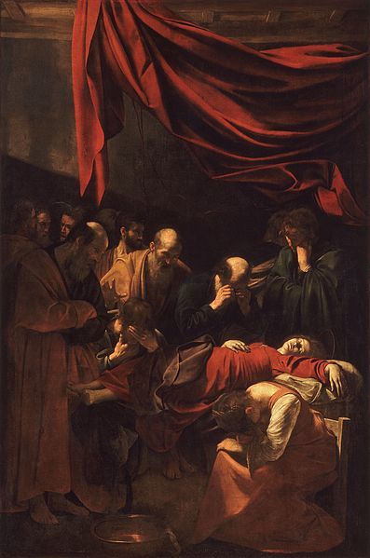
Judith Beheading Holofernes
Death of the Virgin

