Slide 1
Jensen Ackles

Slide 2
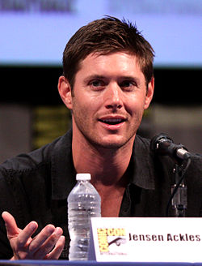
Summary of the main
Jensen Ross Ackles (born March 1, 1978) is an American actor and director. He is known for his roles in television as Eric Brady inDays of our Lives, which earned him several Daytime Emmy Award nominations, as well as Alec/X5-494 in Dark Angel and Jason Teague in Smallville. Ackles currently stars as Dean Winchester on the CW series Supernatural.

Slide 3
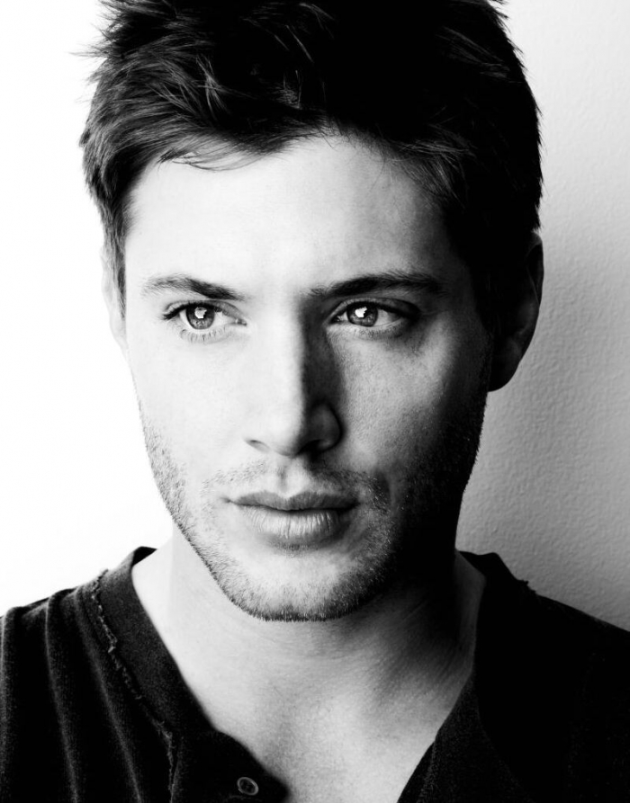
Early life
Ackles was born in Dallas, Texas, the son of Donna Joan (née Shaffer) and Alan Roger Ackles, an actor. Ackles has a brother, Joshua, who is three years older, and sister, Mackenzie, who is seven years younger. He is of English, Irish, and Scottish ancestry. He had planned to study sports medicine at Texas Tech University and to become a physical therapist, but instead moved to Los Angeles to start his acting career.

Slide 4
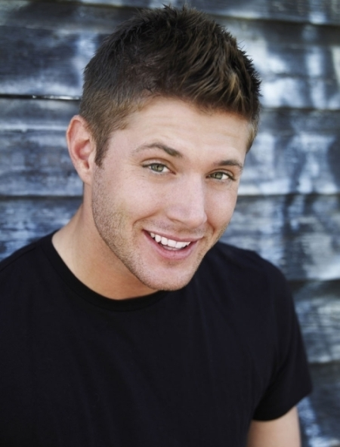
Career
After modelling on and off since the age of 4, Ackles began to concentrate on an acting career in 1996. He appeared in several guest roles on Mr. Rhodes, Sweet Valley High, and Cybill before joining the cast of the NBC soap opera Days of our Lives as Eric Brady in 1997.

Slide 5
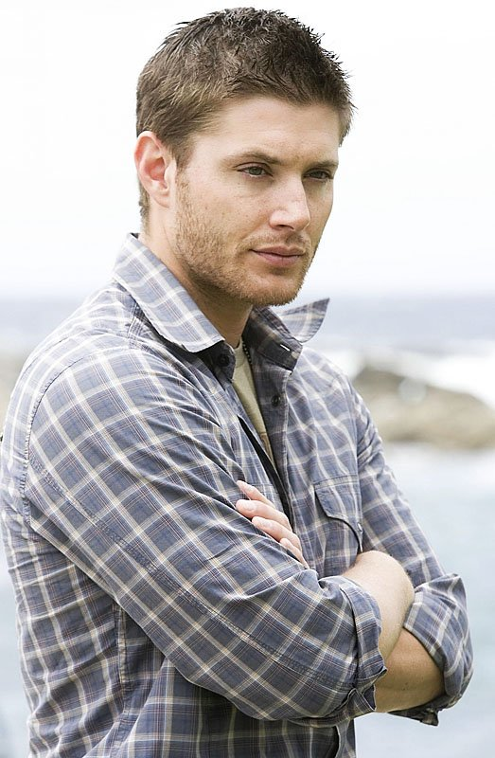
Ackles departed Days of our Lives in 2000 and went on to appear in the mini-series Blonde, about the life of Marilyn Monroe. He also auditioned for the role of the young Clark Kent on Smallville, a role offered to actor Tom Welling instead.

Slide 6
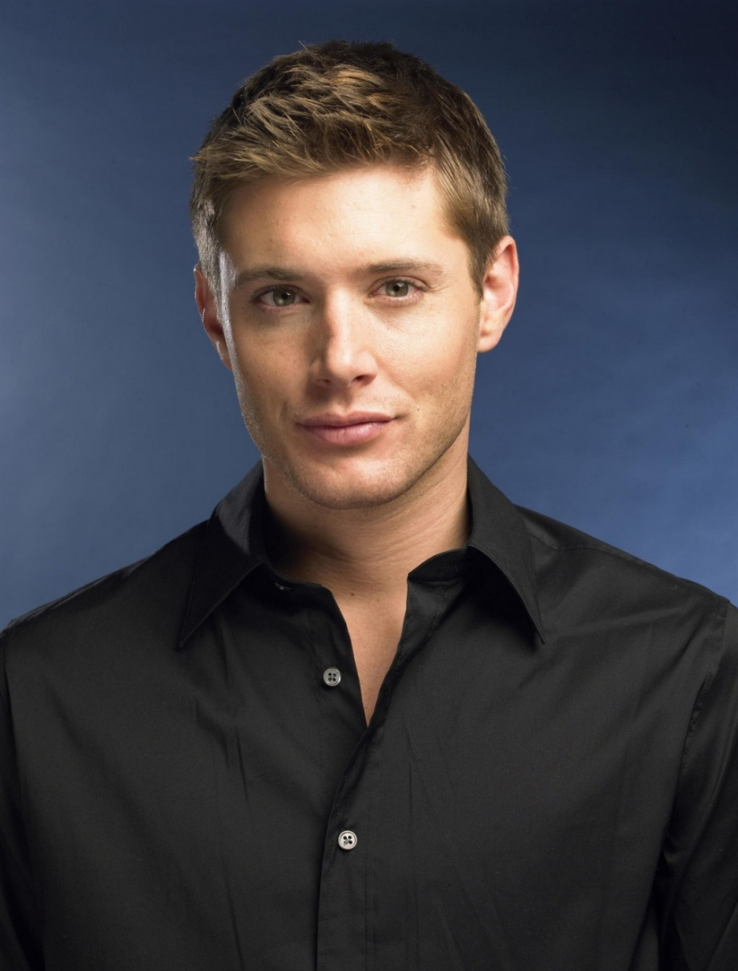
Ackles worked steadily throughout 2003. He joined the cast of the WB's hit show Dawson's Creek during its final season, playing CJ, Jen Lindley's lover. Afterward, Ackles filmed several episodes of the unaired series Still Life for Fox before it was abruptly dropped.

Slide 7
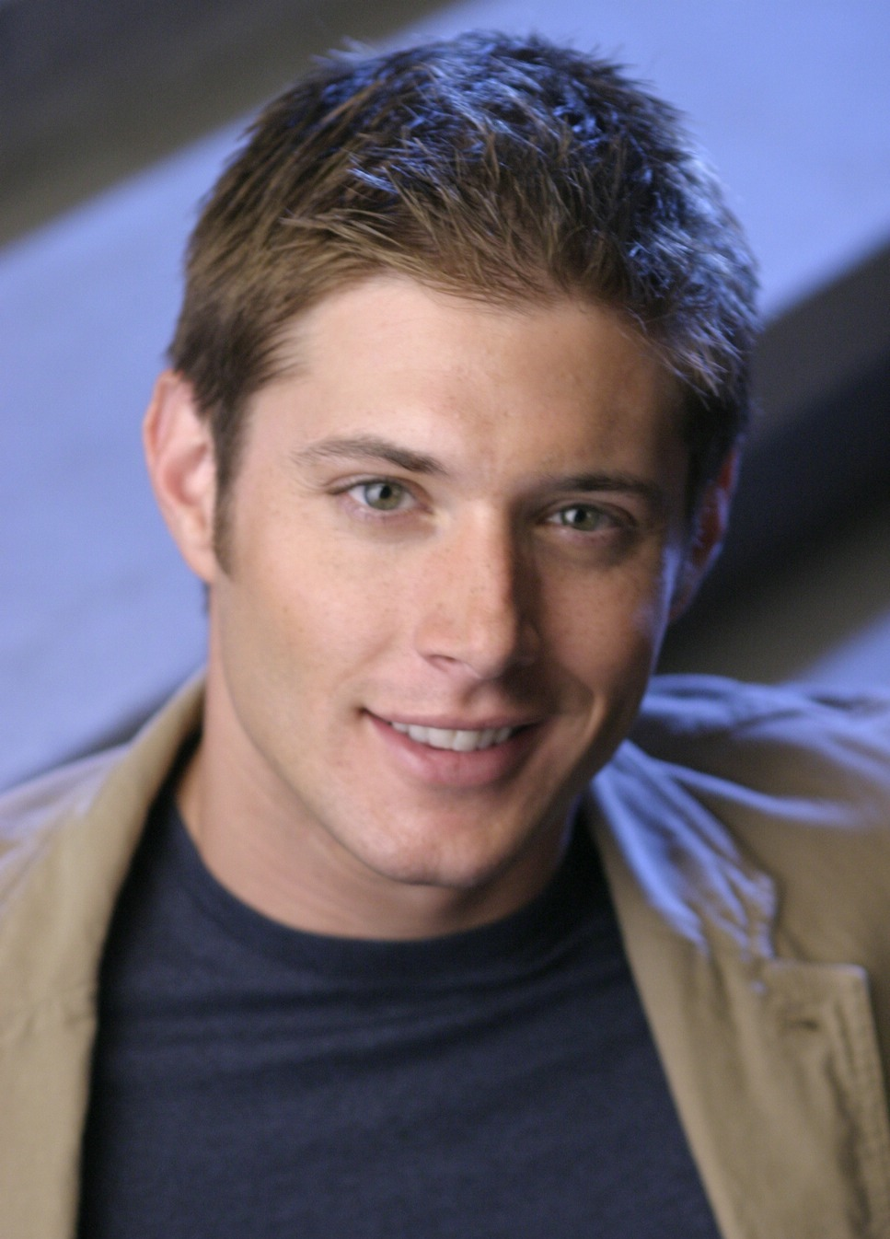
Ackles returned to Vancouver (where Dark Angel was filmed) in 2004 to become a regular on Smallville playing the assistant football coach Jason Teague, who was also the newest romantic interest for Lana Lang (played by Kristin Kreuk).

Slide 8
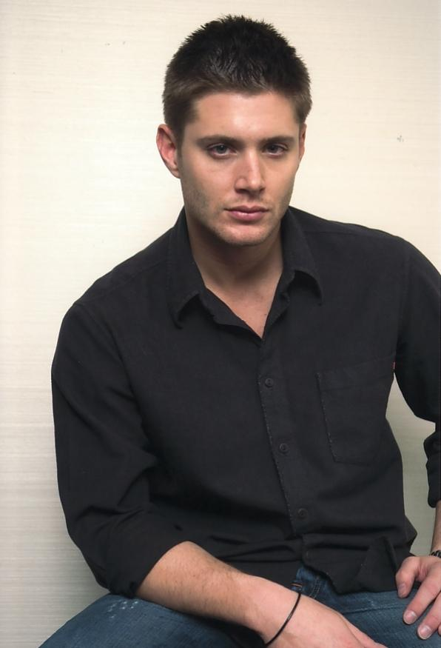
Most recently, Ackles joined the cast of the CW horror/drama series Supernatural in 2005, where he stars as Dean Winchester. Dean and his brother Sam (Jared Padalecki) drive throughout the United States hunting paranormal predators, sometimes with their father, John (Jeffrey Dean Morgan).

Slide 9
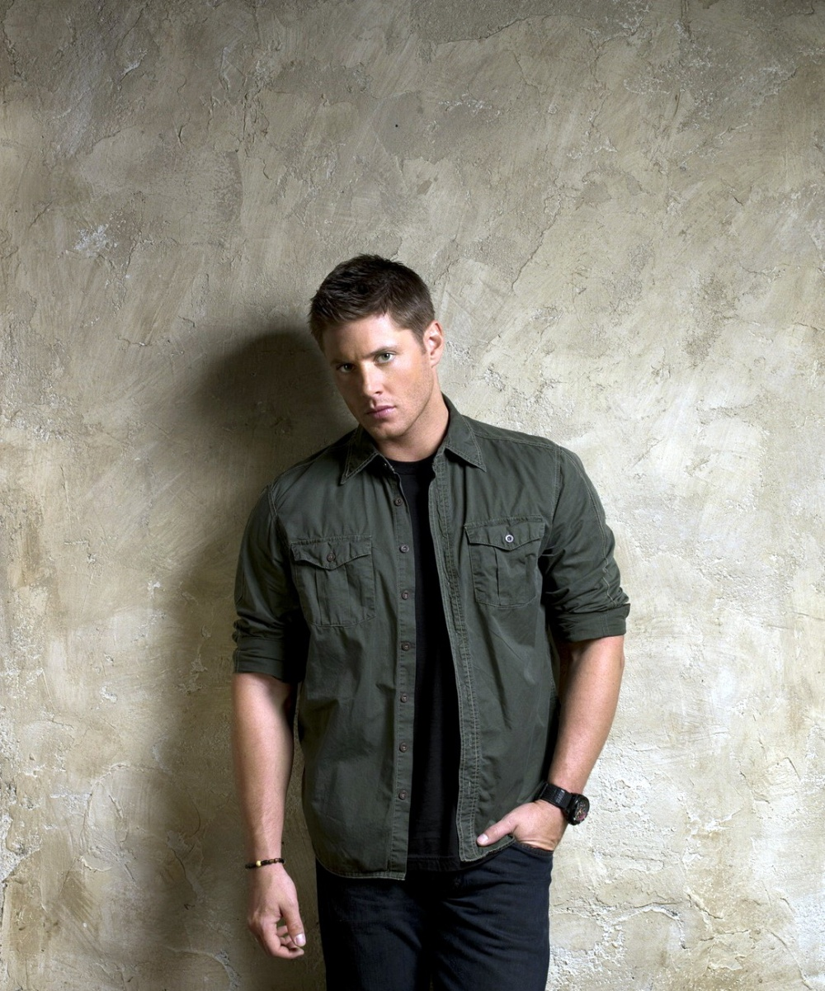
In the summer of 2007, Ackles took on the role of Priestly in the independent comedy Ten Inch Hero. The film began hitting the film festival circuit in early 2007 and Ackles received high praise for his comedic timing in the role.

Slide 10
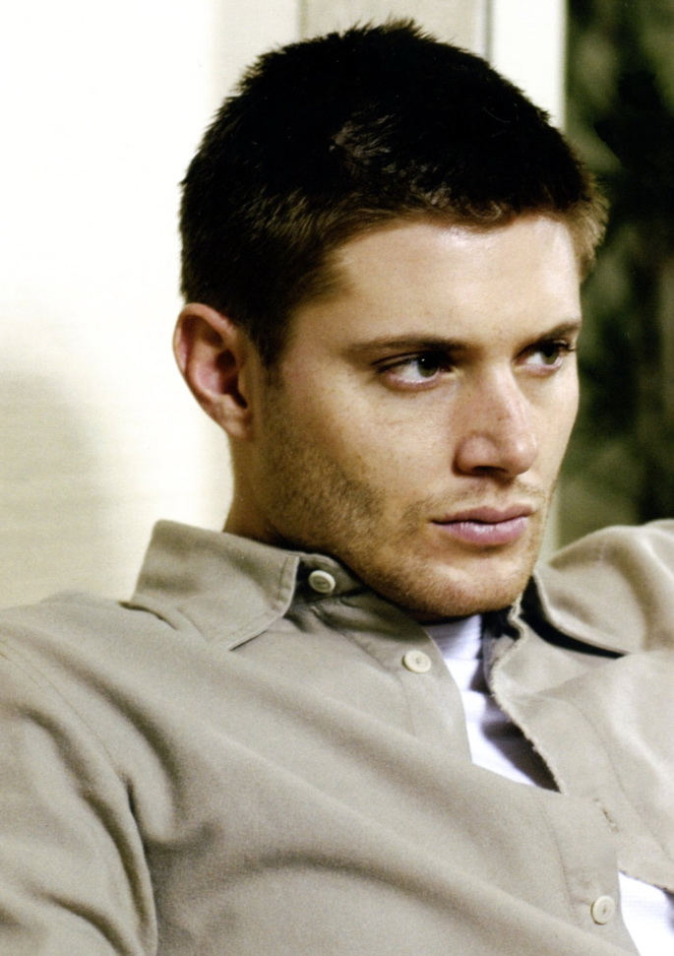
In the summer of 2008, Ackles was cast in the remake of the cult film My Bloody Valentine 3D, which opened nationwide on January 16, 2009.
In summer of 2010, Ackles lent his voice as the Red Hood (Jason Todd) for the animated film, Batman: Under The Red Hood, which was released to DVD and Blu-ray on July 27.
On October 22, 2010, Disney Interactive Studios announced that he would be voicing a character named Gibson in the video game, Tron: Evolution, which was released on December 7, 2010.

Slide 11
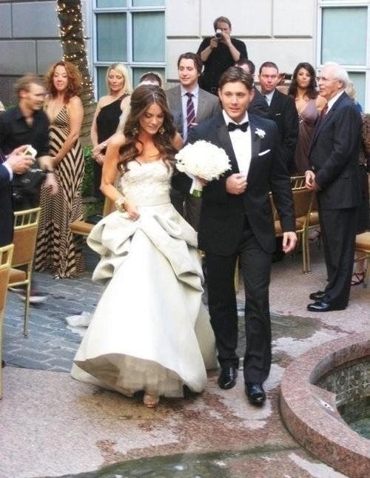
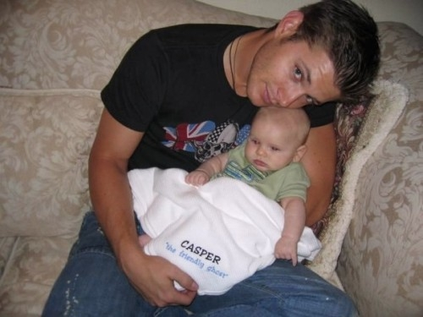
Personal life
After three years of dating, Ackles became engaged to actress, model, and gymnast Danneel Harris in November 2009. The couple married on May 15, 2010 in Dallas, Texas.They have one daughter, Justice Jay "JJ" Ackles, born on May 30, 2013.
Ackles considers himself a non-denominational Christian.

Slide 12
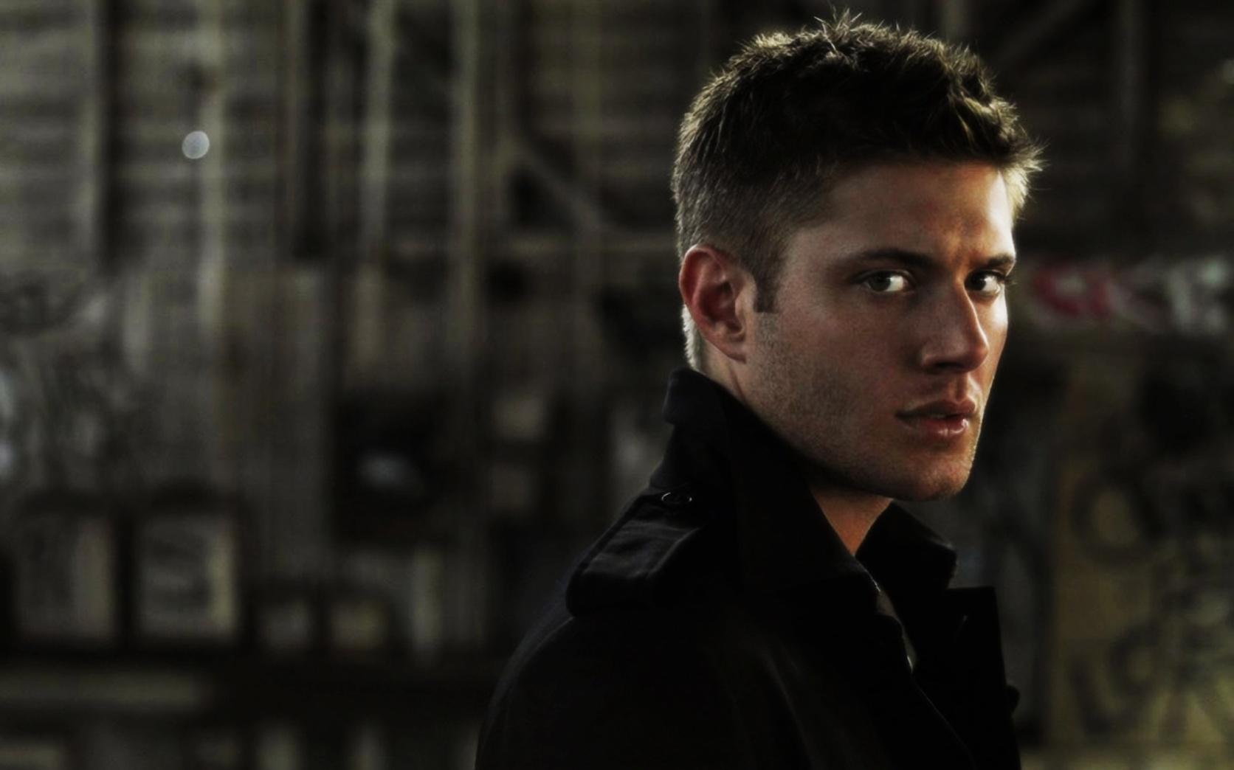
THE END

