Slide 1
Chinese tea drinking ceremony
Prepered
Natalia Semenyik

Slide 2
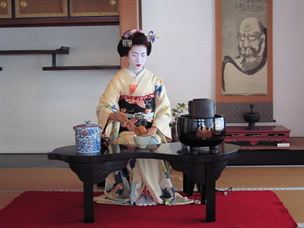
Elegant tea Celestial taught the whole world, ie China. It is in this country originated the custom of holding tea ceremonies. This tea special treatment - not just national drink, and the "light of life" and "the wisest of the plants."

Slide 3
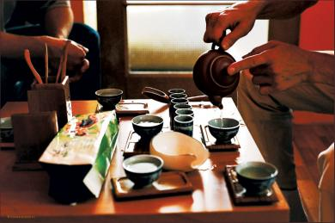
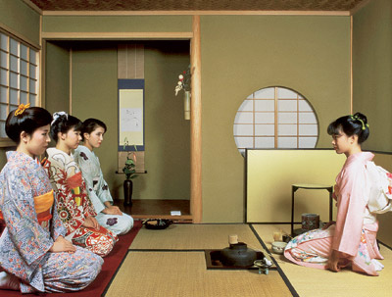
The main goal of Chinese tea drinking ceremony - to reveal the aroma and taste of tea, so haste is undesirable. And soft as silk, soothing sounds of bamboo flutes, small dishes, a variety of tea accessories items not encourage the waving hands. Tranquility and peace - mandatory conditions tea ceremony.

Slide 4
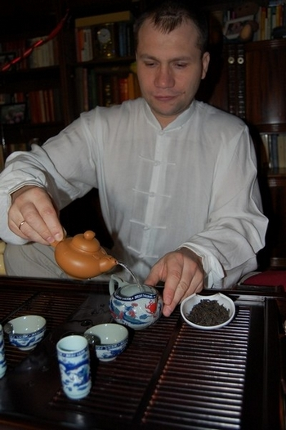
Chinese tea drinking ceremony step by step:
1. Prepare the tea utensils. Shepherds (tea table) decorated statuette tea deity.
2. Boil the water. Preference is given to soft, ideally - spring water. Remove the water from the fire trail on the surface when there are large bubbles and burst.
3. Heated vessels.

Slide 5
Chinese tea drinking ceremony step by step:
4. Designed for brewing tea is poured into chahe (tea box). Then inhale tea, enjoying the scent ...
5. Fill the teapot with dry tea using a funnel.
6. Awakening of tea. Close the kettle lid, shake, shaking kettle from side to side.
7. Pour water into the kettle. The first infusion of tea or drink and use for washing tea leaves.

Slide 6
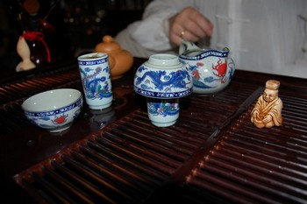
Chinese tea drinking ceremony step by step:
8. The second brew is poured into tall cups (vensyabey) 3/4 volume and low cover cups (chabey). Tightly to one another and overturned. You can make tea trays ready deity, washing his tea.
9. Vensyabey spins clockwise and enjoy the aroma. You can then take the first sip.

