Slide 1
Preliminary English Test
Form 11-A
Okulicheva Olga

Slide 2


What is the PET exam?
The Preliminary English Test (PET), is an English language examination provided by Cambridge English Language Assessment. Cambridge English: Preliminary is an intermediate level qualification which demonstrates the ability to communicate using English for everyday purposes.

Slide 3

Who is it for?
Do this test if you want to know that you have an intermediate level of English. With this level of English you will enjoy holidays in English speaking countries. You should probably continue studying once you have passed the PET exam.

Slide 4

What is the PET test like?
The test has these sections:
1. Reading and Writing are taken together - 90 minutes
2. Listening - 30 minutes
3. Speaking - an interview, 10 minutes.
There are two versions of the PET test:
PET
PET for Schools.
Both versions have the same type of questions. The PET for schools test has content of interest to school-age learners.

Slide 5
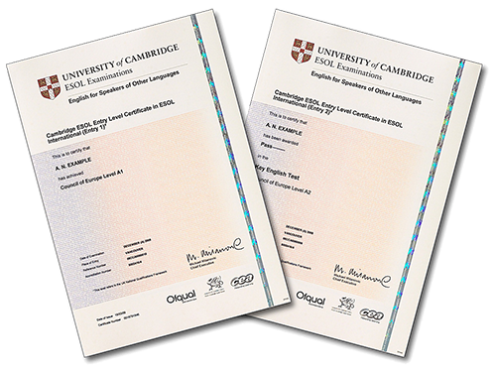
Paper-based or computer-based exams
You can do the PET exam on a computer or on paper. The computer-based exam is available once a month. The paper-based exam is only available six times a year.

Slide 6

Scoring
The Statement of Results has three elements: a grade (Pass with Distinction, Pass with Merit and Pass), a score (out of 100) and the CEFR level. The Statement of Results reflects the total combined score from all three exam papers.
Grade | Score (out of 100) | CEFR Level
Pass with Distinction | 90-100 | B2
Pass with Merit | 85-89 | B1
Pass | 70-84 | B1

Slide 7


Timing and results
Candidates take the Reading and Writing and the Listening papers on the same day. The Speaking paper is often taken a few days before or after the exam.
Dates to take the paper-based exam and computer-based exam are offered at test centres throughout the calendar year. A directory of all global exam centres and their contact details can be accessed on the Cambridge English Language Assessment website.

