Slide 1
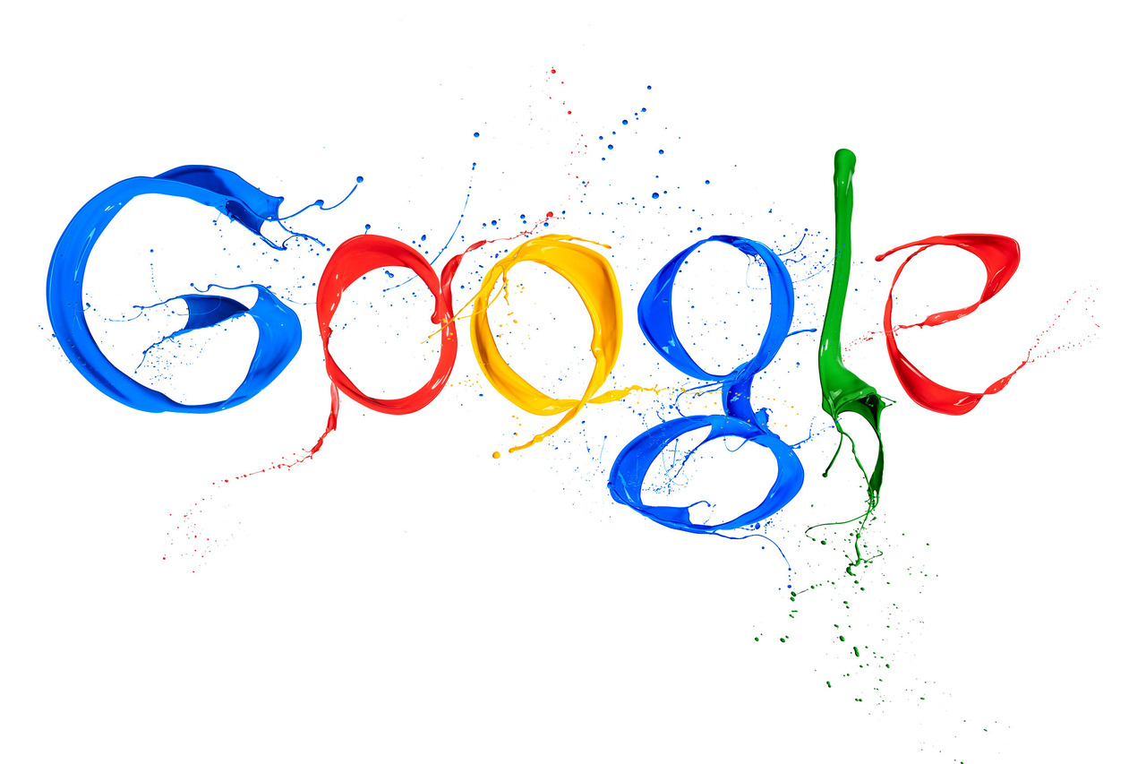
FILIMONOVA KATYA FORM 10
PRESENTATION

Slide 2
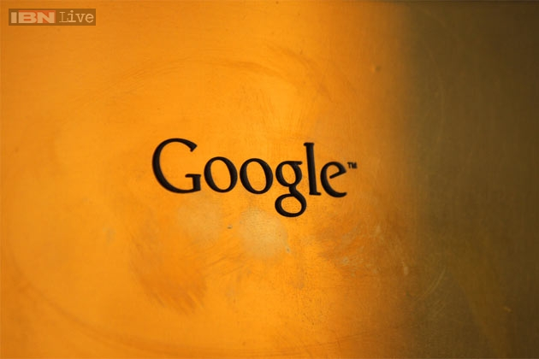
Google is an American multinational corporation specializing in Internet-related services and products. These include search, cloud computing, software, and online advertising technologies. Most of its profits are derived from AdWords.
Google was founded by Larry Page and Sergey Brin while they were Ph.D. students at Stanford University. Together they own about 16 percent of its shares. They incorporated Google as a privately held company on September 4, 1998. An initial public offering followed on August 19, 2004. Its mission statement from the outset was "to organize the world's information and make it universally accessible and useful", and its unofficial slogan was "Don't be evil”. In 2006 Google moved to headquarters in Mountain View, California, nicknamed the Googleplex.
Google on ad-tech London, 2010
Rapid growth since incorporation has triggered a chain of products, acquisitions and partnerships beyond Google's core search engine. It offers online productivity software including email (Gmail), an office suite (Google Drive), and social networking (Google+). Desktop products include applications for web browsing, organizing and editing photos, and instant messaging. The company leads the development of the Android mobile operating system and the browser-only Chrome OS for a netbook known as a Chromebook Google has moved increasingly into communications hardware: it partners with major electronics manufacturers in production of its high-end Nexus devices and acquired Motorola Mobility in May 2012. In 2012, a fiber-optic infrastructure was installed in Kansas City to facilitate a Google Fiber broadband service.
The corporation has been estimated to run more than one million servers in data centers around the world and to process over one billion search requests and about 24 petabytes of user-generated data each day. In December 2013 Alexa listed google.com as the most visited website in the world. Numerous Google sites in other languages figure in the top one hundred, as do several other Google-owned sites such as YouTube and Blogger. Its market dominance has led to prominent media coverage, including criticism of the company over issues such as copyright, censorship, and privacy.

Slide 3
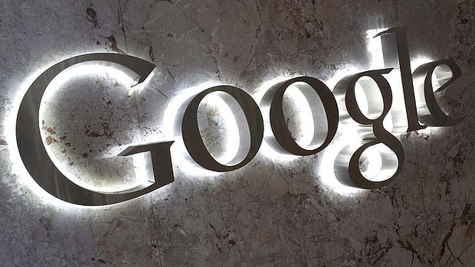
Google logo
Google has had many logos since its renaming from BackRub. The current official Google logo was designed by Ruth Kedar, and is a wordmark based on the Catull typeface.[The company also includes various modifications and/or humorous features, such as cartoon modifications of their logo for use on holidays, birthdays of famous people, and major events, such as the Olympics. These special logos, some designed by Dennis Hwang, have become known as Google Doodles

Slide 4
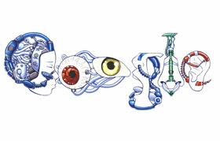
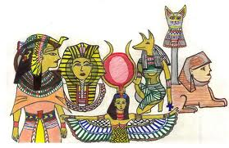
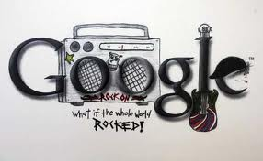
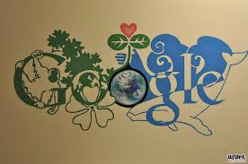
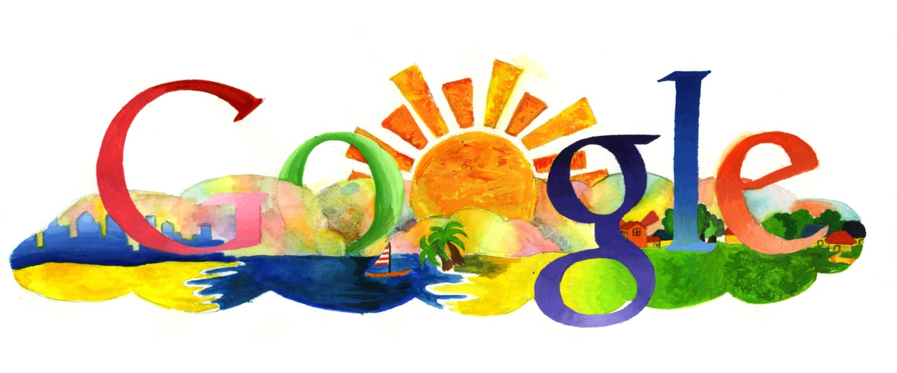
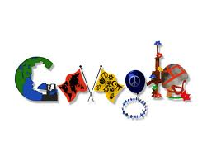
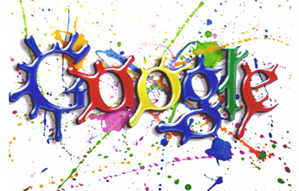
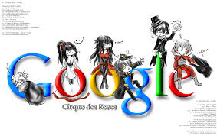
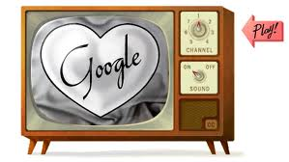
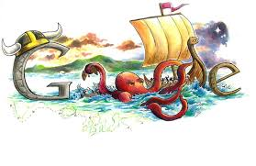
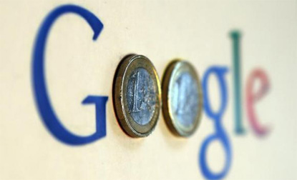
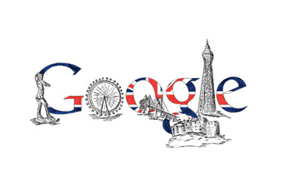
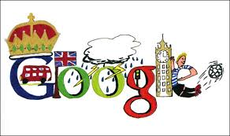

Slide 5
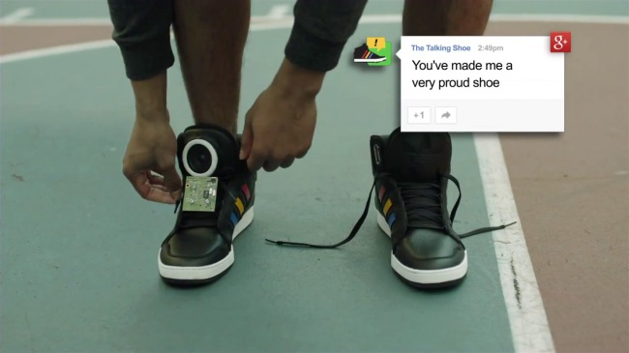
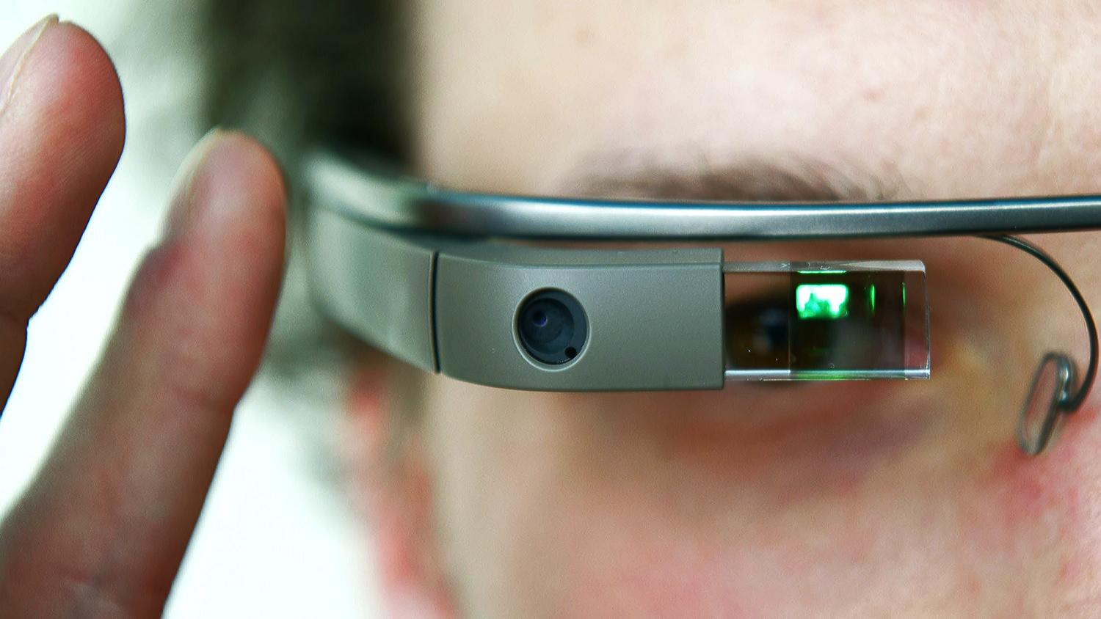
Development Google

Slide 6
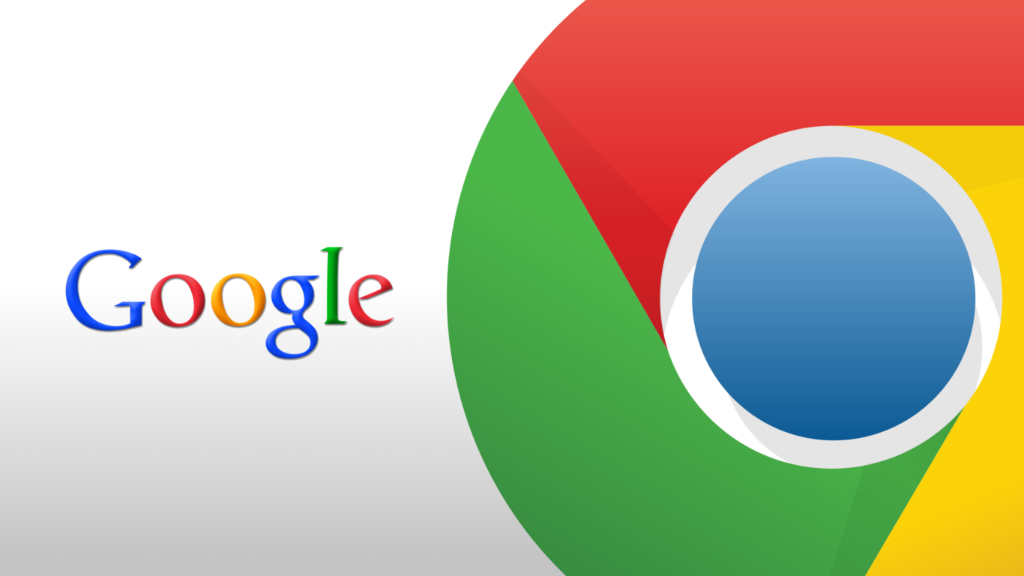
GOOGLE CHROME
Google Chrome is a freeware web browser developed by Google. It used the WebKit layout engine until version 27 and, with the exception of its iOS releases, from version 28 and beyond uses the WebKit fork Blink.It was first released as a beta version for Microsoft Windows on September 2, 2008, and as a stable public release on December 11, 2008.
As of 2013, StatCounter estimates that Google Chrome has a 39% worldwide usage share of web browsers, making it the most widely used web browser in the world.
In September 2008, Google released the majority of Chrome's source code as an open source project called Chromium on which Chrome releases are still based. Notable components that are not open source are the built-in PDF viewer and the built-in Flash player.

Slide 7
GOOGLE GLASS
Google Glass is a wearable computer with an optical head-mounted display (OHMD) that is being developed by Google in the Project Glass researce and development project,with a mission of producing a mass-market ubiquitous computer.Google Glass displays information in a smartphone-like hands-free format,that can communicate with the Internet vianatural language voice commands.
While the frames do not currently have lenses fitted to them, Google is considering partnerships with sunglass retailers such as Ray-Ban or Warby Parker, and may also open retail stores to allow customers to try on the device.The Explorer Edition cannot be used by people who wear prescription glasses, but Google has confirmed that Glass will eventually work with frames and lenses that match the wearer's prescription; the glasses will be modular and therefore possibly attachable to normal prescription glasses.
Glass is being developed by Google X,which has worked on other futuristic technologies such as driverless cars. The project was announced on Google+ by Project Glass lead Babak Parviz, an electrical engineer who has also worked on putting displays into contact lenses; Steve Lee, a product manager and "geolocation specialist"; and Sebastian Thrun, who developed Udacity as well as worked on the autonomous car project. Google has patented the design of Project Glass. Thad Starner. an augmented reality expert, is a technical lead/manager on the project.

Slide 8
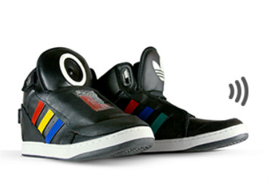
speaking sneakers
.Google clearly wants to change every aspect of our lives, from cars that drive themselves, to glasses that superimpose data on our vision, to its most recent effort, shoes that talk to you. Yes, at South By Southwest, Google announced talking high-topped sneakers that react to your activity – or lack thereof – by providing snarky vocal feedback. Like, “I love the feel of wind in my laces” when you’re pounding pavement, and “This is boring” when you’re not. Because, you know, what we’ve been missing in life are shoes that talk. After all, it’s important to know what our feet are thinking.
Of course, it isn’t our feet talking, so much as Google interpreting what our feet would say, because who knows more about feet than Google? To be fair, they did team up with Adidas, which does know something about feet, and there are no plans to bring these shoes to market, but I’m still not sure this is a great idea

Slide 9
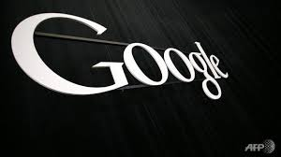
Google has also acquired DeepMind Technologies, an artificial intelligence company in London, reportedly for $400 million.
A Google representative confirmed the deal Sunday via email, but said the company’s isn’t providing any additional information at this time.
News website Re/code said in a report on Sunday that Google was paying $400 million for the company, founded by games prodigy and neuroscientist Demis Hassabis, Shane Legg and Mustafa Suleyman.
The company claims on its website that it combines “the best techniques from machine learning and systems neuroscience to build powerful general-purpose learning algorithms.” It said its first commercial applications are in simulations, e-commerce and games.
Google announced this month it was paying $3.2 billion in cash to acquire Nest, a maker of smart smoke alarms and thermostats, in what is seen as a bid to expand into the connected home market. It also acquired in January a security firm called Impermium, to boost its expertise in countering spam and abuse.
The Internet giant said on a research site that much of its work on language, speech, translation, and visual processing relies on machine learning and artificial intelligence. “In all of those tasks and many others, we gather large volumes of direct or indirect evidence of relationships of interest, and we apply learning algorithms to generalize from that evidence to new cases of interest,” it said.
In May, Google launched a Quantum Artificial Intelligence Lab, hosted by NASA’s Ames Research Center. The Universities Space Research Association was to invite researchers around the world to share time on the quantum computer from D-Wave Systems, to study how quantum computing can advance machine learning.

Slide 10
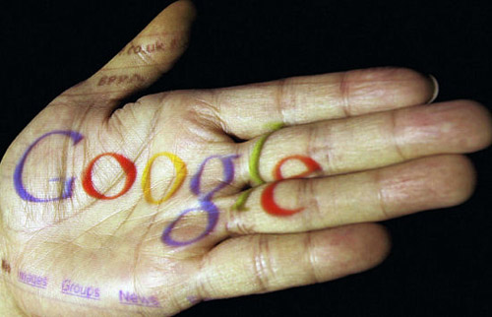
Philanthropy
In 2004, Google formed the not-for-profit philanthropic Google.org, with a start-up fund of $1 billion. The mission of the organization is to create awareness about climate change, global public health, and global poverty. One of its first projects was to develop a viable plug-in hybrid electric vehicle that can attain 100 miles per gallon. Google hired Larry Brilliant as the program's executive director in 2004,and the current director is Megan Smith.
In 2008 Google announced its "project 10¹⁰⁰" which accepted ideas for how to help the community and then allowed Google users to vote on their favorites. After two years of silence, during which many wondered what had happened to the program, Google revealed the winners of the project, giving a total of ten million dollars to various ideas ranging from non-profit organizations that promote education to a website that intends to make all legal documents public and online.
In 2011, Google donated 1 million euros to International Mathematical Olympiad to support the next five annual International Mathematical Olympiads (2011–2015

Slide 11
So all I can say :
Thanks Google !!!

Slide 12
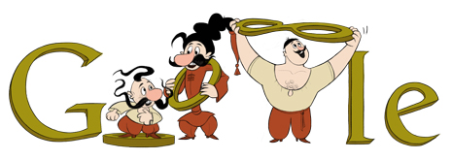
And thanks for
Watching ☺

