Slide 1
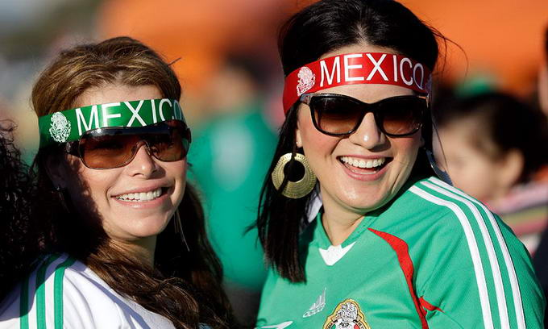
The life of youth in Mexico

Slide 2
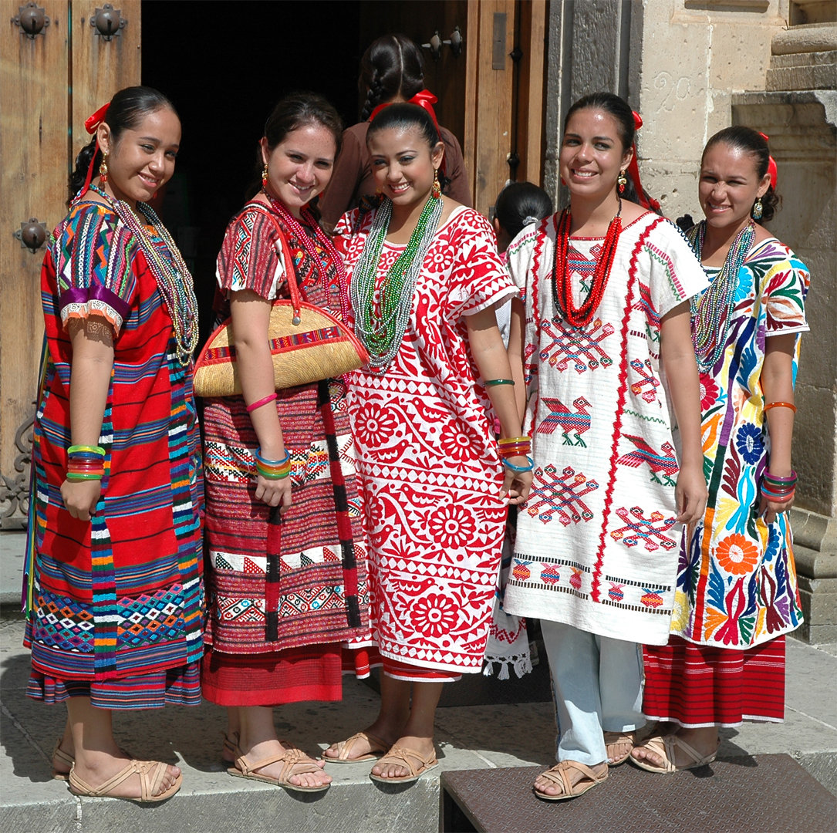
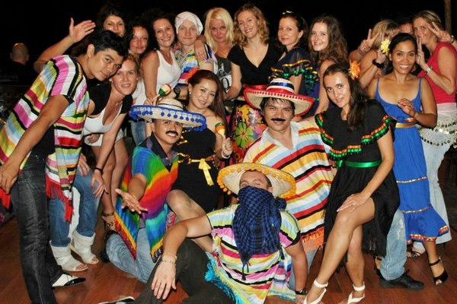
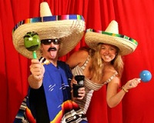
Good people, fun, love to gossip, talk a lot and celebrate.

Slide 3
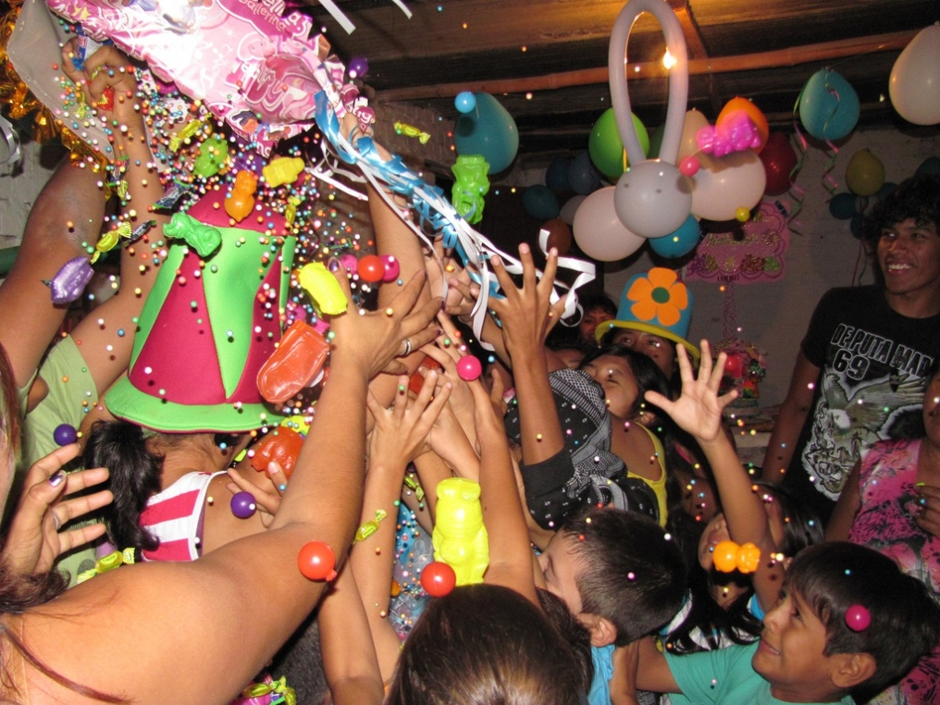
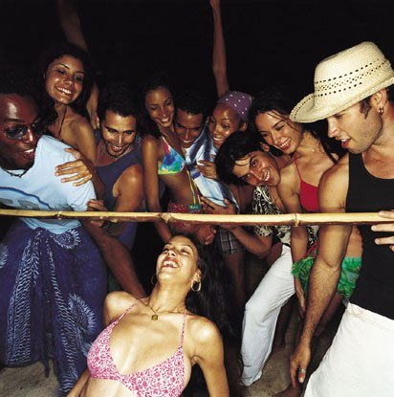
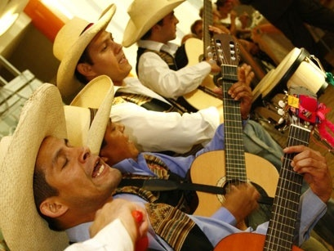
Young Mexicans arrange holidays for any reason, sometimes in their gardens, sometimes in cafes, restaurants and other establishments.

Slide 4
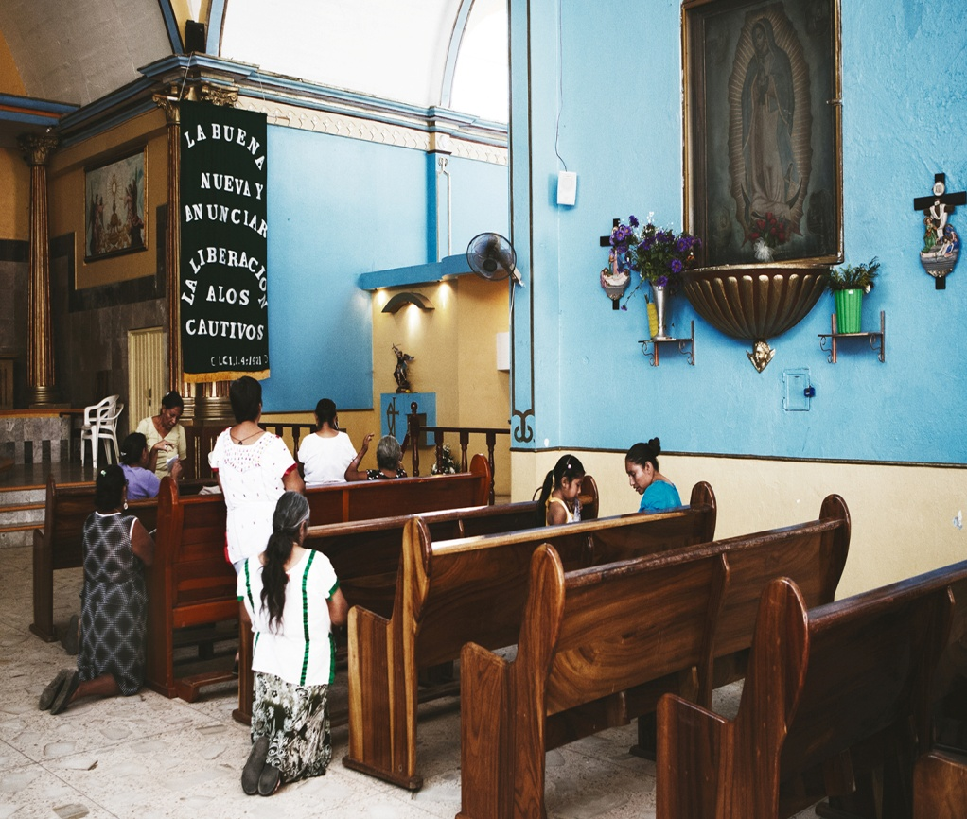
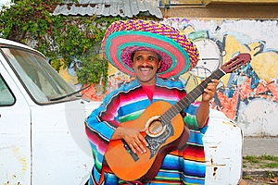
Habits of Mexicans
Do not take off one's shoes at home.
They like to criticize the government and the president.
Going to church on weekends.
Plenty to smile.

Slide 5
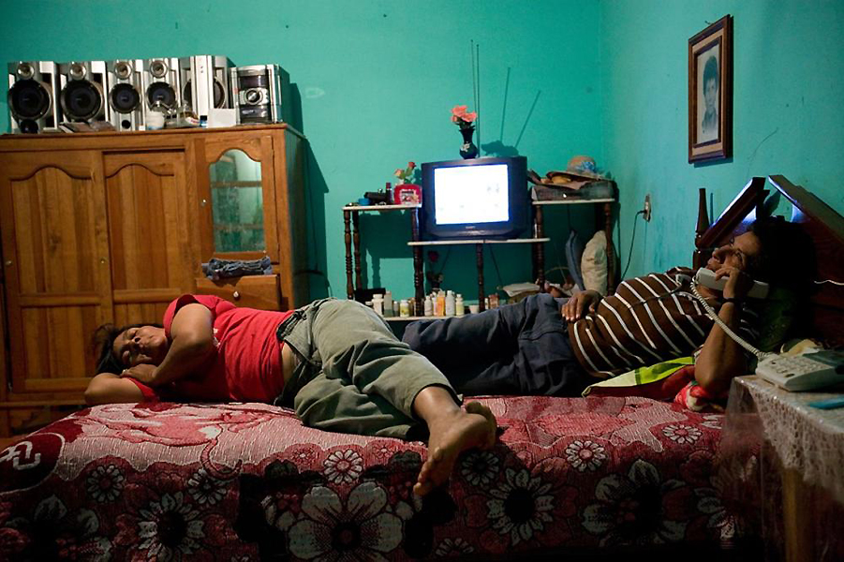
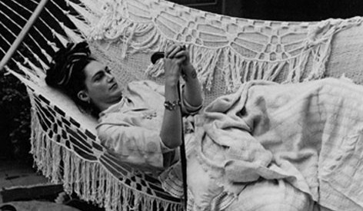
Watch TV all day (do not read books almost);
Every week, going to the cinema.

Slide 6
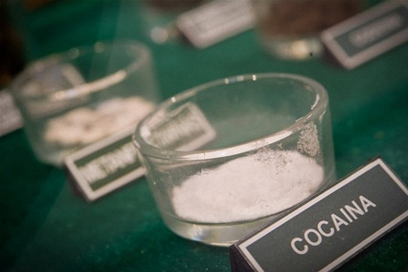
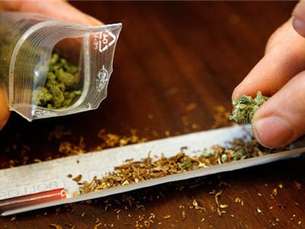
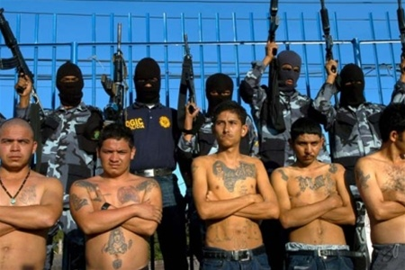
In Mexico spread drugs. Often young people are seller of drugs, and even worse are addicts.

Slide 7
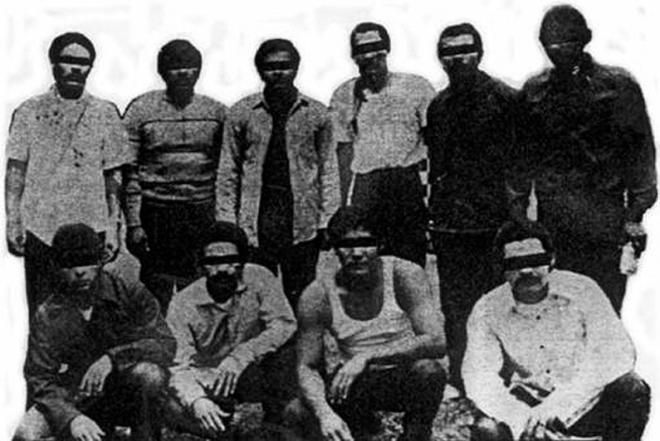
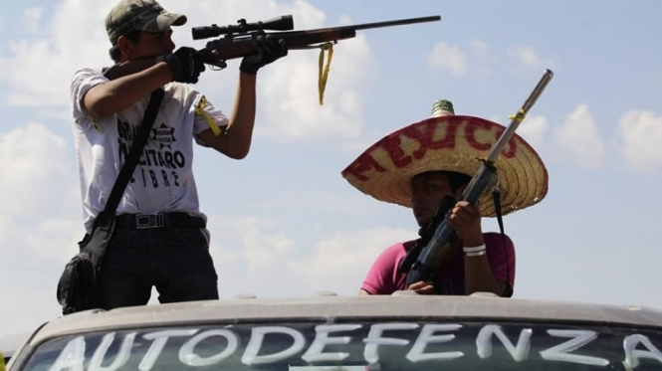
The Mexican Mafia, also known as Laem is a Mexican criminal organization, one of the oldest and most powerful prison gangs USA.

Slide 8
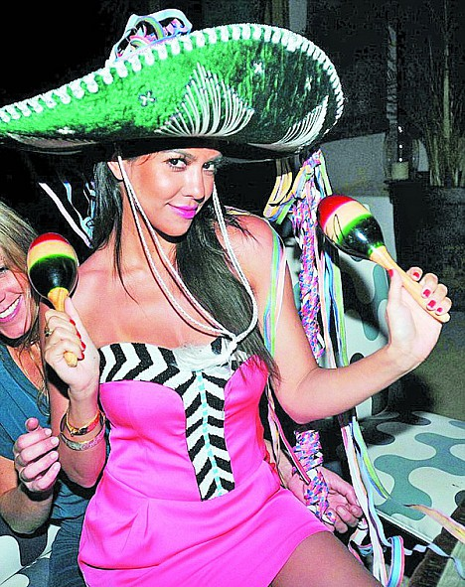
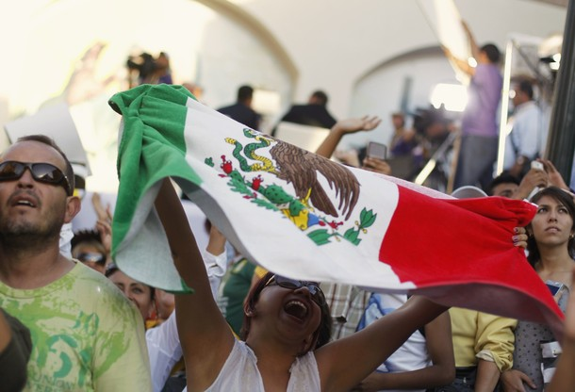
However, youth in Mexico feels happiest in the world, among people aged 9 - 30 years in 24 countries on five continents.

Slide 9
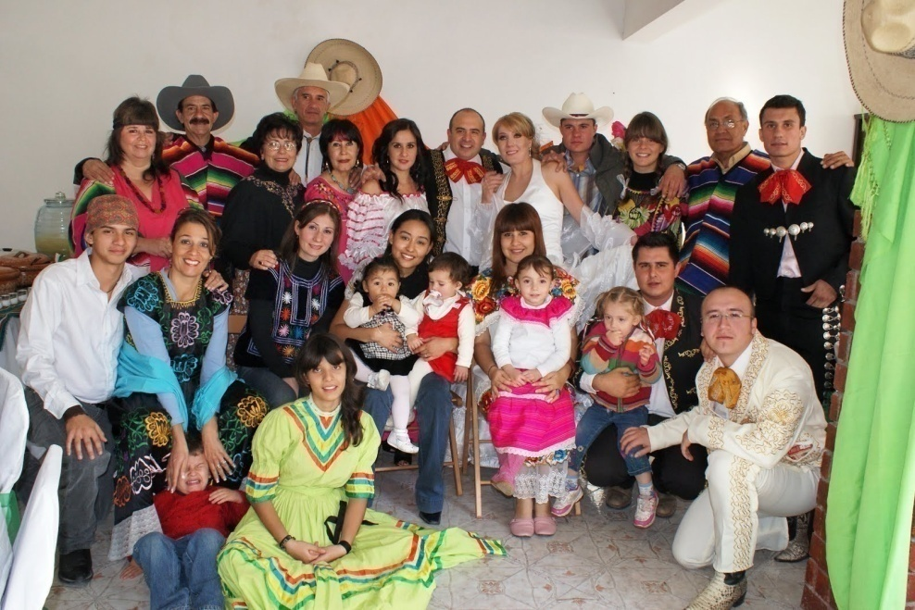

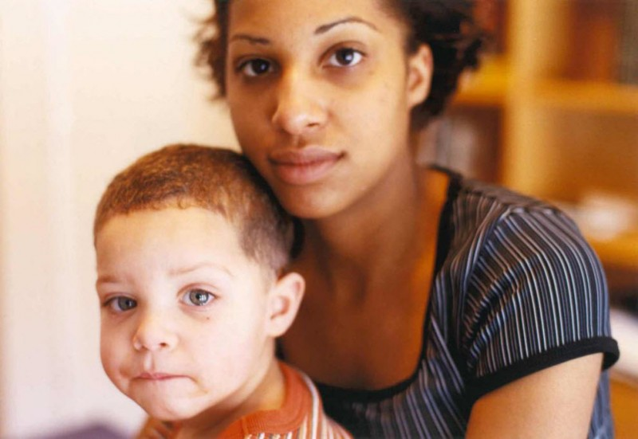
Happiness for young Mexicans is strong family ties and the prosperity of the region, and later success in life.

Slide 10
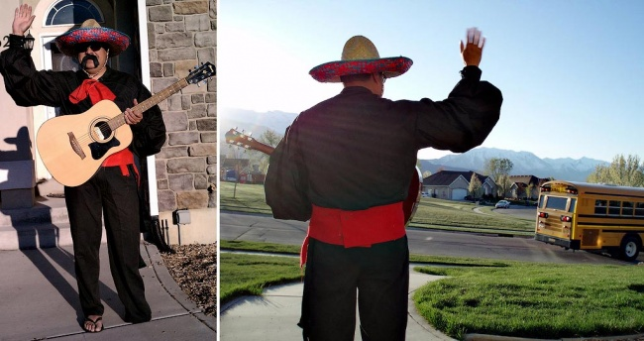
The end

