Slide 1
The election of the President of Ukraine

Slide 2
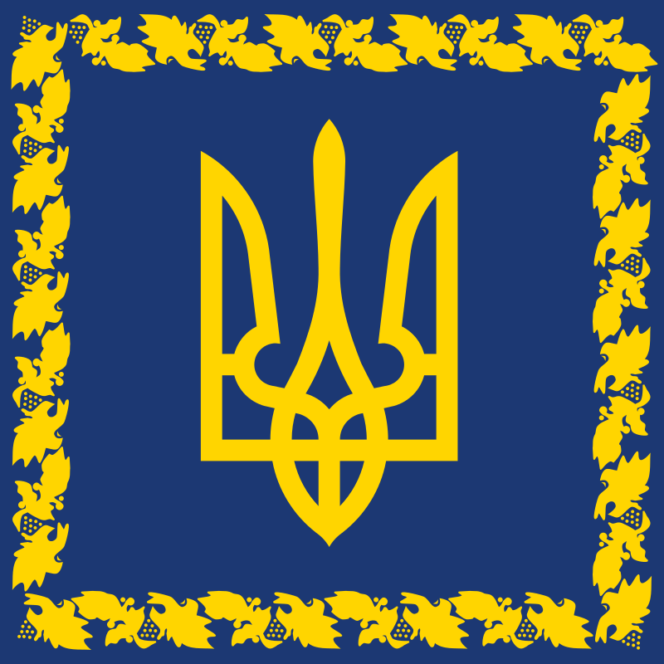
Ukrainian President is the head of the Ukrainian state. He is elected by the people of Ukraine for five years.

Slide 3
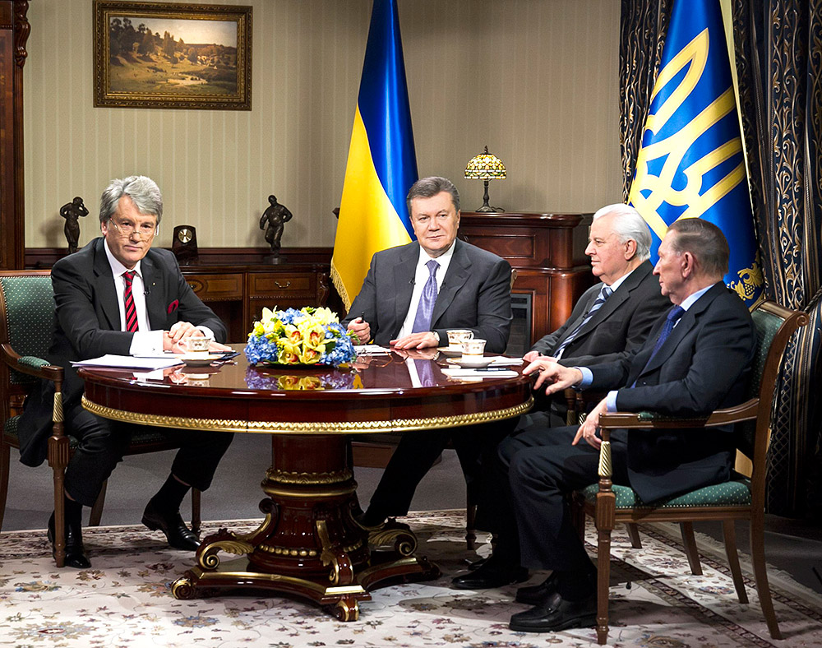
According to the Constitution, the President is the head of state and acts on its behalf. The President of Ukraine is the guarantor of state sovereignty and territorial integrity of Ukraine, of the Constitution of Ukraine, the rights and freedoms of men and citizens.

Slide 4
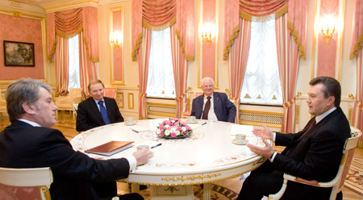
The President of Ukraine is elected by the citizens of Ukraine on the basis of universal, equal and direct suffrage by secret ballot for a term of five years.
The President of Ukraine may be a citizen of Ukraine who has attained 35 years of having the right to vote, residing in Ukraine for the last 10 years prior to election day and knows the state language.

Slide 5
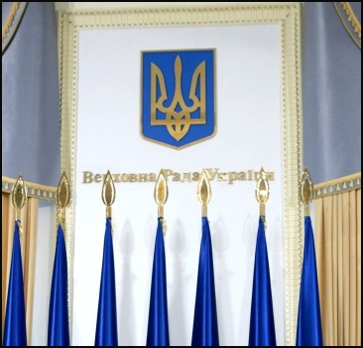
One person can not be elected as the President of Ukraine for more than two consecutive terms.
Regular elections of the President of Ukraine are held on the last Sunday in March, the fifth year of the President of Ukraine.

Slide 6
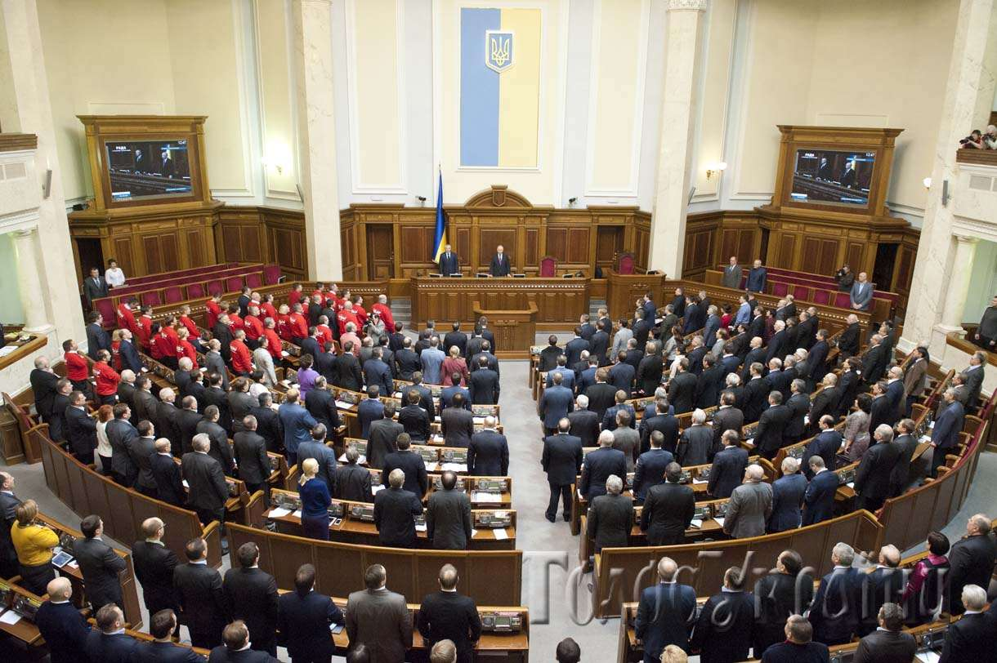
In case of early termination of the powers of the President of Ukraine presidential elections in Ukraine are held within ninety days after the termination of the authority. Procedure for election of the President of Ukraine is established by law.

Slide 7
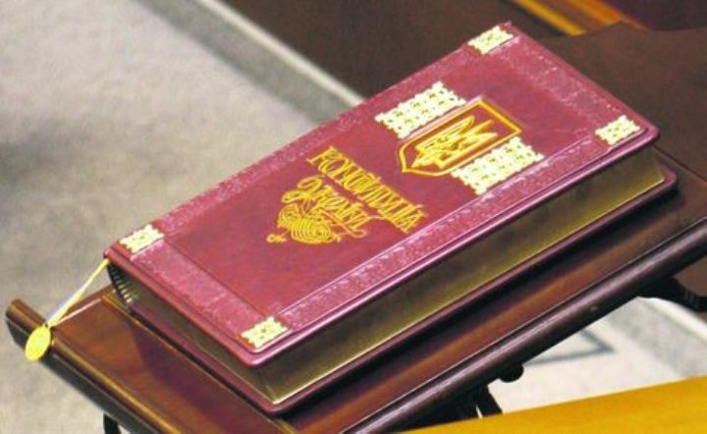
The newly elected President takes office not later than 30 days after the official announcement of the election results after taking the oath to the people of Ukraine at the session of the Verkhovna Rada of Ukraine.

Slide 8
If the new president was elected in the early elections, his assumption of office occurs not later than five days after the official announcement of the election results.

