Slide 1
Everyone Loves a Horror Story
Olga Donchenko
Runova Margarita
11-V

Slide 2
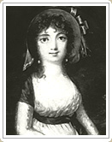
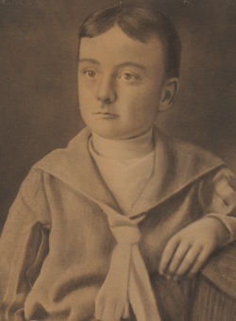
Poe’s Childhood
Parents: David Poe Elizabeth Atkins
Edgar Poe was born in Boston on January 19, 1809, to David and Elizabeth Poe. Elizabeth died in 1811 shortly after separating from David and taking the three children David, Edgar, and Rosalie, with her. Edgar was adopted by Mr. and Mrs. John Allan. a successful and stable Richmond merchant.

Slide 3

Poe’s Young Adult Years
When Poe was 6, he went to school in England for 5 years. He learned Latin and French, as well as math and history. Later he returned to school in America and continued his studies. Edgar Allan went to the University of Virginia in 1826. He was 17. Poe spent most of 1826 at the University of West Virginia, doing well in his studies, but running up gambling debts and drinking.

Slide 4

Trouble Follows Poe
Edgar Allan had no money, no job skills, and had been shunned by John Allan. Edgar went to Boston and joined the U.S. Army in 1827. He did reasonably well in the Army and attained the rank of sergeant major. In 1829, Mrs. Allan died and John Allan tried to be friendly towards Edgar and signed Edgar's application to West Point. In 1830, Edgar Allan entered West Point as a cadet. He didn't stay long because John Allan refused to send him any money.

Slide 5
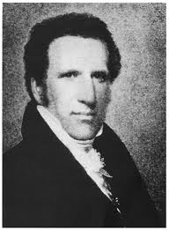
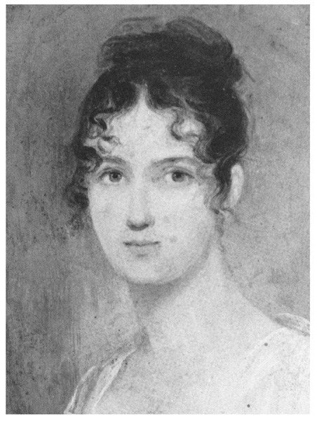
Struggling Writer
In 1831, Edgar Allan Poe went to New York City where he had some of his poetry published. He submitted stories to a number of magazines and they were all rejected. Poe had no friends, no job, and was in financial trouble. He sent a letter to John Allan begging for help but none came. John Allan died in 1834 and did not mention Edgar in his will.
JOHN ALLAN - POE'S FOSTER FATHER
FRANCES ALLAN - POE'S FOSTER-MOTHER

Slide 6
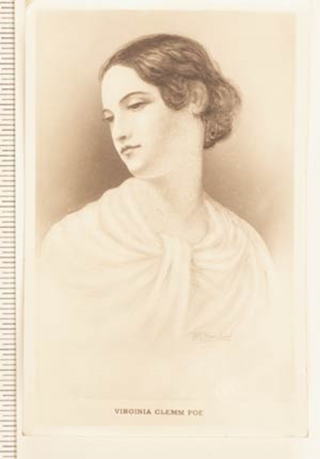
Career and marriage
Poe worked as a newspaper editor and writer throughout his life, but he never made enough money to be comfortable. In 1836, Poe married Virginia Clemm. She died in 1847 from tuberculosis.

Slide 7
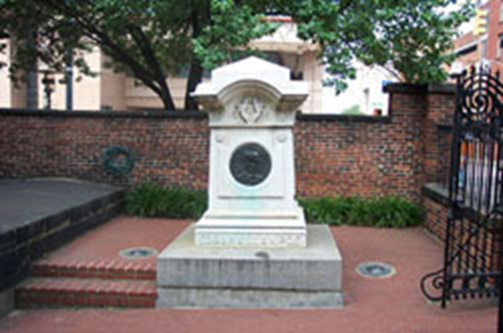
Poe’s Death
On October 3, 1849, Poe was found on the streets of Baltimore delirious, "in great distress, and... in need of immediate assistance", according to the man who found him, Joseph W. Walker. He was taken to the Washington College Hospital, where he died on Sunday, October 7, 1849, at 5:00 in the morning

Slide 8
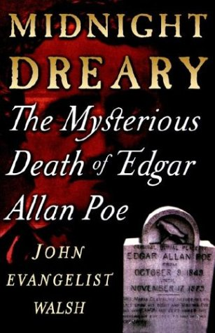
Mystery of Poe’s Death
Some sources say Poe's final words were "Lord help my poor soul." All medical records, including his death certificate, have been lost. Newspapers at the time reported Poe's death as "congestion of the brain" or "cerebral inflammation", common euphemisms for deaths from disreputable causes such as alcoholism.

Slide 9
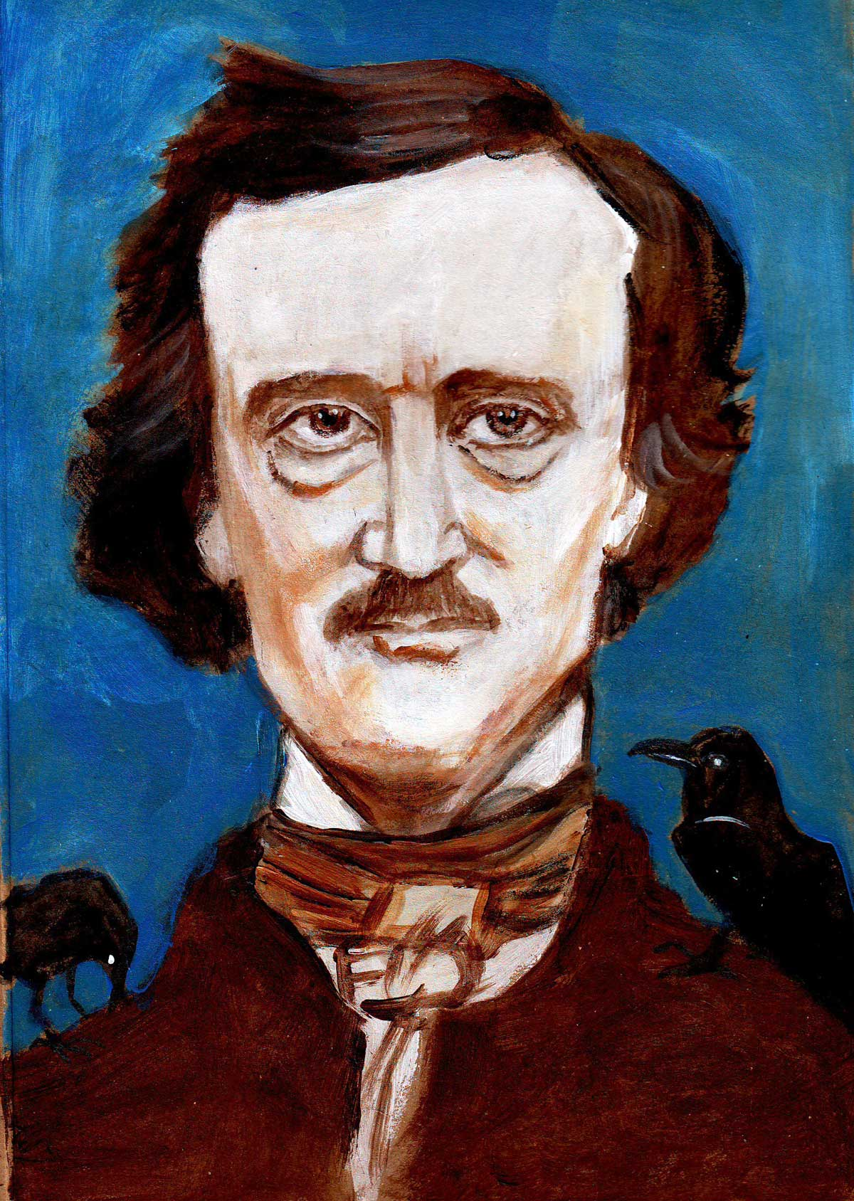
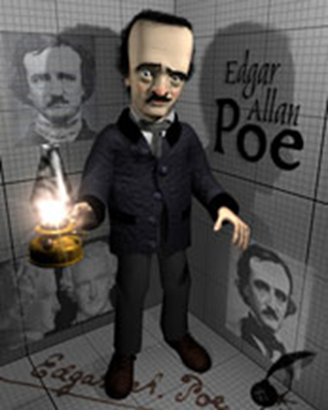
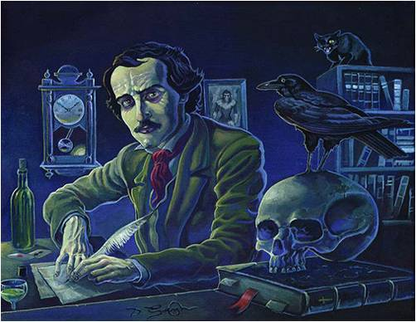
Significance
father of modern short story
father of detective story
father of psychoanalytic criticism

Slide 10
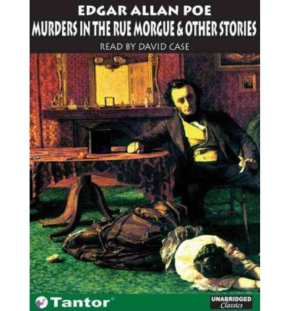
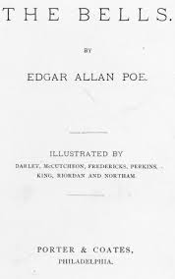

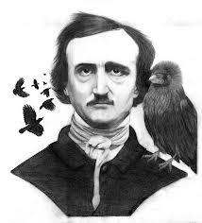
Poe’s Masterpieces Written
Poe published some of best known works:
The Raven
The Tell-Tale Heart
The Black Cat
The Bells
The Murders in the Rue Morgue
The Masque of the Red Death

Slide 11
The Black Cat by Edgar Allan Poe
Plot
Climax
Narrator murders his wife after she stops his attempt to rid of the cat.
Hangs cat and house catches on fire.His crazy actions rage on with his intemperance.
The narrator hides the bod of his wife in the wall.
Rising action
Falling action
Inciting incident:The cat’s eye is gauged out.This is the first point of tension that gets the major conflict of the man driven by his alcoholism.
Old man is introduced as an alcoholic, who married young and his household has may pets,but his favorite is his black cat,Pluto.
The man is thrown into jail.The story is composed of him reminiscing on his actions.
Exposition
Denouement

Slide 12
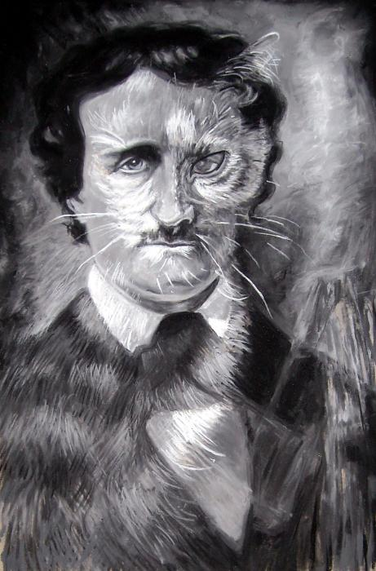

Theme
The guilt trapped within one’s conscience will haunt them to their downfall.

Slide 13
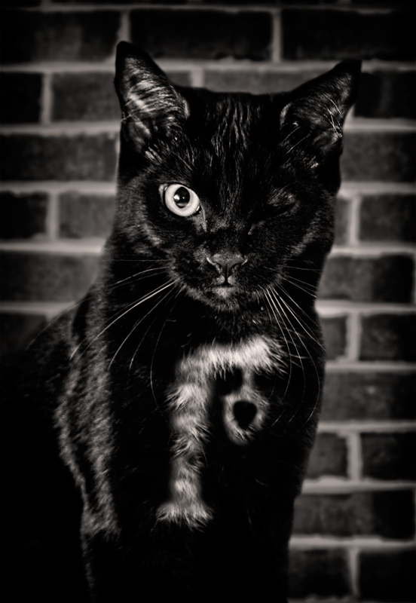
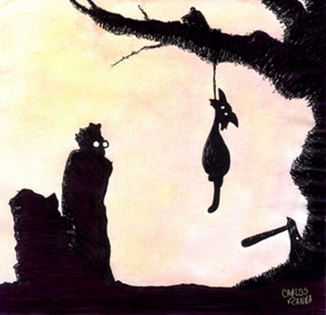
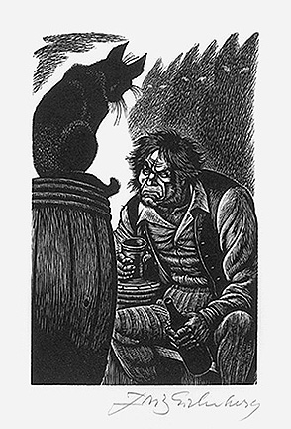
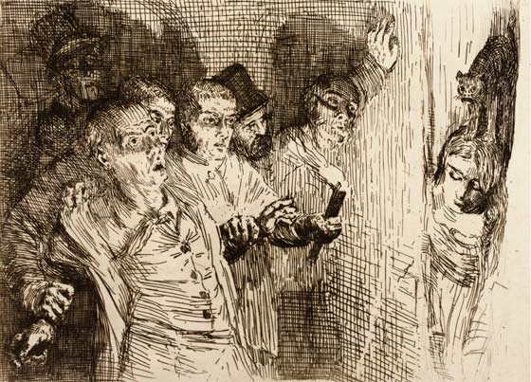
Important Symbols
Pluto and New Cat-narrator’s conscience (it is always there with the gallows and inability to be killed, as a reminder of the terrible crime)
The New’s Cat resemblance in that it is missing an eye and the white spot on the fur in the shape of gallows is there to haunt and constantly remind him of the crime.
The coincidence that the cats are black symbolizes the evil that follows him.
Alcoholism-evil within him.His own intemperance drives him to wound the cat and smother his morals.
The wall-temporary containment of narrator’s conscience/representation of bad deeds

Slide 14
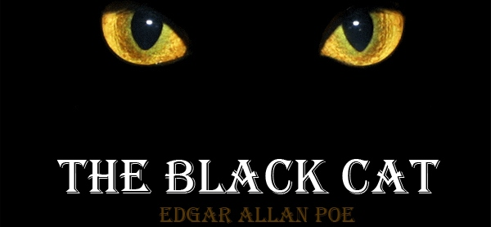
Character Relationships
Protagonist-The narrator(tries to ignore his wrongdoings)
Antagonist- The Cat( serves as his conscience of everything he has done)
In the story this man transforms from an animal lover to an animal abuser and murderer under the influence of alcohol. He blames his actions on the cat.Some would say that the second Cat was the reincarnation of Pluto.
Influence of other characters:
Relationships between he and his wife is an important aspect of the story.
His violence overcomes his relationship with her, seen in his murdering her after her attempt to save his own conscience(cat)

Slide 15
Major Conflict
Narrator vs Cat
The narrator’s physical battle with the Cat ,expressed through his violent and abusive
actions towards it. It shows battle with his own conscience.It begins at the inciting incident.
Narrator vs Intemperance
The conflict between the narrator and himself expressed in the story through the effective use of symbols.

Slide 16
Literature
http://rmc.library.cornell.edu/poe/exhibition/familyhistory/
http://www.awesomestories.com/assets/john-allan
http://www.awesomestories.com/assets/frances-allan
http://www.shmoop.com/black-cat-poe/
http://en.wikipedia.org/wiki/Edgar_Allan_Poe

