Slide 1

Italian cuisine
10-V
Suharskaya Olga

Slide 2
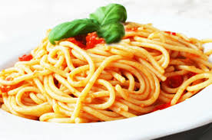
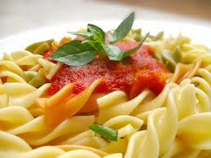
Pasta

Slide 3
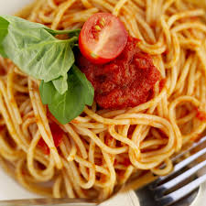
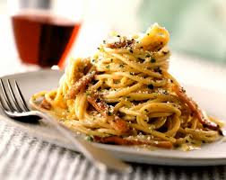
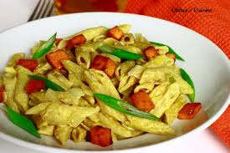
Pasta is a staple food of traditional Italian cuisine, with the first reference dating to 1154 in Sicily. It is also commonly used to refer to the variety of pasta dishes. Typically pasta is made from an unleavened dough of a durum wheat flour mixed with water and formed into sheets or various shapes, then cooked and served in any number of dishes. It can be made with flour from other cereals or grains, and eggs may be used instead of water. Pastas may be divided into two broad categories, dried (pasta secca) and fresh (pasta fresca). Chicken eggs frequently dominate as the source of the liquid component in fresh pasta.

Slide 4
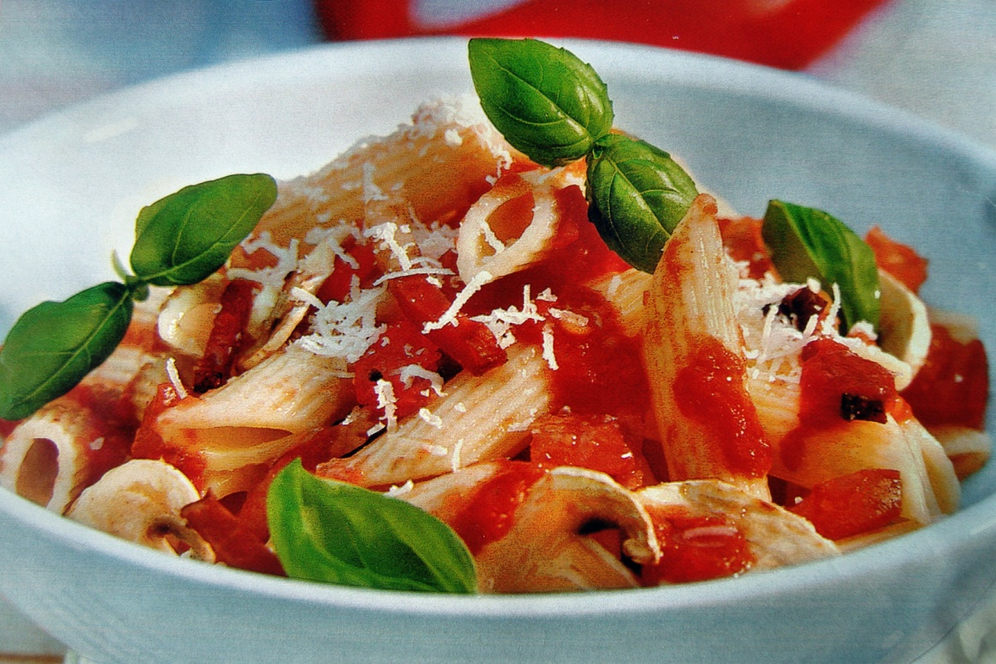
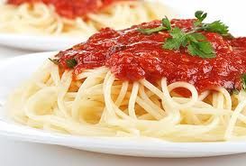
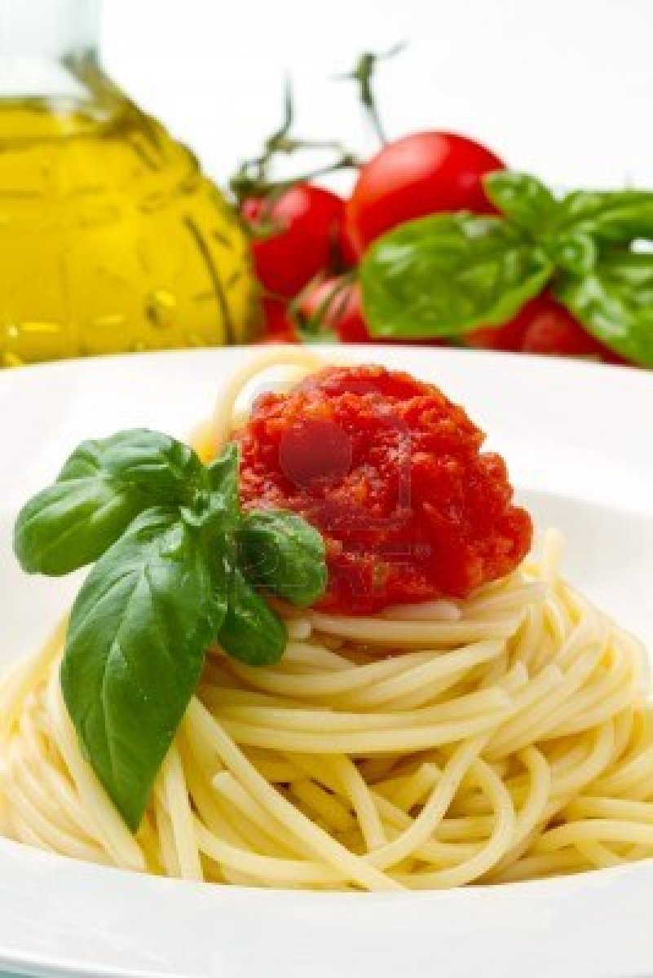
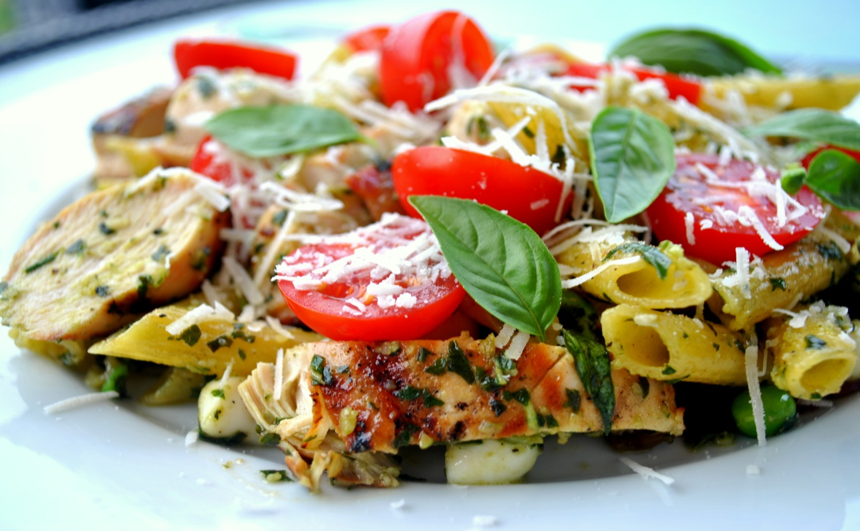

Slide 5
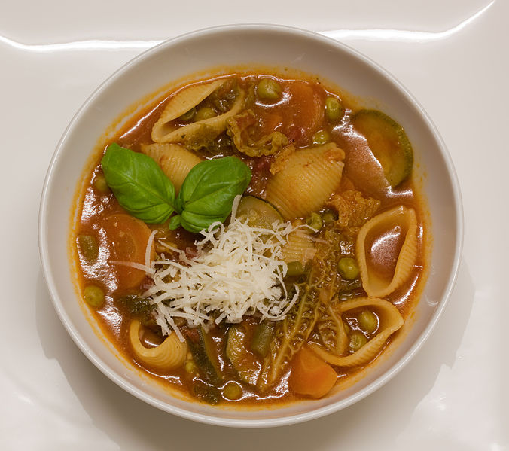
Minestrone

Slide 6
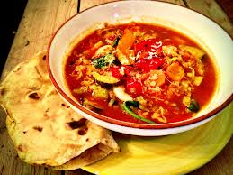
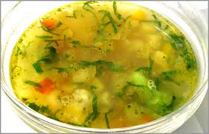
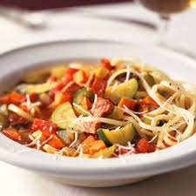
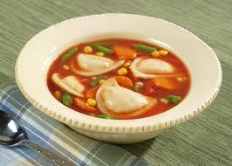
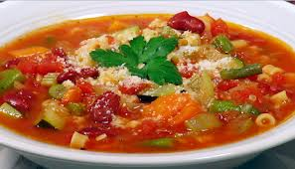
Minestrone is a thick soup of Italian origin made with vegetables, often with the addition of pasta or rice. Common ingredients include beans, onions, celery, carrots, stock, and tomatoes.
There is no set recipe for minestrone, since it is usually made out of whatever vegetables are in season. It can be vegetarian, contain meat, or contain a meat-based broth (such as chicken stock). Angelo Pellegrini, however, argued that the base of minestrone is bean broth, and that Roman beans (also called Borlotti beans) "are the beans to use for genuine minestrone".

Slide 7
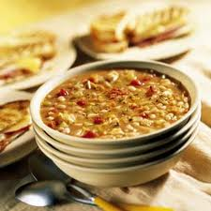
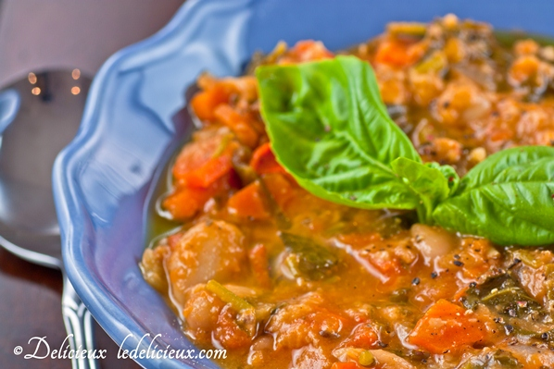
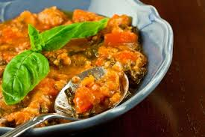
Ribollita
Ribollita is a famous Tuscan soup, a hearty potage made with bread and vegetables. There are many variations but the main ingredients always include leftover bread, cannellini beans and inexpensive vegetables such as carrot, cabbage, beans, silverbeet , cavolo nero , and onion. Its name literally means “ reboiled ".

Slide 8
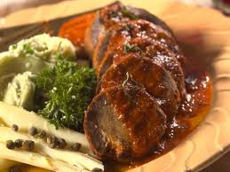
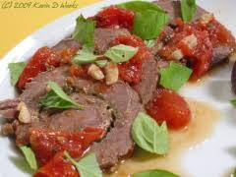
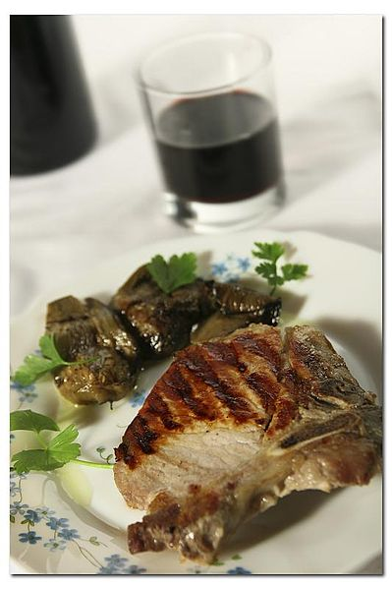
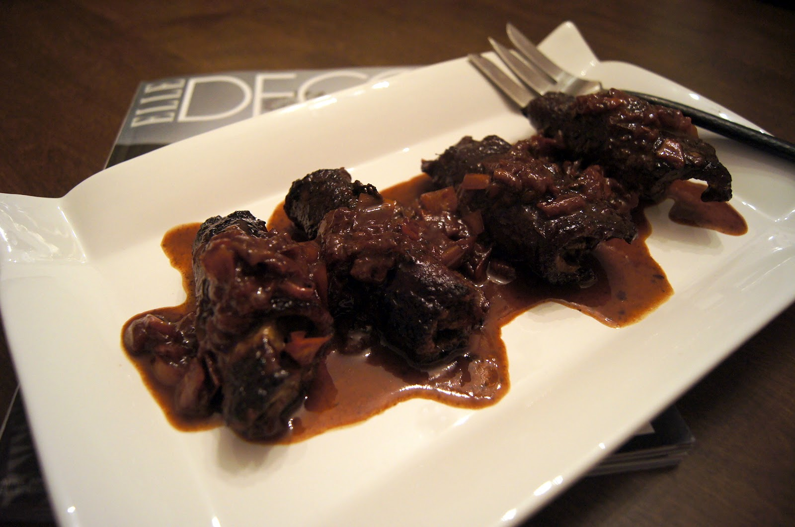
Braciola
Braciola is the name of an Italian dish. Braciole are slices of meat that are pan-fried or grilled, often in their own juice or in a small amount of light olive oil. They are different from the finer cut fettine ("small/thin slices"), which never have bone and are generally thinner.

Slide 9
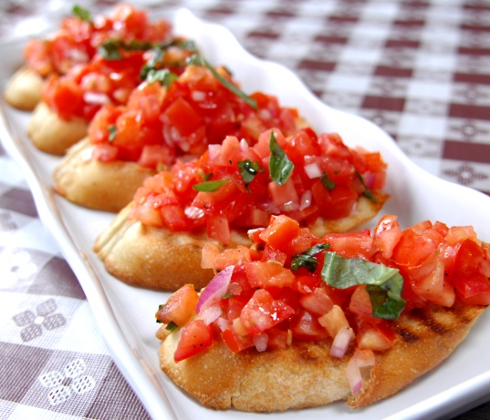
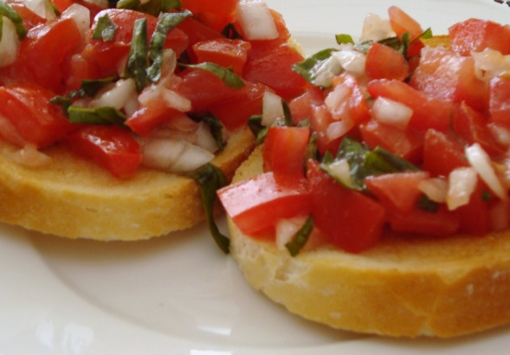
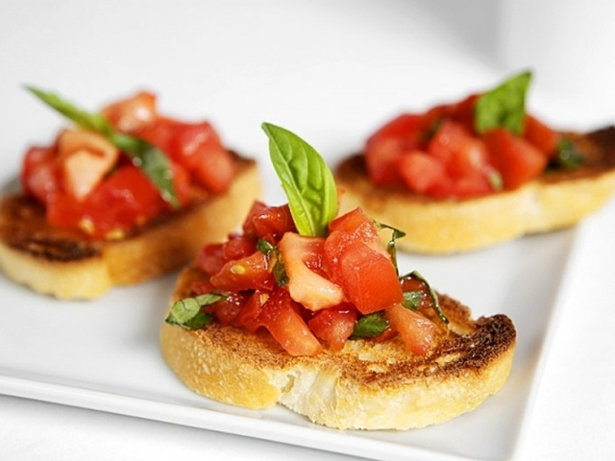
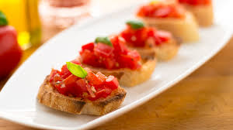
Bruschetta
Bruschetta is an antipasto from Italy consisting of grilled bread rubbed with garlic and topped with olive oil, salt and pepper. Variations may include toppings of tomato, vegetables, beans, cured meat, or cheese; the most popular recipe outside of Italy in olves basil, fresh tomato, garlic and onion or mozzarella. Bruschetta is usually served as a snack or appetizer. In some countries, a topping of chopped tomato, olive oil and herbs is sold as bruschetta.

Slide 10
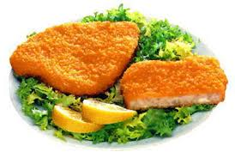
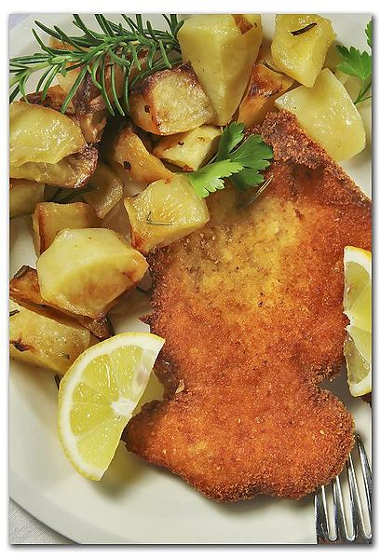
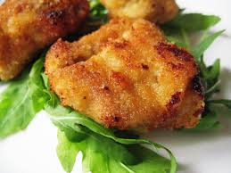
Cotoletta
Cotoletta (from Italian: costoletta = "little rib", because of the rib that remains attached to the meat during and after the cooking) is an Italian word for veal breaded cutlet.
Cotoletta alla milanese is a fried cutlet similar to Wiener schnitzel, but cooked "bone-in". It is fried in clarified butter or olive oil and traditionally uses exclusively milk-fed veal.

Slide 11
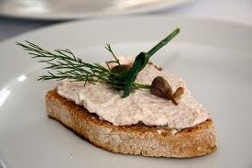
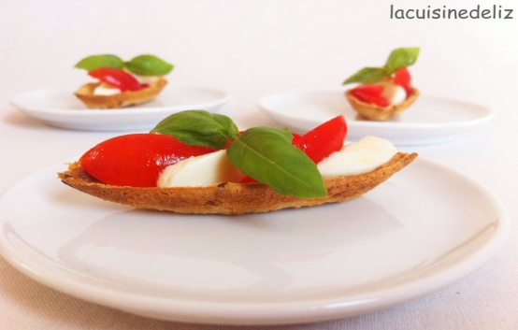
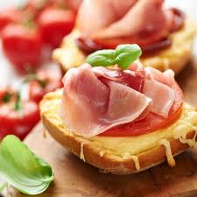
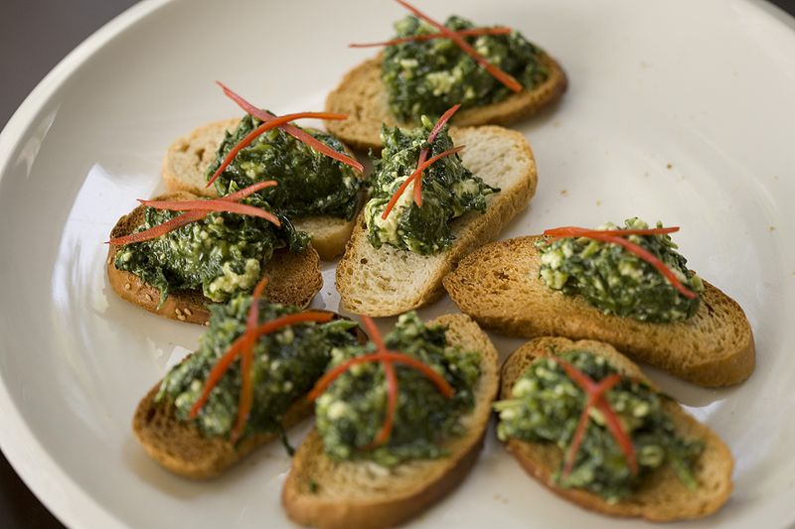
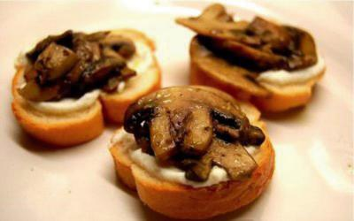
Crostino
Crostino (meaning "little toast" in Italian) is an Italian appetizer consisting of a small slice of grilled or toasted bread and toppings. The toppings may include a variety of different cheeses,meats, and vegetables, or may be presented more simply with a brush of olive oil and herbs or a sauce. Crostini are typically made using Italian ciabattas and are often served with wine.

Slide 12
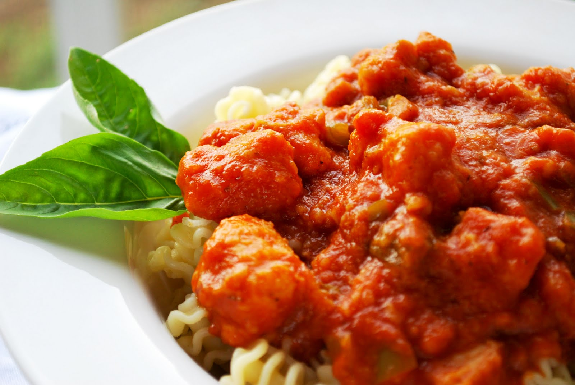
Cacciatore
Cacciatore means "hunter" in Italian. In cuisine, alla cacciatora refers to a meal prepared "hunter-style" with tomatoes, onions, herbs, often bell pepper, and sometimes wine. Cacciatore is popularly made with braised chicken (pollo alla cacciatora) orrabbit (coniglio alla cacciatora). The salamino cacciatore is also a small salami, popular amongst Italians.

Slide 13
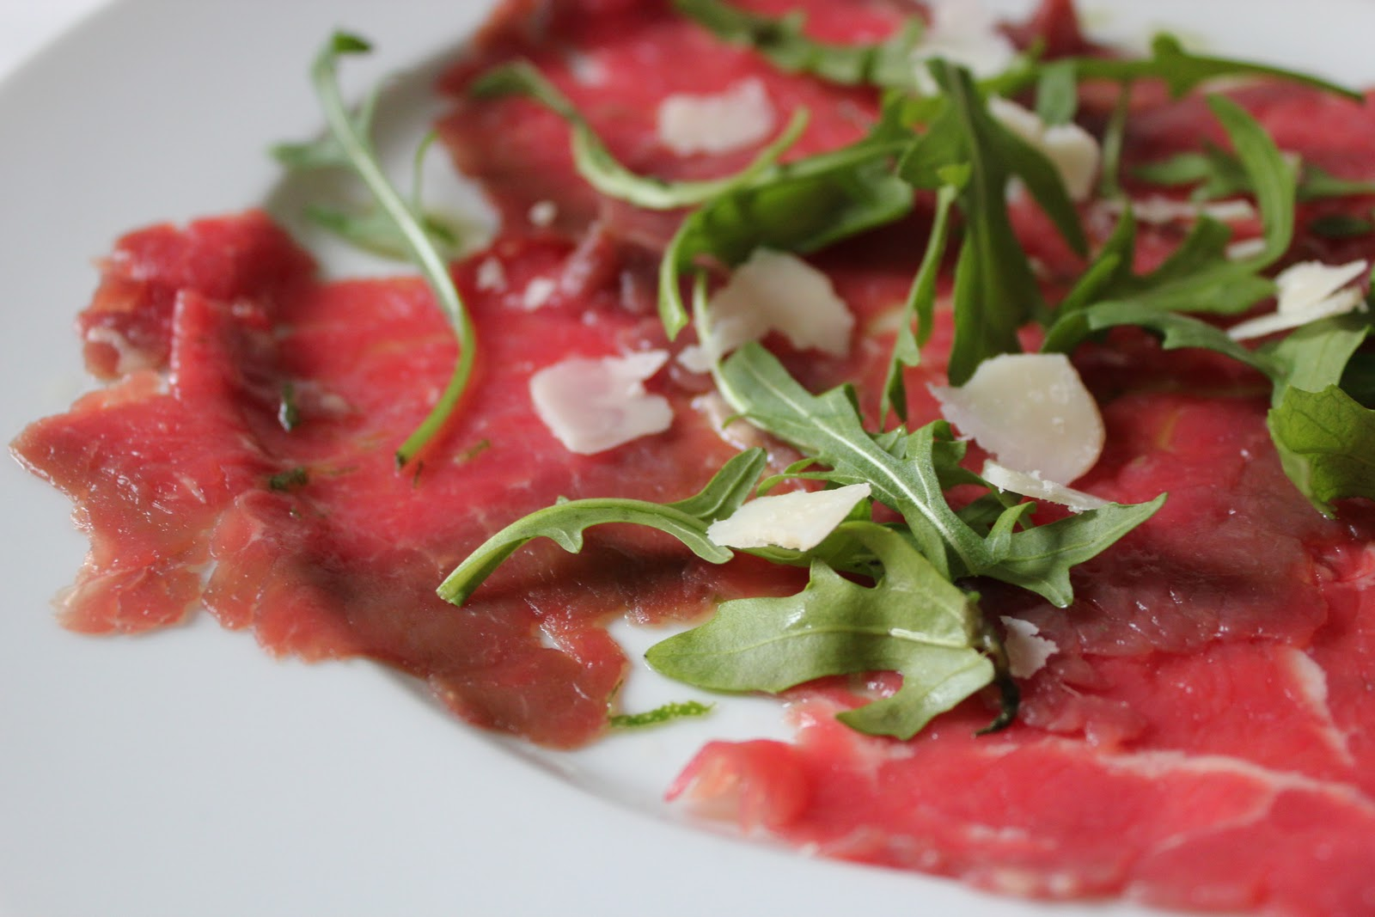
Carpaccio
Carpaccio is a dish of raw meat or fish (such as beef, veal, venison, salmon or tuna), thinly sliced or pounded thin and served mainly as an appetizer.

Slide 14
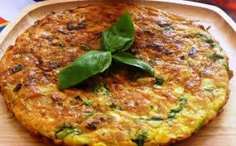
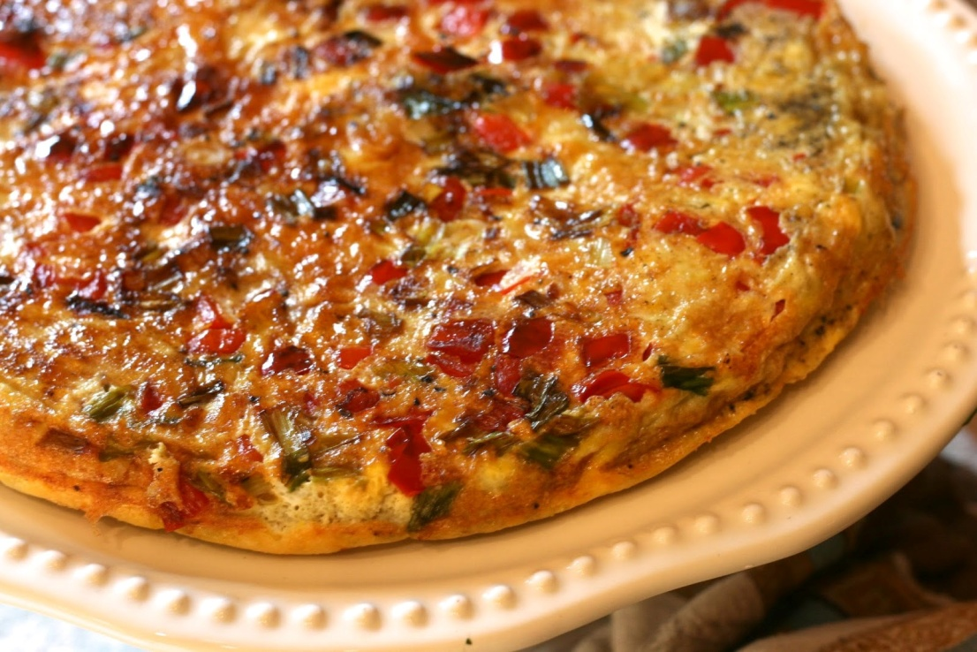
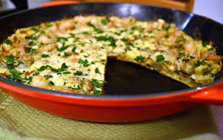
Frittata
Frittata is an egg-based Italian dish similar to an omelette or crustless quiche, enriched with additional ingredients such as meats, cheeses, vegetables or pasta.

Slide 15
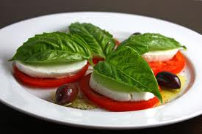
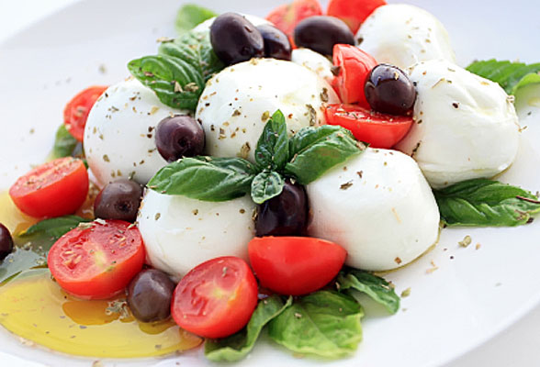
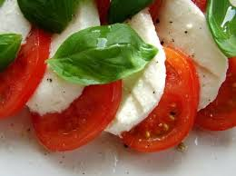
Insalata Caprese
Insalata Caprese is a simple salad, made of sliced fresh mozzarella, tomatoes and basil, seasoned with salt, and olive oil. In Italy, unlike most salads, it is usually served as an antipasto (starter), not a contorno (side dish).

Slide 16
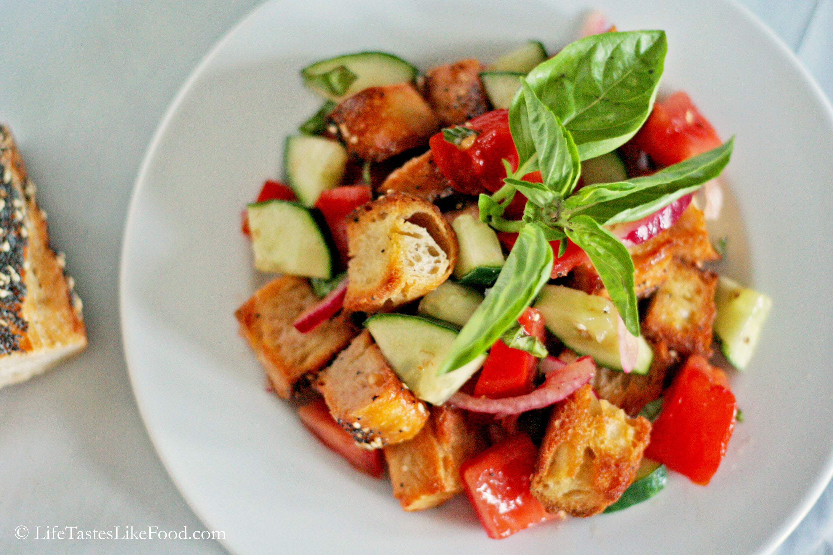
Panzanella
Panzanella or panmolle is a Tuscan salad of bread and tomatoes popular in the summer. It includes chunks of soaked stale bread and tomatoes, sometimes also onions and basil, dressed witholive oil and vinegar. It is also popular in other parts of central Italy.

Slide 17
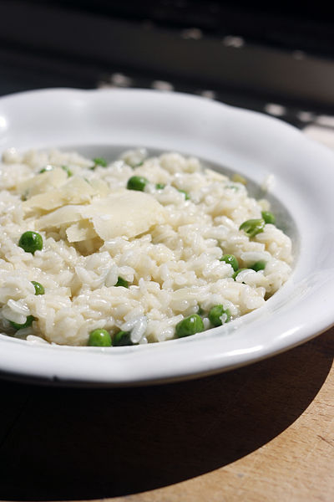
Risotto
Risotto is an Italian rice dish cooked in broth to a creamy consistency. The broth may be meat-, fish-, or vegetable-based. Many types of risotto contain butter, wine and onion. It is one of the most common ways of cooking rice in Italy.

Slide 18
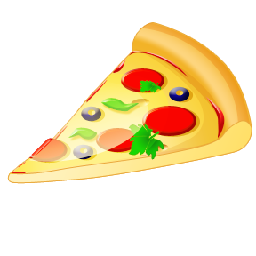
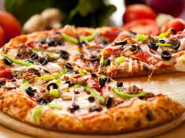
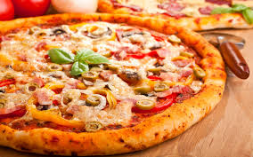
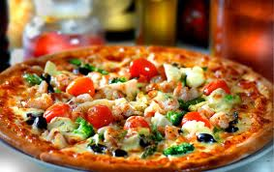
Pizza
Pizza is an oven-baked, flat, round bread typically topped with a tomato sauce, cheese and various toppings. The modern pizza was invented in Naples, Italy, and the dish has since become popular in many parts of the world.[ An establishment that makes and sells pizzas is called a "pizzeria". Many varieties of pizza exist worldwide, along with several dish variants based upon pizza. Pizza is cooked in various types of ovens, and a diverse variety of ingredients and toppings are utilized. In 2009, upon Italy's request, Neapolitan pizza was safeguarded in the European Union as a Traditional Speciality Guaranteed dish.

Slide 19
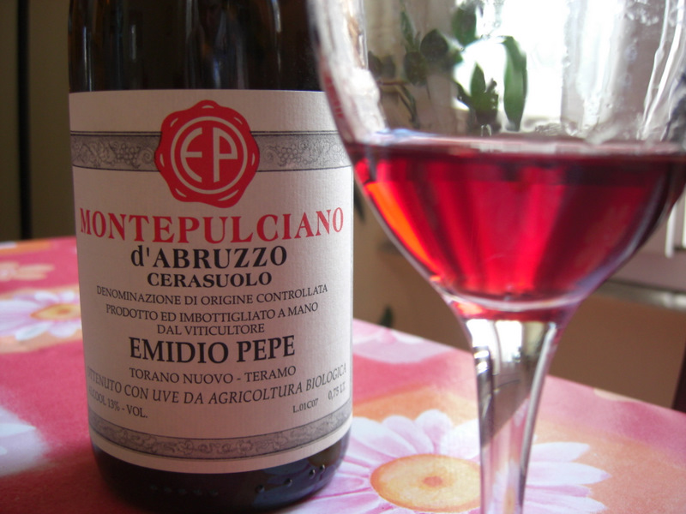

Abruzzo (wine)
Abruzzo is an Italian wine region located in the mountainous central Italian region of Abruzzo along the Adriatic Sea. It is bordered by the Molise wine region to the south, Marche to the north and Lazio to the west. Abruzzo's rugged terrain, 65% of which is mountainous, help to isolate the region from the winemaking influence of the ancient Romans and Etruscans in Tuscany but the area has had a long history of wine production.

Slide 20


Espresso
Espresso is coffee brewed by forcing a small amount of nearly boiling water under pressure through finely ground coffee beans. Espresso is generally thicker than coffee brewed by other methods, has a higher concentration of suspended and dissolved solids, and has crema on top (literally cream, a creamy foam on the surface of the coffee). As a result of the pressurized brewing process, the flavors and chemicals in a typical cup of espresso are very concentrated. Espresso is the base for other drinks, such as a caffè latte, cappuccino, caffè macchiato, cafe mocha, or caffè Americano. Espresso has more caffeine per unit volume than most beverages, but the usual serving size is smaller—a typical 60 mL of espresso has 80 to 150 mg of caffeine, a little less than the 95 to 200 mg of a standard 240 mL cup of drip-brewed coffee.

