Slide 1
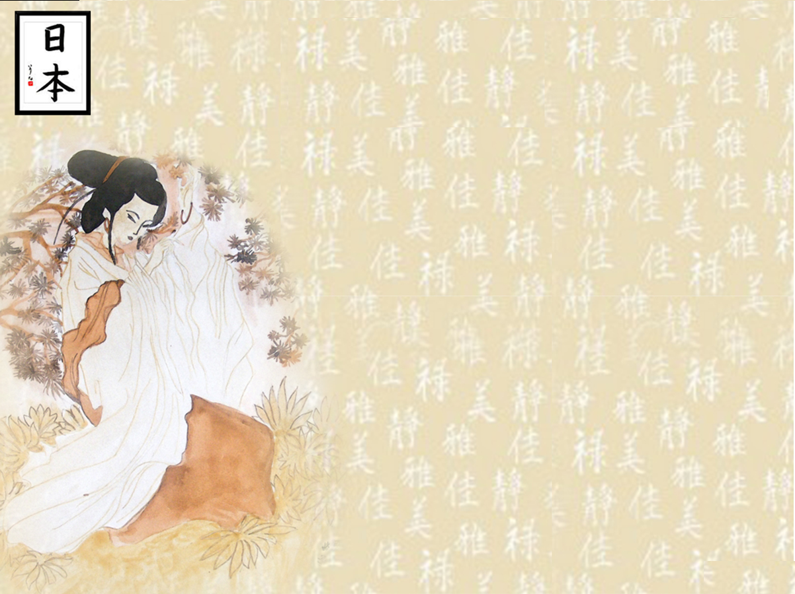
Japan
日本, にっぽん / にほん

Slide 2
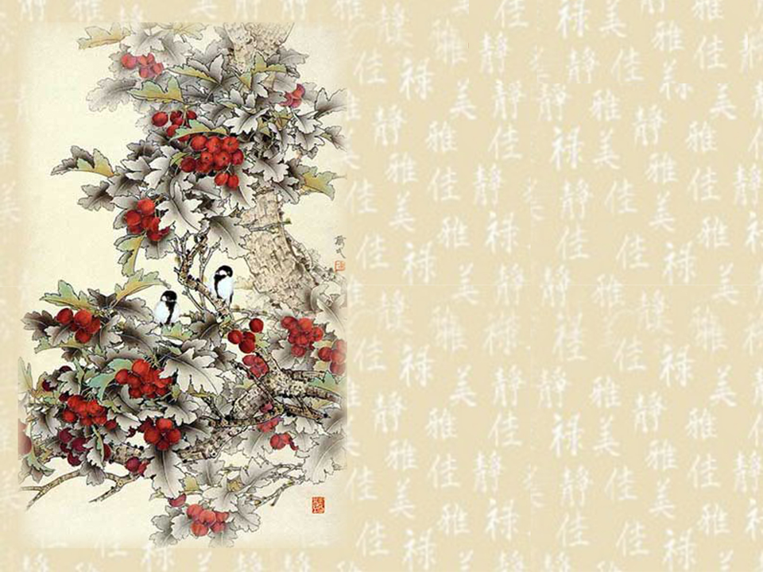
  Сapital: Tokio
  Location: Eastern Asia, island chain between the North Pacific Ocean and the Sea of Japan, east of the Korean Peninsula
  Area:
  total: 377,835 sq km
  land: 374,744 sq km
  water: 3,091 sq km

Slide 3
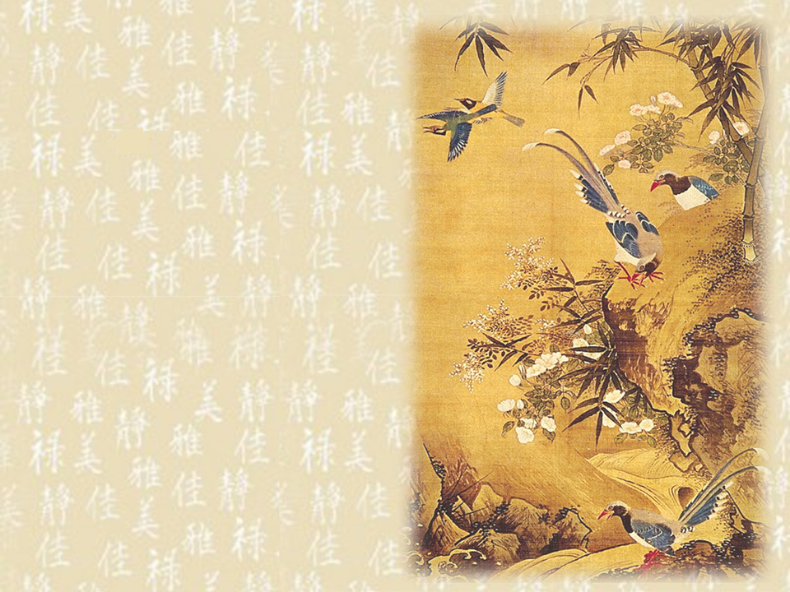
Climate: varies from tropical in south to cool temperate in north
Terrain: mostly rugged and mountainous
Elevation extremes:
lowest point: Hachiro-gata -4 m
highest point: Mount Fuji 3,776 m
Population: 127,463,611 (July 2006 est.)
Religions: observe both Shinto and Buddhist 84%, other 16% (including Christian 0.7%)
Languages: Japanese

Slide 4
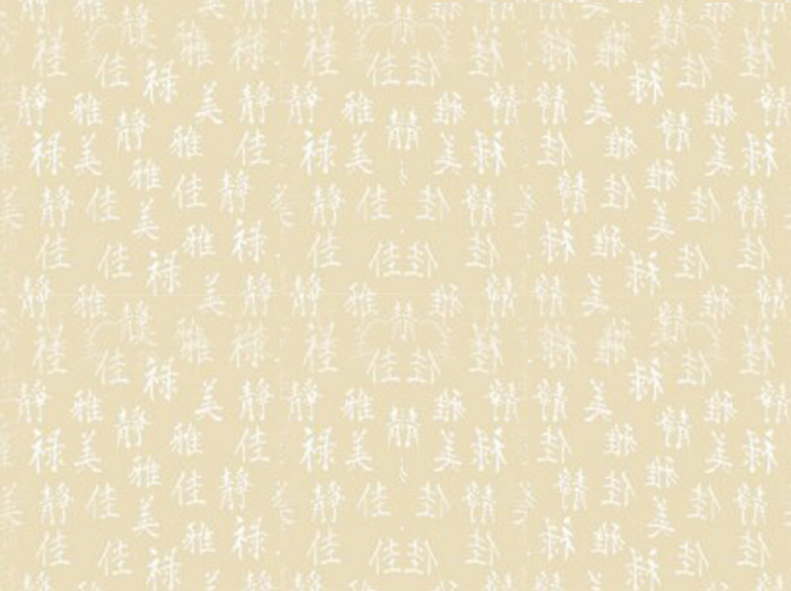
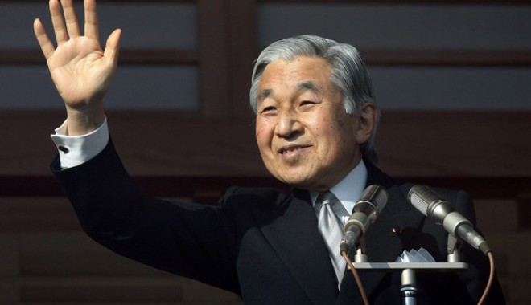
Empero akihito

Slide 5
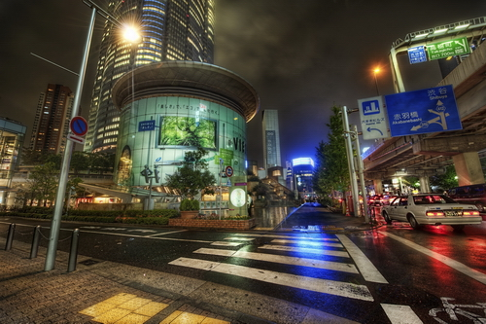

Slide 6
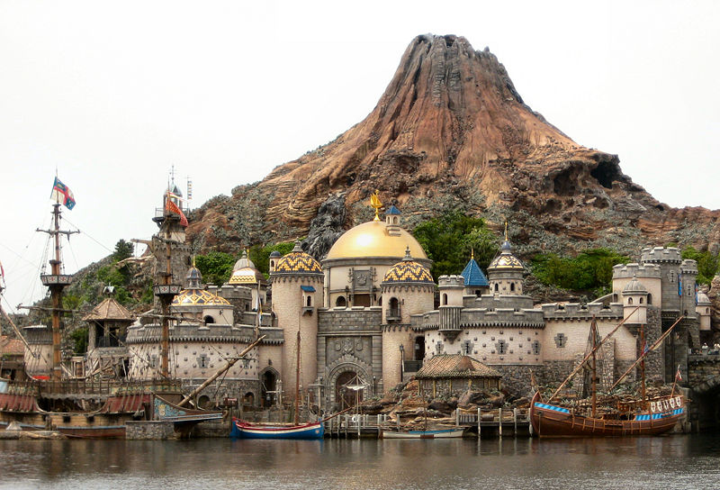
Disney Sea

Slide 7
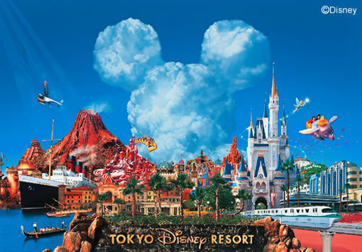
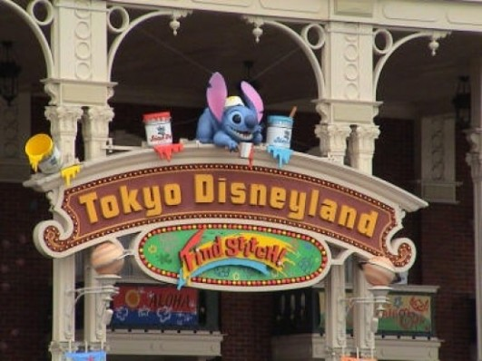
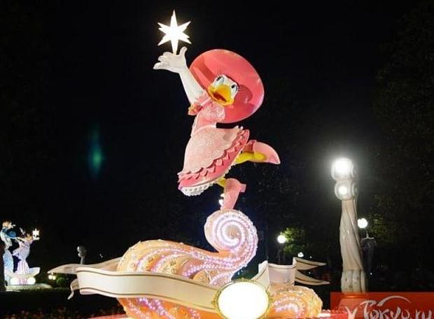

Slide 8
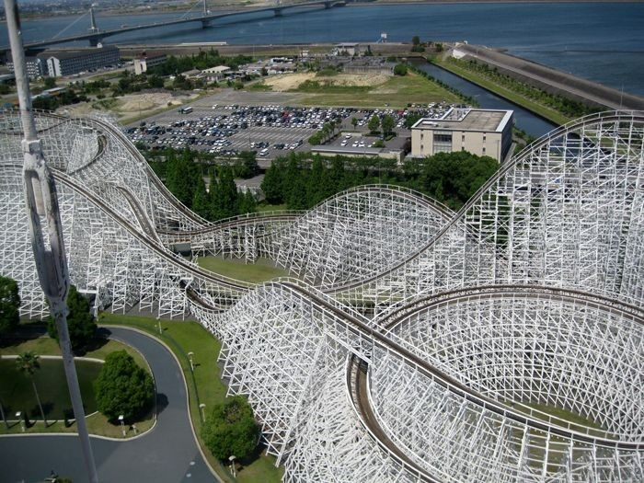

Slide 9
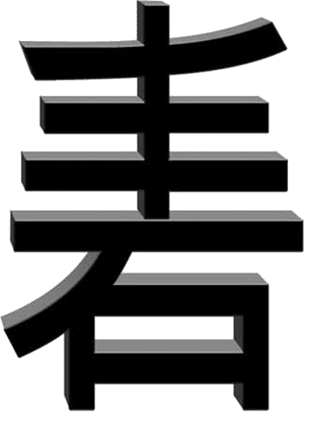

Slide 10
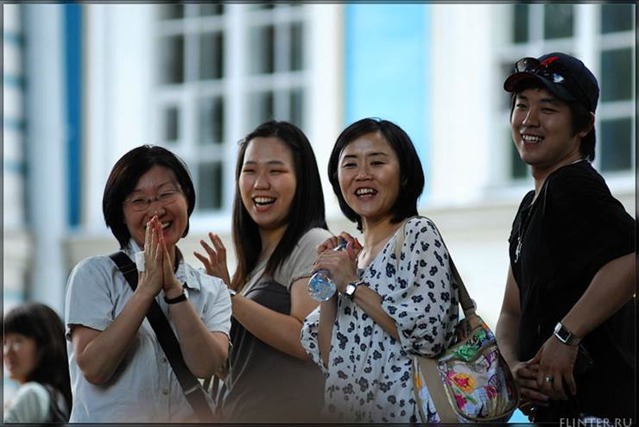

Slide 11
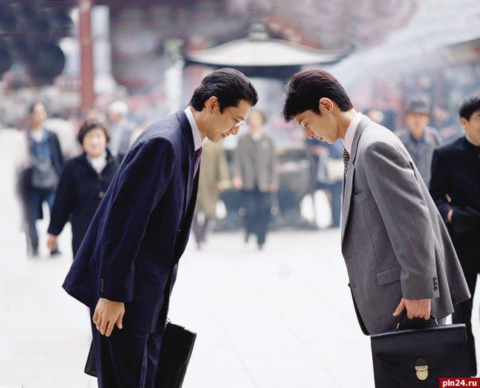
Thank you for your attention

