Slide 1

Paintings by famous artists
Project work student

Slide 2
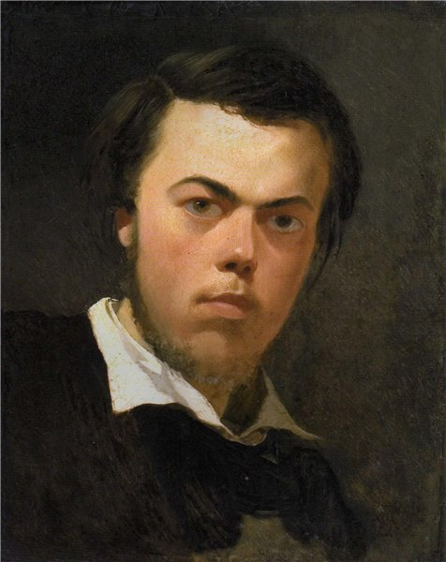
Sternberg
Vasily Ivanovich Sternberg (* February 12, 1818, St. Petersburg - † September 8, 1845, Rome) - Ukrainian painter, landscape and genre painter.

Slide 3
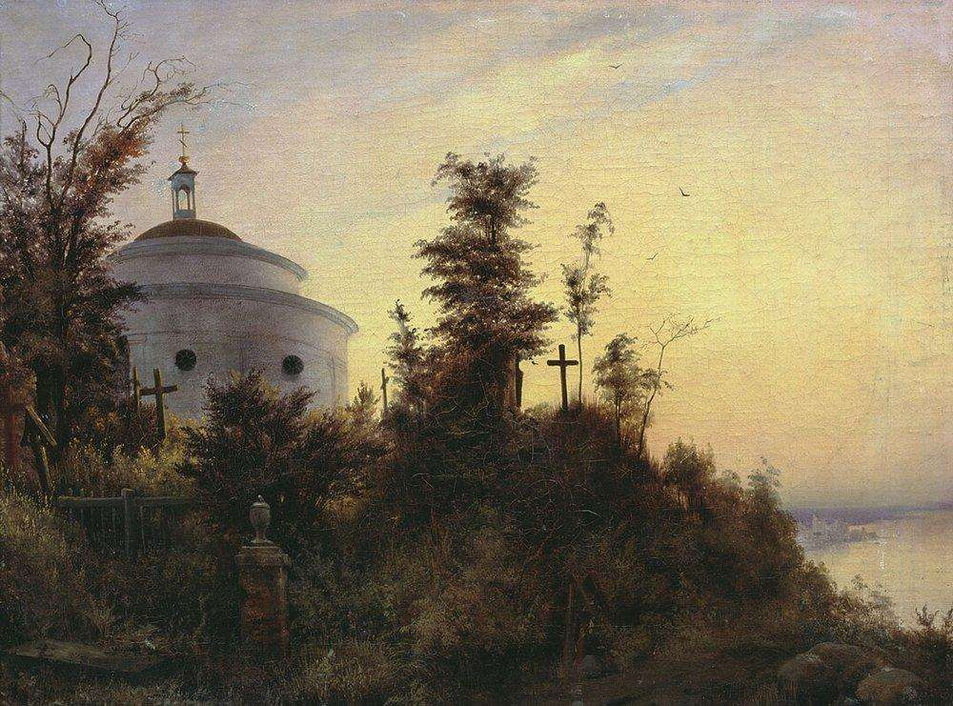
Askold's Grave

Slide 4
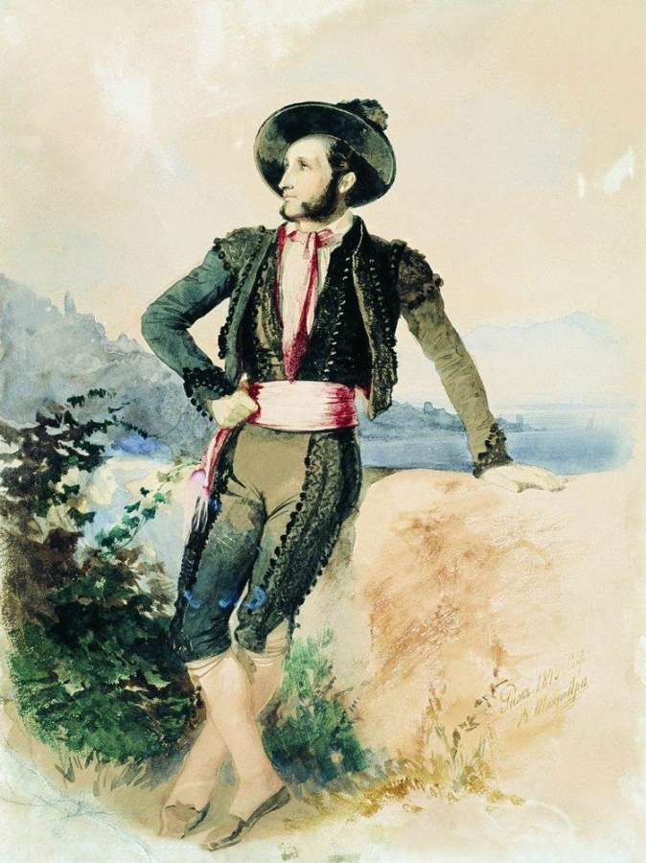
Aivazovsky Italian suit

Slide 5
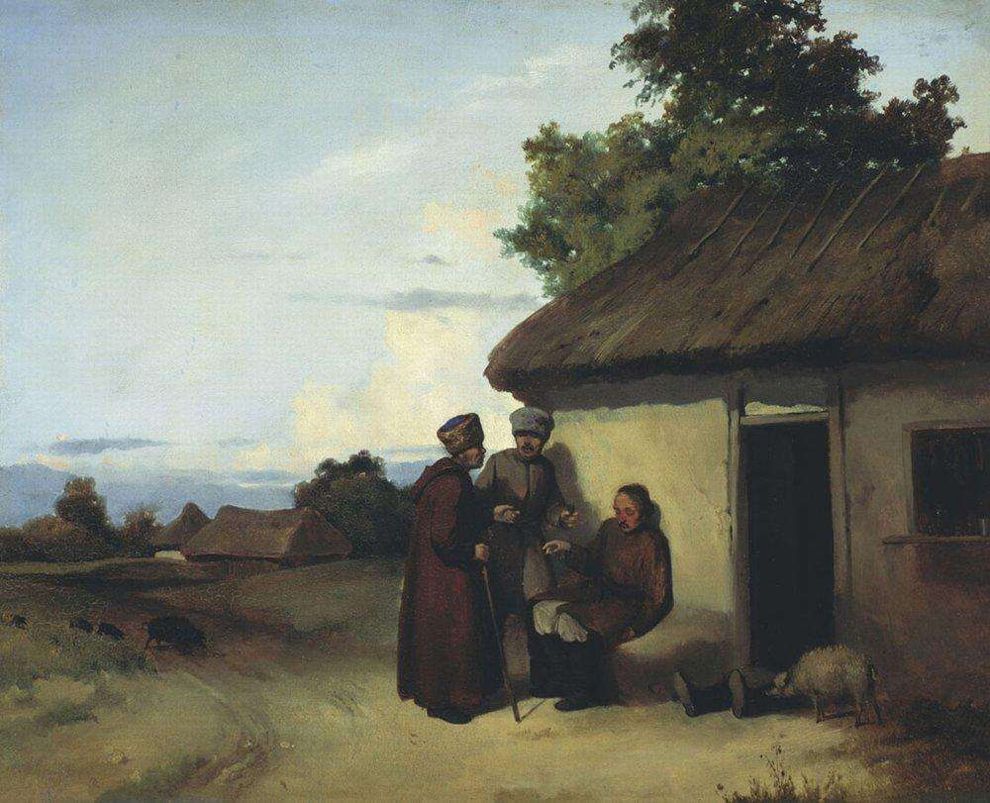
Malorossiysky tavern

Slide 6
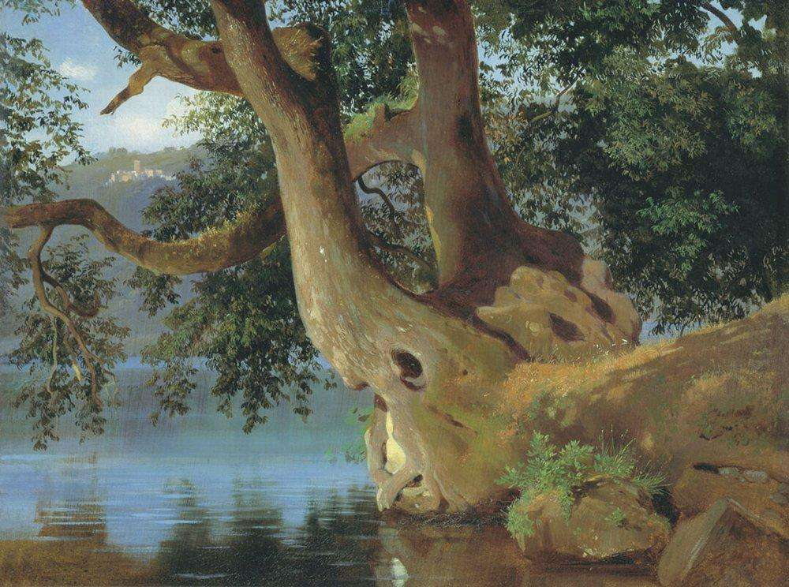
Lake Nemi near Rome

Slide 7
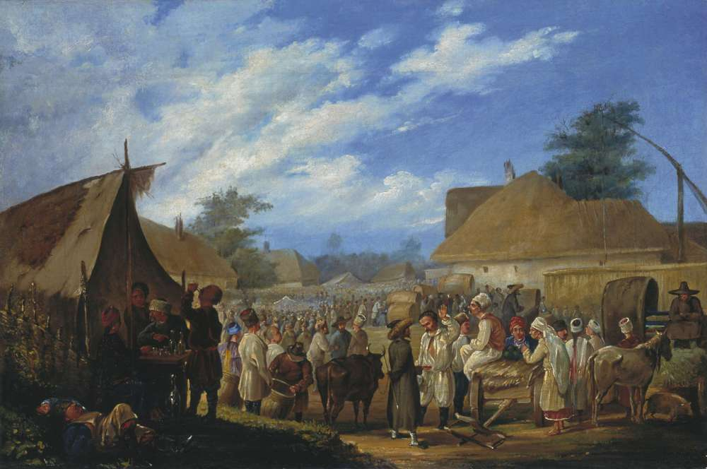
Fair in Ukraine

Slide 8
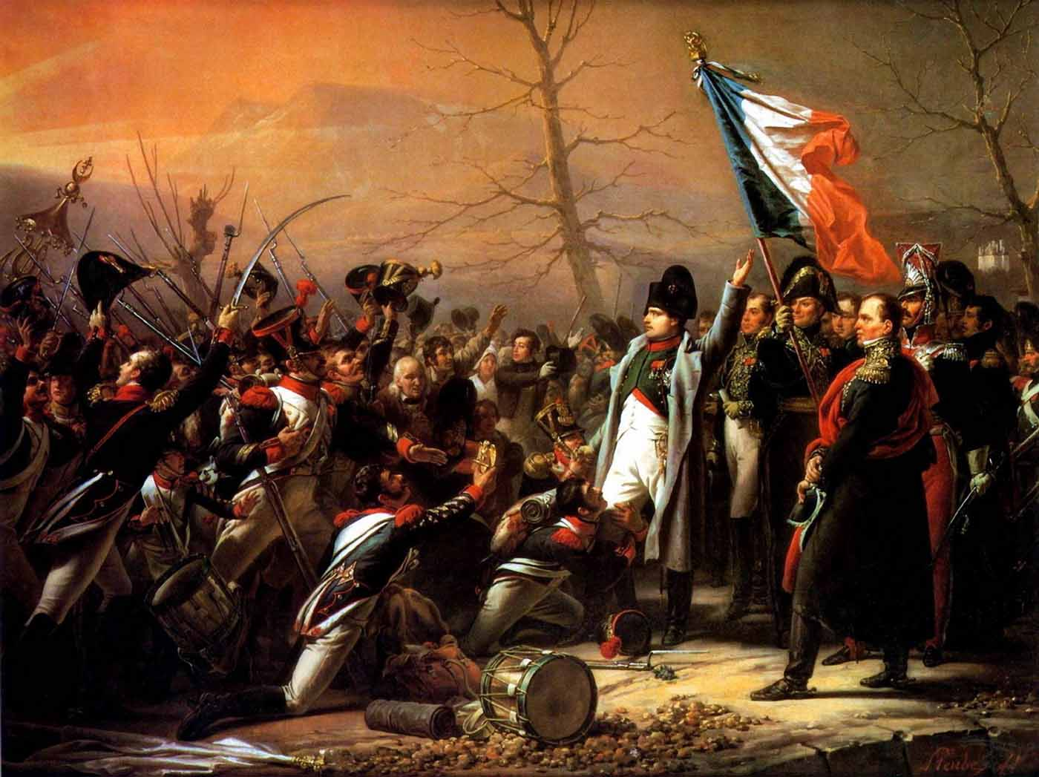
Return of Napoleon from Elba

Slide 9
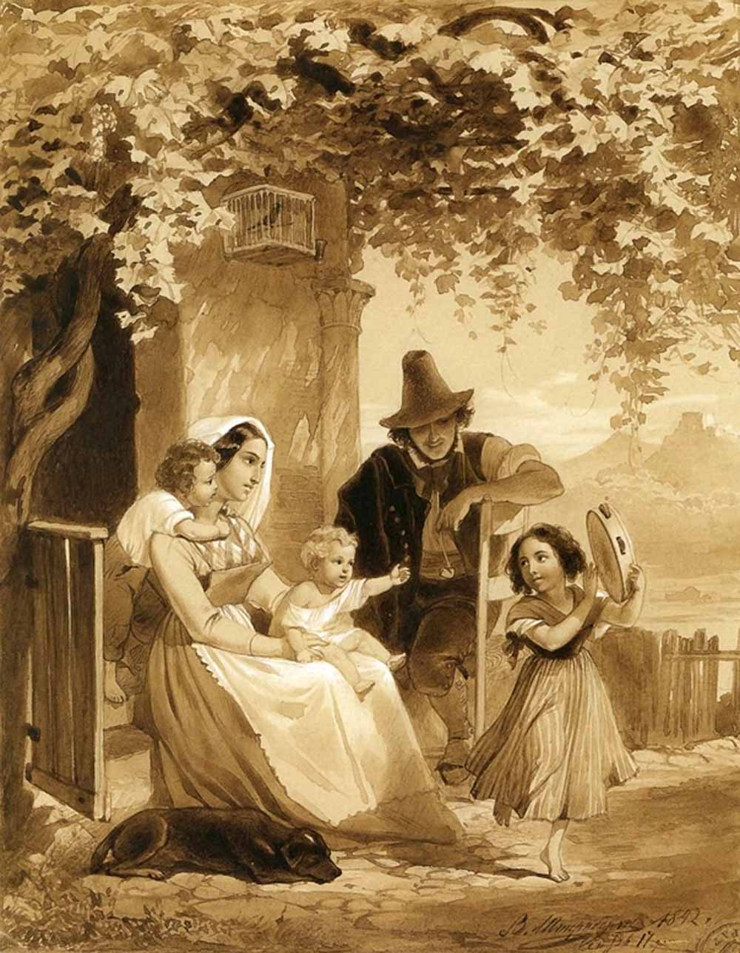
Italian family

Slide 10
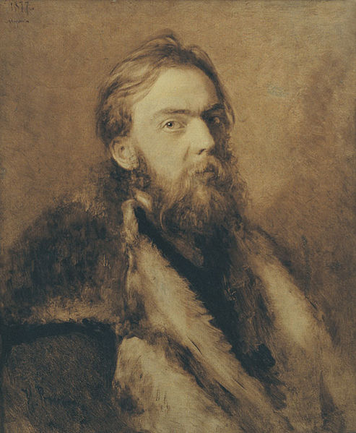
Nikolai Murashko
Nikolai Murashko (* May 20, 1844, Deaf - † September 22, 1909, Bucha) - Ukrainian painter and teacher. Uncle Ant Alexander (1875-1919) - Ukrainian painter, educator and social activist

Slide 11
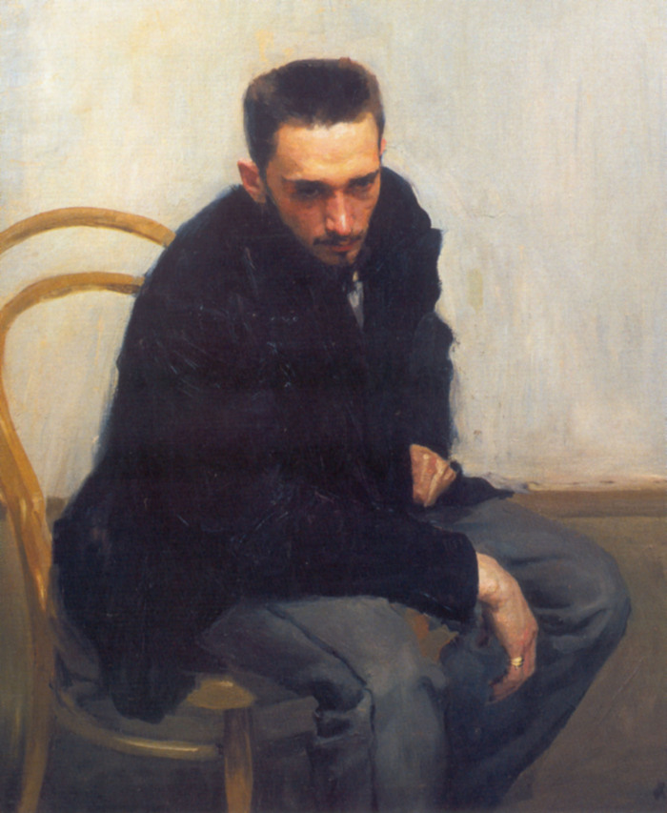
Nikolai Petrov. 1897-1898

Slide 12
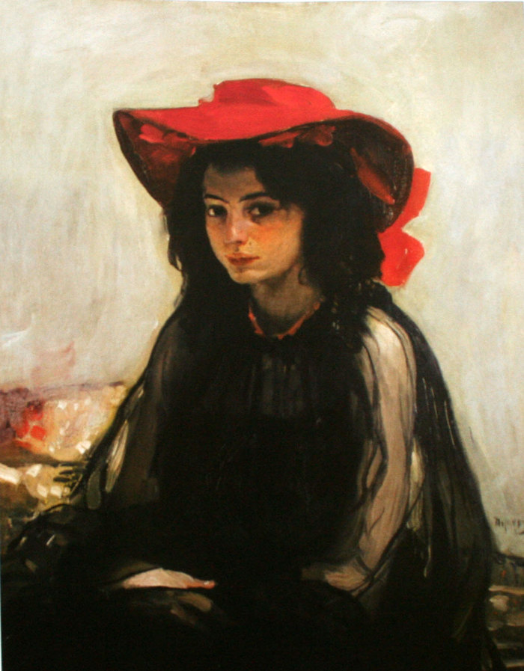
Girl in a red hat. 1902-1903

Slide 13
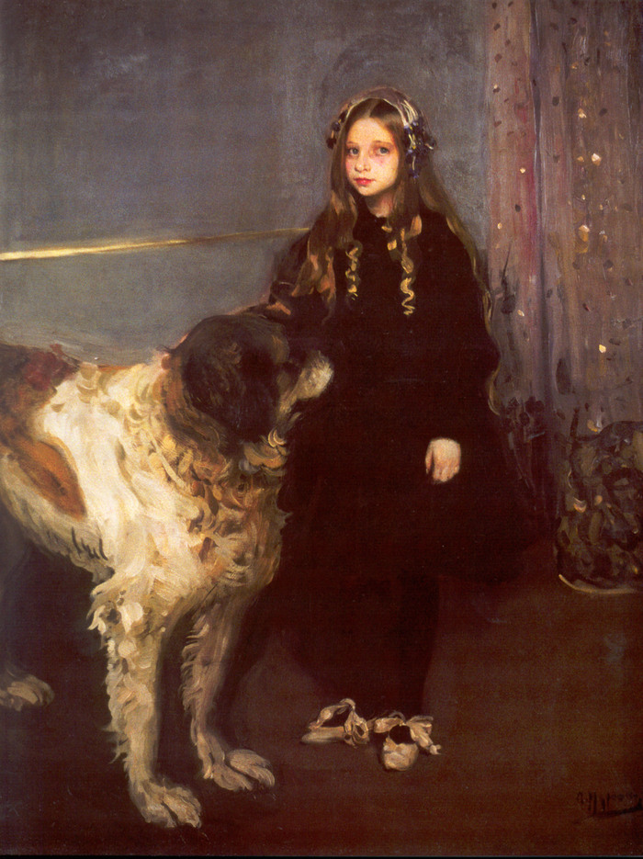
Girl with a dog. 1903-1904

Slide 14
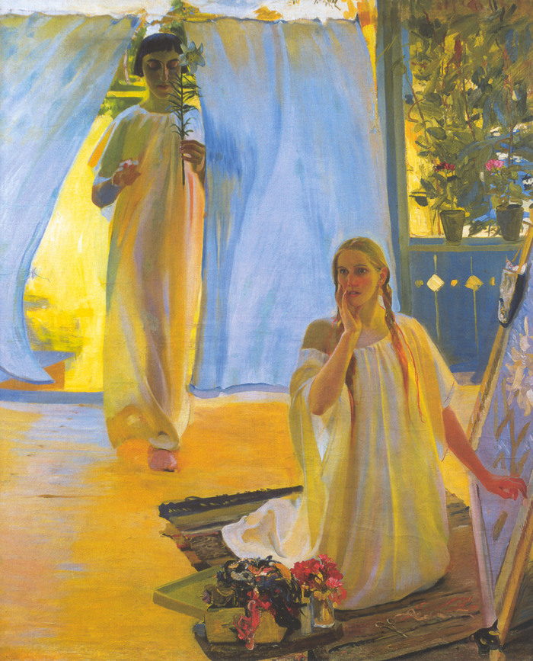
Annunciation. 1909

Slide 15
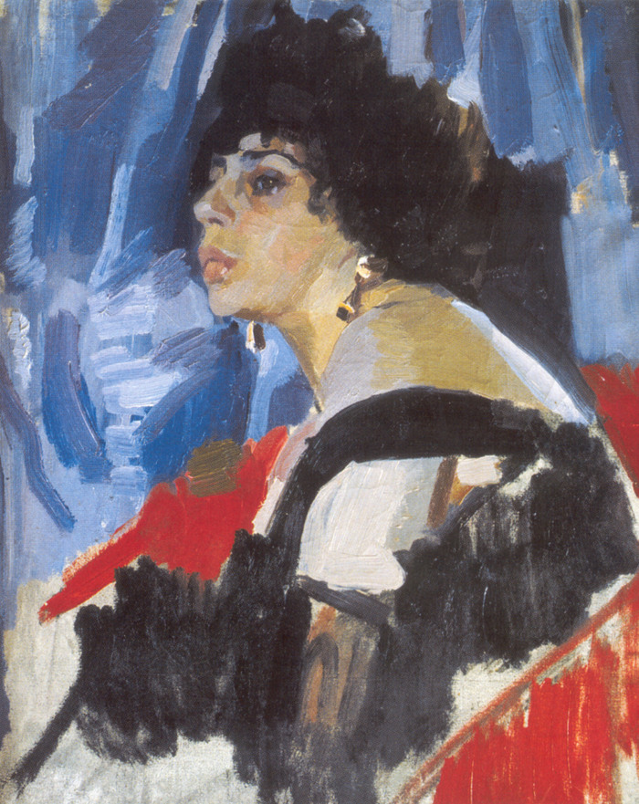
The Woman in Black. 1917

Slide 16
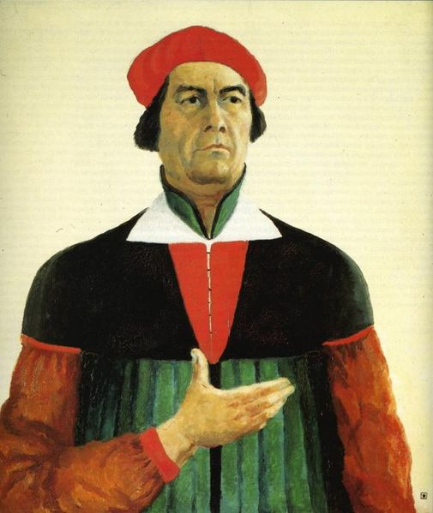
Malevich
Kazimir Malevich (* 11 (23) Dire 1878 [1] (for іnshimi danimi - 1879 [2]), Kiev - † 15 travnya 1935 Lenіngrad) - ukrainian avant-garde artist, one іz zasnovnikіv novih napryamkіv in abstract mistetstvі - Suprematism that Cubo, teacher, theorist Mistetstvo.

Slide 17
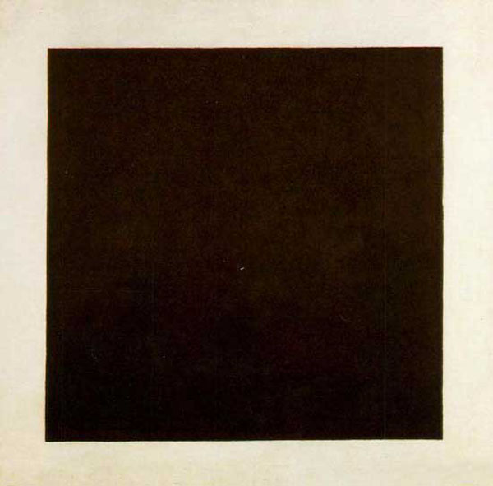
Black Square

Slide 18
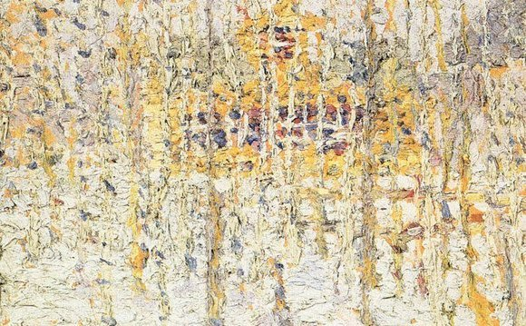
Winter Landscape (1906)

Slide 19
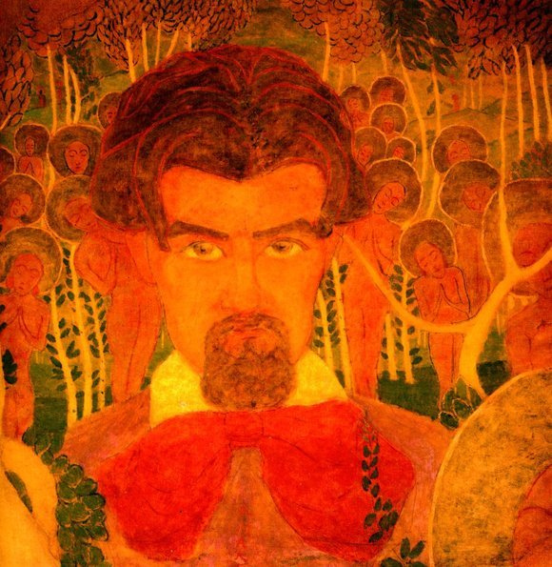
Self-Portrait (1907)

Slide 20
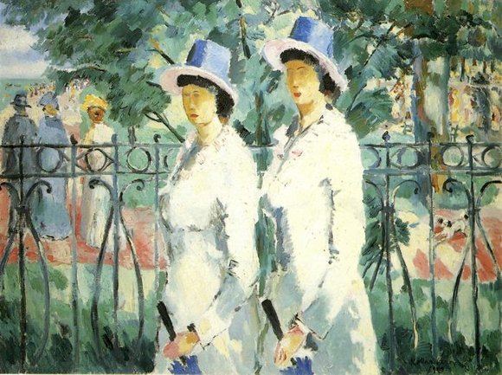
Sisters (1910)

Slide 21
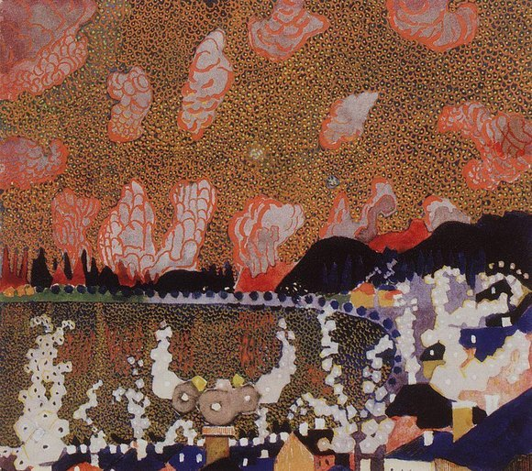
Town (1910)

Slide 22
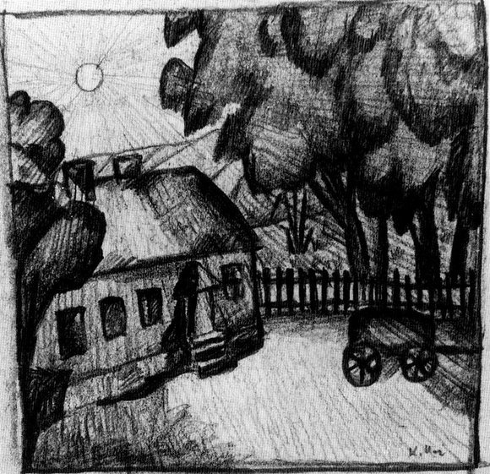
House of fencing (1911)

Slide 23
Thank you for viewing my work.

