Slide 1
Cubisme

Slide 2
Cubism originated in 1907 in Europe. Became the basis of his pagan culture, the main advantage of which is a full disclosure of the depicted events and objects.
The new trend is called "Cubism" because of the similarity of visual techniques with geometric shapes. Artists Cubists revolutionized the art, they rejected all the conventions and canons optical realism, rejected perspective, chiaroscuro, found the means of artistic expression
In the development of cubism are three periods: sezanovsky, analytical, synthetic.

Slide 3
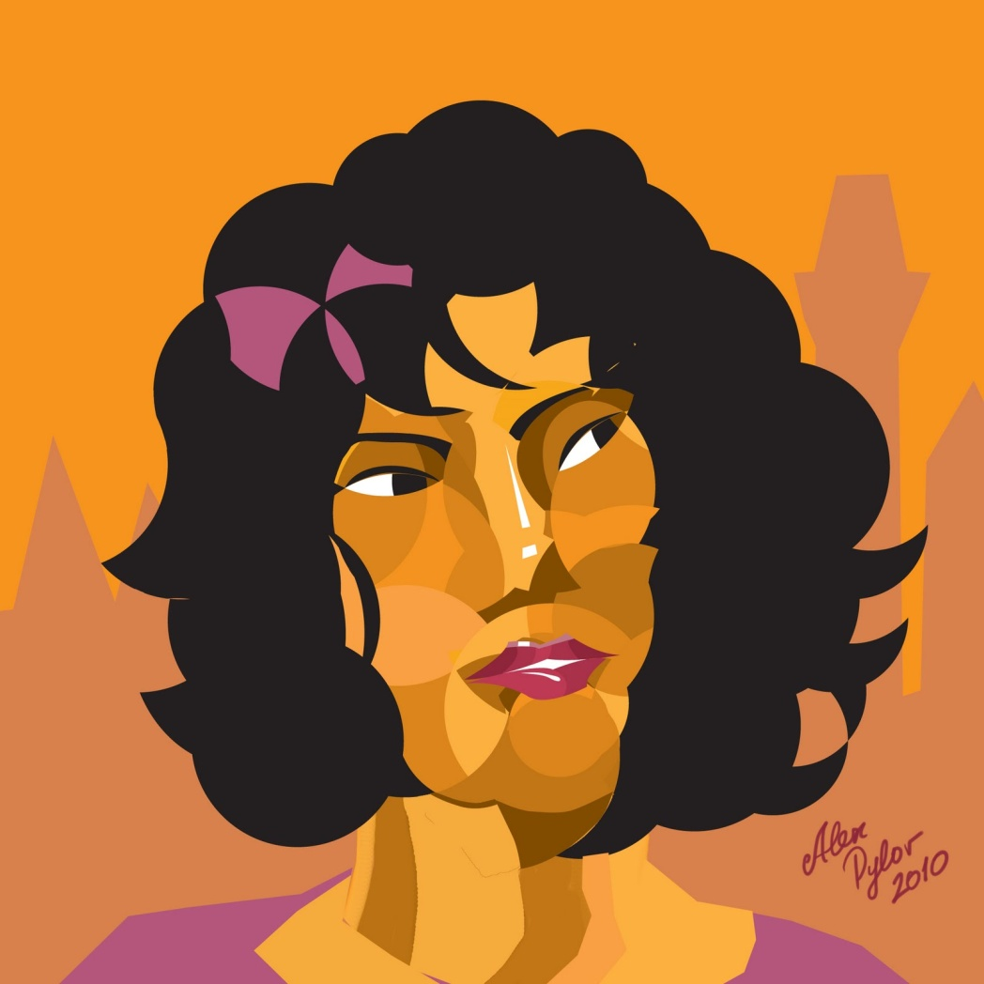
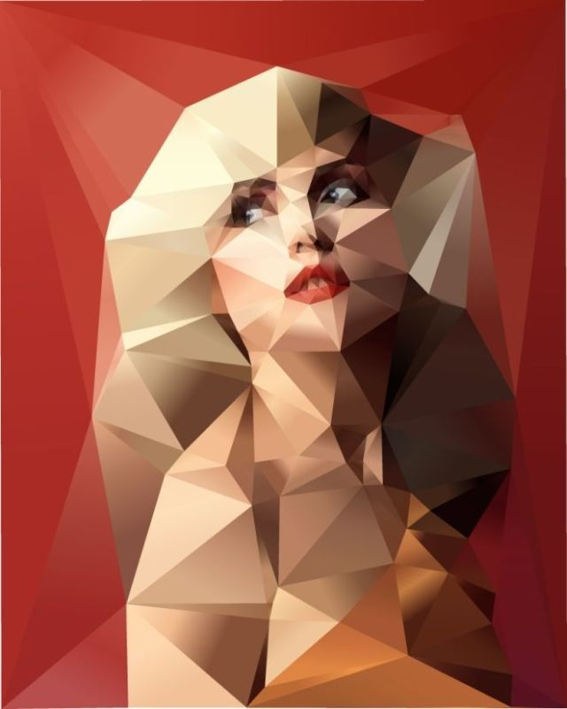
The main objective of the work of artists-Cubists was to create a new reality, through the renunciation of reality, not its comprehension.
The most outstanding representatives of cubism and its founders believe the two great artists - Pablo Picasso and Georges Braque.

Slide 4
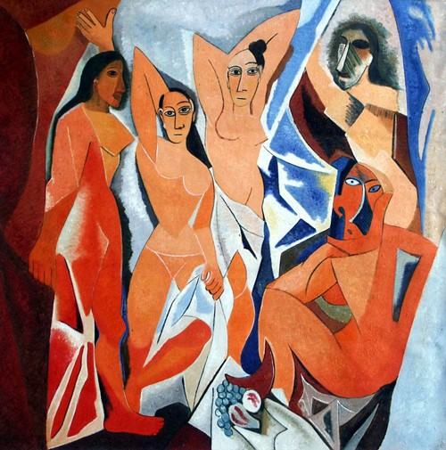
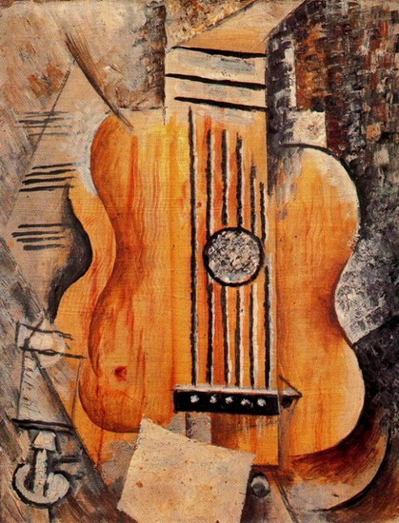
Picasso "Les Demoiselles d'Avignon"
Picasso "Guitar"

Slide 5
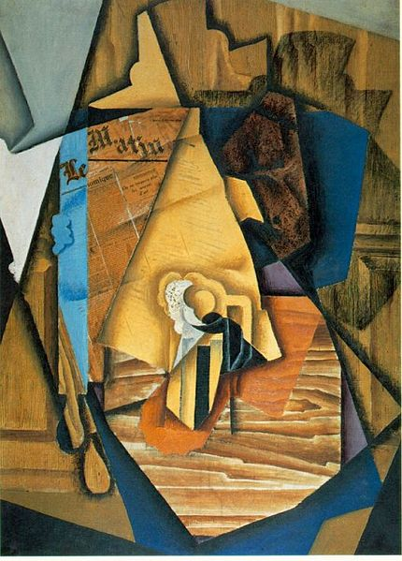
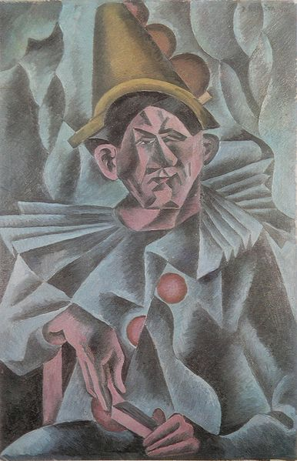
Juan Gris "The man in the cafe"
B. Kubišta. "Pierrot"

