Slide 1



Study Abroad
Manakova Svitlana 11-A

Slide 2



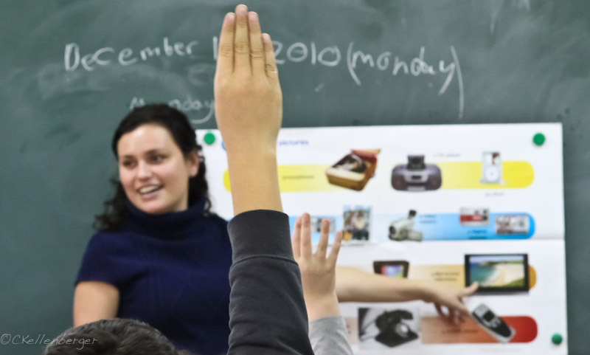

According to research by experts in the field of education the best way to train - it is away from home, from the city, with an atmosphere of learning and mental activity.

Slide 3




Increases the flow of students to U.S. universities, Australia, Switzerland, known for its schools of hotel business.
Increases the flow of students to U.S. universities, Australia, Switzerland, known for its schools of hotel business.
Those who are trained in England, considered, after graduation, highly qualified specialists. Very prestigious to be educated in this country.
Continuous learning is preferred in areas of business organization, information technology, economics, finance, fashion and design.

Slide 4
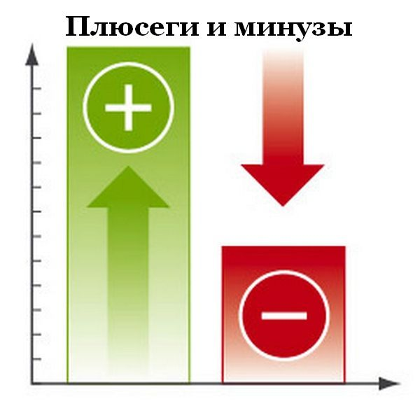
Advantages of studying abroad
• High quality education focused on the application in real life.
• Passage of practice on the basis of successful companies.
• The possibility of employment on the basis of training on the leading manufactures.
• Participation in research projects on the basis of laboratories equipped with the latest equipment and personnel.
• Language practice.
• The ability to study the culture of other people.
• Obtaining a diploma of international standard, giving the right to get a job with a degree in any country.
• The possibility of obtaining permanent residence in a country where the education received by the rating systems.
• The possibility of part-time work, limited by the hour, during training, which slightly reduces the financial burden on the parents of the student.
• Early maturing young people far away from their parents.

Slide 5


Disadvantages of studying abroad
• The high cost of tuition fees, as well as for accommodation.
• The language barrier .
• Transport accessibility .
• Expensive cost of living.
• The psychological discomfort during the adjustment to life in a foreign country far from unfamiliar parents and friends.
• Difficulty in getting a student visa, which in recent years has only increased due to migration problems in other developed countries .

Slide 6
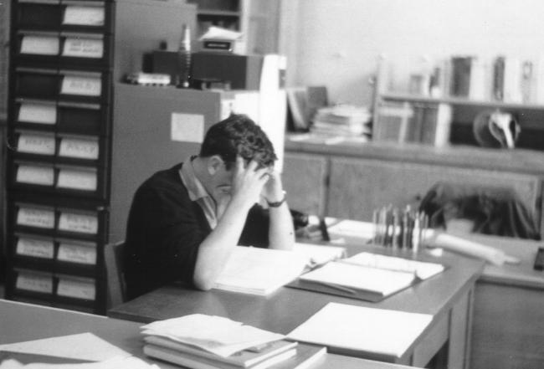

Slide 7








All difficulties can be overcome if a young person is confident in the correctness of the chosen objectives and clearly aware of the need to achieve it.
Therefore, studying abroad can be a good start adult life with the availability of commitment, efficiency and understanding of new prospects.

Slide 8

The games.

Slide 9




Advantages or Disadvantages
need to help him get to the place.
The high cost of tuition fees, as well as for accommodation.
Language practice
Expensive cost of living
Obtaining a diploma of international standard, giving the right to get a job with a degree in any country.

Slide 10



Advantages or Disadvantages
High quality education focused on the application in real life
Early maturing young people far away from their parents
The language barrier
The psychological discomfort during the adjustment to life in a foreign country far from unfamiliar parents and friends.

Slide 11
Thank you!

