Slide 1
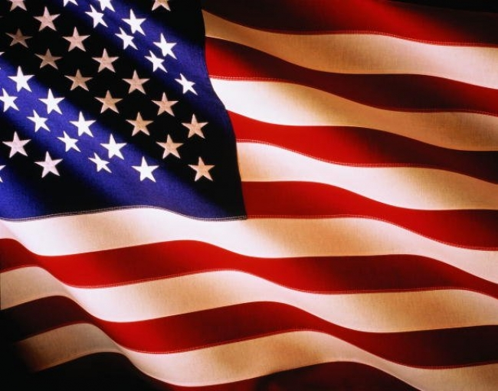
Attractions USA

Slide 2
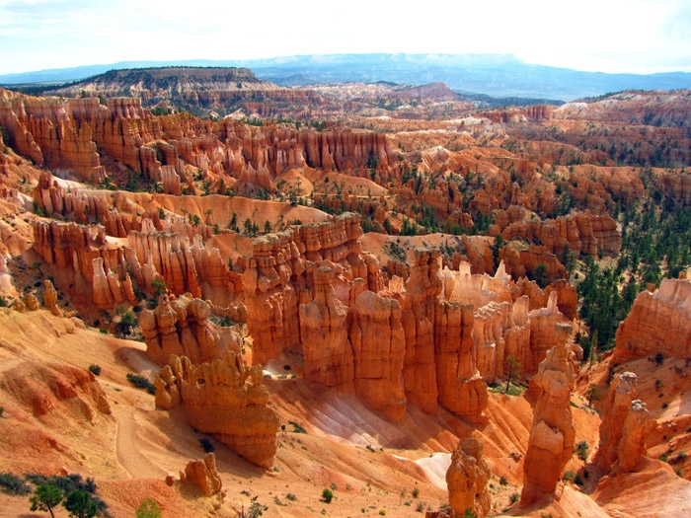
Bryce Canyon National Park, Utah

Slide 3
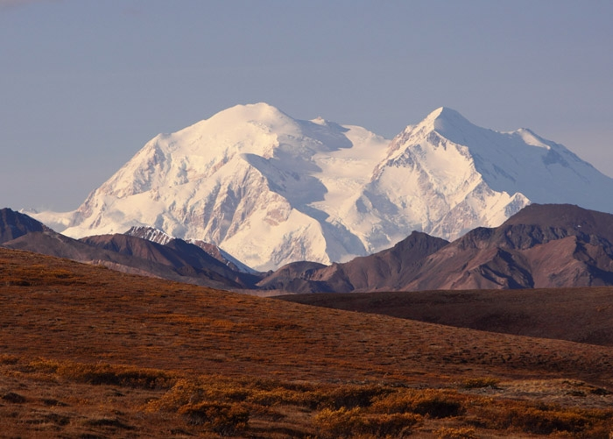
Mount McKinley, Alaska

Slide 4
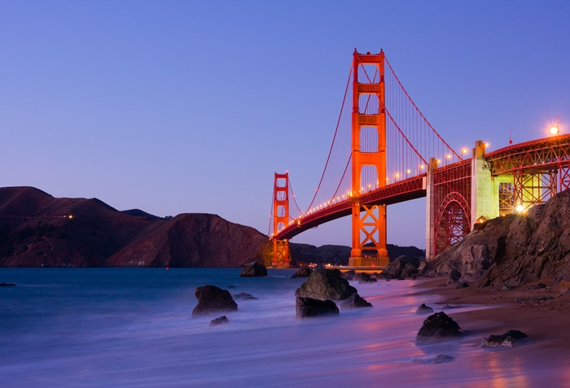
The Golden Gate Bridge in San Francisco

Slide 5
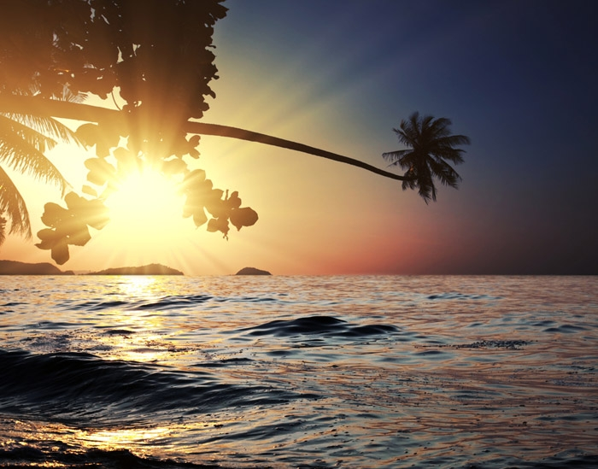
Pali Coast, Hawaii

Slide 6
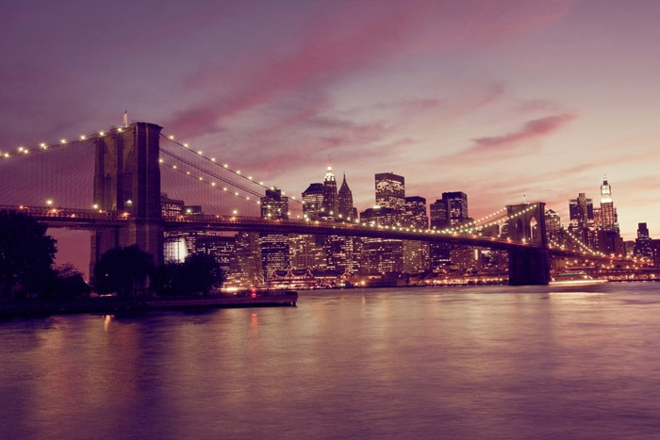
New York at night

Slide 7
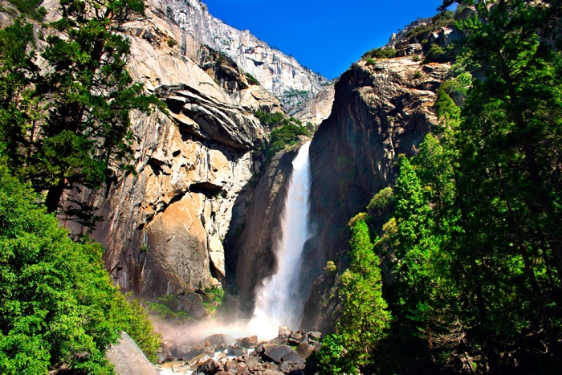
Fire waterfall in Yosemite National Park

Slide 8
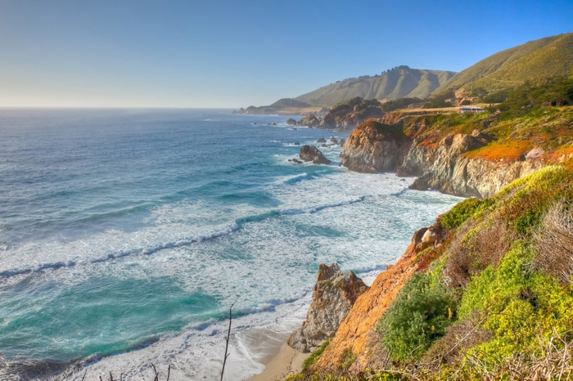
Big Sur. Wild Coast of California

Slide 9
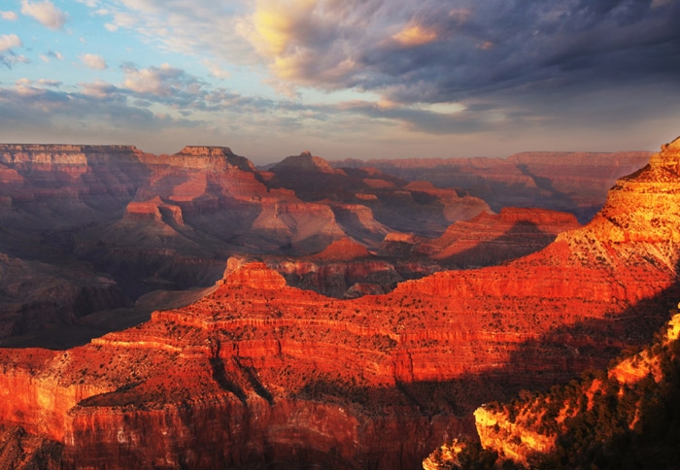
Grand Canyon National Park in Arizona

Slide 10
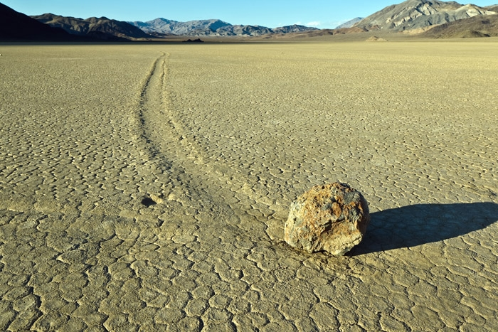
Death Valley in California

Slide 11
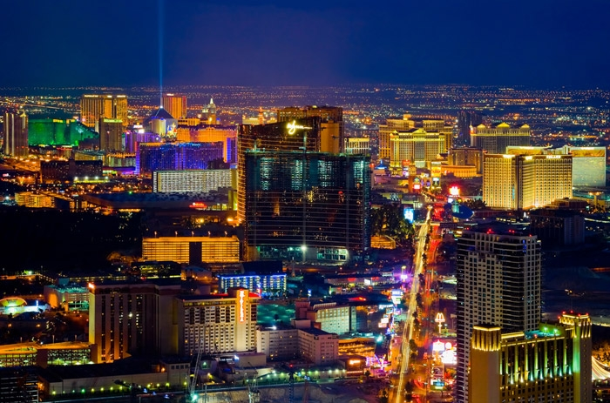
Night Las Vegas

Slide 12
Anzhelika Yakymiv

