Slide 1
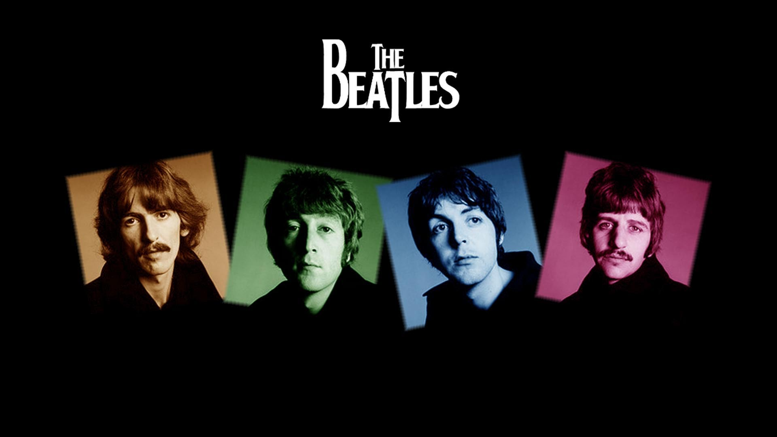
The Beatles

Slide 2
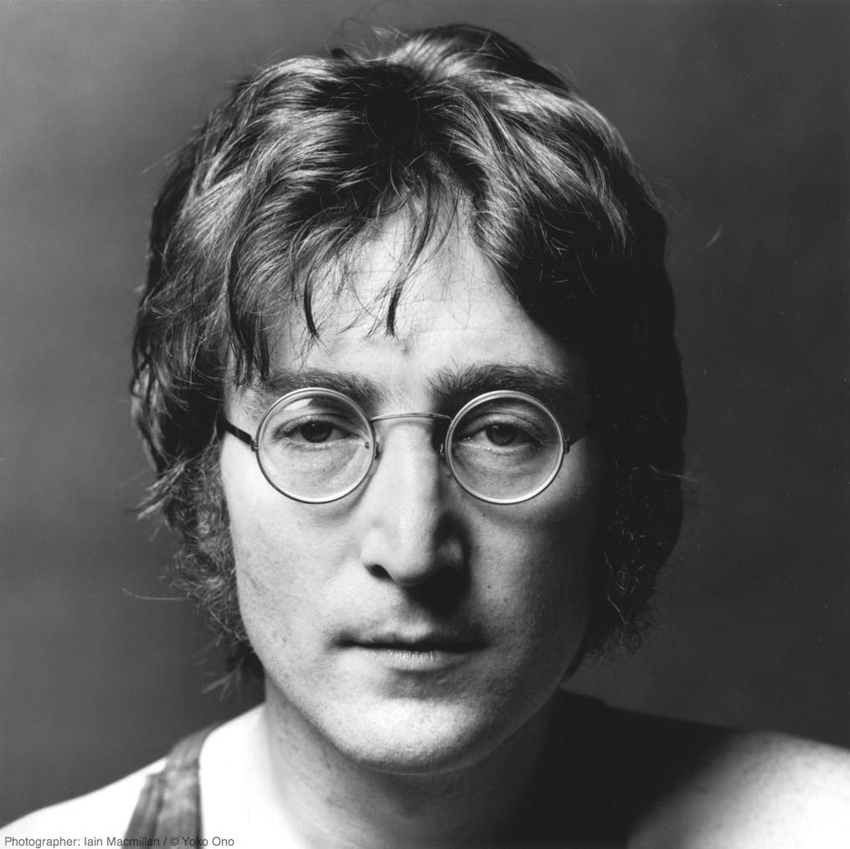
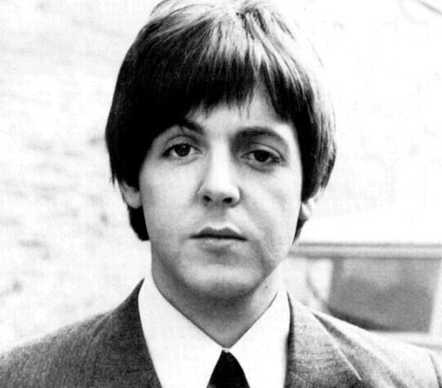
The members of the band:
John Lennon
Paul McCartney
1940 - 1980
1942

Slide 3
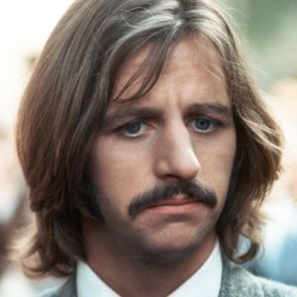
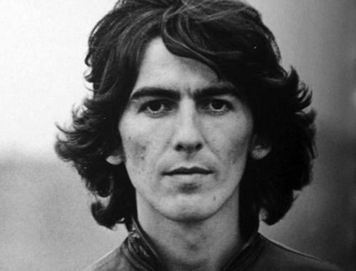
The members of the band:
George Harrison
Ringo Starr
1943 - 2001
1940

Slide 4
Biography
The Beatles were a pop group that took the world by storm. Their music, clothing, and hairstyles changed the world of the young. They made their first single in 1962, their first album in 1963, their last record in 1969, and broke up in 1970.
Even though the Beatles became famous in 1963, they started playing in Liverpool (where they grew up) in the late 50's, when they were called the Quarrymen.
In 1960 the band changed their name to the Beatles.
On February 7, 1964, the Beatles' plane touched down at Kennedy International Airpart. Two days later, they made television history. Seventy-three million people watched the Beatles on the Ed Sullivan Show, the record for largest viewing audience in America. That year, they made their first movie, A Hard Day's Night. The Beatles did their first world tour. People showed their love for the Beatles by buying records, clothing, posters. Boys copied their hairstyles and their clothing. This craze was called "Beatlemania".

Slide 5
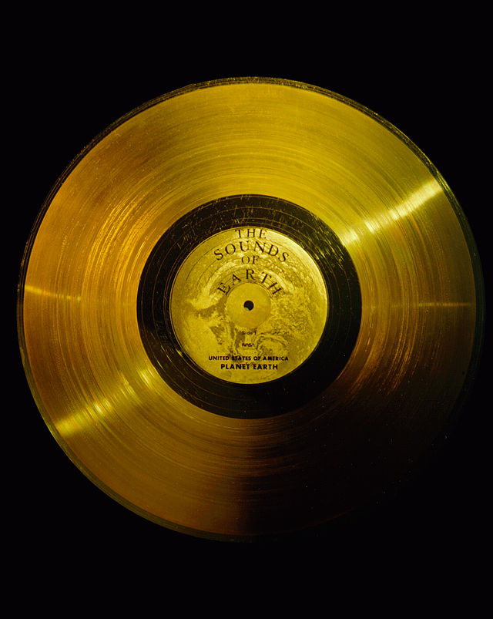
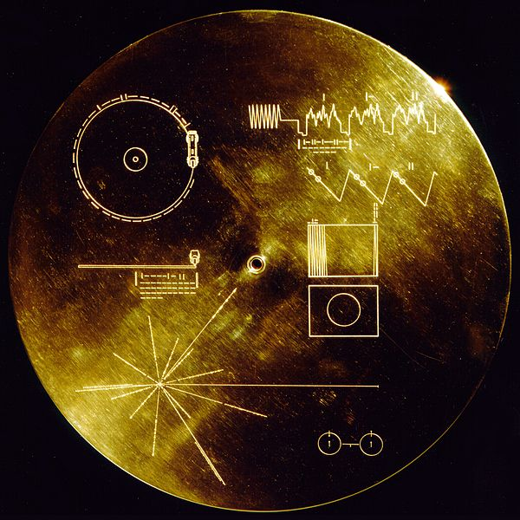
The Beatles' "Here Comes the Sun" was almost sent out to space.
The Voyager Golden Records were phonograph records which were placed in the Voyager spacecrafts launched in 1977. The purpose of the records was to portray the diversity of life and culture on Earth, designated for any intelligent life in the universe who might find them.
Carl Sagan was an astronomer working on the project back in the 70’s. He had wanted “Here Comes the Sun” included on the records, and The Beatles favored the idea. Unfortunately, EMI refused to release the rights (probably because of the copyright infringing habits of aliens) and so it was not included.

Slide 6
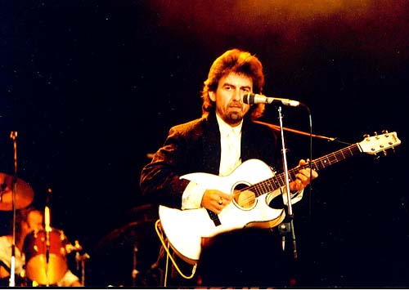
George Harrison stabbed seven times!
In 1999, Harrison was sleeping comfortably in his home with his wife when a man broke into the house. He began loudly calling Harrison’s name until he came out of the bedroom. Harrison’s wife Olivia called the police while Harrison went to see what the commotion was from. Almost immediately Abram attacked Harrison with a knife, stabbing him seven times.
Harrison was severely wounded with a punctured lung and head injuries, and would have been killed if his wife hadn't struck the assailant with a fire poker! After fifteen minutes Abram was arrested by the police.

Slide 7
"Yesterday" by the Beatles has been covered over 1,600 times.
In 1986 it held the record for most recorded song. It has been covered by Elvis Presley, Frank Sinatra, Gladys Knight, and James Brown. The song reportedly came to Paul McCartney in a dream and when he first played it, he wasn't sure if he had already heard it before.

Slide 8
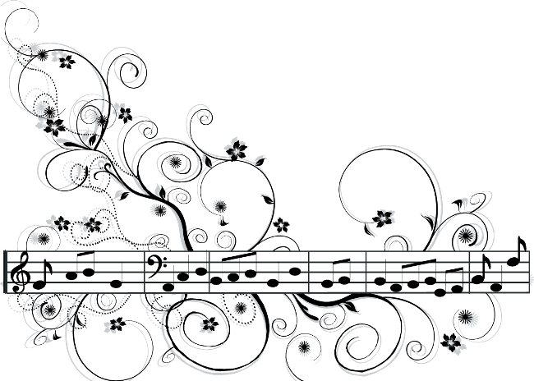
None of The Beatles Could Read Music
The Beatles are talked about as one of the best bands of all times but surprisingly none of The Beatles could even read music! Although they could play the guitar, and wrote their own lyrics, they never learned how to read music.

Slide 9
The Beatles planned to start their own utopian community on Greek islands.
In 1967, The Beatles almost bought an island off the coast of Athens, Greece, where they planned to set up a sort of utopian community with their friends and family. John Lennon seemed to be the one encouraging the plan and said, "They’ve tried everything else. Wars, nationalism, fascism, communism, capitalism, religion – none of it works. So why not this?"

Slide 10
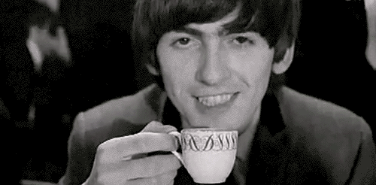
A dentist introduced The Beatles to LSD.
John Riley, the "wicked dentist" as George Harrison described him, introduced Harrison, Harrison's wife, Patti Boyd, John Lennon, and Lennon's wife, Cynthia Lennon, to LSD when they were all hanging out. After putting it into their coffees, Cynthia Lennon described the room "as big as the Albert Hall". In "The Beatles Anthology," the incident is recalled by Harrison:
The first time we took LSD was an accident. It happened sometime in 1965, between albums and tours. We were innocent victims of the wicked dentist whom we'd met and had dinner with a few times...
...The dentist said something to John and John turned to me and said, 'We've had LSD.'

Slide 11
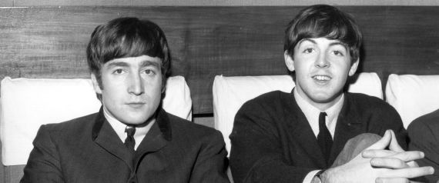
John Lennon was drunk when he first met Paul McCartney.
On July 6, 1957, Paul McCartney met John Lennon of The Quarrymen. After The Quarrymen show, the two ended up playing music together and Lennon was pretty drunk, recalled McCartney:
At Woolton village I met him. I was a fat schoolboy and I realized he was drunk.
In that time McCartney was 15 and Lennon 16.

