Slide 1
Presentation
Country Study
Film production companies of the United States
Compailed by Iryna Napadiy and Marta Dombrovska
Form VII (11)-A
LUGH
Teacher N. Stakhnyak

Slide 2
Film production companies of the United States

Slide 3
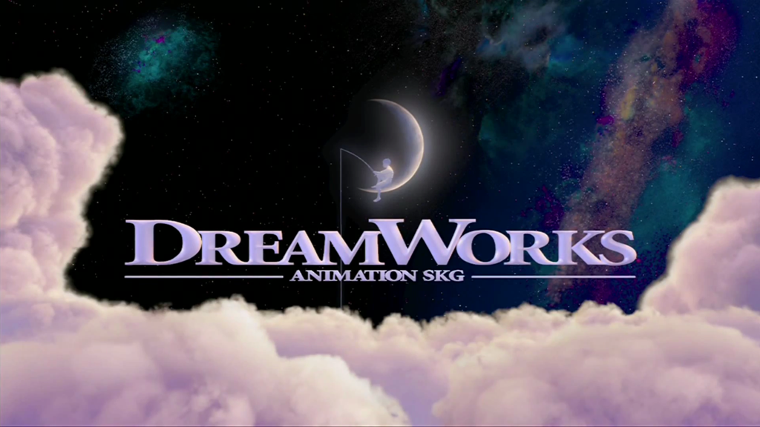
Dreamworks Animation

Slide 4
DreamWorks Animation creates high-quality entertainment, including CGanimated feature films, television specials and series and live entertainment properties, meant for audiences around the world. The Company has world-class creative talent, a strong and experienced management team and advanced film making technology and techniques. DreamWorks Animation has been
named one of the “100 Best Companies to Work For” by FORTUNE Magazine
for four consecutive years. In 2013, DreamWorks Animation ranks #12 on the
list. All of DreamWorks Animation’s feature films are produced in 3D. The
Company has theatrically released a total of 27 animated feature films.

Slide 5
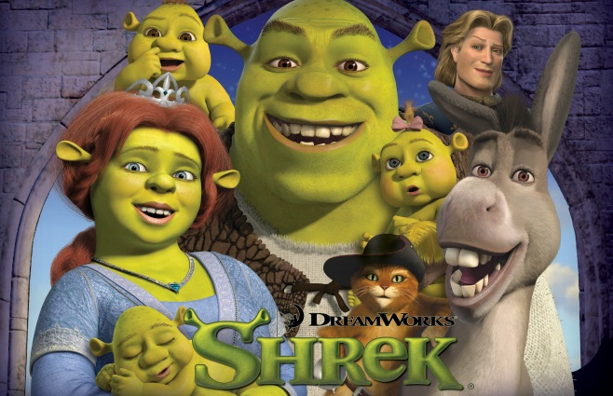
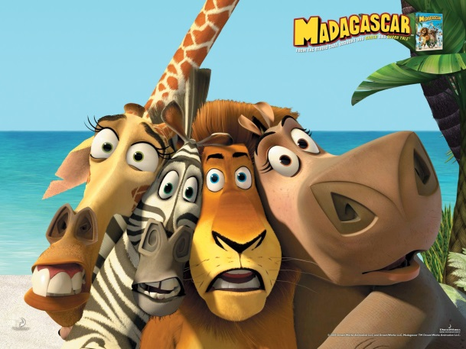
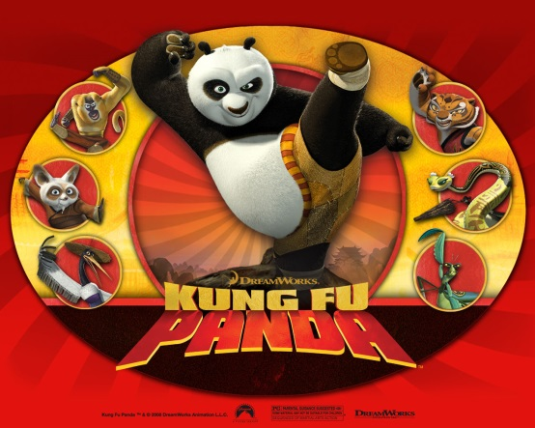
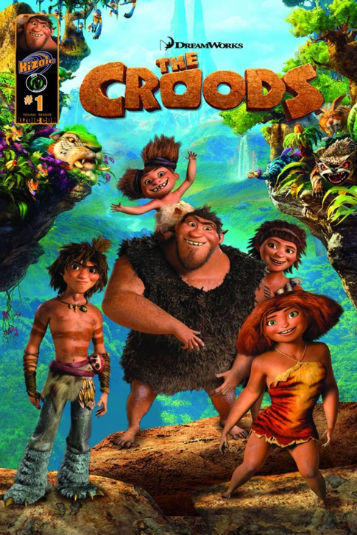
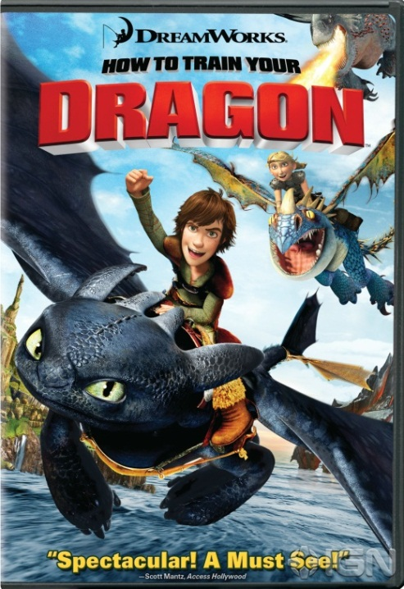
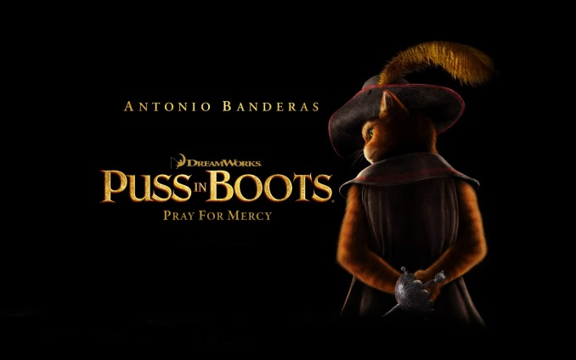
Company released such movies like Shrek, Madagascar, Kung Fu Panda, How to Train Your Dragon, Puss In Boots and The Croods.

Slide 6
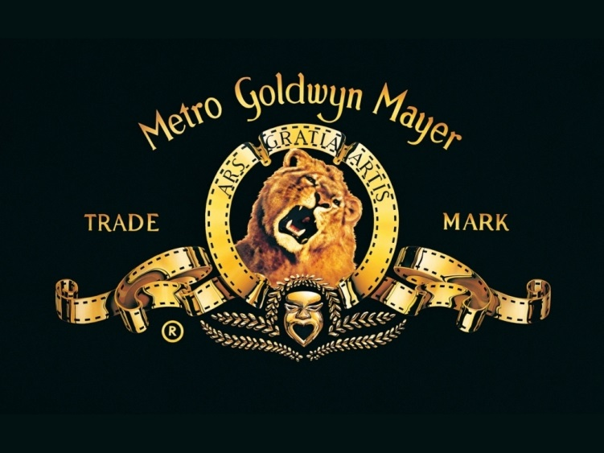
Metro-Goldwyn-Mayer

Slide 7
MGM and its legendary roaring lion logo was formed in April 1924, by theater magnate Marcus Lowe. During a golden three decades from 1924 to 1954, the Culver City-based studio dominated the movie business, creating a Best Picture nominee every year for two straight decades. One of the more memorable years at the Academy Awards® was in 1939 when MGM's Gone With the Wind and MGM's The Wizard of Oz were both nominated for Best Picture. Gone With the Wind took home Best Picture that year, along with 8 other Oscars. The Wizard of Oz secured two Oscars.

Slide 8
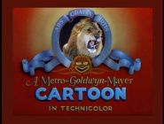
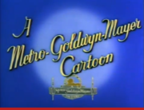
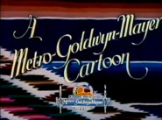
LOGOS:
1st Logo (August 16, 1930-July 18, 1942)
2nd Logo (August 22, 1942-August 3, 1946)

Slide 9
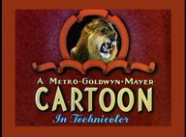
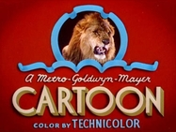
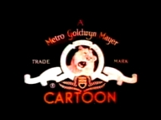
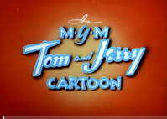
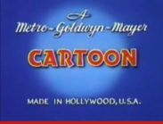
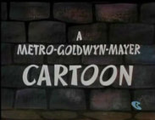
4th Logo (March 15, 1952, June 14, 1952-September 18, 1954)
5th Logo (September 7, 1961-December 1, 1962, 1965)
3rd Logo (August 31, 1946-May 17, 1952)

Slide 10
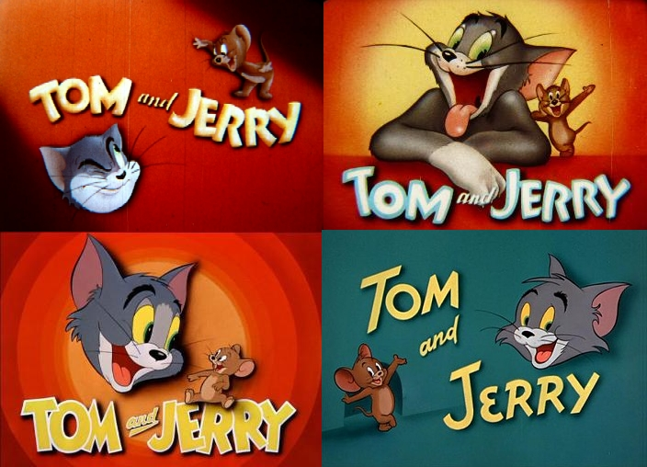
The most famous movie of this studio is “TOM AND JERRY”
1940-1957

Slide 11
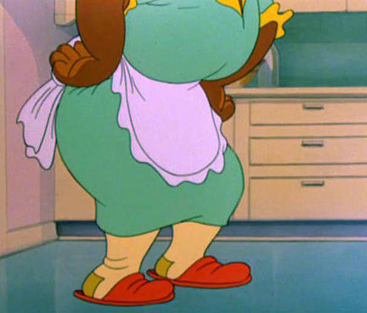
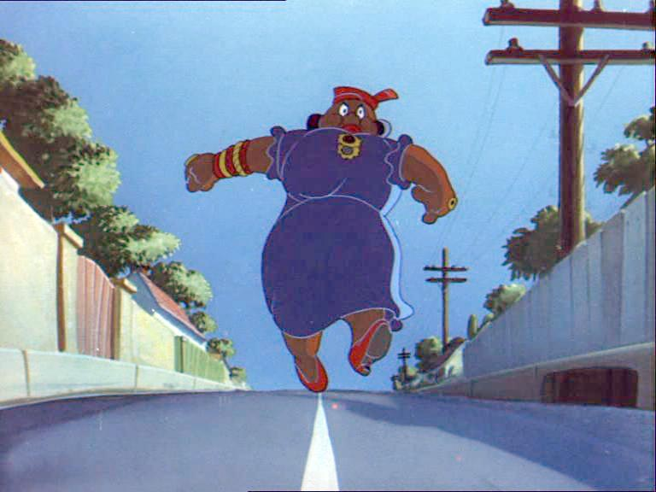
Cartoon hero
“Mammy Two Shoes’’

Slide 12
Paramount Pictures

Slide 13
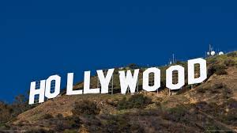
Paramount is the fifth oldest surviving film
studio in the world. It is one of the largest
(top-grossing) film studios and one of the
most major film studios in Hollywood district
of LA. The Studios at Paramount has almost
a century of experience providing the best
production services from development through post production. The Studio won the very first Academy Award for Best Picture in 1927. Along the way, they’ve only become better at everything they do. Today, they’ve emerged as an international leader in the production of film and TV entertainment. They engineer partnerships with projects large and small in a ceaseless effort to create celebrated movies, television shows, and commercials.

Slide 14
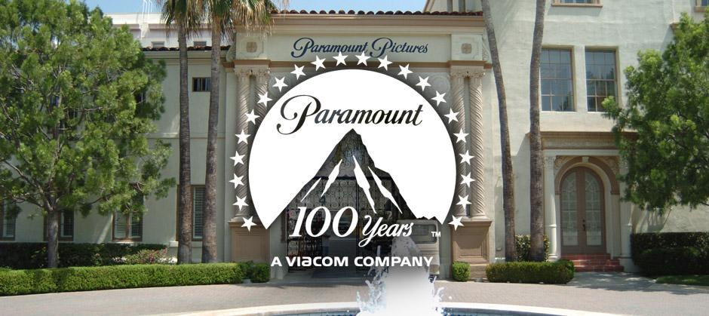
The year 2012 marks an exceptional milestone for Paramount Pictures - 100th year in show business.

Slide 15
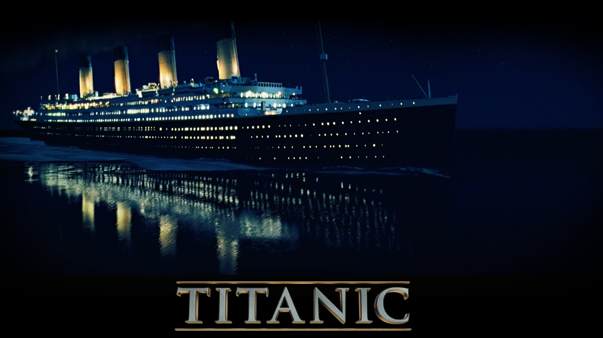
The most famous movie of Paramount Pictures is
“TITANIC”

Slide 16
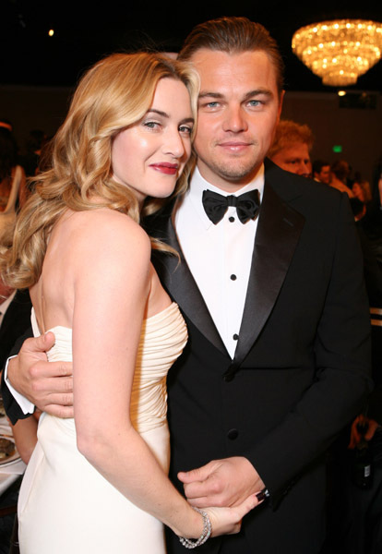
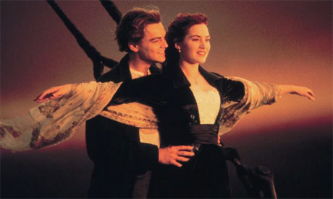
In film stared some of the best Hollywood actors Leonardo DiCaprio and Kate Winslet

Slide 17
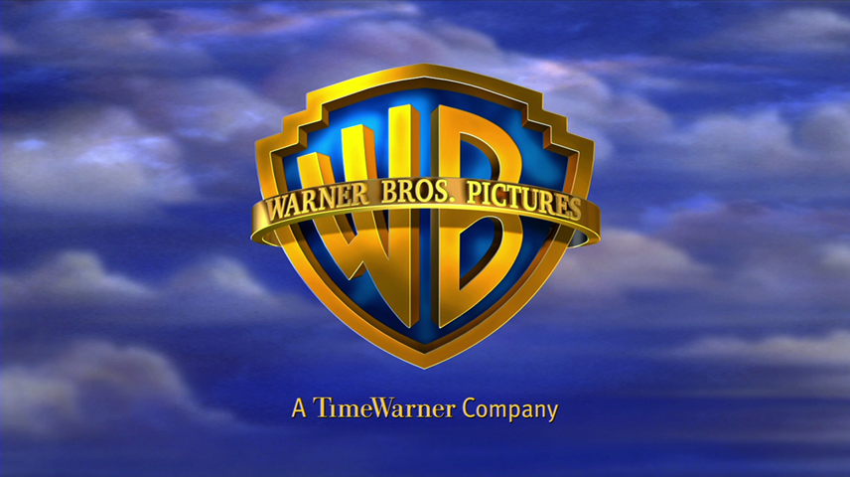
warner brothers PICTURES

Slide 18
Has been at the forefront of the motion picture industry since its inception and continues to be a leading creative force in the industry. Warner Bros. Pictures produces and distributes a wide-ranging slate of some 18-22 films each year.
Founded: April 4, 1923
Among the films on Warner Bros. Pictures’ 2013 slate are The Great Gatsby, The Hangover Part III, Man of Steel.

Slide 19
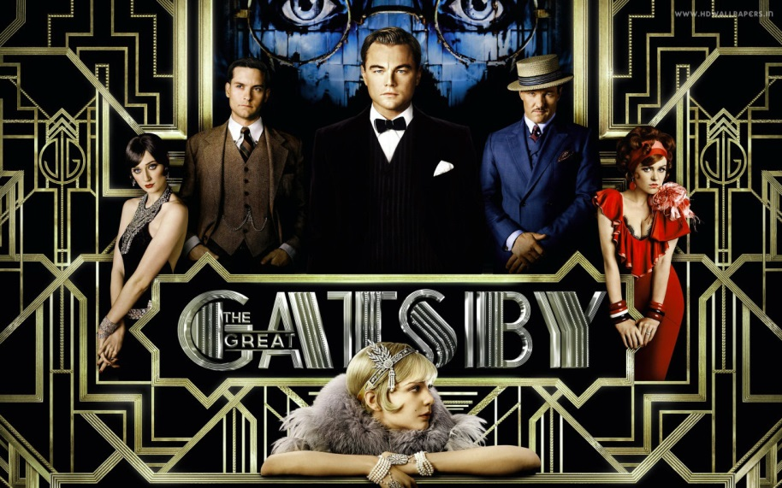
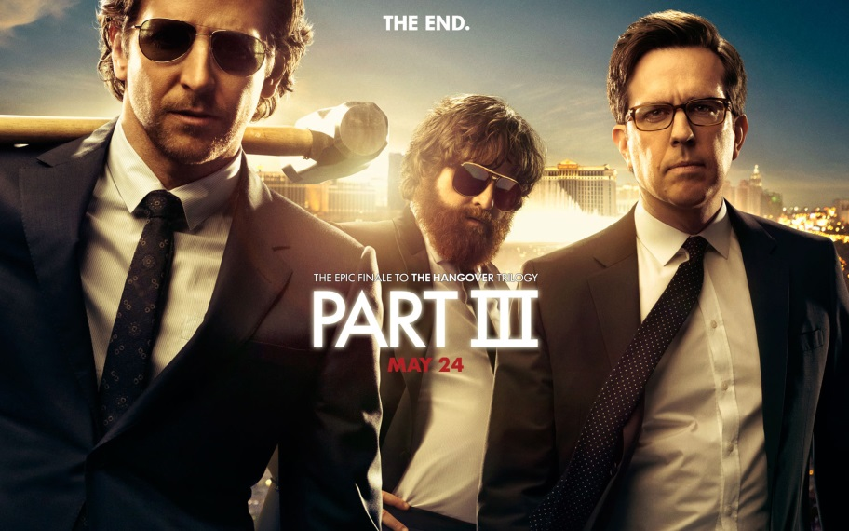

Slide 20
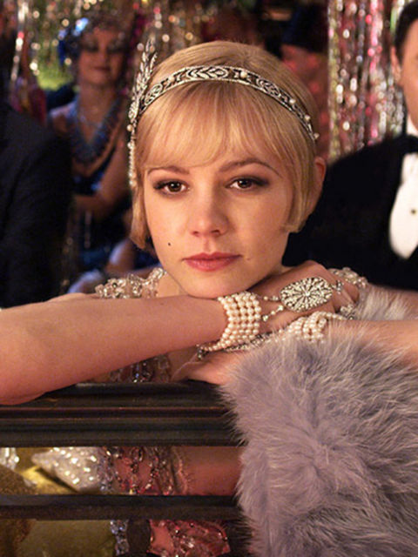
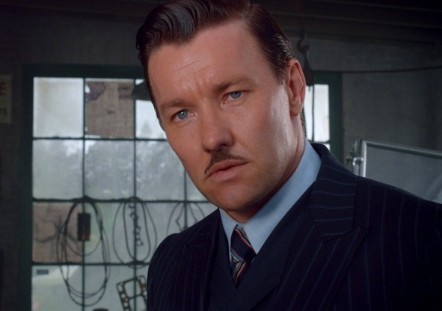
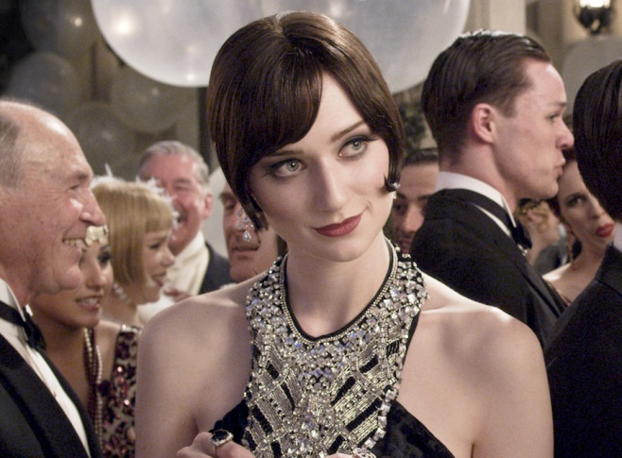
Actors who worked with warner brothers pictures
The Great Gatsby:
Leonardo DiCaprio
Carey Mulligan
Joel Edgerton
Elizabeth Debicki etc.

Slide 21
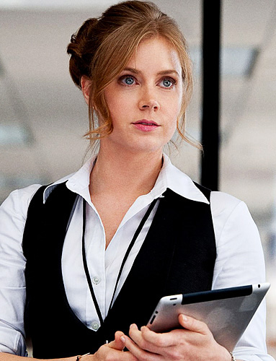
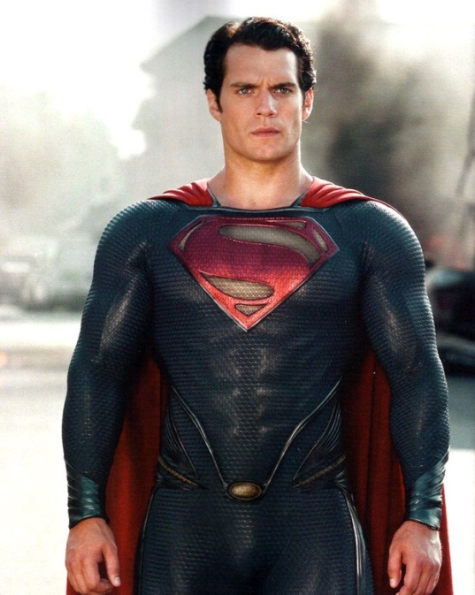
Man of steel
Henry Cavill
Amy Adams
Michael Shannon
Diane Lane
Kevin Costner etc.

Slide 22
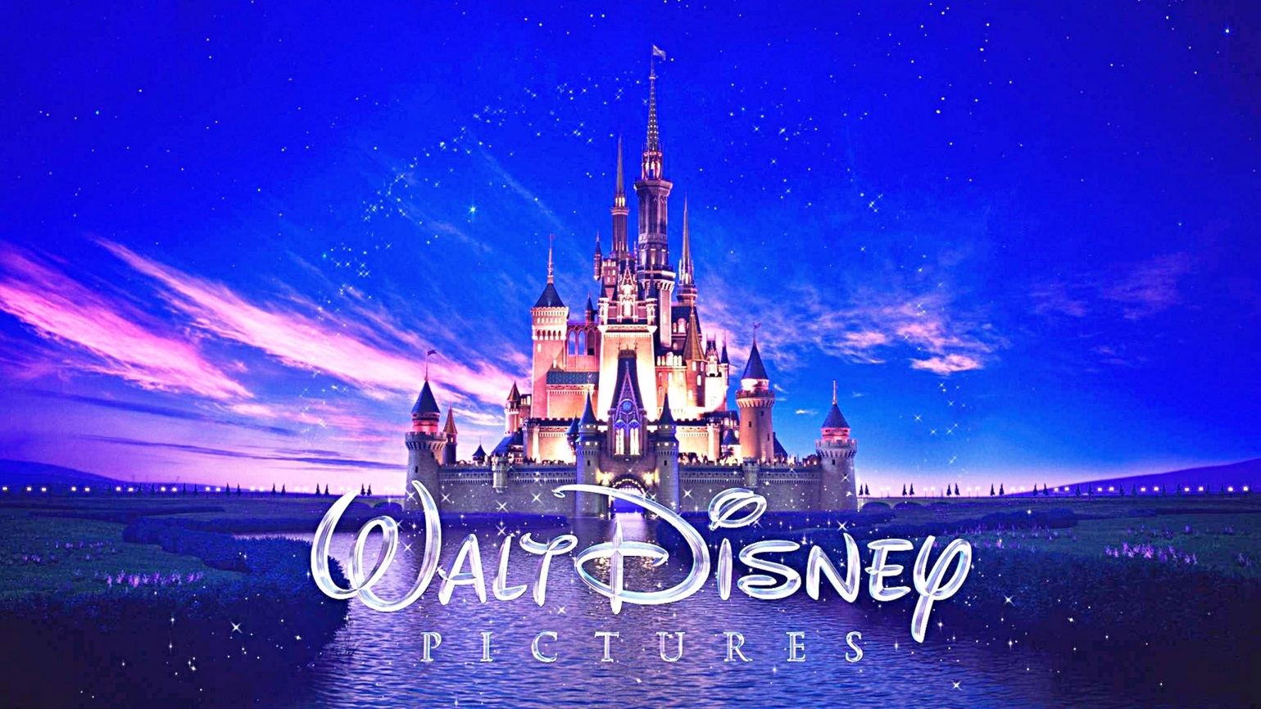
Walt Disney Pictures

Slide 23
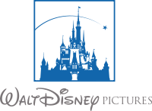
Walt Disney Studios Motion Pictures -- Disney has explored new worlds through magical storytelling since its first completely live-action film, Treasure Island in 1950. Across pirate-laden high-seas or down a mysterious rabbit hole, Disney’s collaborations with renowned artists and filmmakers has produced some of the most successful live-action family films in history, including Disney’s Alice in Wonderland and the Pirates of the Caribbean films, with more epic adventures on the horizon including Maleficent and Tomorrowland.
Founded in 1950

Slide 24
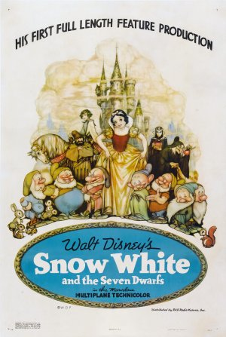
The 1st company movie is “The Snow White”
Was created in 1937

Slide 25
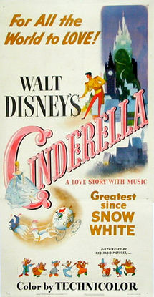
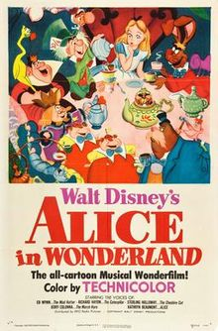
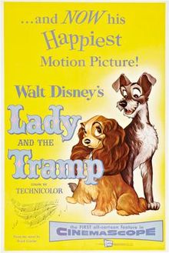
The most famous
Walt Disney Pictures movies:
Alice in Wonderland
1951
Lady and the Tramp
1955
Cinderella
1950

Slide 26
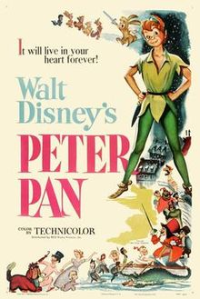
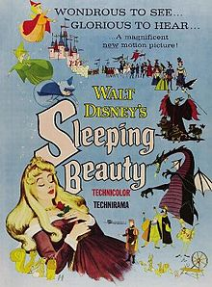
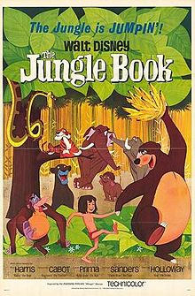
Peter Pan
1953
Sleeping Beauty
1959
The Jungle Book
1967

Slide 27
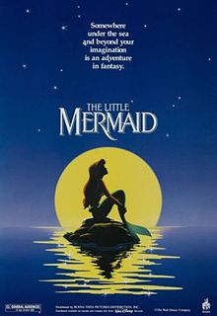
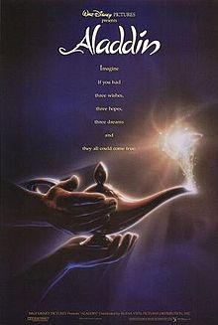
Winnie the Pooh
1977
The Little Mermaid
1989
Aladdin
1992

Slide 28
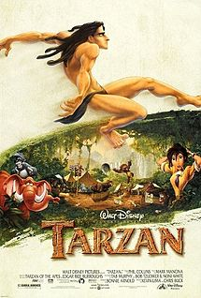
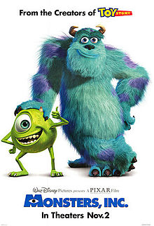
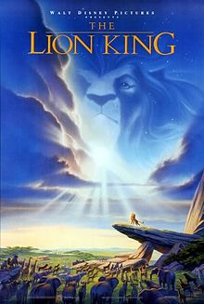
Monsters, Inc.
2001
The Lion King
1994
Tarzan
1999

Slide 29
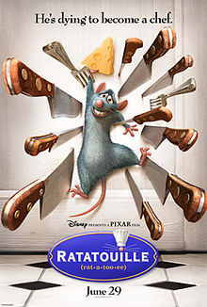
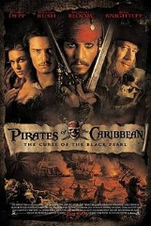
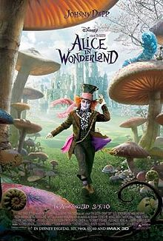
Pirates of the Caribbean
2003
Alice in Wonderland2010
Ratatouille
2007

Slide 30
Once Walt Disney said:

Slide 31
Thank you for attention!

Slide 32
Used Literature
http://en.wikipedia.org/wiki/List_of_film_production_companies
http://www.paramountstudios.com/working-on-the-lot/general-info/history.html
http://www.mgm.com/#/about/mgm-history
http://www.movieinsider.com/c2/#.Un4t4vnIZH4
http://www.dreamworksanimation.com/company
http://www.paramountstudiotour.com/
http://en.wikipedia.org/wiki/The_Great_Gatsby_(2013_film)
http://en.wikipedia.org/wiki/Man_of_Steel_(film)
http://en.wikipedia.org/wiki/Alice's_Adventures_in_Wonderland
http://www.movieinsider.com/c3/#.Un6dWnDIaEd

