Slide 1
Glasgow

Slide 2
Glasgow -largest city in Scotland and third most populous in the UK (after London and Birmingham). Located in the west central part of Scotland, on the Clyde River, 32 km from its mouth.

Slide 3
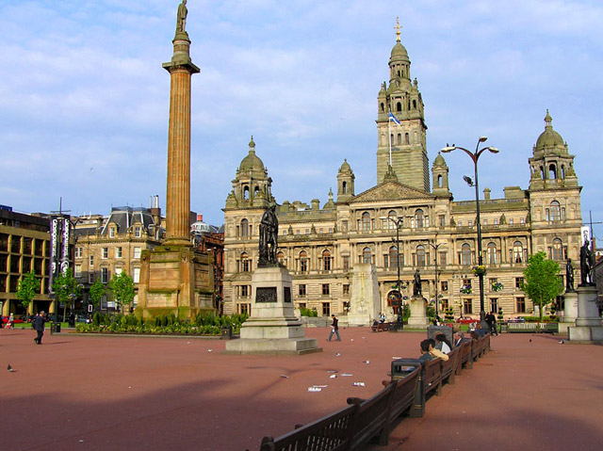

Slide 4
Architecture
Most of the architectural heritage of the city of the XIX century and the beginning of XX century, when Glasgow was rightly considered the second city of the Empire. Homes built in this period, a wide variety of styles.

Slide 5
Architecture
The most important contemporary architectural projects in Glasgow should include…

Slide 6
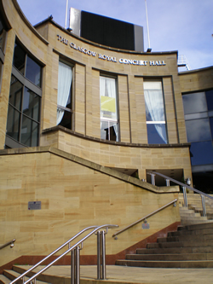
The Royal Concert Hall (1990)

Slide 7
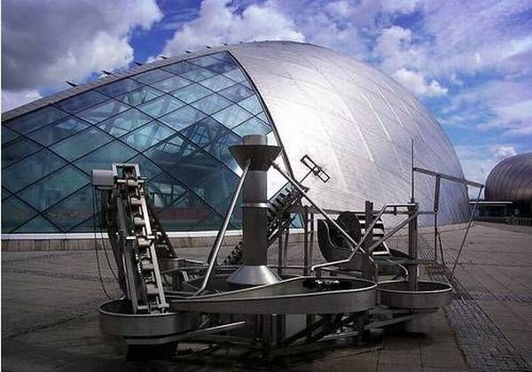
The building of the Center for Science Glasgow (2001)

Slide 8
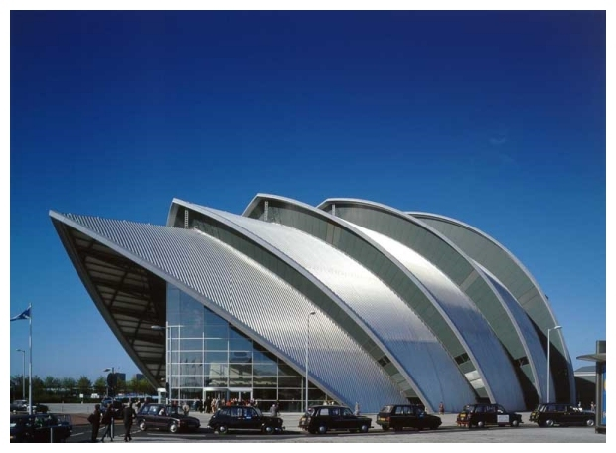
Complex Scottish Exhibition and Conference Centre (1983 to 2007)

Slide 9
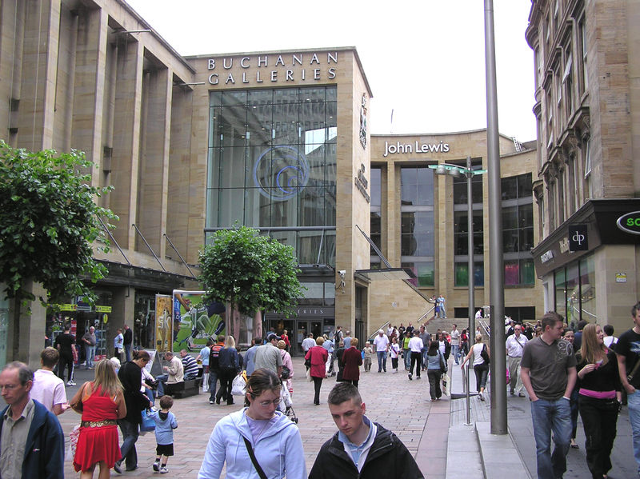
Shopping centers Buchanan Galleries (1999)

Slide 10
Museums and galleries
The most important collection of paintings and art objects presented in Kelvingrove Gallery, the most visited museum in Scotland. Among its exhibits - paintings by Rembrandt, Rubens, Titian, Van Gogh, Monet, Picasso, Dali.

Slide 11
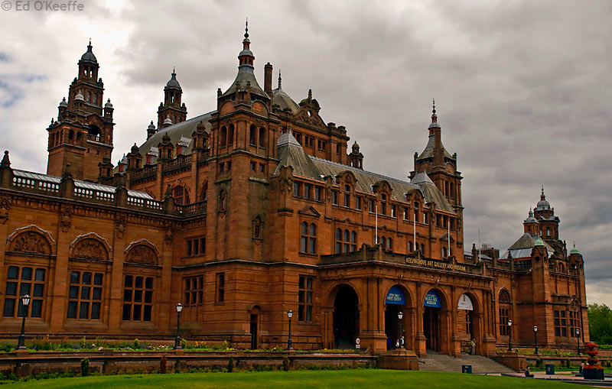
Art Gallery and Museum Kelvingrove

Slide 12
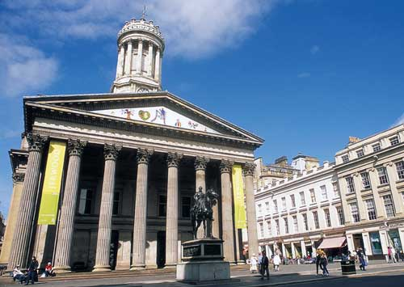
Gallery of Modern Art

Slide 13
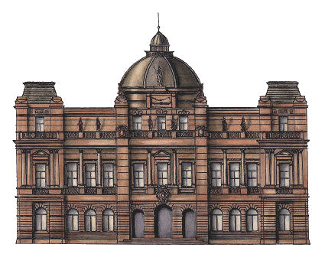
People's Palace

Slide 14
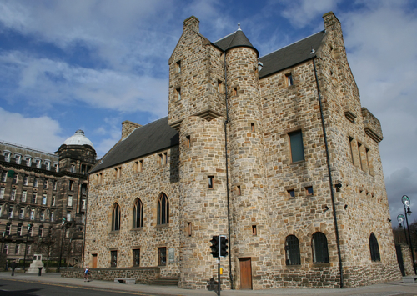
The Museum of Religious Life and Art of St. Mungo

Slide 15
Libraries
The city has 37 public libraries, including the largest reference library in Europe - the Mitchell Library. Its collection contains 1.3 million books, 35,000 maps, photographs, microfilms, and newspaper archives.

Slide 16
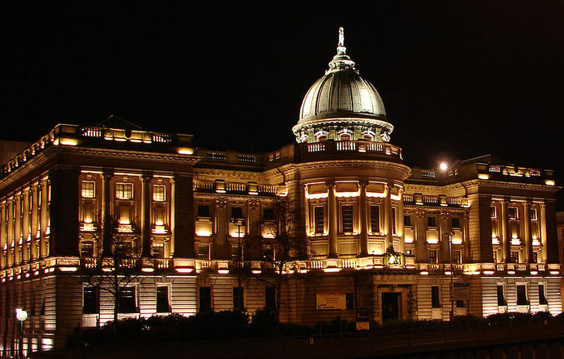

Slide 17
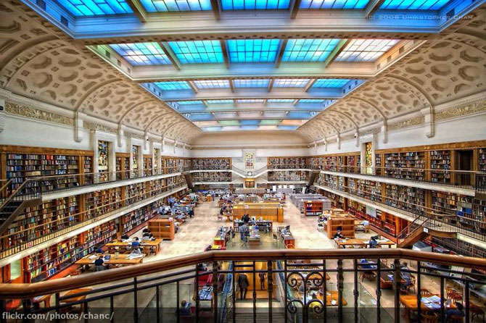

Slide 18
Clubs, concert halls and cinemas
The music scene of the city - one of the brightest in the UK. Among the large sites, in addition to the Royal Concert Hall and the Scottish Exhibition and Conference Centre, it should be noted the second most important British rock platform - The Barrowlands.

Slide 19
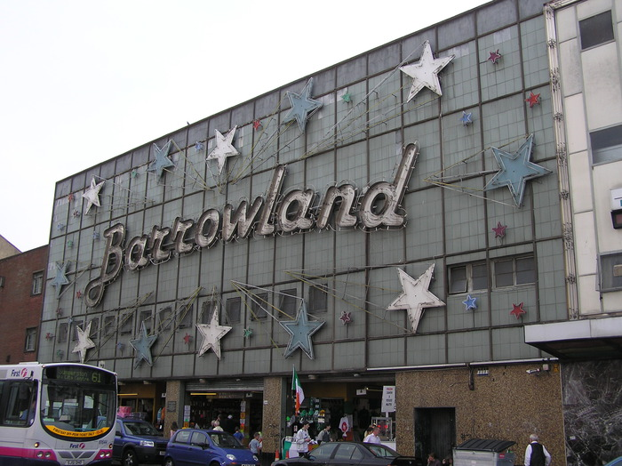
Dancing The Barrowlands

Slide 20
Glasgow nightclubs, as well as in other big cities, focus on a variety of musical genres. The most popular ones are: The Arches, Blanket, Campus, Cathouse, Cube, Garage, Tiger Tiger, The Tunnel and other.

Slide 21
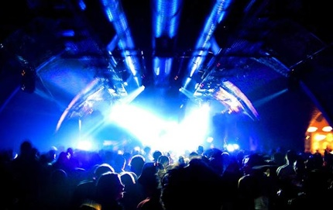
The Arches

Slide 22
In Glasgow there are more than 10 theaters, including those opened in 2001, the 18-hall Cineworld, which is listed in the Guinness Book of Records as the tallest cinema in the world.

Slide 23
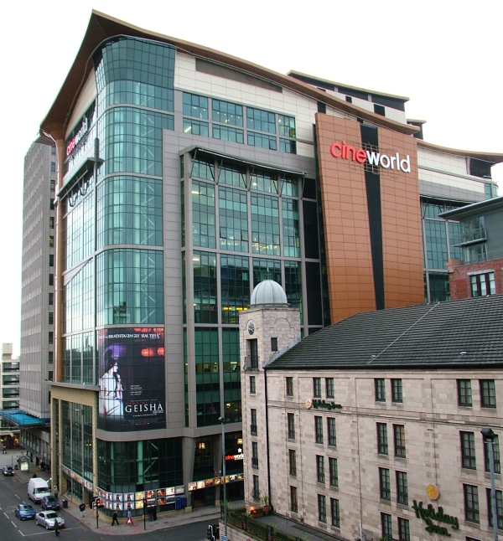
Cineworld

Slide 24
That's all! Thank you for your attention!

