Slide 1
Presentation
Anastasia Semko
Form 9
School of Podilia

Slide 2

Rap

Slide 3
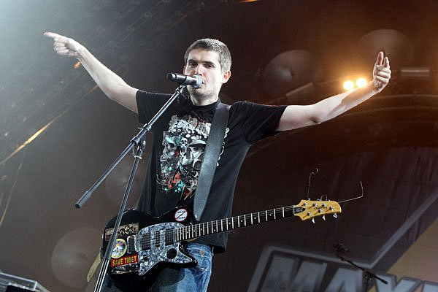
Rapper(also known as hip- hoppers ) - rhythmical recitative, usually read the music with a heavy beat.

Slide 4
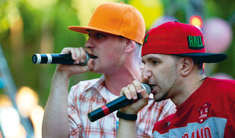
Hip hop as music and culture formed during the 1970s in New York City, particularly among African American youth residing in the Bronx.

Slide 5
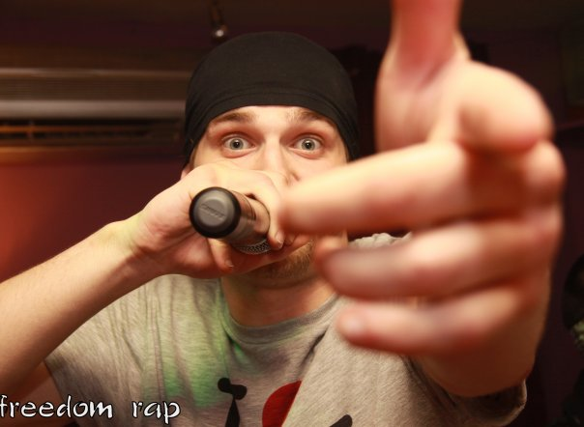
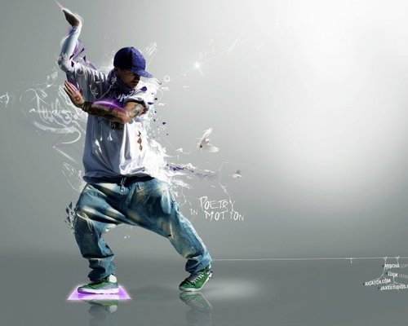

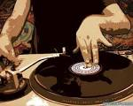
The main hip- hop culture , that is , include: rap , break, graffiti , DJing , some sports .

Slide 6
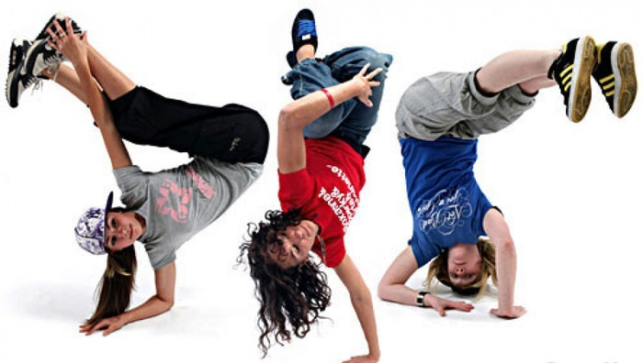
Break - a dance component of the subculture that includes elements of acrobatics and pantomime.

Slide 7

Graffiti - original paintings made ​​by paints sprayed with cans , with almost obligatory presence of text.

Slide 8

DJing - it's music to rap and break, though, of course , DJing can exist separately.

Slide 9


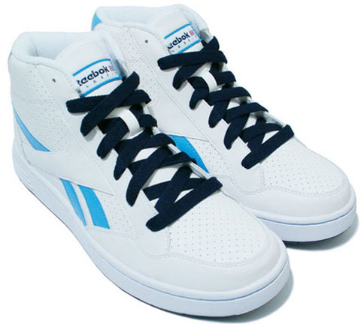
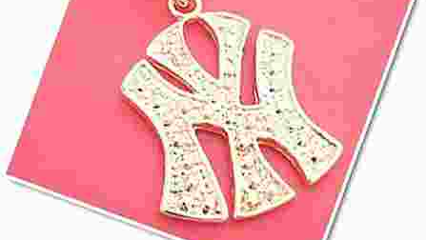
Style
Jeans "pipe" and tight shirts or sports shirts, jacket, jewelry, stylized rap culture. Most rappers shirts hanging to his knees and slipping jeans graze the floor. Caps, "baseball", turned back, waist packs, chains, sports jackets, T-shirts, all of this required "gadgets" of the young rapper.

Slide 10

Popular rappers Ukraine
Jarmak

Slide 11

Misha Krupin

Slide 12
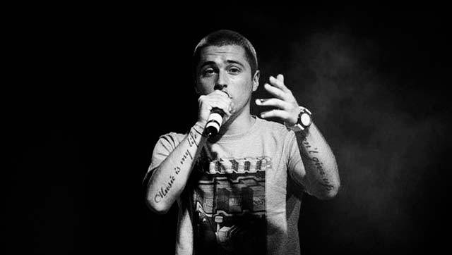
Bruce Lee

Slide 13
Thank you for attention.

