Slide 1
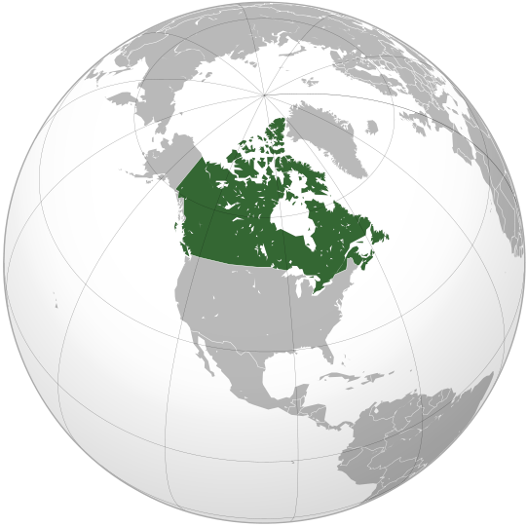
Canada

Slide 2
Canada is one of the most developed countries.
In size Canada is the second in the world after Russia.
The capital of Canada is Ottawa, which is situated on the lank of the Ottawa River.
It is famous for its beautiful parks.
It is also known as the city of bridges.

Slide 3
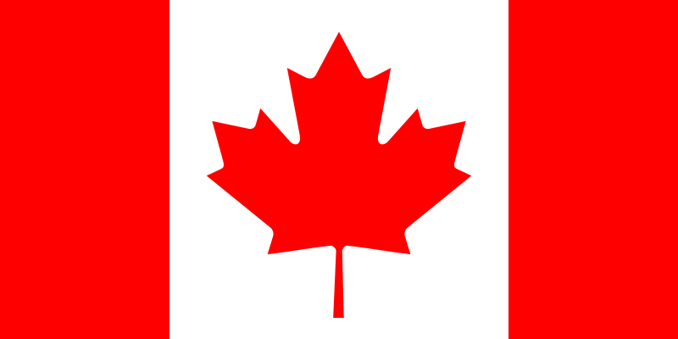
Flag of Canada

Slide 4
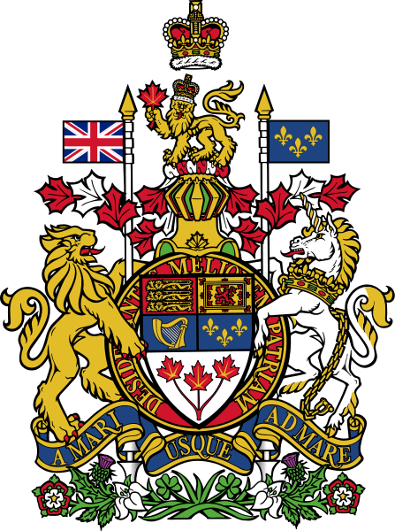
Coat of arms of Canada

Slide 5
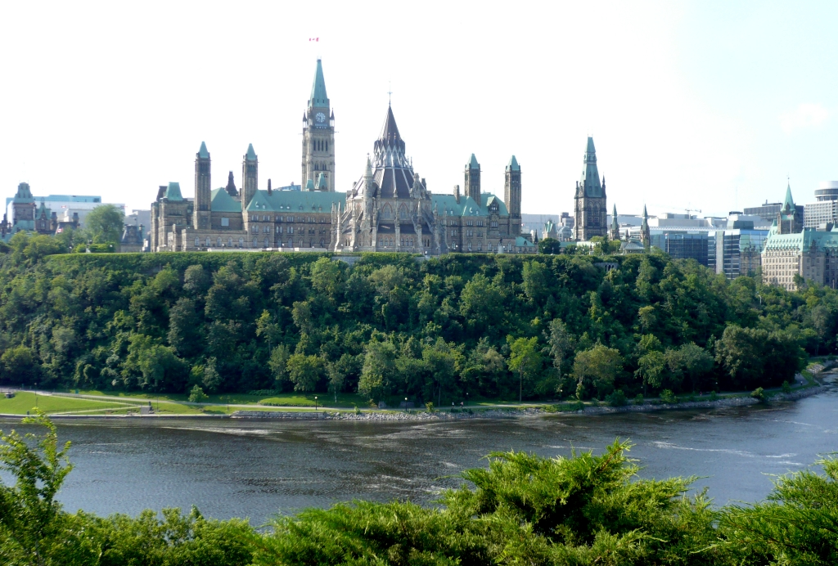
Ottawa river

Slide 6
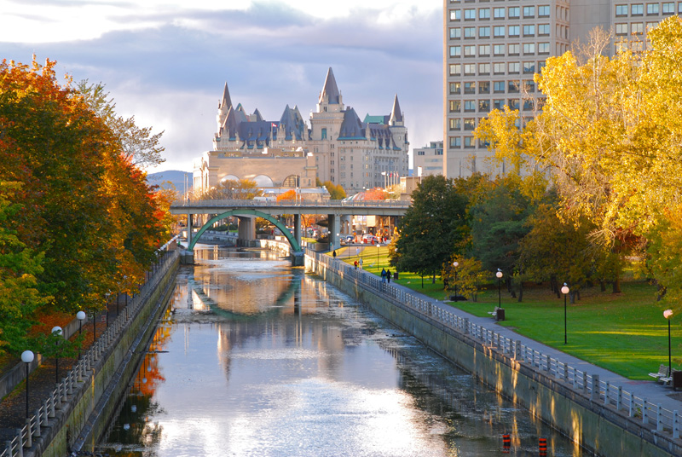

Slide 7
Canada is very rich in forest, minerals and fur- bearing animals.
It holds the first place in the world in the amount of forest.
The population of Canada is about 25 million people.
There are a lot of rivers and lakes in Canada.

Slide 8
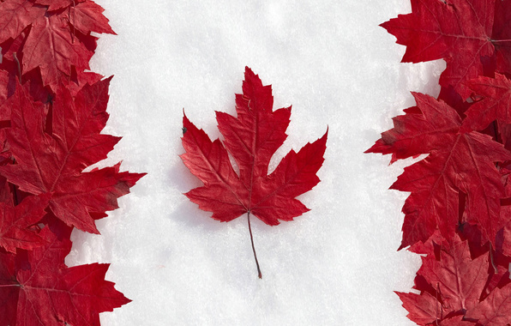

Slide 9
Niagara Falls

Slide 11
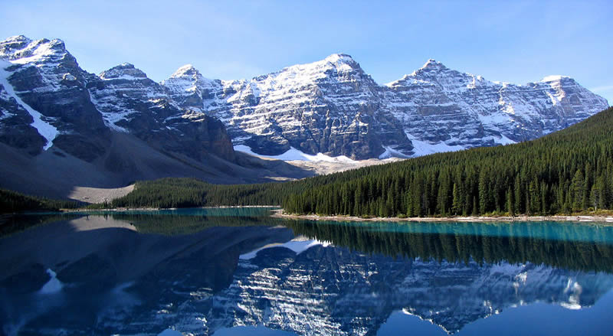
Beautiful Canada

Slide 12
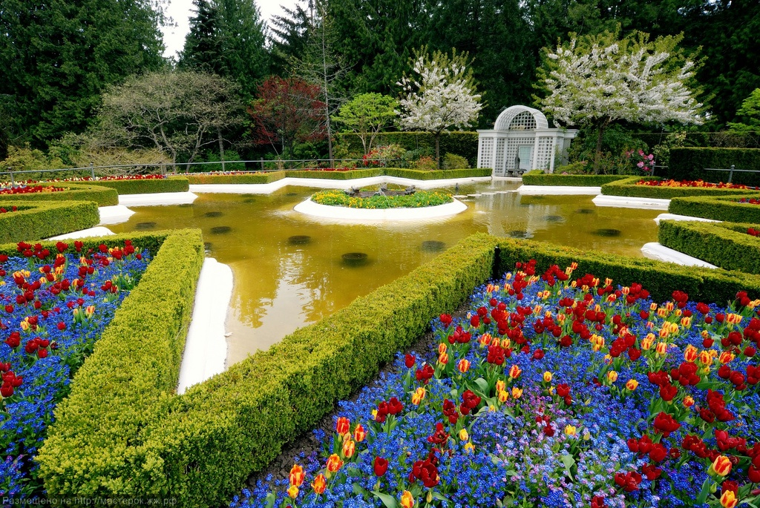
The Butchart Gardens

Slide 15
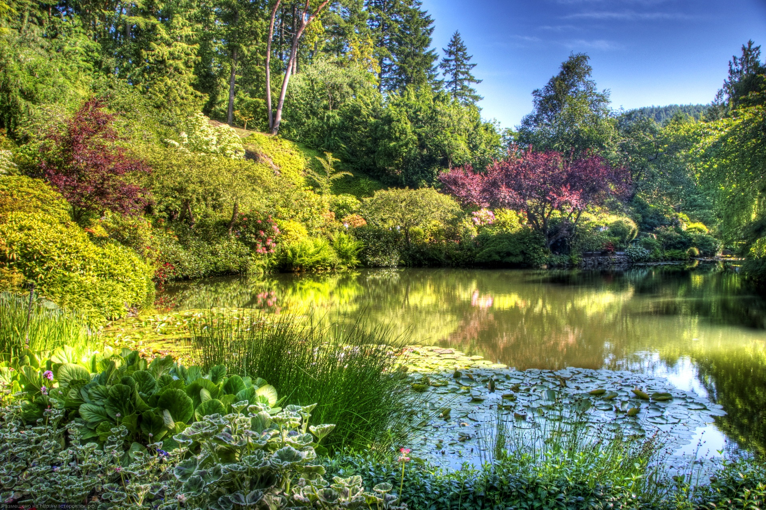

Slide 16
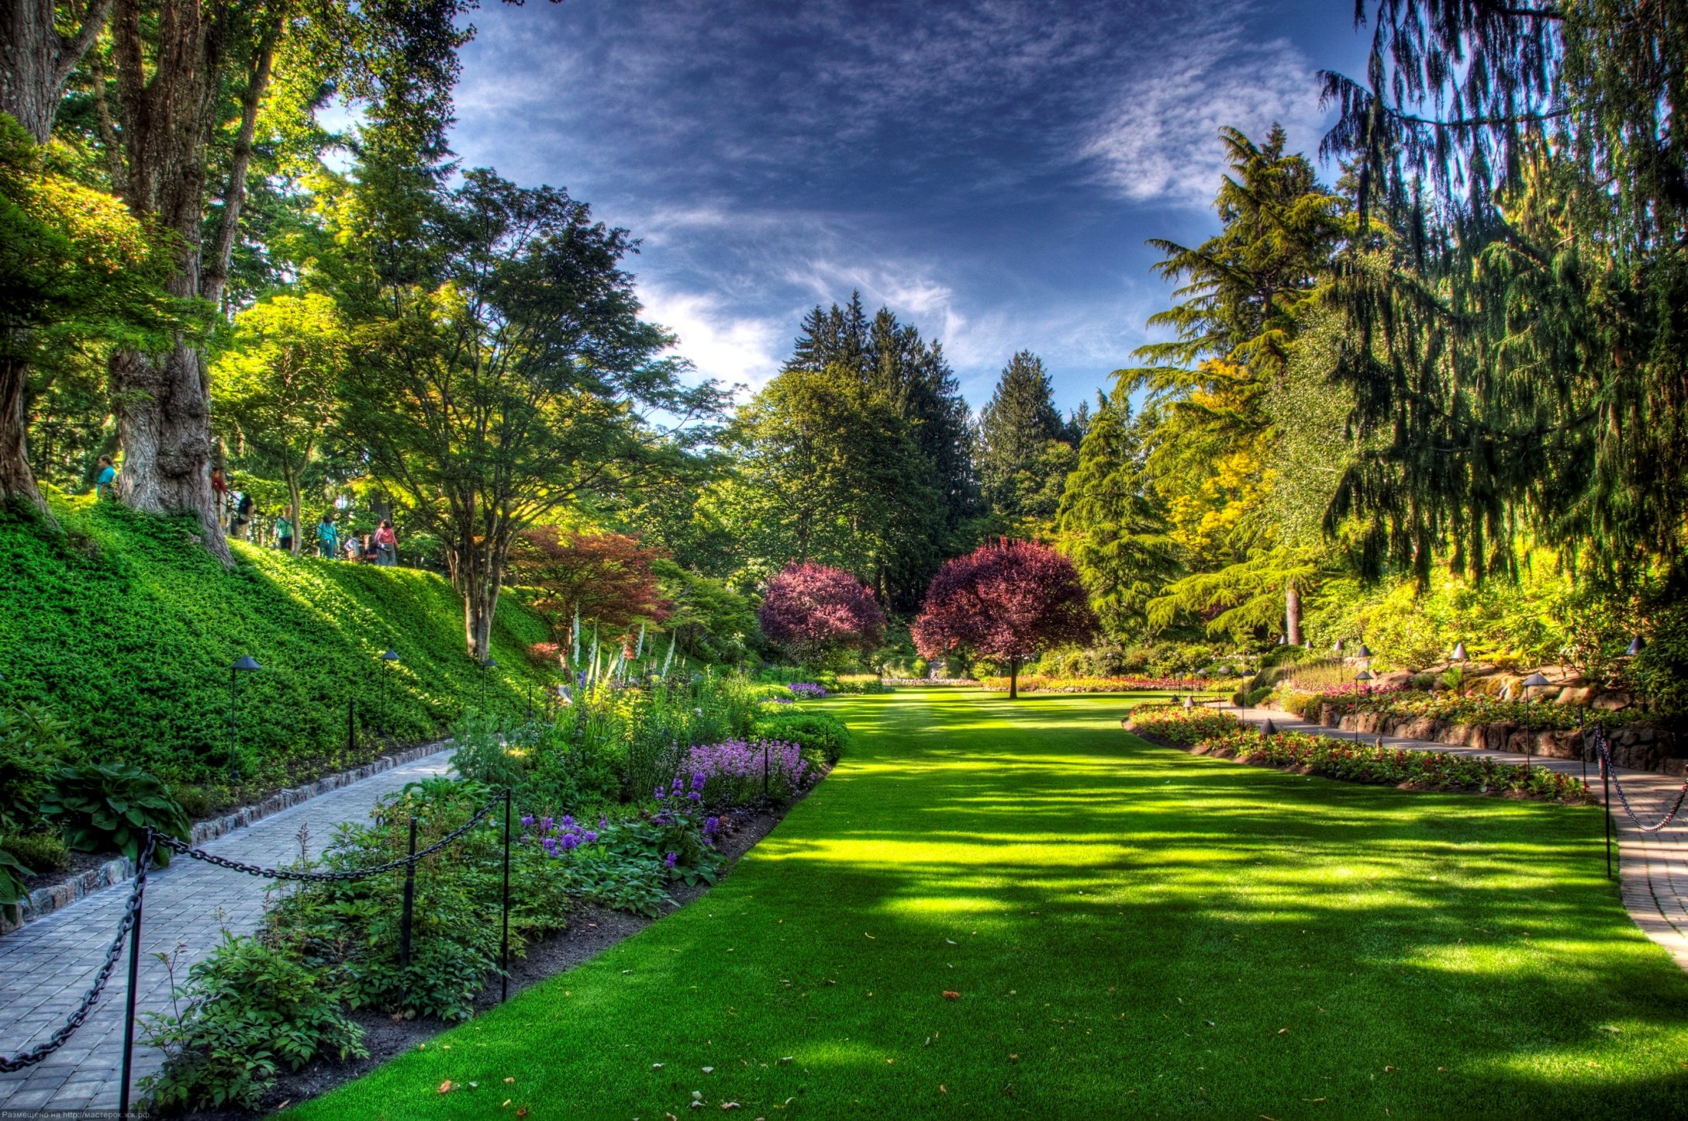

Slide 17
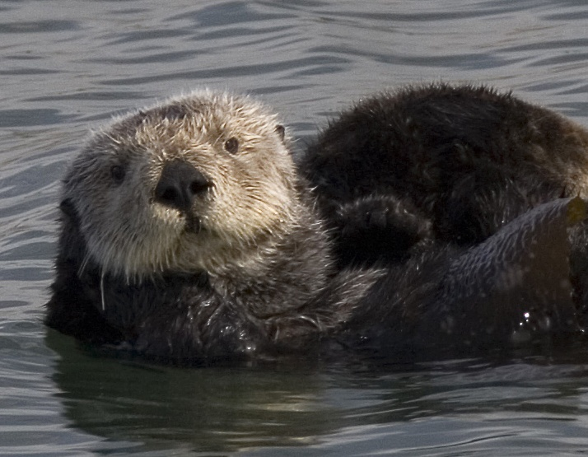
Fur-bearing animals

Slide 18
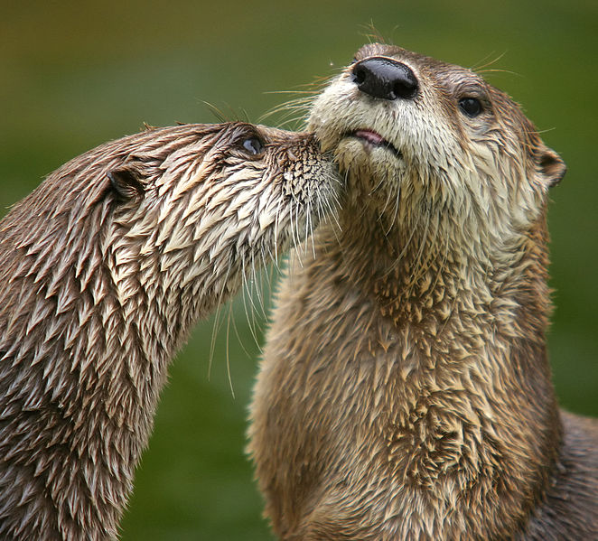
Northern River Otter

Slide 19
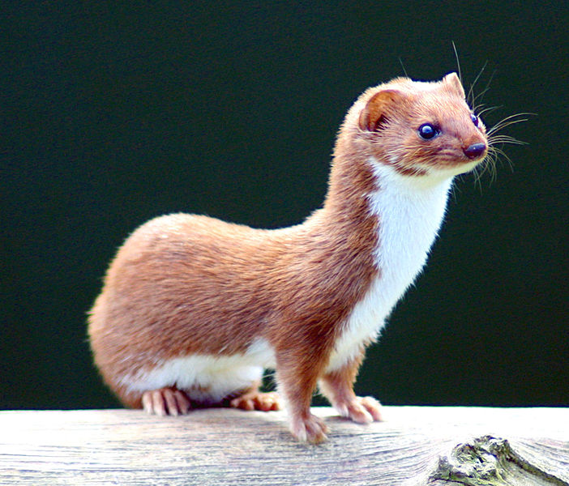
Least weasel

Slide 20
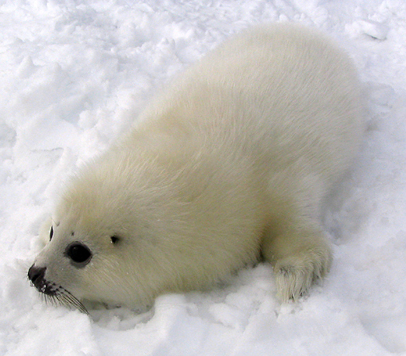
Harp seal

Slide 21
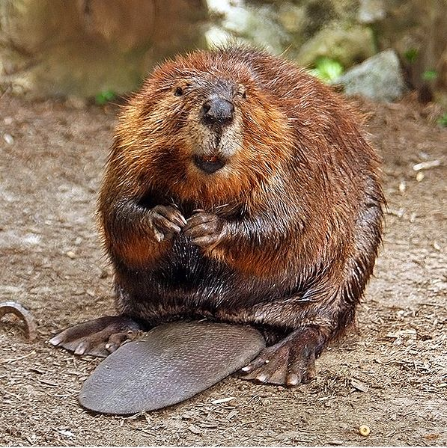
North American beaver

Slide 22
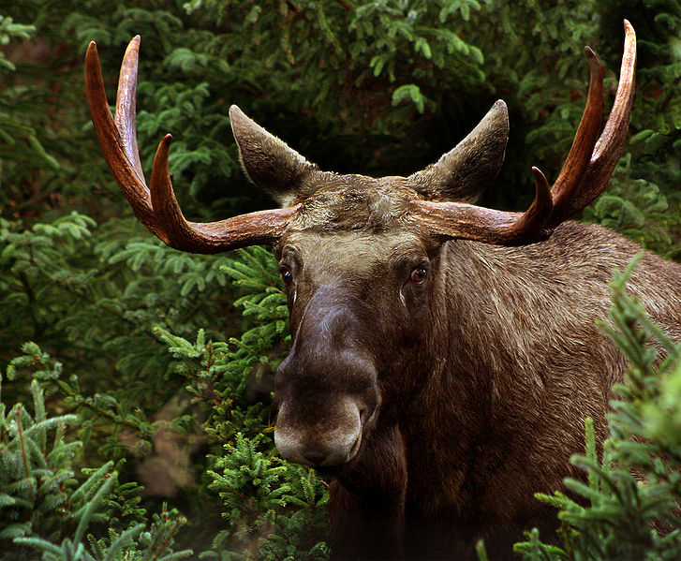
Moose

Slide 23
Canada is a huge country.
There are thirty-nine National Parks in Canada.
I want to visit Canada.
Thank you very much!

