Slide 1
The most popular cinemas and theatres
Form I course
Gladiy Lesya
Educational complex №3

Slide 2
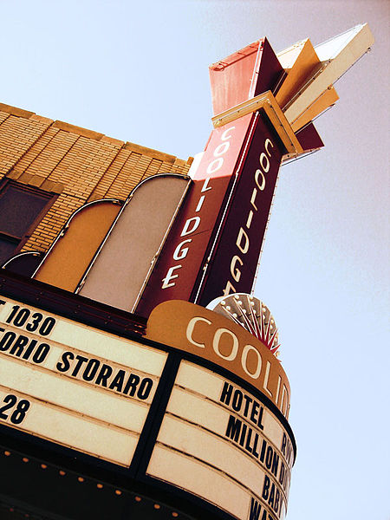
The Coolidge Corner Theatre is New England's most successful independent, not-for-profit cinema. Built as a church in 1906

Slide 3
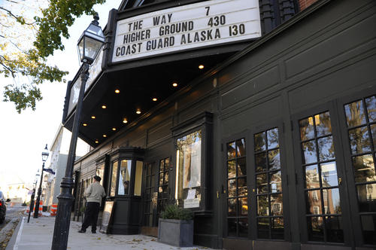
The Jane Pickens Theatre was built in 1834 as the Zion Episcopal Church, it was renamed “The Strand” in 1919 and became Newport’s center for film.

Slide 4
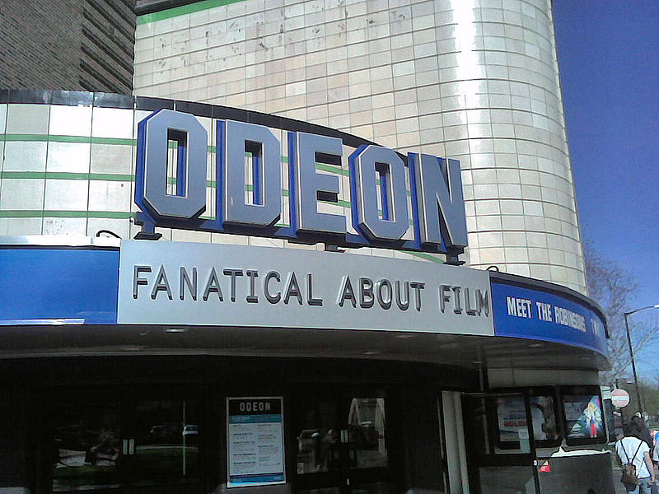
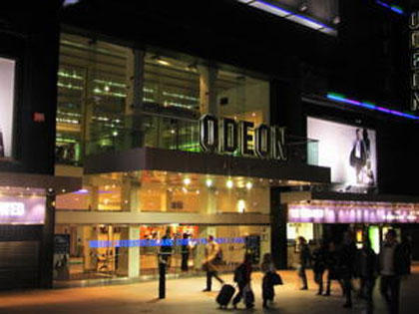
Odeon Cinemas is a British chain of cinemas operating in the United Kingdom and Ireland. The first Odeon cinema was opened by Oscar Deutsch in 1928, in Brierly Hill in the West Midlands

Slide 5
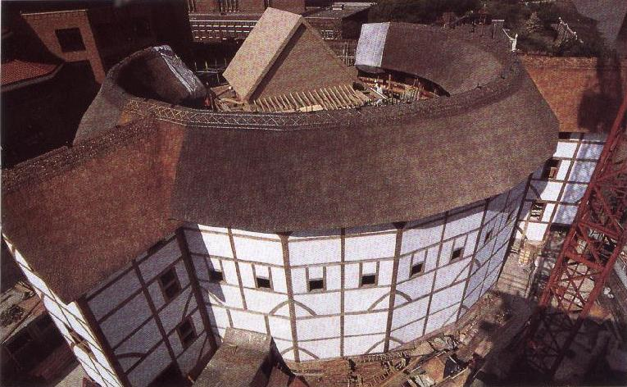
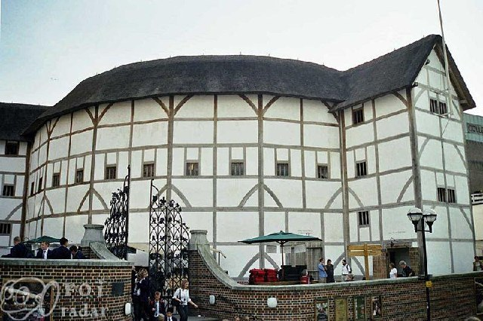
The Globe Theatre. It was a theatre in London associated with William Shakespeare. It was built in 1599 by Shakespeare's playing company.

Slide 6
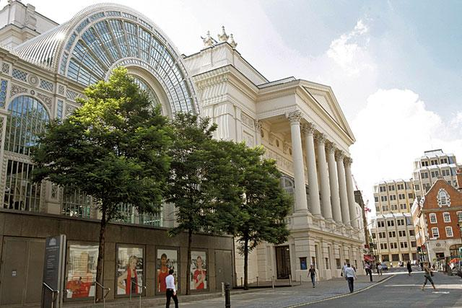
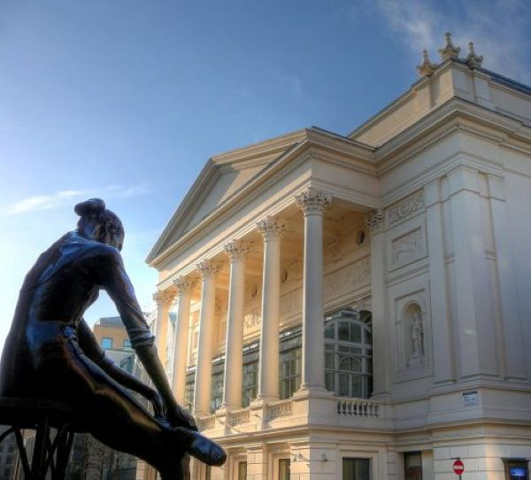
The Royal Opera House is an opera house and major performing arts venue in Covent Garden, central London.

Slide 7
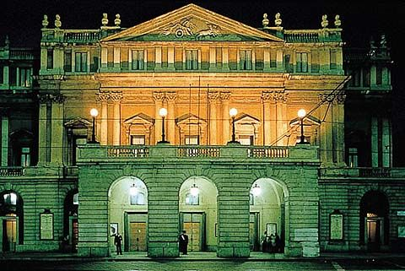
La Scala (the official name Teatro alla Scala) is the most famous opera house in Milan, Italy. The theatre was opened on 3 August 1778.

Slide 8
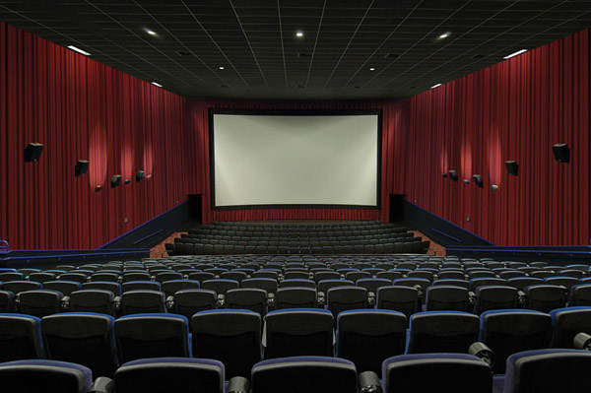

Cinema and theatre are always interesting…

Slide 9
Thank you for your attention!

