Slide 1
The english language in the modern world

Slide 2
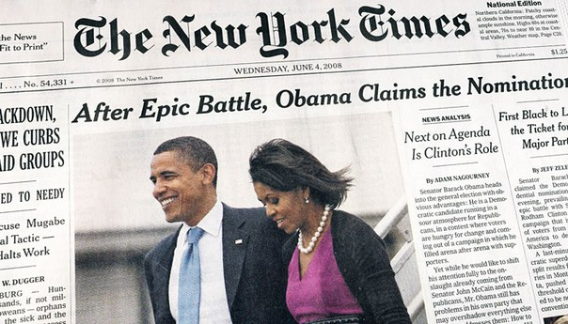
culture
With English, you can always communicate with business partners to participate in international conferences, read international newspapers and magazines. Many of the world’s top films, books and music are published and produced in English. Therefore by learning English you will have access to a great wealth of entertainment and will be able to have a greater cultural understanding.

Slide 3
CAREER
The other importance of the language is that it creat a greater opportunity for a job. As we know, in this modern world, businesses are targetting at quatities of employees; and, knowing English is one of those qualities. Consequently, if we know English and good at it, we will have more chances to get a job.

Slide 4
A TRIP ABROAD
Everyone knows that modern man is the personality of a versatile and curious, seeking in his life to visit as many different countries and cities to get acquainted with the culture and customs of other nations. And how this is possible without knowledge of the English language? In tourist countries, whether Turkey or Spain, everyone who works with tourists speak English.

Slide 5
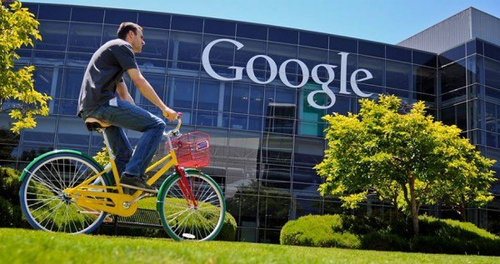
organizations
English is the dominant business language and it has become almost a necessity for people to speak English if they are to enter a global workforce. Many private organizations or public buildings use English in their business.

Slide 6
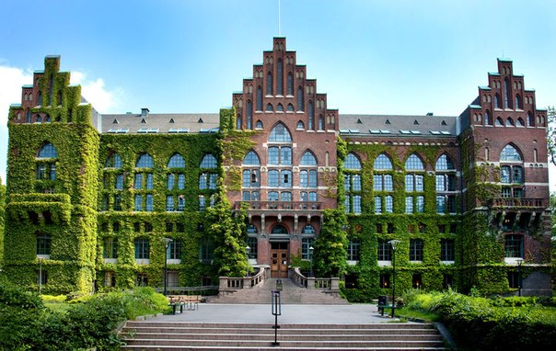
Science
Knowledge of the English language gives the opportunity to study in prestigious universities abroad. English is now used almost exclusively as the language of science. The fact that English is the de facto global language of science is not likely to change anytime soon.

