Slide 1
British Cuisine

Slide 2
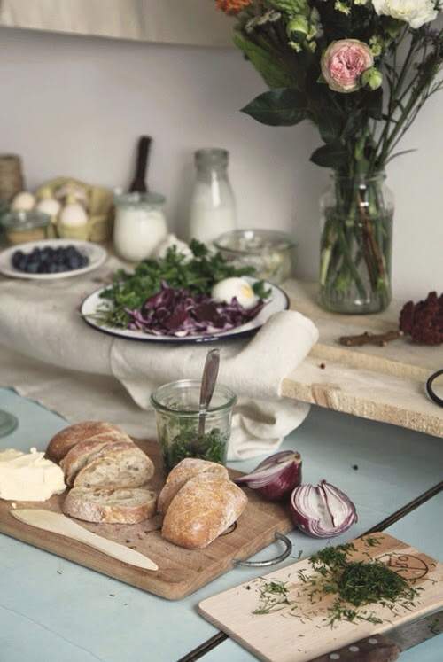
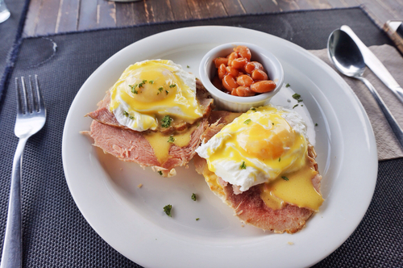
English cooking is heavy, substantial and plain. The usual meals in England are: breakfast, lunch or dinner, afternoon tea, high tea or supper.

Slide 3
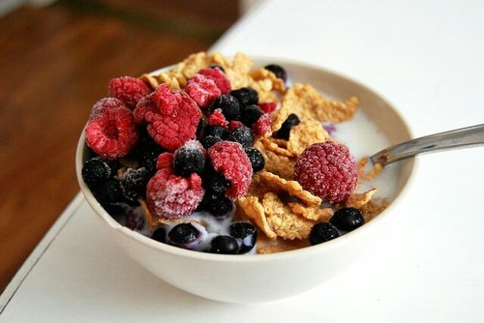
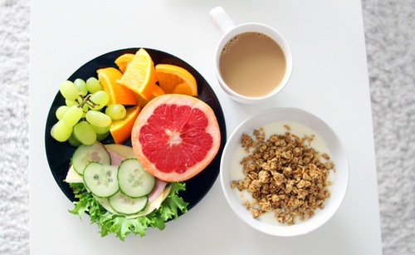
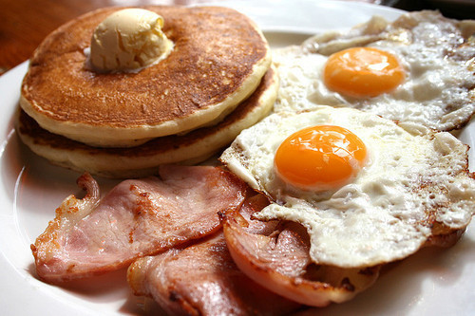
In the morning an Englishman has his favorite breakfast of cornflakes with milk and sugar or porridge followed by fried bacon and eggs. Breakfast is generally a bigger meal than they have on the toast and butter. Perhaps some fruit will also be eaten.

Slide 4
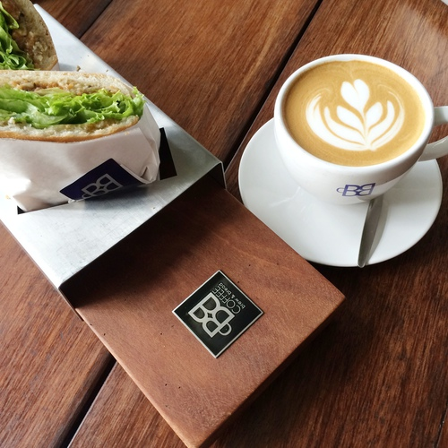
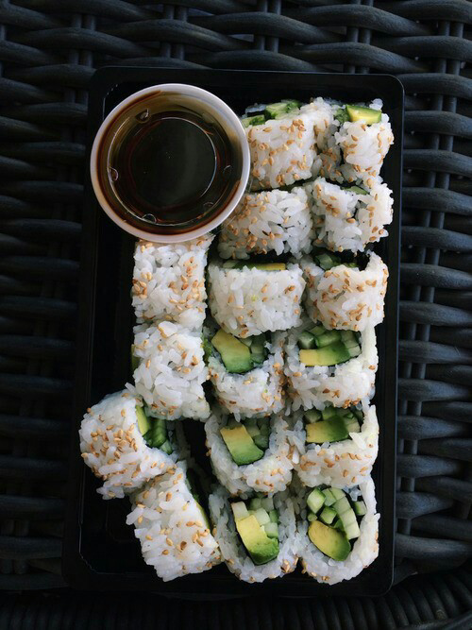
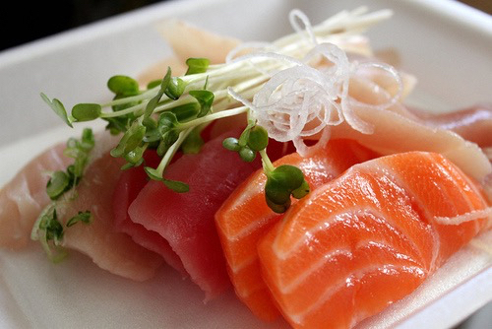
For a change one can have cold ham, or perhaps fish, some coffee and a roll.

Slide 5
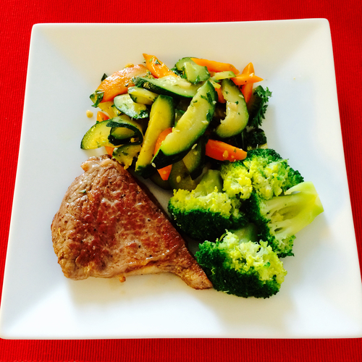
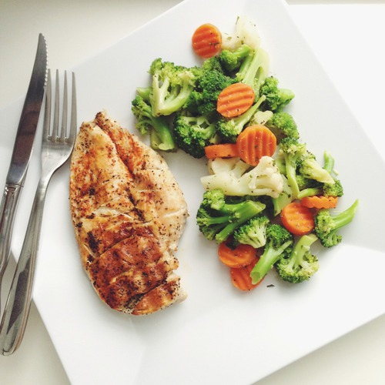
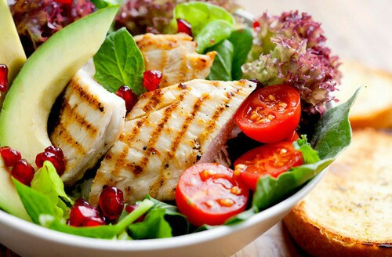
The usual midday meal consists of two courses – a meat course accompanied by plenty of vegetables.

Slide 6
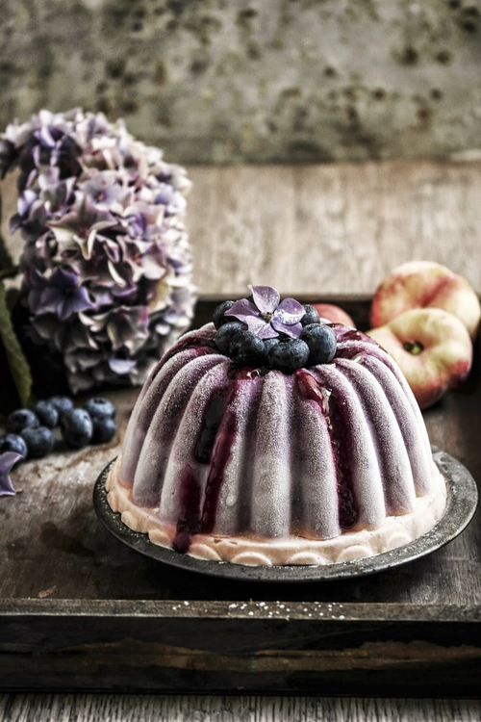
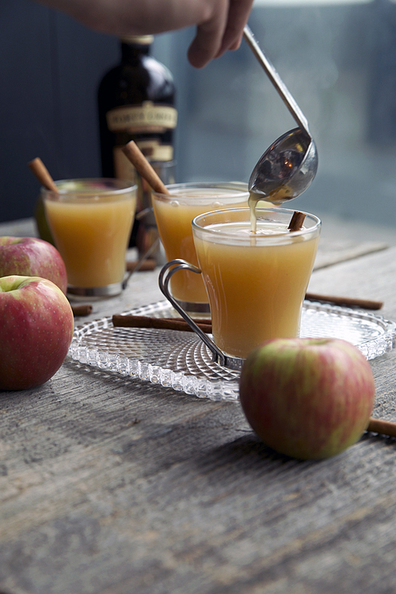
After it comes a sweet pudding or some stewed fruit.

Slide 7
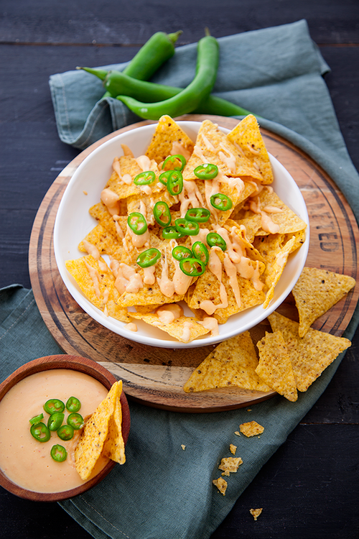
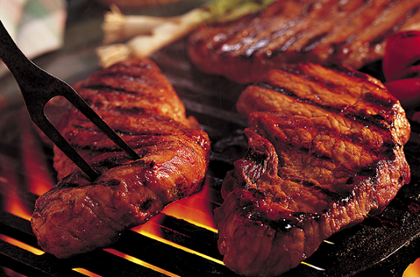
Most Englishmen like what they called good plain food. Usually they have beef steaks, chops, roast beef and fried fish and chips. They are not over fond of soup, remarking that it leaves them without free room for the more important meat course.

Slide 8
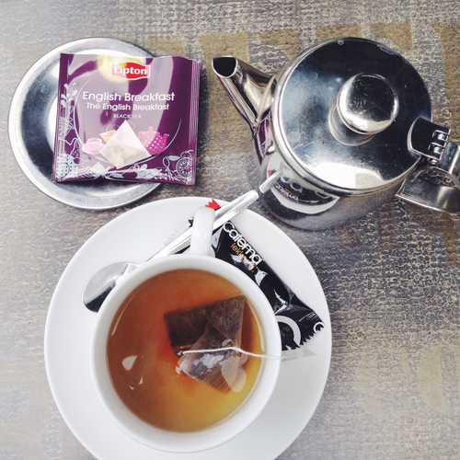
Afternoon tea one can hardly call a meal. This may mean a cup of tea and a cake taken in the sitting-room or at work. For many Englishmen it is a social occasion when people often come in for a chat over their cup of tea.

Slide 9
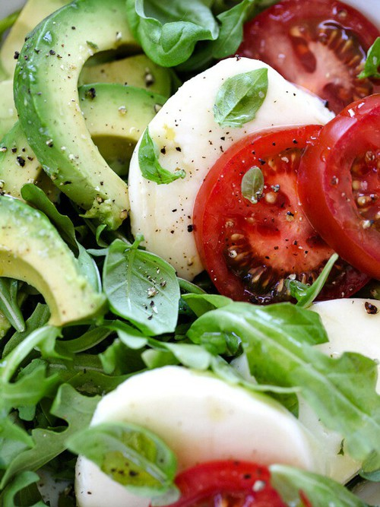
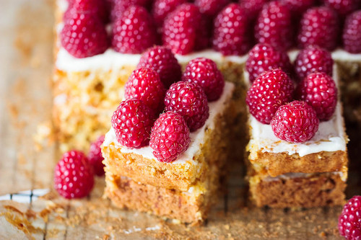
But some people like to have the so-called “high tea” which is quite a substantial meal. In a well-to-do family it will consist of ham, tomatoes and salad, or tinned salmon, and sausage, with strong tea, bread and butter, then stewed fruit, or a tin of pears, apricot or pineapple with cream and custard, and pasties, or a bun.

Slide 10
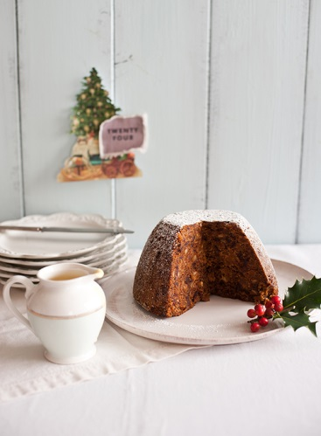
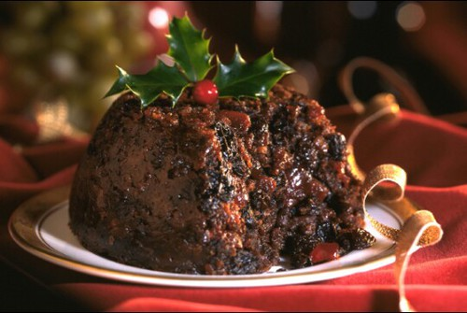
It is well-known that every national cuisine has got its famous specialties. It isn't possible to imagine some holidays and celebrations without them. For example, Christmas pudding for British cuisine means very much. Some English people could dispense with turkey and goose, but a Christmas dinner in Britain without a traditional Christmas pudding would be strange indeed!

