Slide 1
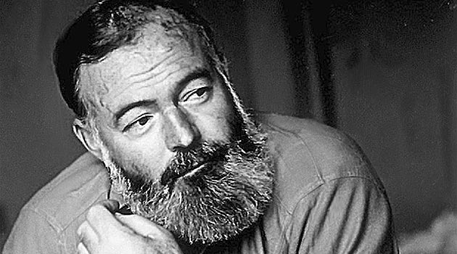
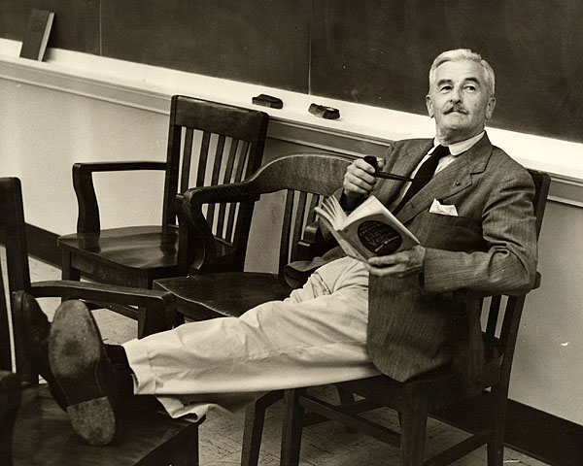
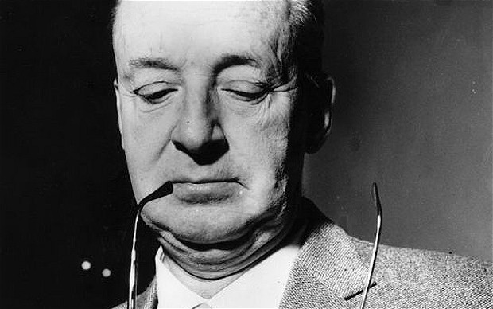
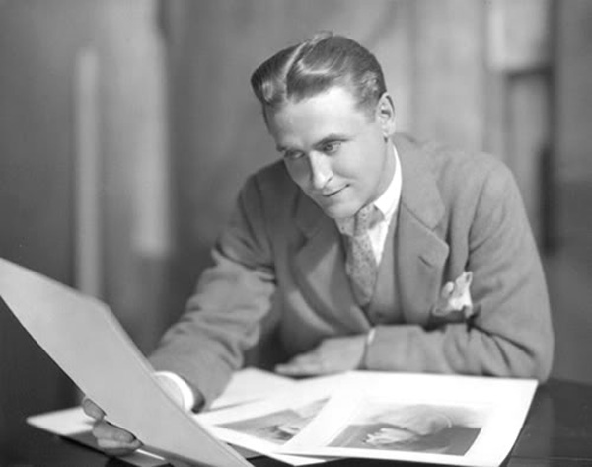
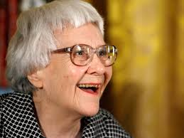
American Literature
20th century

Slide 2
• The Great Gatsby by F. Scott Fitzgerald (1925)
• An American Tragedy by Theodore Dresier (1925)
• For whom the bell tolls by Ernest Hemingway (1926)
• The Sound and the Fury by William Faulkner (1929)
• The Tropic of Cancer by Henry Miller (1934)
• Gone with the Wind by Margaret Mitchell (1936)
• The Pearl by John Steinbeck (1939)
• All the King’s Men by Robert Penn Warren (1946)
• The Naked and the Dead by Norman Mailer (1948)
• The Catcher in the Rye by J.D. Salinger (1951)
•  Herzog by Saul Bellow (1953)
• Fahrenheit 451 by Ray Bradbury (1953)
• To Kill a Mockingbird by Harper Lee (1960)
• Invitation to a Beheading by Vladimir Nabokov (1958)

Slide 3
Depression-era literature
Depression era literature was blunt and direct in its social criticism. John Steinbeck (1902–1968). His style was simple and evocative, winning him the favor of the readers but not of the critics. Steinbeck often wrote about poor, working-class people and their struggle to lead a decent and honest life.
Henry Miller assumed a unique place in American Literature in the 1930s when his semi-autobiographical novels, written and published in Paris, were banned from the US. His major work is Tropic of Cancer .

Slide 4
Post–World War II
The period in time from the end of World War II up until the late 1960s and early 1970s saw the publication of some of the most popular works in American history such as To Kill a Mockingbird by Harper Lee.
Though born in Canada, Chicago-raised Saul Bellow would become one of the most influential novelists in America in the decades directly following World War II. In Herzog Bellow painted vivid portraits of the American city and the distinctive characters.

Slide 5
From J.D. Salinger's The Catcher in the Rye , the perceived madness of the state of affairs in America was brought to the forefront of the nation's literary expression.
Immigrant authors such as Vladimir Nabokov, with Lolita, forged on with the theme and took a concerted step away from their Lost Generation predecessors, developing a style and tone of their own.

Slide 6
Nobel Prize in Literature winners
1930: Sinclair Lewis (novelist)
1936: Eugene O'Neill (playwright)
1938: Pearl S. Buck (biographer and novelist)
1948: T. S. Eliot (poet and playwright)
1949: William Faulkner (novelist)
1954: Ernest Hemingway (novelist)
1962: John Steinbeck (novelist)
1976: Saul Bellow (novelist)
1978: Isaac Bashevis Singer (novelist, wrote in Yiddish)
1980: Czesław Miłosz (poet and essayist, wrote in Polish)
1987: Joseph Brodsky (poet and essayist, wrote in English and Russian)
1993: Toni Morrison (novelist)

