Slide 1
CARDIFF

Slide 2
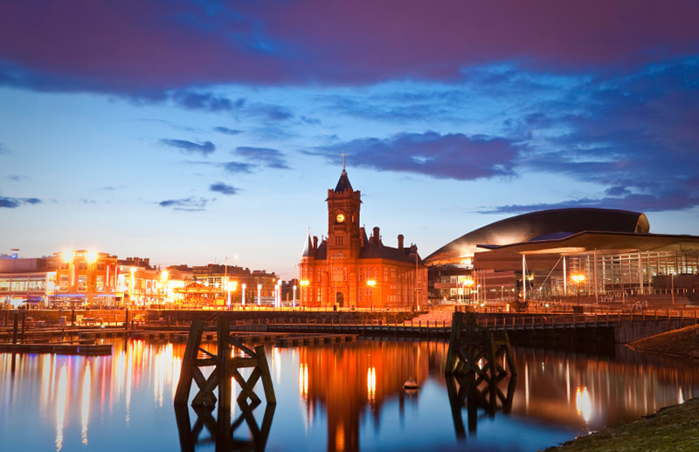
Cardiff is the capital and largest city in Wales and the ninth largest city in the United Kingdom.

Slide 3
Welcome to Cardiff!

Slide 4
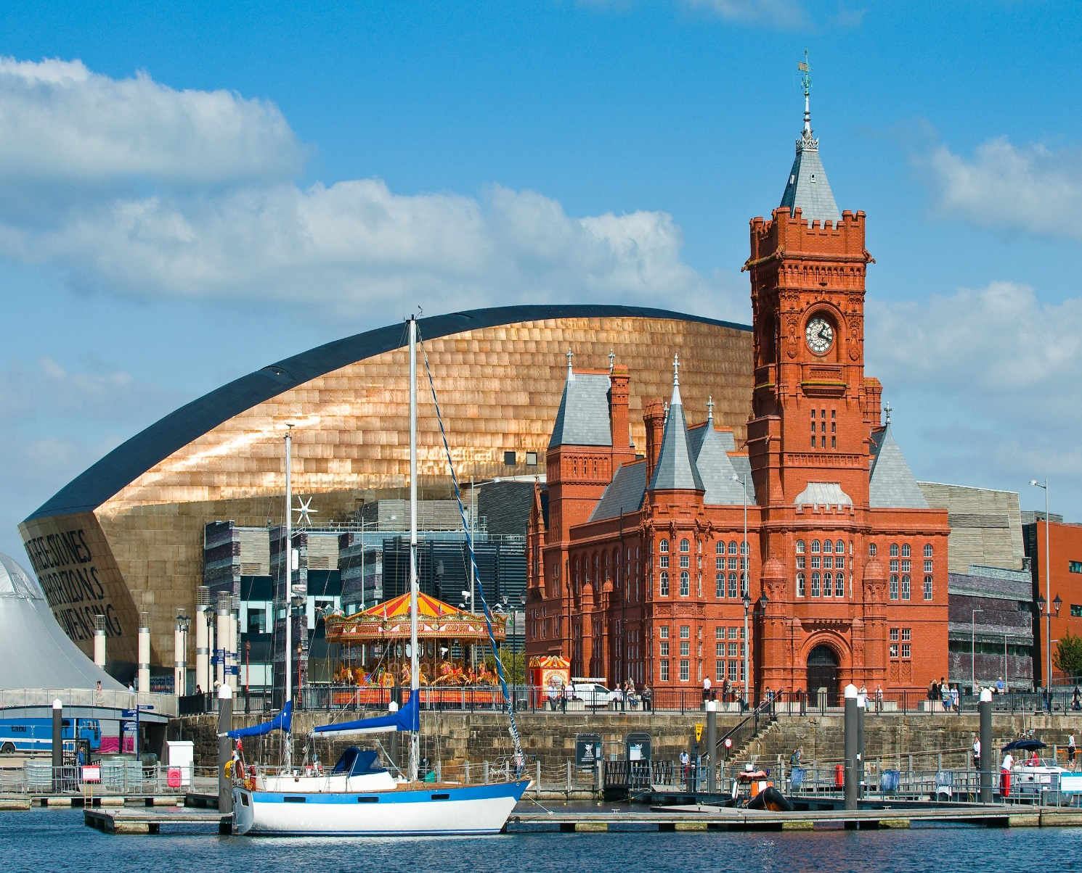
Hello, my name is Mary and today we are in Cardiff.

Slide 5
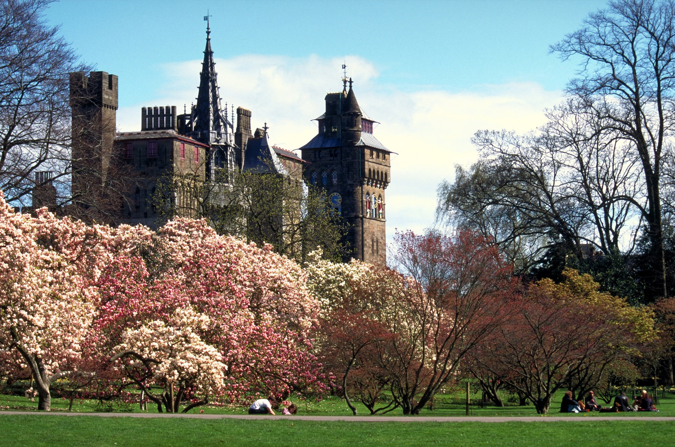
Today I will tell and show you famous places in Cardiff.

Slide 6
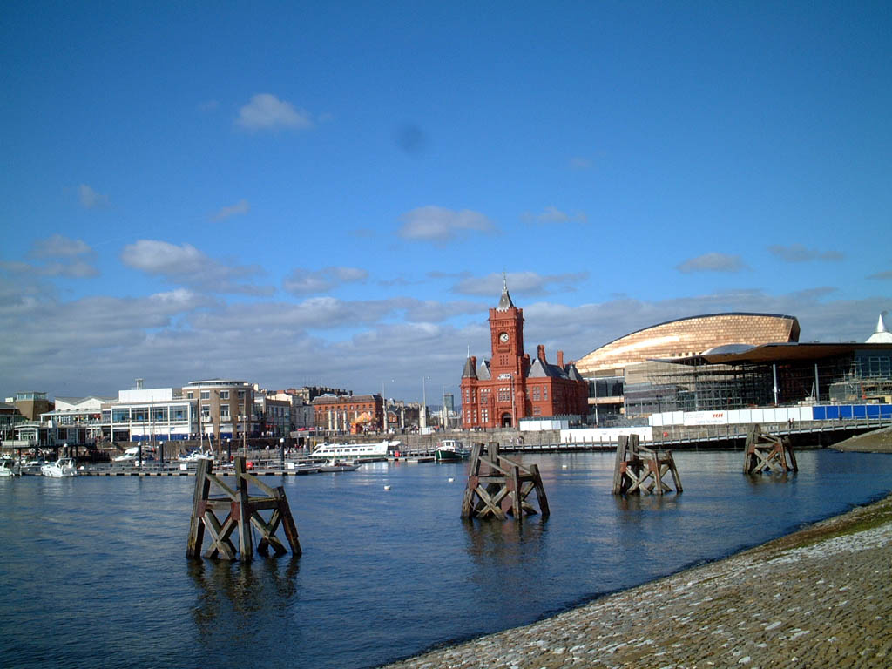
Сenter Сardiff City

Slide 7
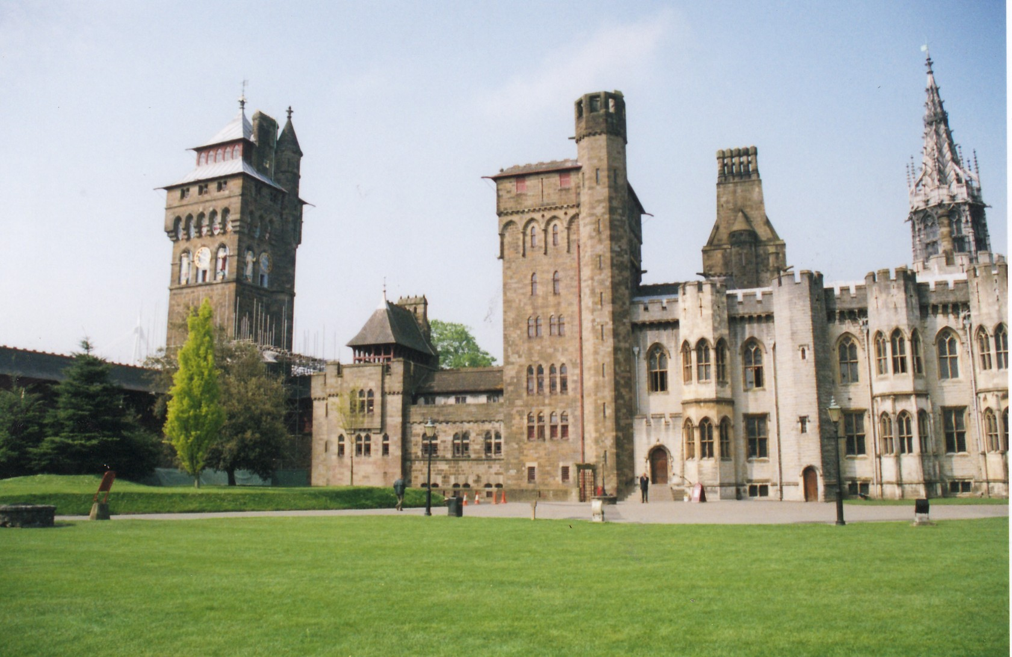
cardiff castle

Slide 8
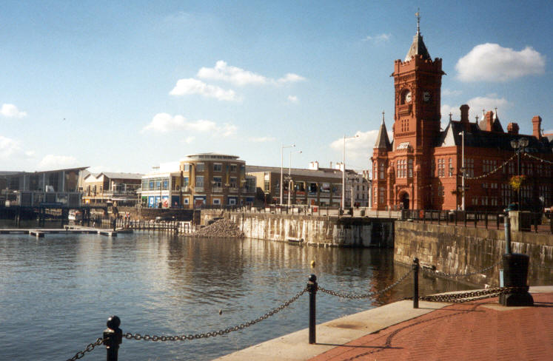
Cardiff Bay is the area created by the Cardiff Barrage in South Cardiff, the capital of Wales. Cardiff Bay played a major part in Cardiff’s development by being the means of exporting coal from the South Wales Valleys to the rest of the world, helping to power the industrial age. The coal mining industry helped fund the building of Cardiff into the Capital city of Wales.

Slide 9
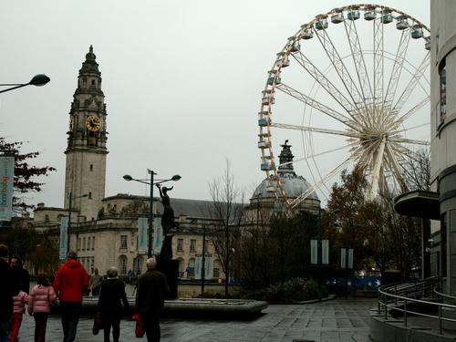
Museum Avenue

Slide 10
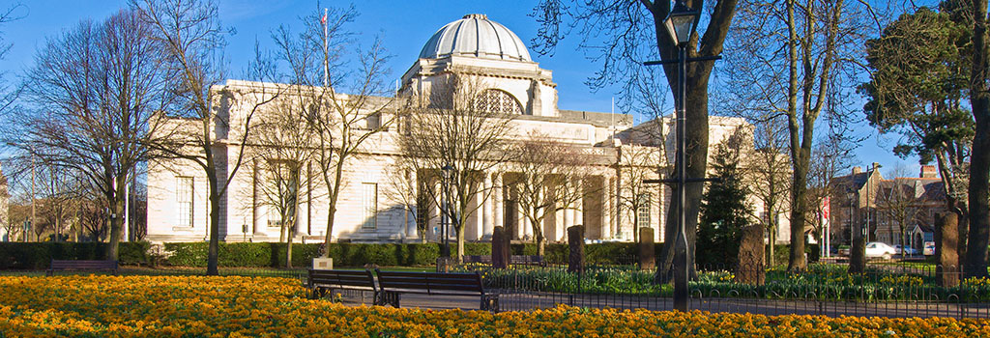
National Museum Cardiff

Slide 11
  The National Museum of Wales was founded in 1905.
  The museum has collections of archaeology, botany, fine and applied art.

Slide 12
Until We Meet Again!

