Slide 1
English Painters
Yana Linik
Form 10
School of Lypyny

Slide 2
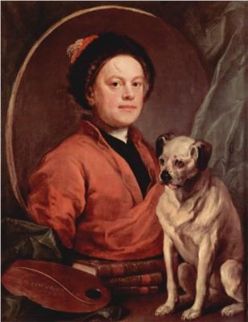
1. William Hogarth
William Hogarth (1697-1764) was the first great English painter who raised English pictorial art to a high level of importance.
He was a man of remarkably individual character and thought.
W. Hogarth had friends among famous English writers J. Swift, H. Filding.
He was the first English painter who brought painting closer to literature and theatre.

Slide 3
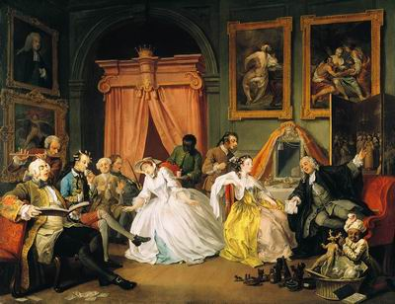
Marriage la Mode

Slide 4
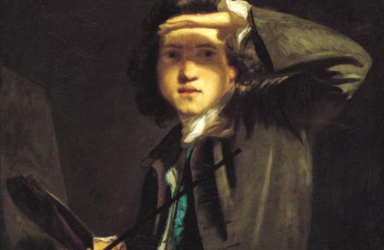
2. Reynolds Sir Joshua
Sir Joshua Reynolds (1723—1792), the first President of the Royal Academy of Arts, was not only a painter but the founder of the academic principles of the "British school".
Reynolds was the most outstanding portraitist of the 18th century.
In his pictures he did not only paint portraits but produced characters.

Slide 5
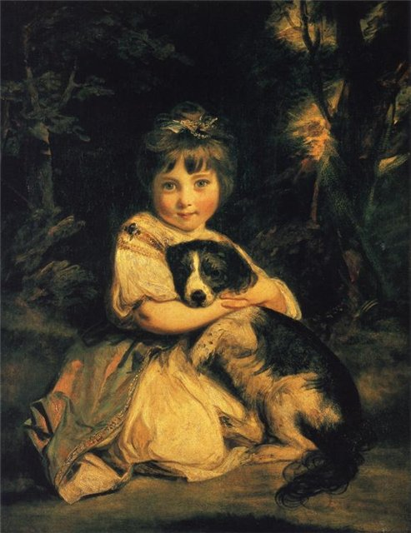
Love Me, Love My Dog.

Slide 6
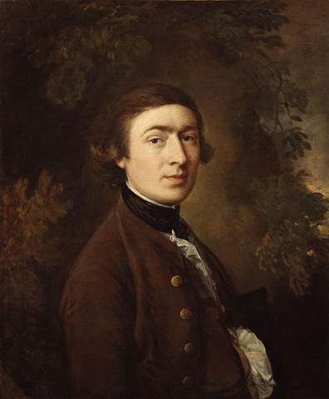
3. Thomas Gainsborough
Thomas Gainsborough (1727— 1788) was a brilliant portrait painter.
A good amateur violinist and a lover of the drama, he was an artistic person.
T. Gainsborough is the creator of the great English school of landscape painting.
His great love for the English country and his delicate understanding of nature are felt in his pictures

Slide 7
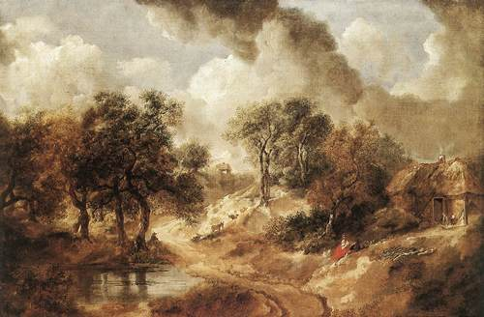
Landscape

Slide 8
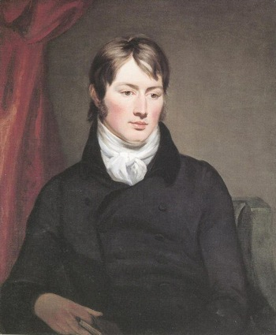
4. John Constable
John Constable is one of the greatest landscape painters.
He was the first landscape painter who considered that every painter should make his sketches direct from nature, which is working in the open air.
Constable was a realist.
The most famous of his works are “Flatford Mill”, “The white horse”, “Waterloo Bridge” and others.
Constable may truly be considered the father of modern landscape painting.

Slide 9
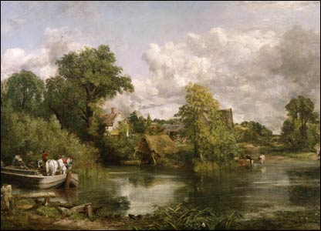
The white horse

Slide 10
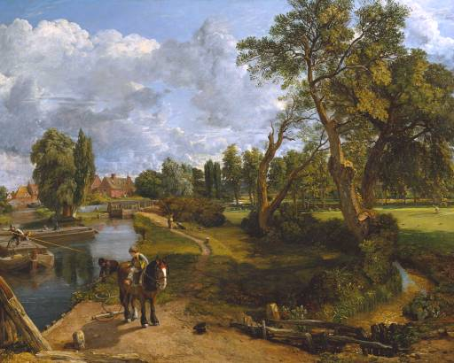
Flatford Mill

Slide 11
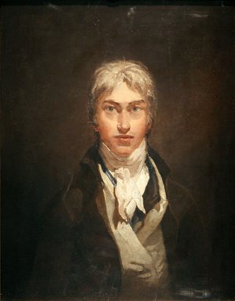
5. Joseph Turner
Another famous English painter was Joseph Turner (1775—1851), whose business was to paint the light.
He proved that with the help of light it is, possible to show qualities of any subject.
Turner was a representative of Romanticism.
Turner's "The Shipwreck", "Burning of the Houses of Parliament" and "Snow Storm" are masterpieces of the great artist.

Slide 12
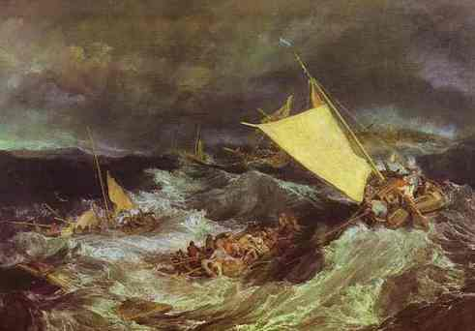
The Shipwreck

Slide 13
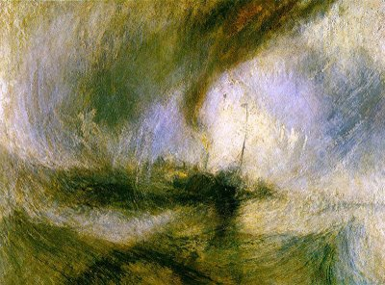
Snow Storm

Slide 14
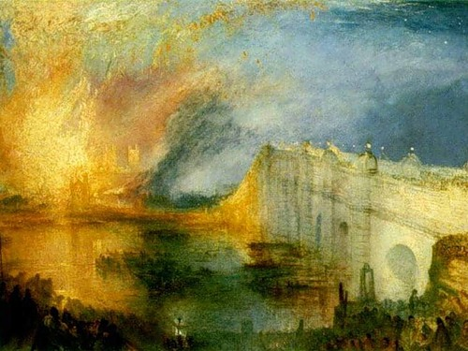
Burning of the Houses of Parliament

Slide 15
Thank you for your attention !

