Slide 1

BBC World Service

Slide 2

The BBC World Service is the world's largest international broadcaster, broadcasting news, speech and discussions in 28 languages to many parts of the world on analogue and digital shortwave platforms, internet streaming, podcasting, satellite, FM and MW relays. The World Service was reported to have reached 188 million people a week on average in June 2009. It does not carry advertising, and the English language service broadcasts 24 hours a day.
BBC

Slide 3
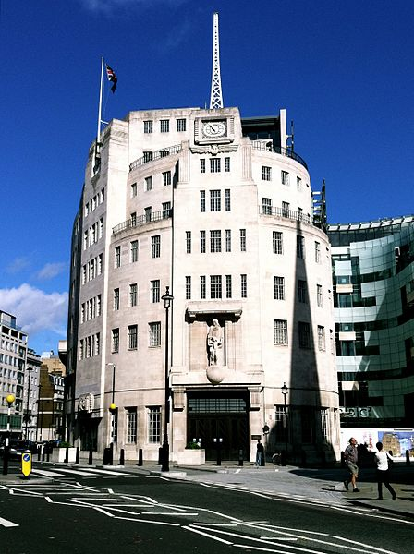
Operation
The BBC World Service currently broadcasts from Broadcasting House in London, headquarters of the corporation as a whole. The service itself is located in the new constructions of the building and contains radio and television studios for use by the several language services. The building will also contain an integrated newsroom used by the international World Service, the international television channel BBC World News, the domestic television and radio BBC News bulletins, the BBC News Channel and the local news for the BBC London region on television and radio.

Slide 4

The British Radio (Sound Broadcasting)
The BBC operates four domestic sound broadcasting services and two main groups of external broadcasting services. There are more than 160 studios for the domestic sound programs, of which more than 60 are in London. The domestic services, which produce over 20,000 programs hours a year, are designed to cater for the varying tastes of a diverse listening public.

Slide 5
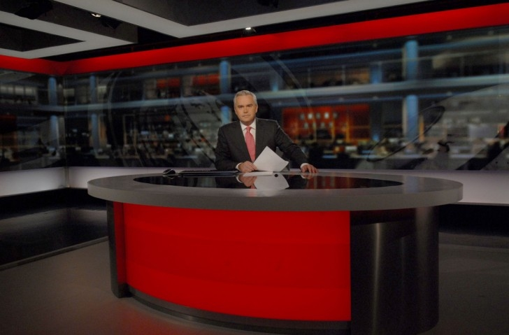
Television Broadcasting
In 1936 the BBC launched the world's first public television service. BBC studio productions come from main London studios, fully equipped regional studios at Manchester, Birmingham, Cardiff, Glasgow and other cities. The first regional independent television service ITA (In-dependent Television Authority) appeared in 1955. Generally speaking, both BBC and the ITA provide programs of music, drama, light entertainment, variety and films.

