Slide 1
Ivan Aivazovsky
Presented
by
Polina Shepel

Slide 2
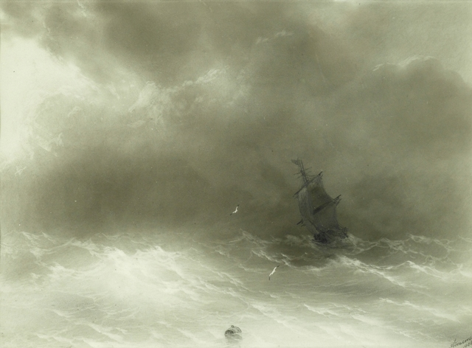
Gallery of famous artist
Strong Wind

Slide 3
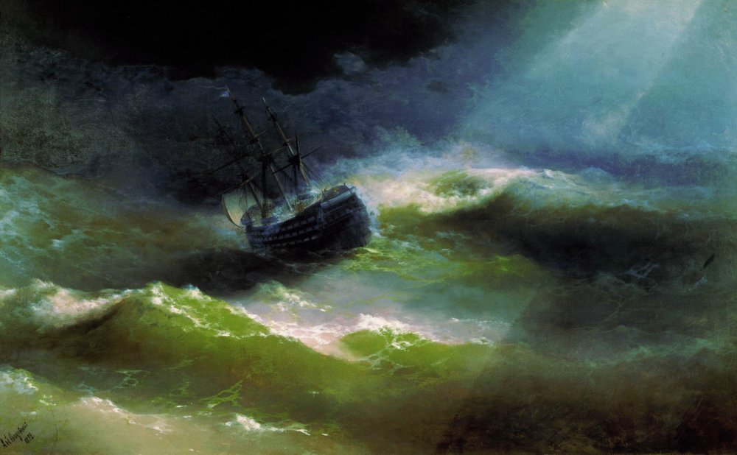
Ship «Empress Maria» in storm

Slide 4
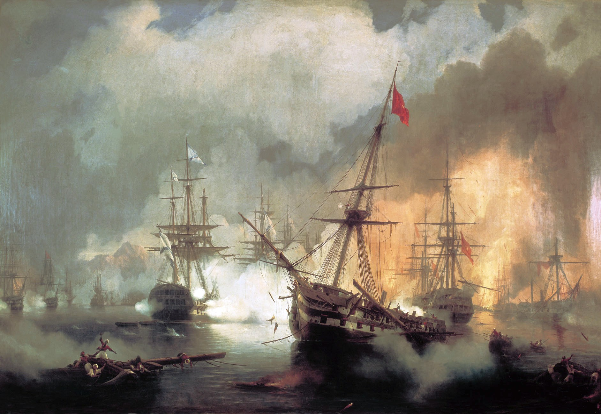
Russians at navarino

Slide 5
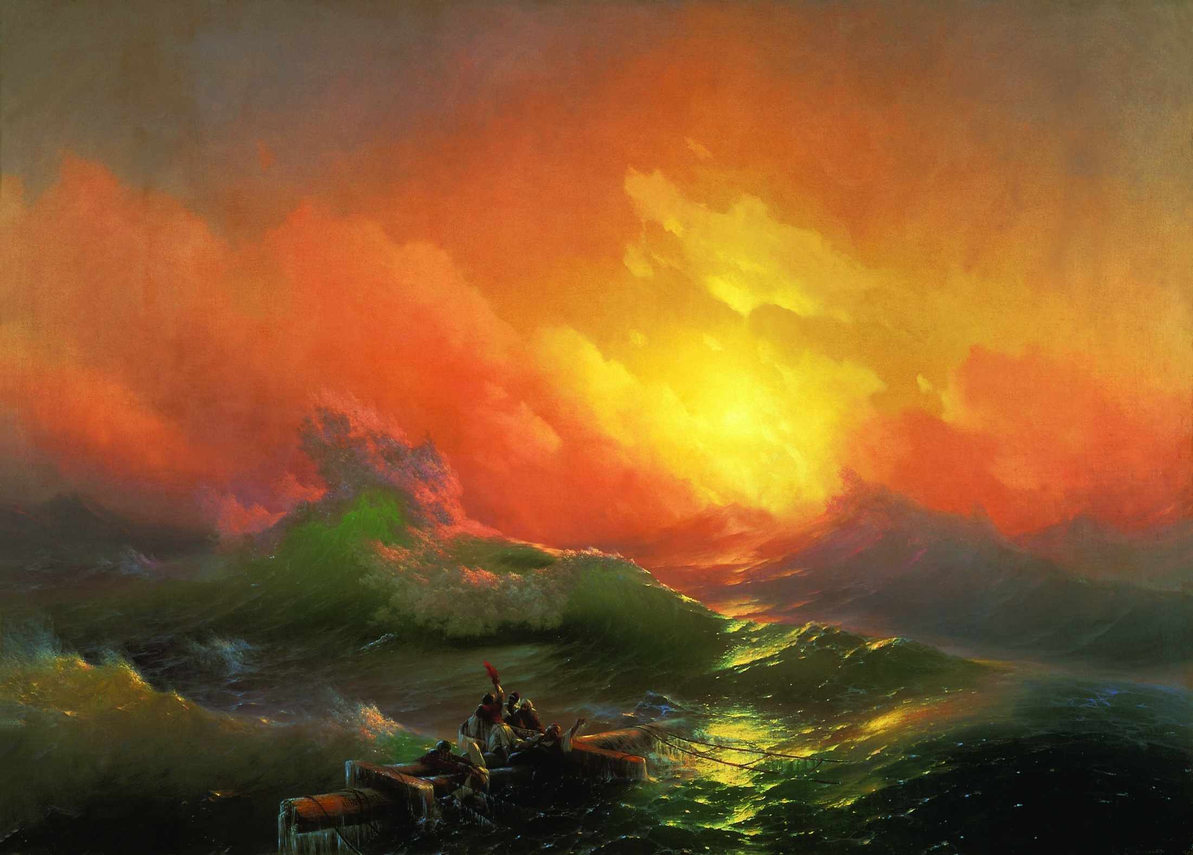
The Ninth Wave

Slide 6
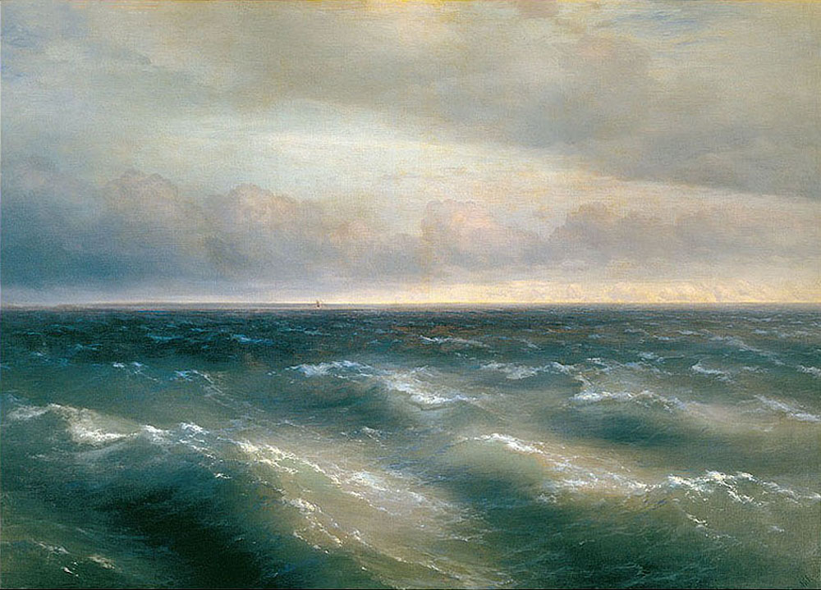
Black sea

Slide 7
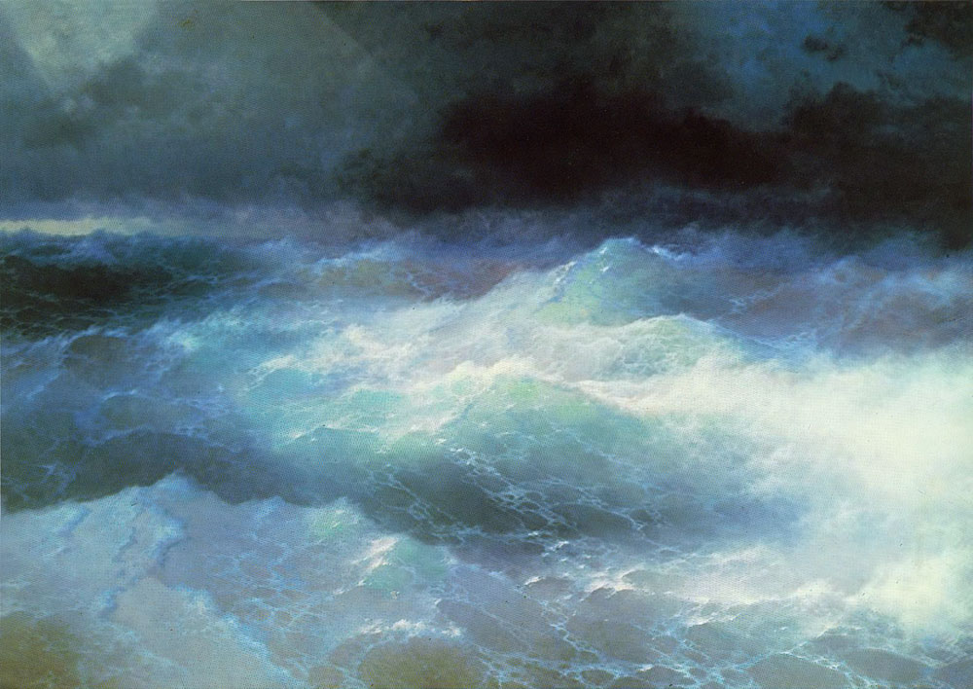
Among waves

Slide 8
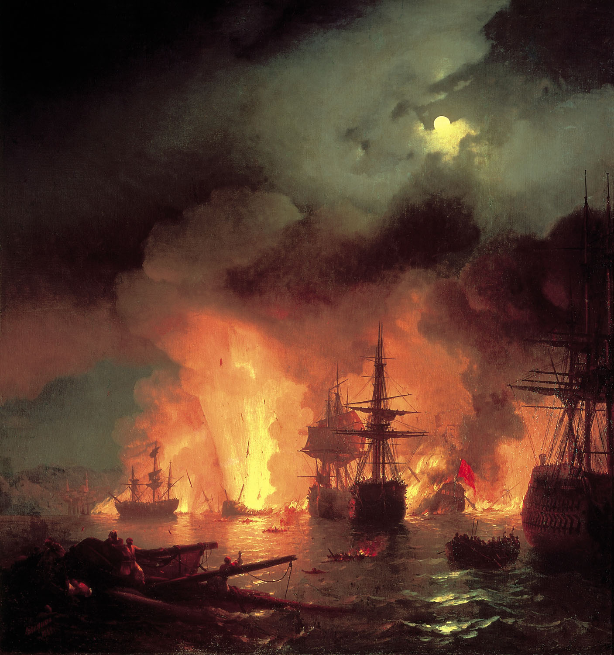
Battle of Chesma

Slide 9
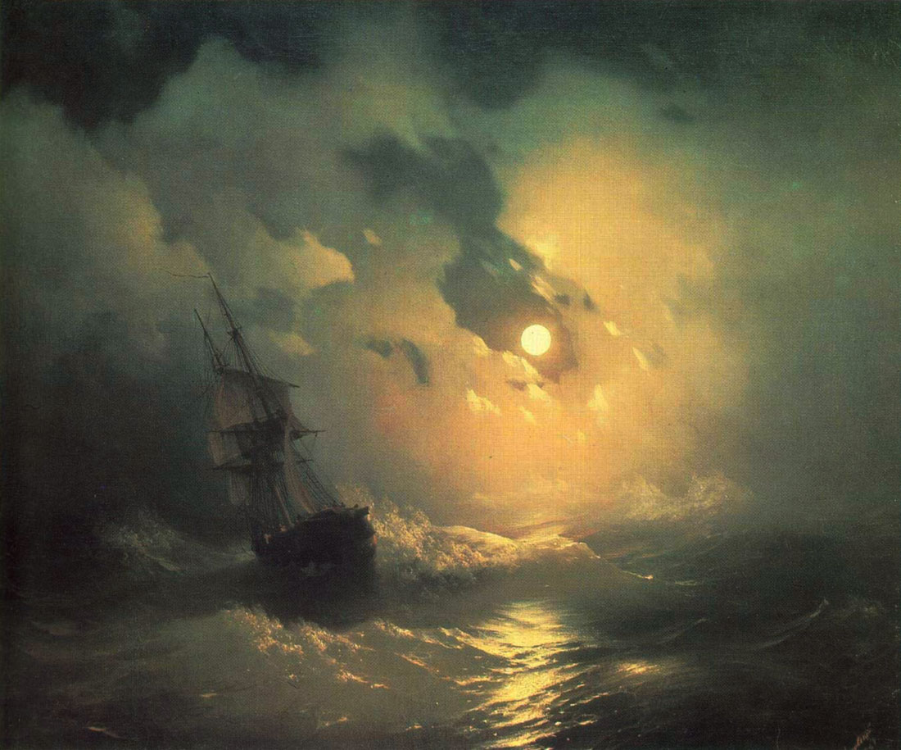
Stormy sea at nigh

Slide 10
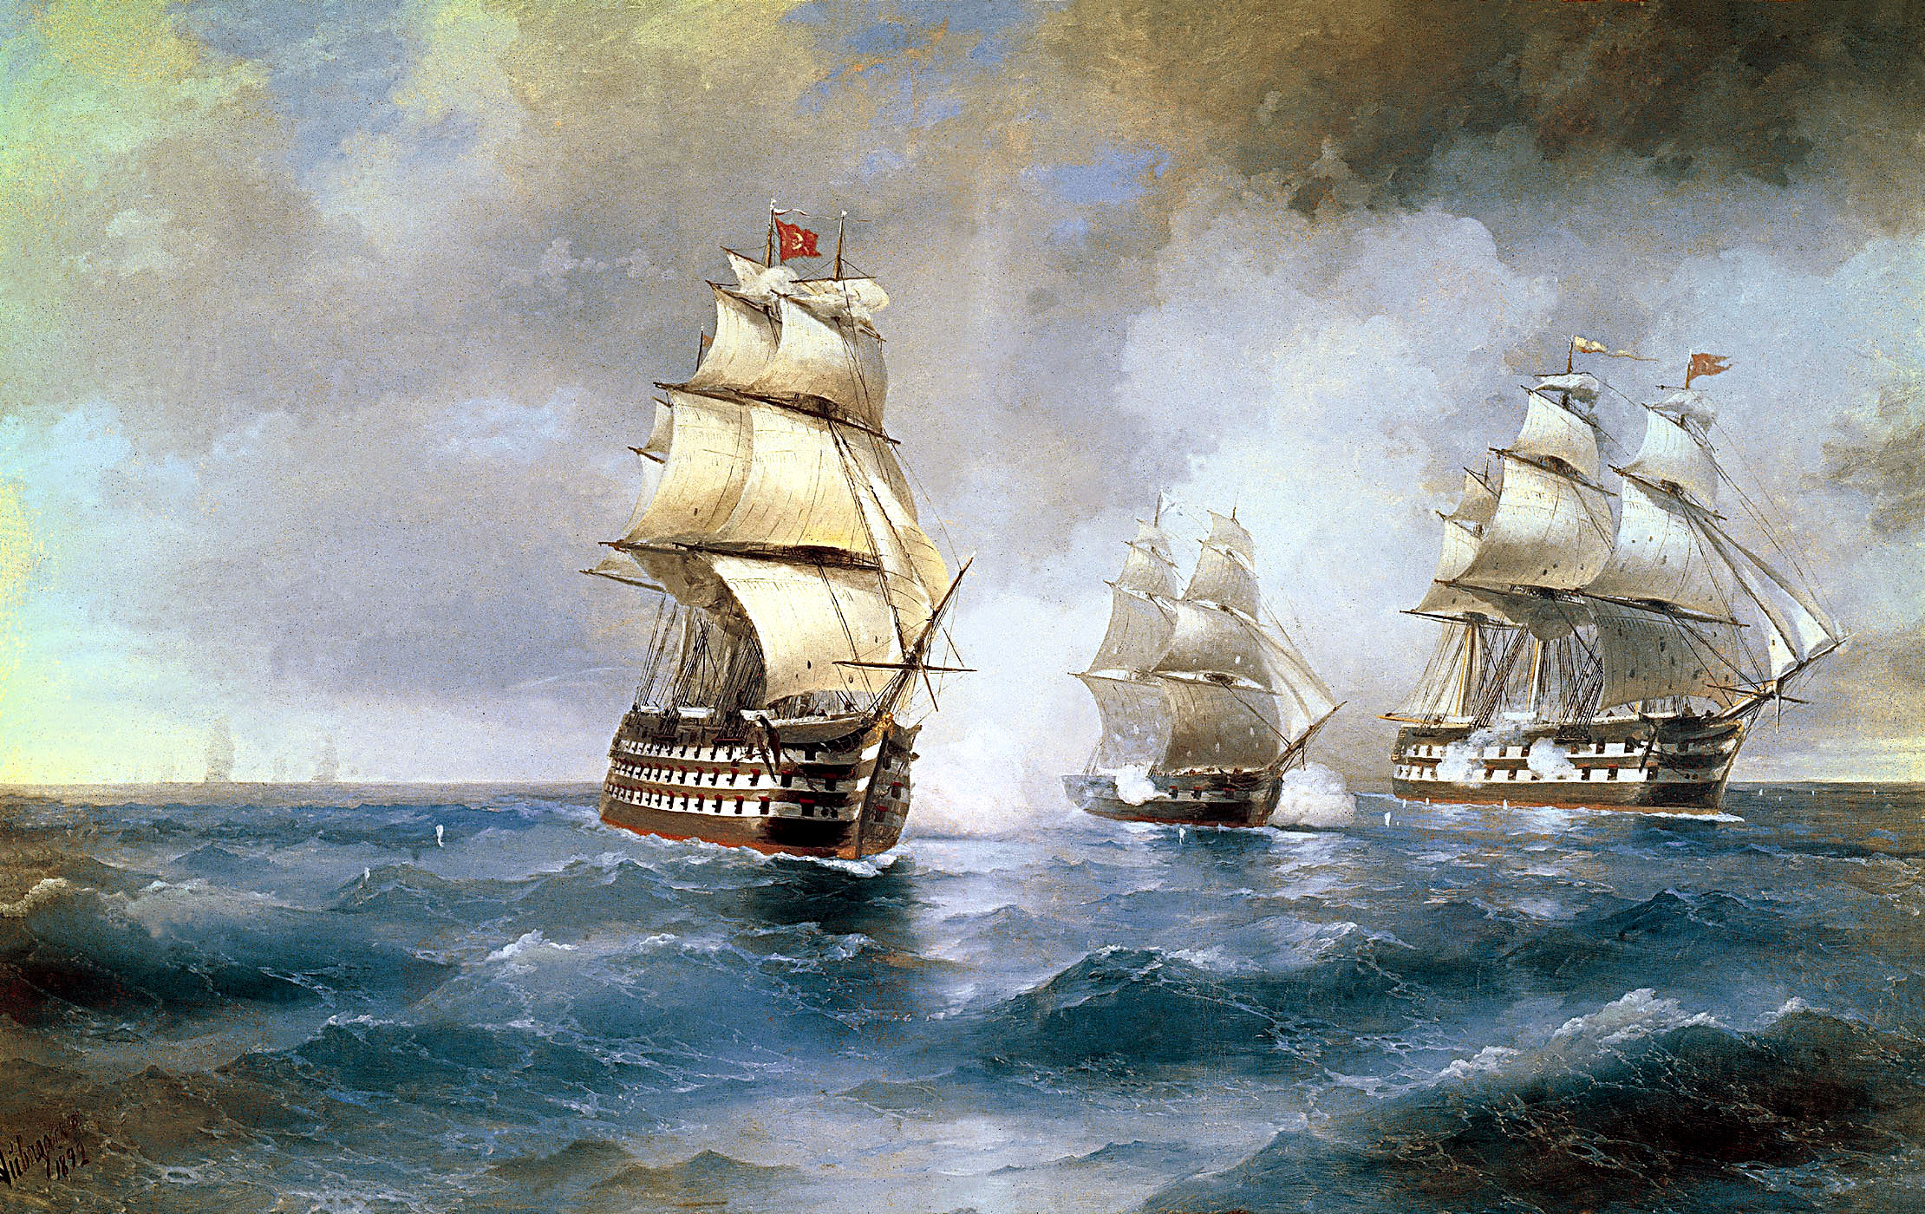
Brig "Mercury" Attacked by Two Turkish Ships

