Slide 1
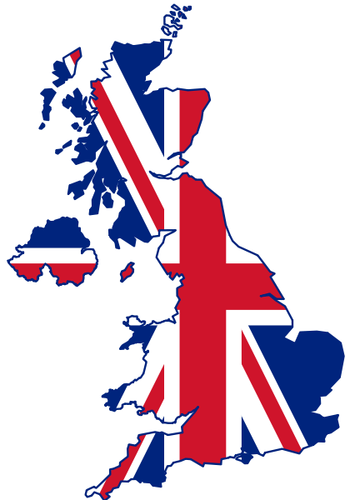
The Symbols of the United Kingdom

Slide 2
This is a list of the symbols of the United Kingdom(England, Northern Ireland, Scotland and Wales). Each separate entry has its own set of unique symbols.

Slide 3
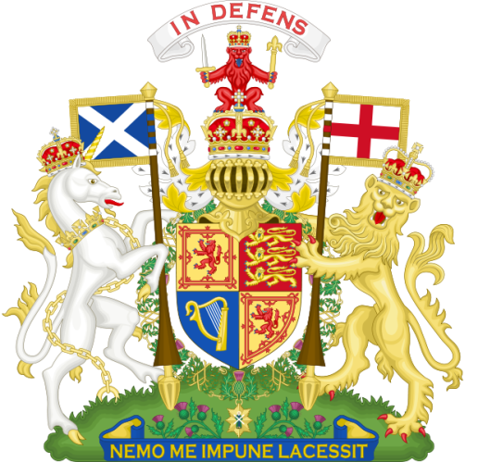
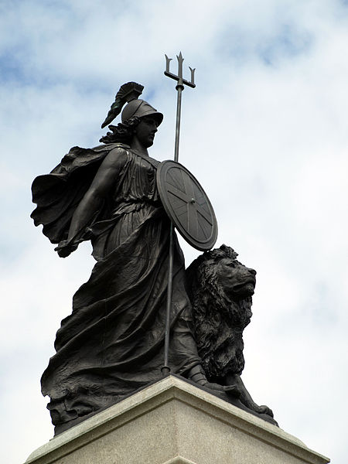
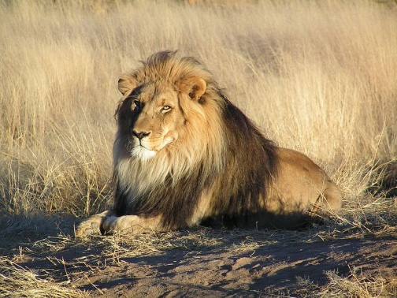
Symbols of the United Kingdom of Great
Britain and Northern Ireland
Union Jack
National personification
National
animal
Coat of arms
Motto «God and my right» (as used in England, Northern Ireland & Wales)

Slide 4
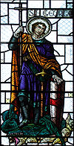
England
Flag of
England
St.George
Tudor rose
Lion
Royal arms
Motto "God and my right"

Slide 5
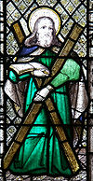
Scotland
Flag of Scotland
St.Andrew
Thistle
Unicorn
Royal arms
Motto
"In Defence"

Slide 6
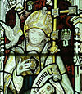
Wales
Flag of Wales
St.David
Daffodil
Red dragon
Royal badge
Motto "Wales forever"

Slide 7
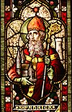
Northern Ireland
Flag of Northern Ireland
St.Patrick
Shamrock
Bulldog
Coat of arms

