Slide 1
Daily Routine
Notes:
you snooze, you lose an expression which states that anyone will miss out on a great opportunity if they don't remain aware or open to communication.
"I tried to call you about those concert tickets, but there was no answer...guess you were still crashed out.... so I took Marsha instead.
We had an awesome time, both at the show AND afterwards! :)"
"oh well, you snooze you lose I guess."

Slide 2
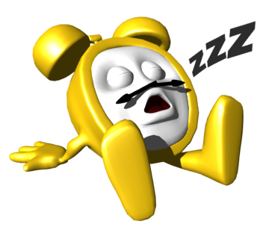
press the snooze button

Slide 3
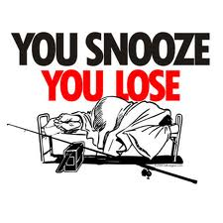

Notes:
you snooze, you lose is an expression which states that anyone will miss out on a great opportunity if they don't remain aware or open to communication.
"I tried to call you about those concert tickets, but there was no answer...guess you were still crashed out.... so I took Marsha instead.
We had an awesome time, both at the show AND afterwards! :)"
"oh well, you snooze you lose I guess."

Slide 4
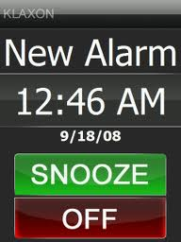
Set up/ turn off the alarm
Notes:
Set up – snooze button; turn off – off button

Slide 5
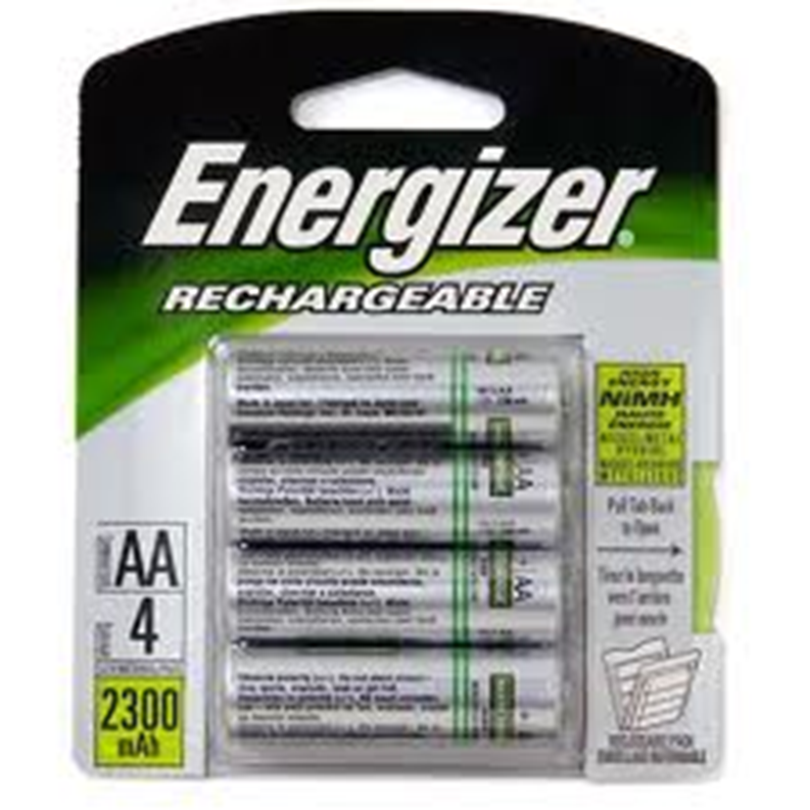
To recharge a cell-phone

Slide 6
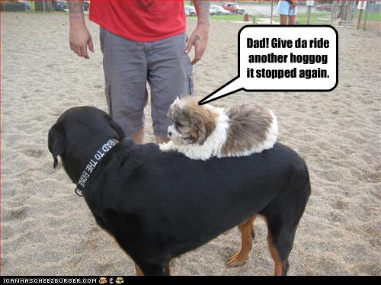
To give smb. a ride
Notes:
Ride = ездить верхом, подвозить

Slide 7
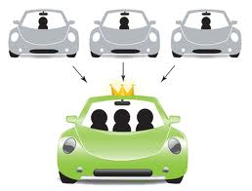
To carpool with smb.

Slide 8


Slide 9

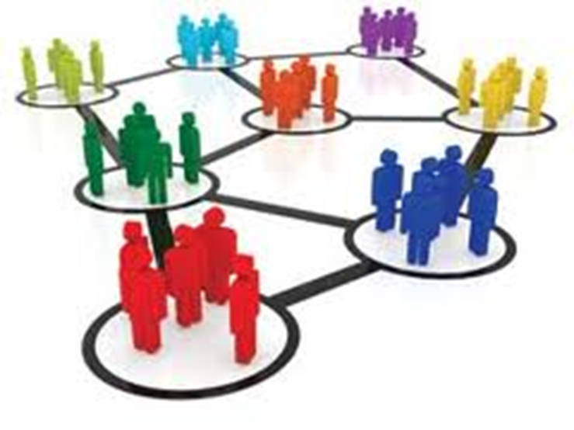
To spent time in social nets

Slide 10
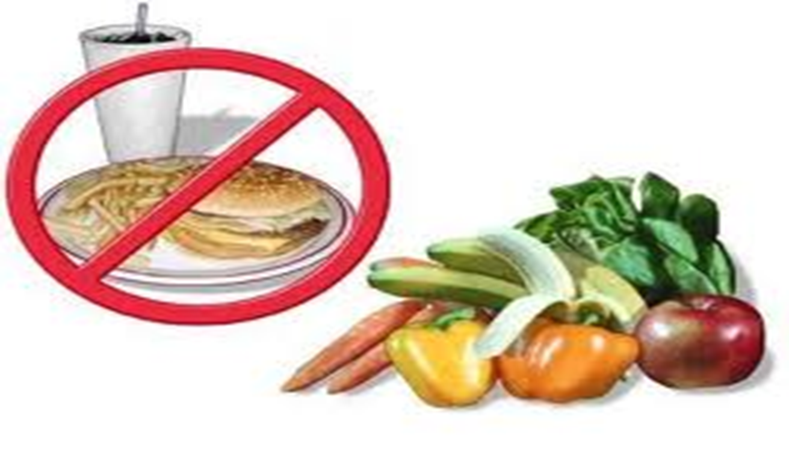
To eat healthy food and avoid junk food

Slide 11
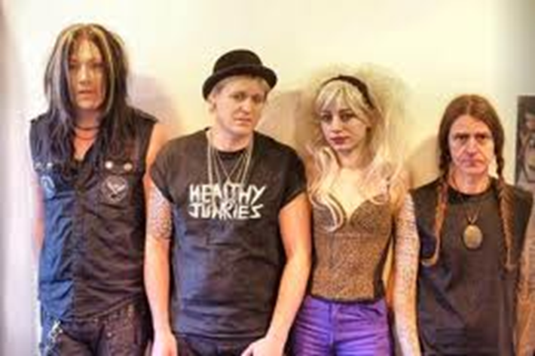
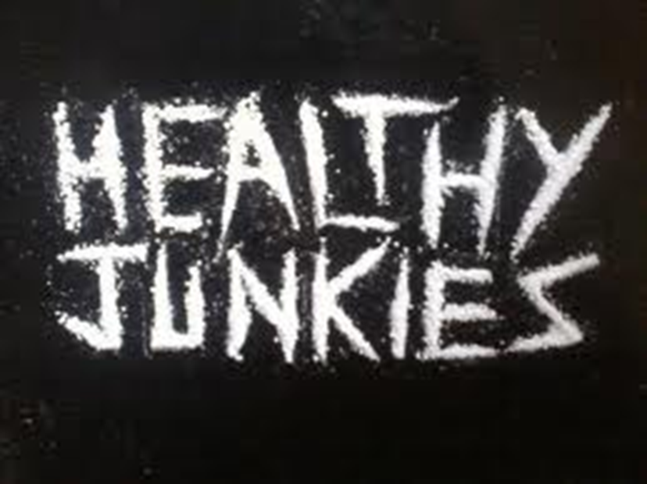
Notes:
Healthy junkies – famous rock group. What does this name mean?

Slide 12

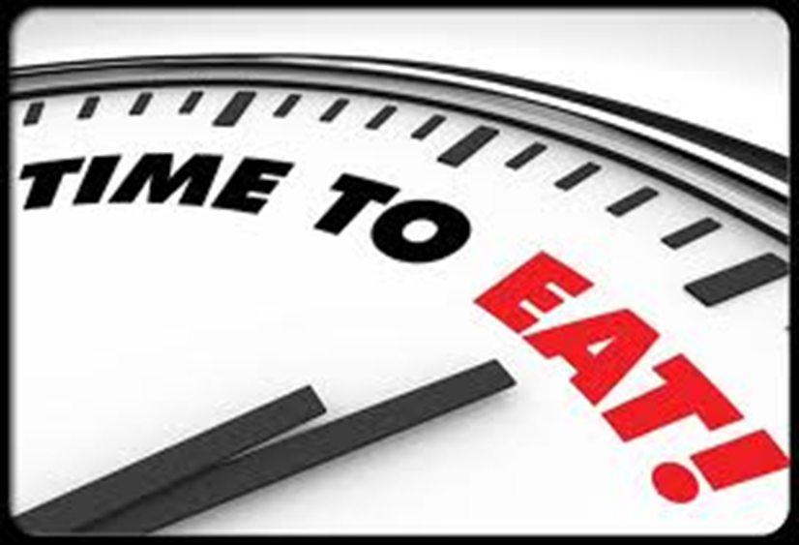
No snacks instead of regular meals
Notes:
The No S Diet – no snacks, no sweets, no seconds (консервы). You MUST keep this diet on the days that do not start with S! (You can eat all this on Saturday and Sunday = weekend valve).

Slide 13
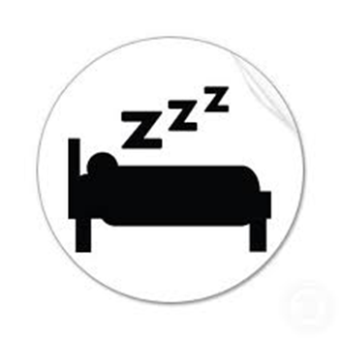


Pet-free and electronics-free sleep

Slide 14


Slide 15

To get along with…
Notes:
Long row

Slide 16
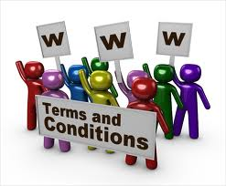

To be in good terms with …
Notes:
Terms and conditions; terms of use – to be in good terms with

Slide 17
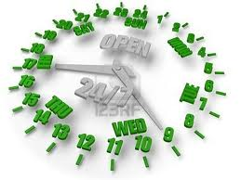
To work around the clock 24/7

Slide 18
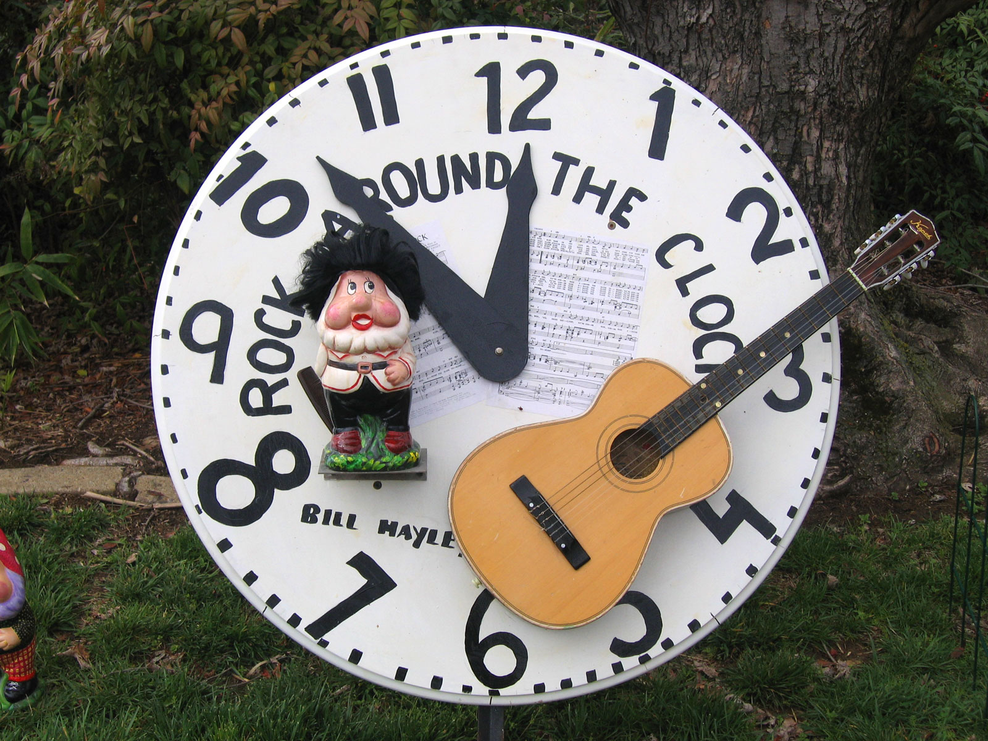

Slide 19


Slide 20
Around the clock bridal shower
At an around-the-clock shower each guest is assigned a time of day to which they will purchase a coordinating gift. You can have multiple guests do the same time for a larger category like dinnertime, etc. Not sure what to get for which hour? Here are some great suggestions:
8 AM – toaster, potholders, tea set, coffee maker
9 AM – towels, bath accessories, bubble bath
10 AM – workout clothes, weights
12 PM – bbq set, dinnerware, games
7 PM – cocktail set, wine, silverware, dinnerware
10 PM – lingerie, bath oils, books

Slide 21
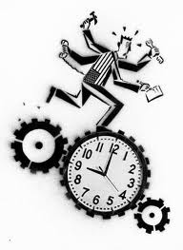
To work overtime
Notes:
He is OVER time

Slide 22

Notes:
Overtime in football = additional time after the match

Slide 23
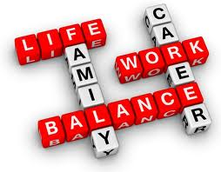
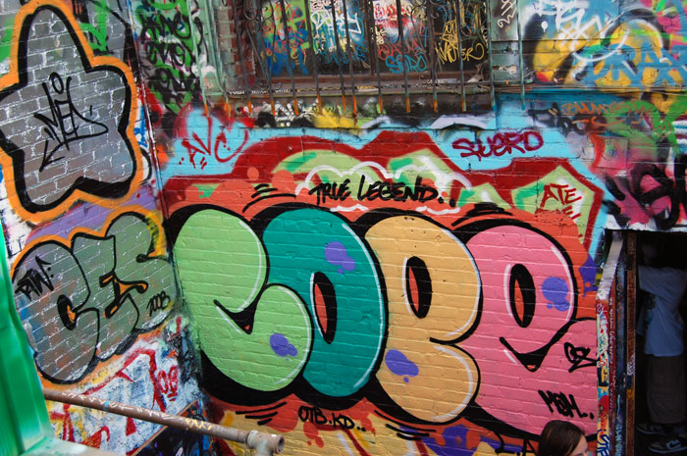

To cope with work properly

Slide 24
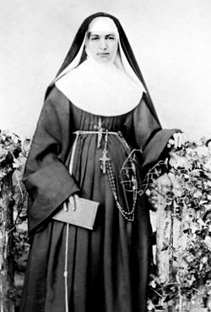
Marianne Cope, known as the Saint Marianne of Molokaʻi, was a German-born American
who was a member of
the Sisters of Saint Francis
of Syracuse, New York.
She spent many years caring for
the lepers on the island of
Molokaʻi in Hawaiʻi.

Slide 25
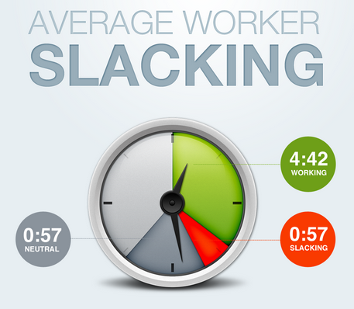
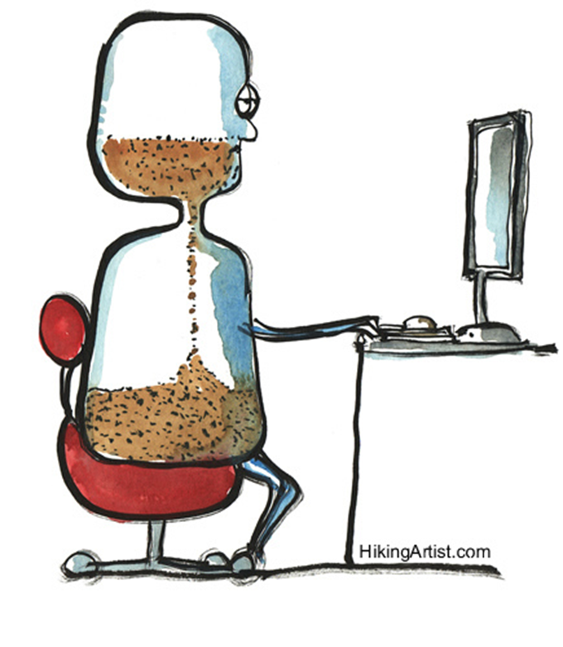
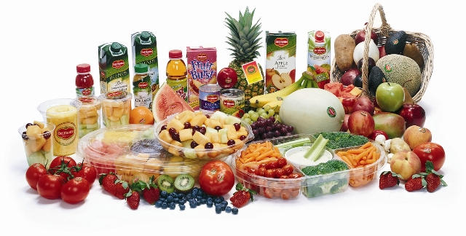
To spend time productively
Notes:
Slacking = lacking in activity, not busy

Slide 26
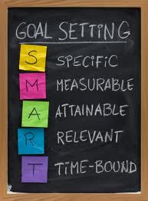

To set a goal and have a break after it

Slide 27
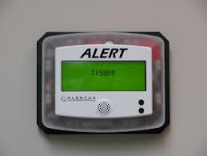

To use most alert time for studying

Slide 28
Proverbs and Sayings

Slide 29
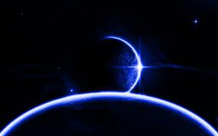
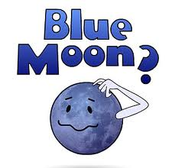
Once in a blue moon

Slide 30
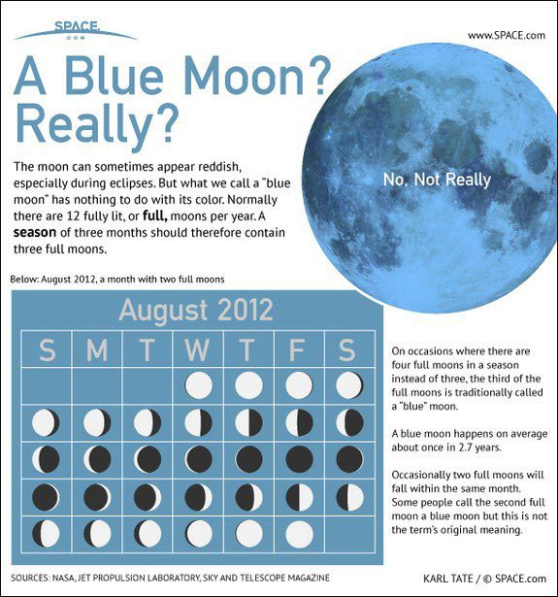

Slide 31
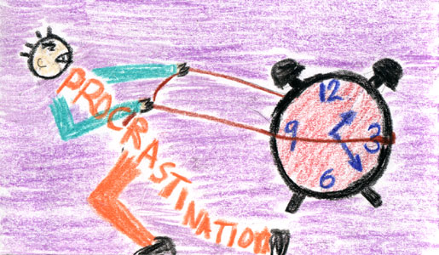
Procrastination is a thief of time

Slide 32
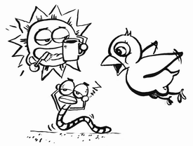
The early bird catches the worm

Slide 33
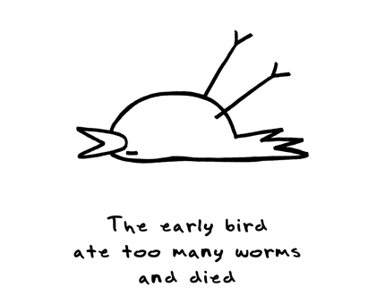

Slide 34
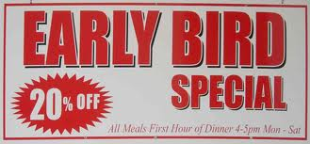

Notes:
Businesses offer discounts for those, who buy early

Slide 35

Early to bed, early to rise make a man healthy, wealthy and wise

Slide 36
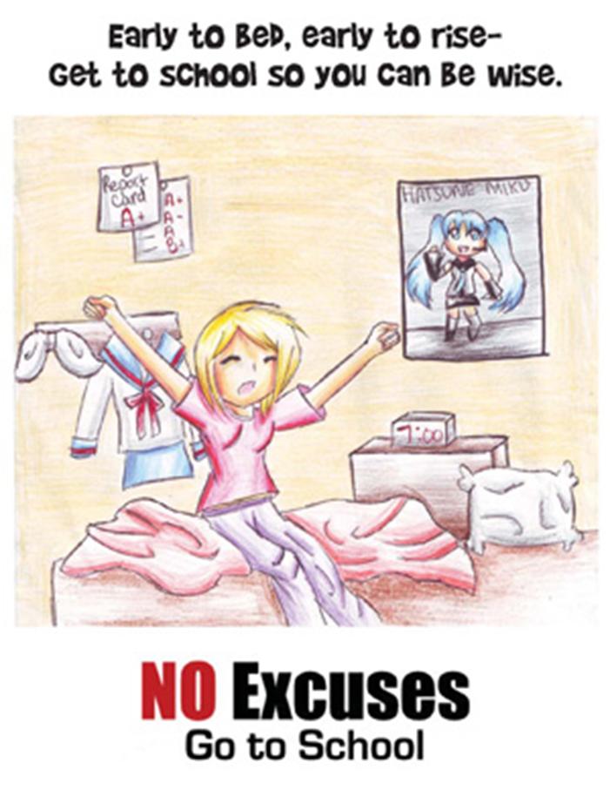

Slide 37
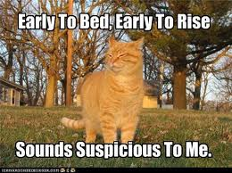

Slide 38


Slide 39

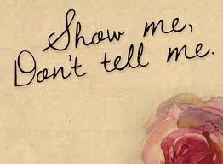
Actions speak louder than words

Slide 40
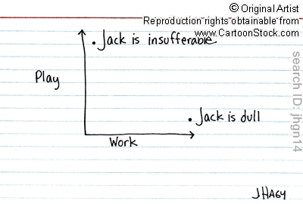
All work and no play makes Jack a dull boy

Slide 41
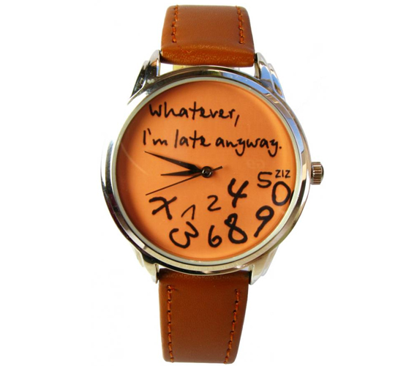
Better late than never

Slide 42
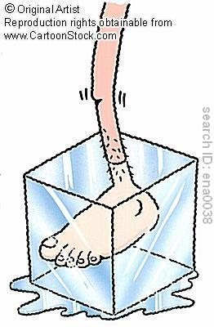

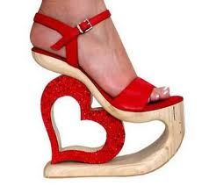
Cool smb.’s heels

Slide 43
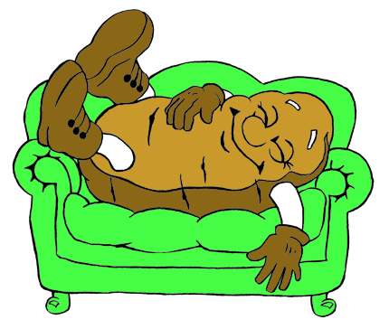
Couch potato

Slide 44
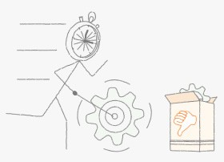
Haste makes waste

Slide 45
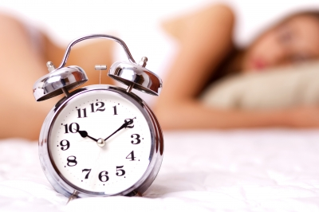
One hour sleep before midnight is worth two after

Slide 46
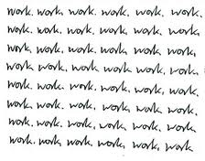
To be a workaholic

Slide 47
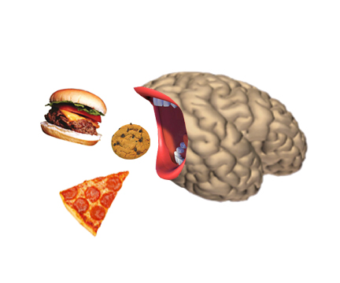
Food for thought

Slide 48
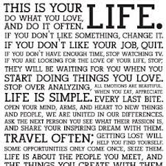
It’s easier said than done

Slide 49
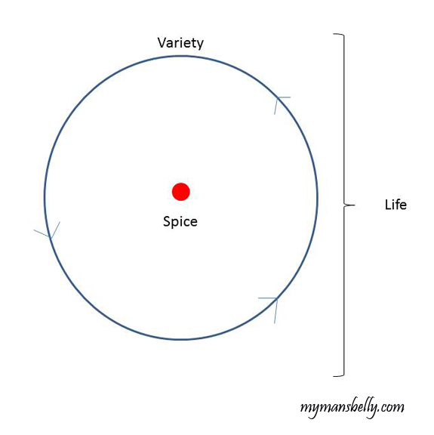
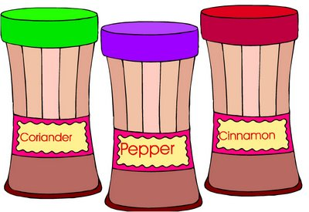
Variety is the spice of life

Slide 50
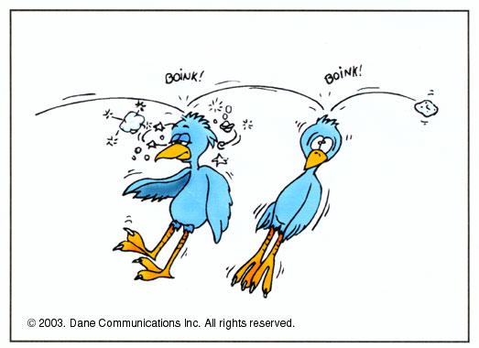
Kill two birds with one stone

Slide 51
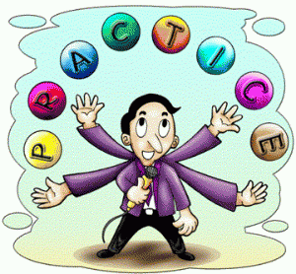
Practice makes perfect

Slide 52
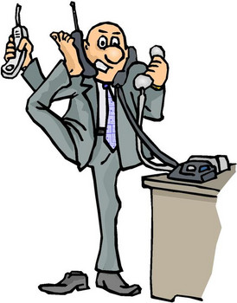
Life is hectic nowadays

Slide 53
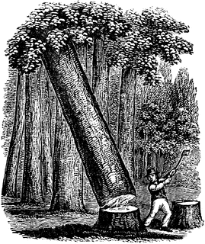
Little strokes fell great oaks

