Slide 1
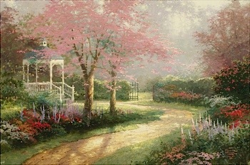
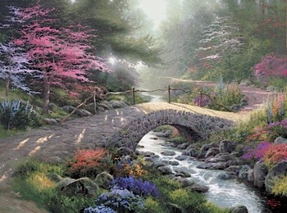
Thomas Kinkade
Thomas Kinkade: paintings and wonderful biography

Slide 2
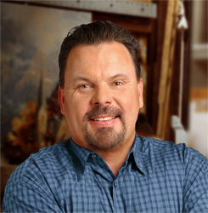
Thomas Kinkade (January 19, 1958 – April 6, 2012)[ was an American painter of popular realistic, bucolic, and idyllic subjects. He is notable for the mass marketing of his work as printed reproductions and other licensed products via The Thomas Kinkade Company. He characterized himself as "Thomas Kinkade, Painter of Light," a phrase he protected through trademark but one originally attributed to the English master J.M.W. Turner(1775–1851). It is estimated that 1 in every 20 American homes owns a copy of one of his paintings.

Slide 3
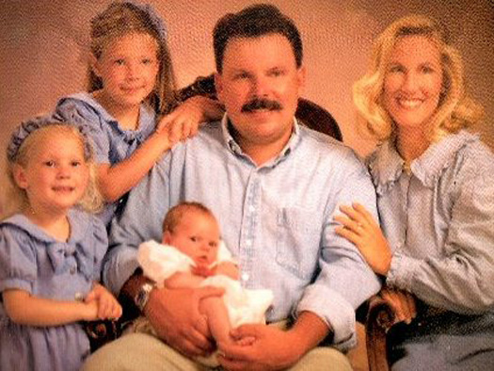
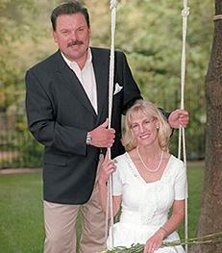

Slide 4
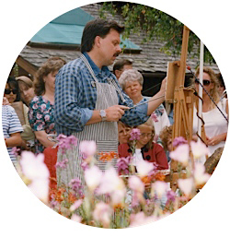
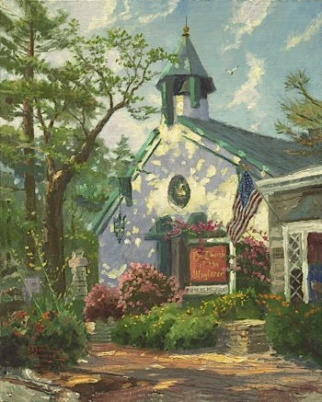
There's a grain of truth in every joke.

Slide 5
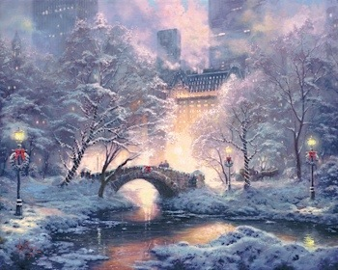
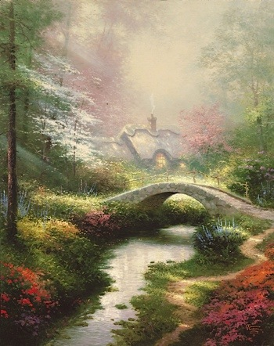
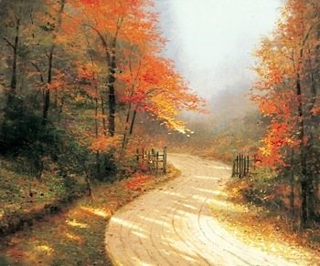

Slide 6
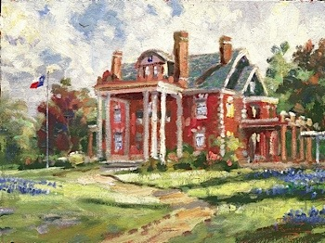
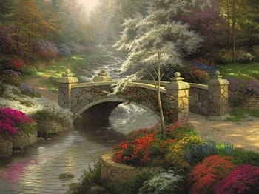
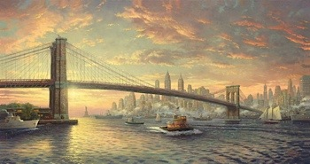
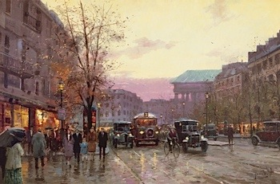

Slide 7
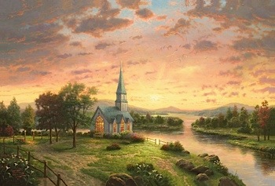
"I am a devout Christian . Spirituality - is what brings me inspiration ." "I consider it my duty to the artist through my music appeal to all people , no matter what denomination they belong to . Fact that I paint, carries a message of peace and joy for all people. "

Slide 8
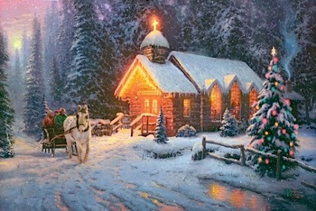
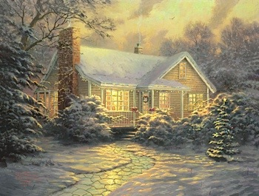
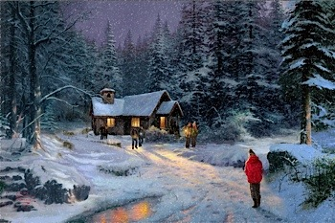

Slide 9

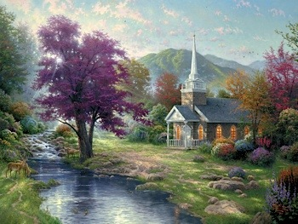

Slide 10
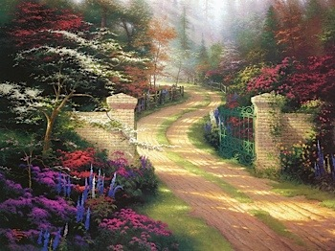



Slide 11
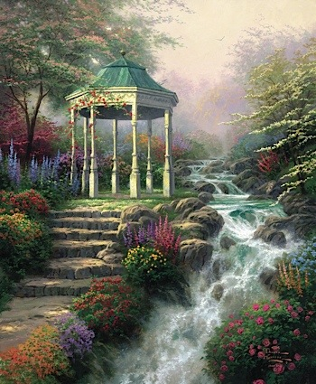
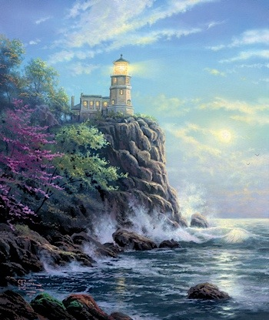

Slide 12


Slide 13
THE
END

