Slide 1
Denmark
Customs and traditions

Slide 2
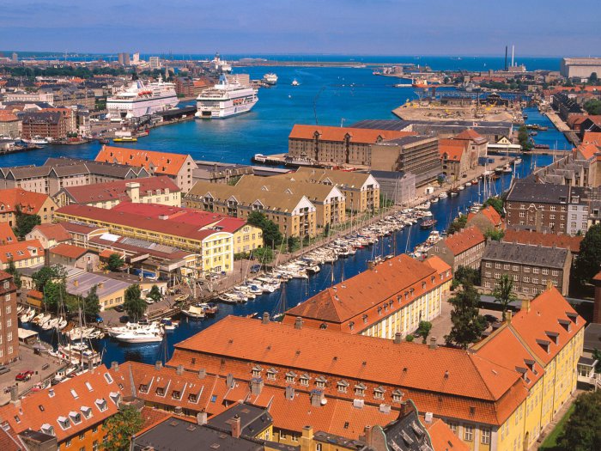
Kingdom of Denmark - a small European country - the smallest and southernmost of the Nordic kingdom. Denmark is a constitutional monarchy in the northwestern part of Europe. The country occupies the Jutland peninsula and 406 islands in the straits and seas of the North and Baltic Seas. The Kingdom of Denmark also includes the rights of autonomy Faroe Islands and the world's largest island is Greenland.

Slide 3
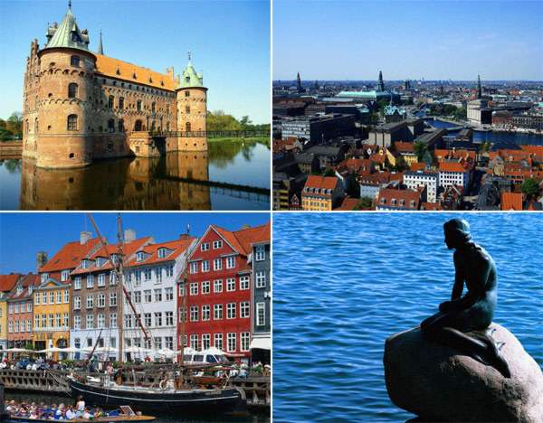

Slide 4
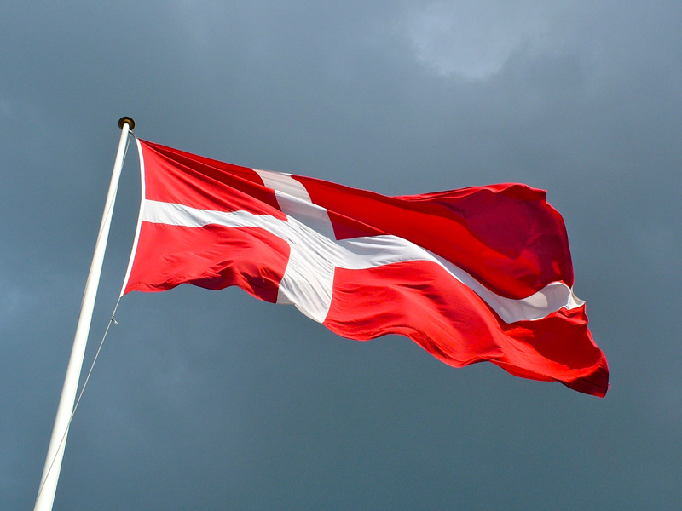
Denemark- customs and traditions
Denmark was once part of Sweden, but now the Scandinavians themselves Danes are considered the people of the southern nature, they are more alive and active. Traditionally, the Danes love their Queen, his home and his beer.

Slide 5
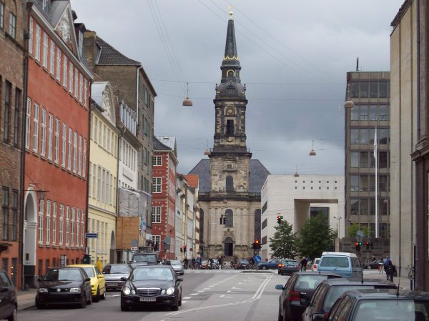
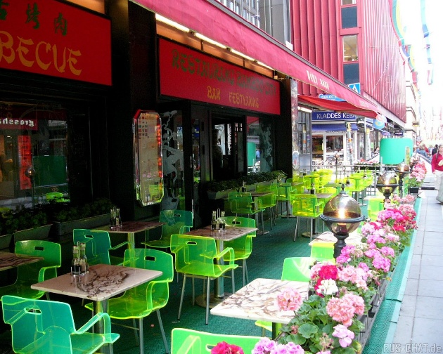
Danes respect the laws and it is very afraid of prison, though many residents of the more backward countries, they seem resort. Danes strictly enforce order everywhere, but such rules do not reach the point of absurdity, for example, in Sweden, where a dumped rubbish in the wrong place can accompany the police station and then to jail.

Slide 6
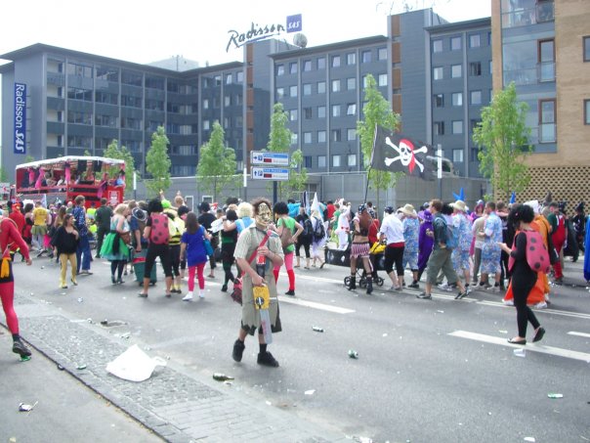
It is believed that in Denmark, motorists do not follow the rules of the road, just like the Italians, it is absolutely ridiculous looking information that is prohibited by local dogs barking, and postmen on public money to buy them treats to coax a particularly evil representatives of these four-legged friends of man. Marriage in Denmark is concluded only after the wedding night to morning. If you come to visit the Dane does not necessarily have to skimp on the words of gratitude and praise for the comfort of home and dinner, in response to thank the hosts will know no bounds

Slide 7
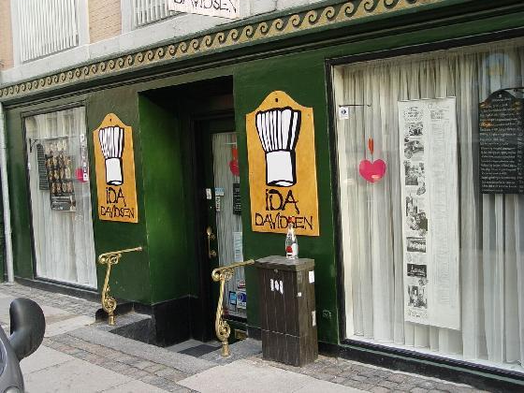
I note the Danish tradition in the form of food here than anywhere else in the world of popular sandwiches and snacks, so we think all Danes are fed, as it were dry rations. However, in Denmark, Scandinavian food restaurants are very popular with both local and foreigners, who go to Copenhagen only in order to go to the national gourmet restaurant and leave for lunch to thousands of euros.

Slide 8
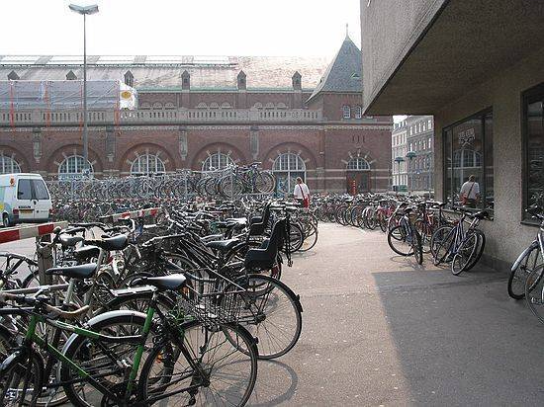
Despite the fact that Denmark is a Nordic country bikes are popular here, about thirty percent of local residents, both in cities and in villages commute to work on bicycles in Copenhagen every step possible to see the big crowded bike parking. Traditional sports for the Danes is football, skiing, and golf as no surprise.

Slide 9
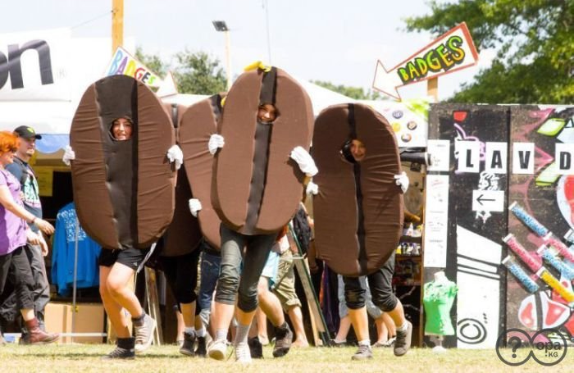
In a country marked the ever popular festivals that are revered in our country. I note the unusual Viking Festival in Frederikssund, on the island of Zealand in the summer with various battles and competitions, the event ends with a large traditional feast.

Slide 10
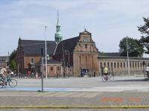
Many employers feed their workers. Money is deducted from the salaries of employees in the amount of 50 euros. Depending on the employer, the amount can vary.
In a large percentage of Denmark buses with free Wi-Fi, and offers use it is only from residents of the state.
As of Denmark no skyscrapers. Only in major cities such as Copenhagen has several buildings up above the 6th floor.
As of Denmark do not consume buckwheat, halva , pickled cucumber, curd , yogurt , on sale , often, is just one type of cooked sausages , as well as one type of cheese. Not made ​​to hang on the window curtains and net curtains.
Drugs without prescription no buy.
As of Denmark in the rain people do not use umbrellas .
Every Sunday in special stores special folders are created with information about discounts on goods from stores addresses of all networks. Any person reviewing the information on where and what discounts are then subject goes to the addresses knowing what and where to buy it .
Denmark is the first country in the world that has established additional taxes on fatty foods with saturated fats. So the government is trying to combat cardiovascular disease . All products are subject to taxation , fat content exceeding 2.3%. The new tax is about $ 3 per kilogram of saturated fat in foods such as cheese , butter, meat, milk , chips and pizza.

Slide 11
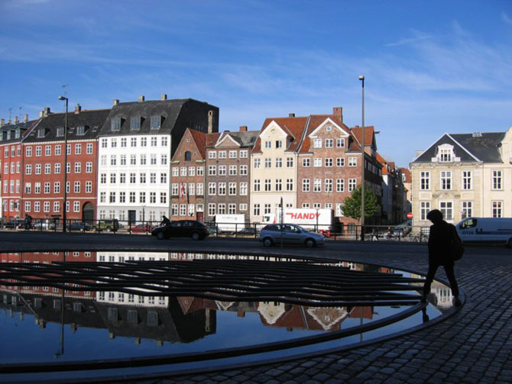
Conclusion
So Denmark is fairy country with crazy festivals, very interesting customs and traditions. The Danes are proud of their butter and unusually tasty bacon, and children of all countries in awe of the Danish national game of building blocks called Lego.

Slide 12
