Slide 1
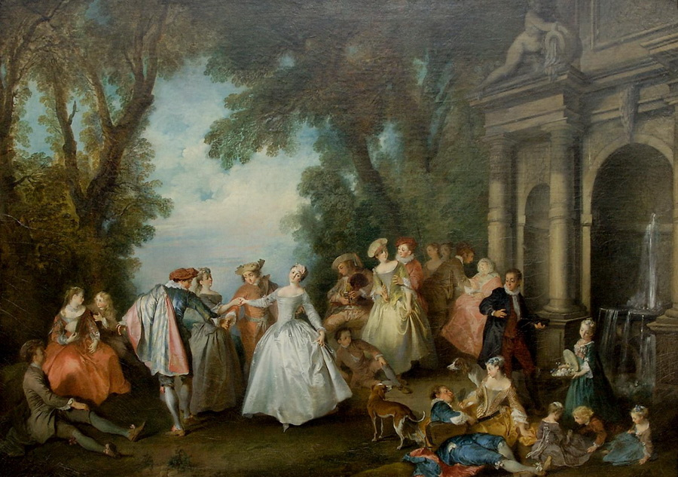
Jane Austen
“First lady” of English literature
By Liz Prishchepa

Slide 2
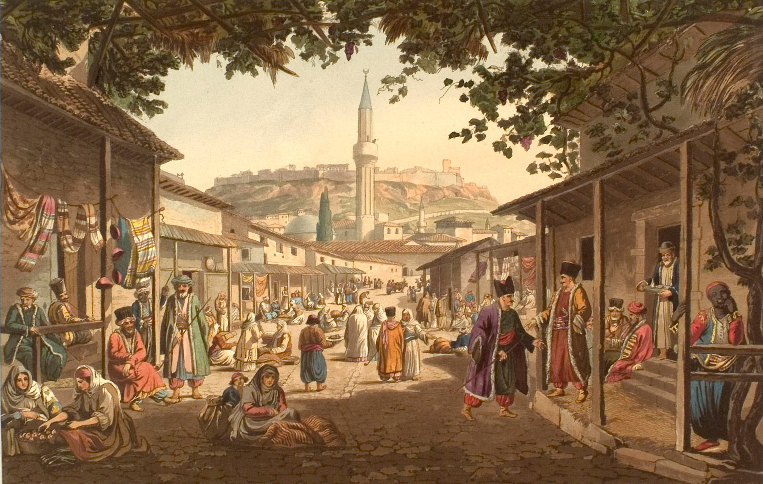
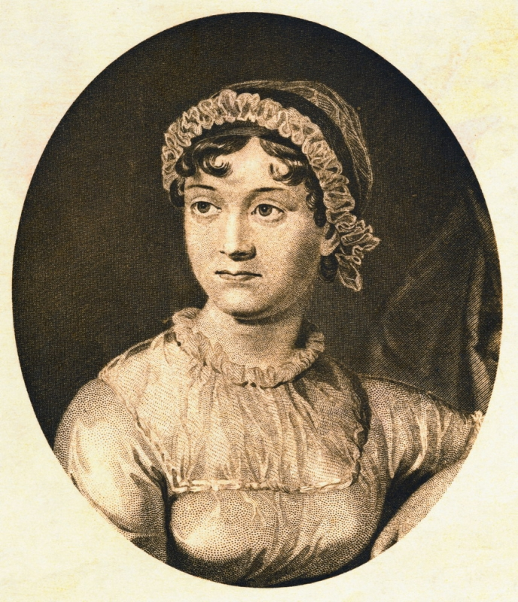
Main information
Jane Austen - (16 December 1775 – 18 July 1817) was an English novelist whose works of romantic fiction earned her a place as one of the most widely read writers in English literature.

Slide 3
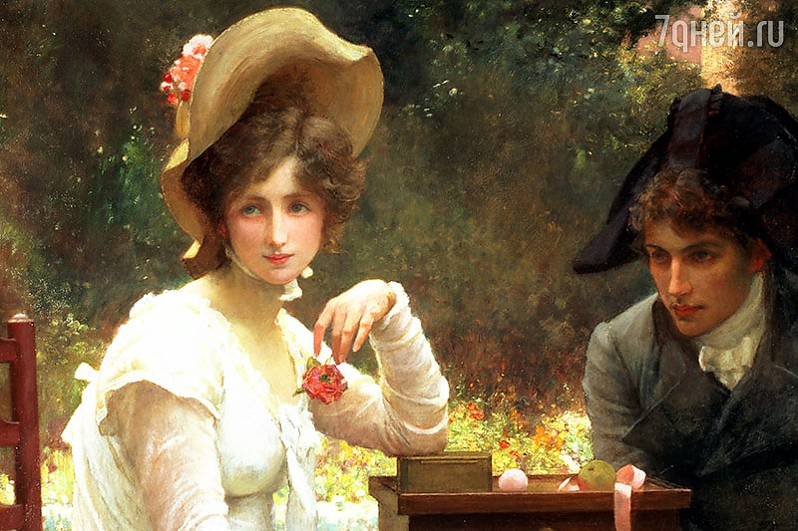

Family
She was born on the 16th of December, 1775 in the village of Steventon, Hampshire. Here were written her first novels: «Pride and Prejudice», «Sense and Sensibility», «Northanger Abbey», although they have not been published for a very long time. Her father, George Austen, was a priest. And her mother was from a noble, but impoverished family. Except Jane there were six boys and one girl.

Slide 4
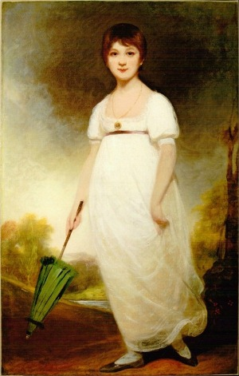
Jane Austen was never married, and all the inventory of not dissipated maternal love transferred to the numerous nieces and literary creations. She called the novel "Pride and Prejudice" "the beloved child".
According to a survey of modern authors who write romance novels, her book "Pride and Prejudice" is the best novel of the genre of all time, but in first time it was rejected by a publisher who found it boring and insignificant.

Slide 5
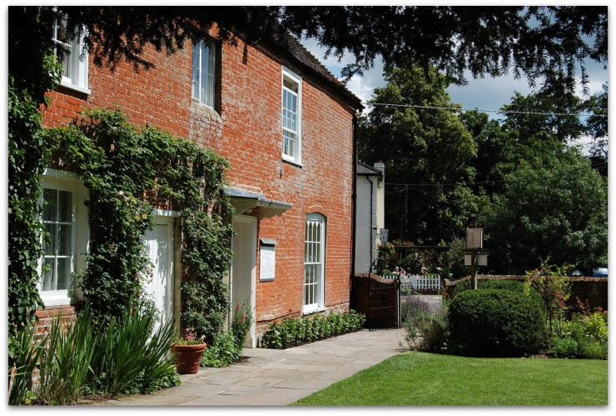
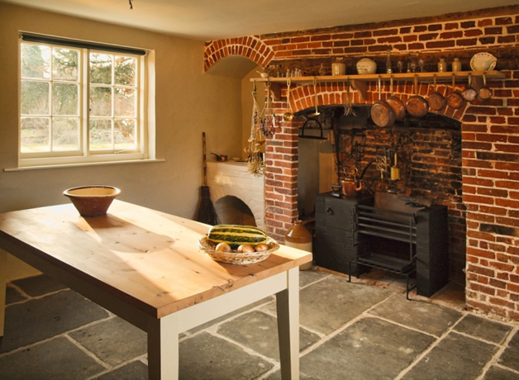
House Museum Jane Austen
House Museum Jane Austen is a small private museum in the village of Chawton. Here the writer Jane Austen spent the last eight years of his life writing "Mansfield Park", "Emma" and "Persuasion."

Slide 6

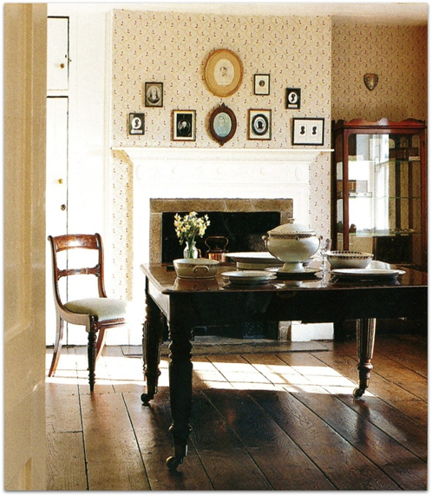
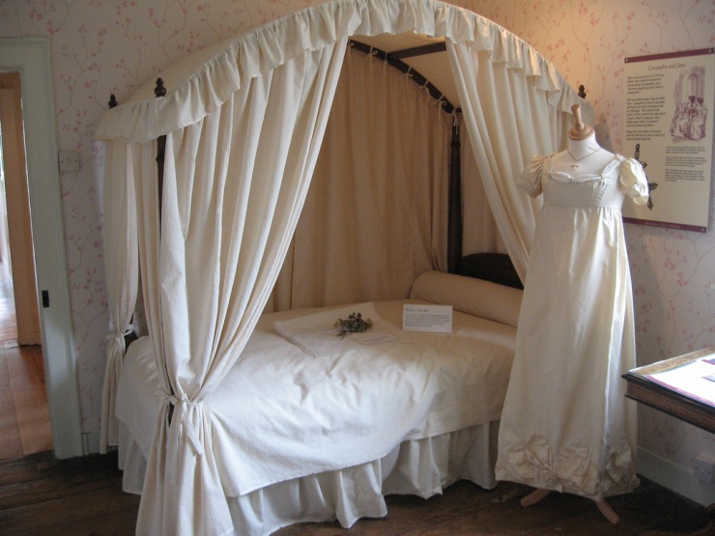
House Museum Jane Austen

Slide 7
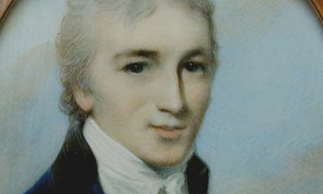
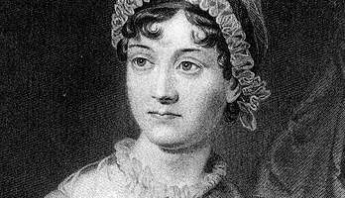
Love story
When Jane was 20 years old, she had an affair with the neighbor, Thomas Lefroyem, future Lord the Supreme Judge of Ireland, and those years the law student. However marriage of young people would be impractical as both families were rather poor, therefore Jane and Tom have to split up with each other. Later she put on a cap, having declared thereby that from now she is the old maid, who said goodbye to hopes for personal happiness, though once the proposal was made to her.

Slide 8
List of works
Novels
Sense and Sensibility (1811)
Pride and Prejudice (1813)
Mansfield Park (1814)
Emma (1815)
Northanger Abbey (1818, posthumous)
Persuasion (1818, posthumous)
Short fiction
Lady Susan (1794, 1805)
Unfinished fiction
The Watsons (1804)
Sanditon (1817)
Other works
Sir Charles Grandison (adapted play) (1793, 1800)
Plan of a Novel (1815)
Poems (1796-1817)
Prayers (1796-1817)
Letters (1796-1817)

Slide 9
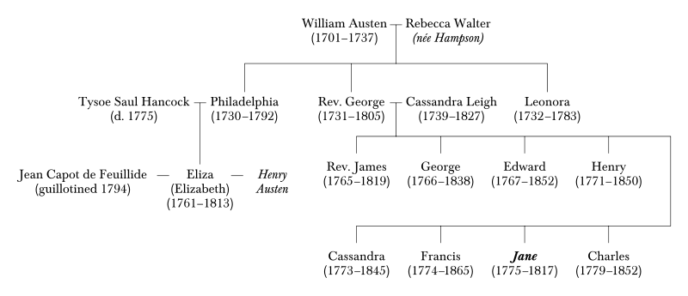
William Austen family tree two generations

Slide 10



adaptations

Slide 11


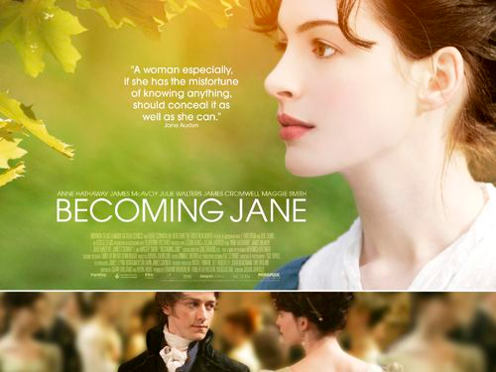
Filmography about Jane Austen
«The Real Jane Austen», 2002;
«Miss Austen Regrets», 2007;
«Jane Austen», 2007;
«Jane Austen Book Club», 2007.

