Slide 1
WWF
World wide fund

Slide 2
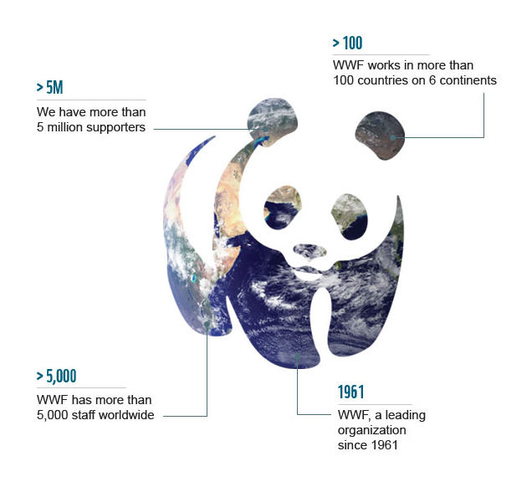
WWF's mission is to conserve nature and reduce the most pressing threats to the diversity of life on Earth.
Our vision is to build a future in which people live in harmony with nature.

Slide 3
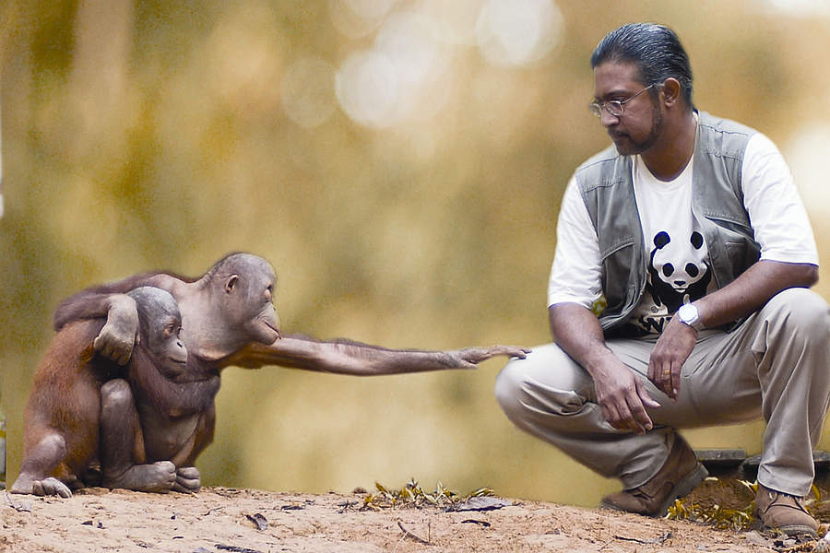
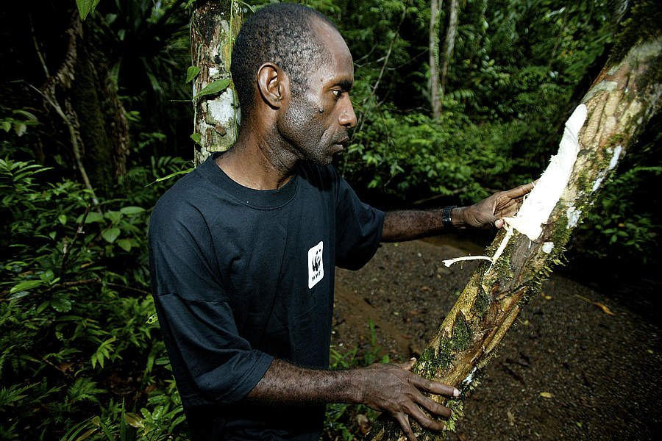
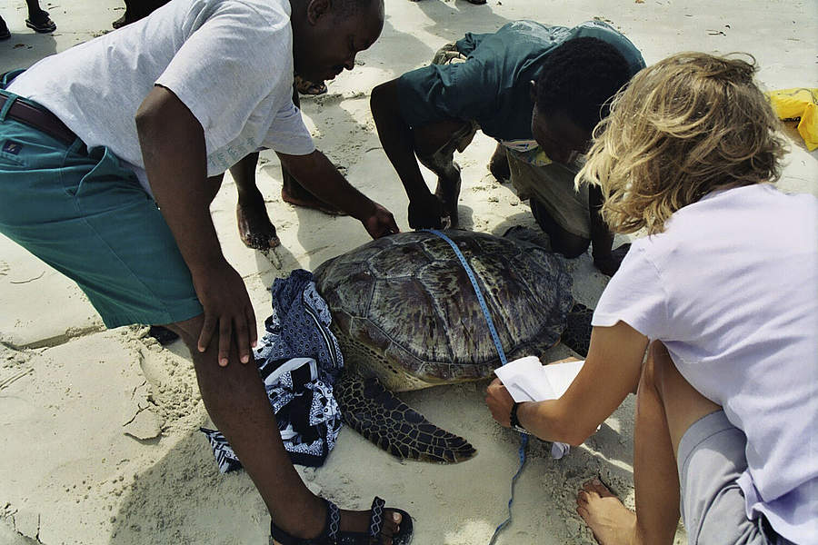
STRATEGIC PLAN
Combining traditional conservation with humanity’s unstable use of natural resources
Focusing efforts on the most important places, species, and footprint areas
Integrating this work from the local level to the global
Taping into the enormous power we all have to protect biodiversity and steer the world towards stability

Slide 4
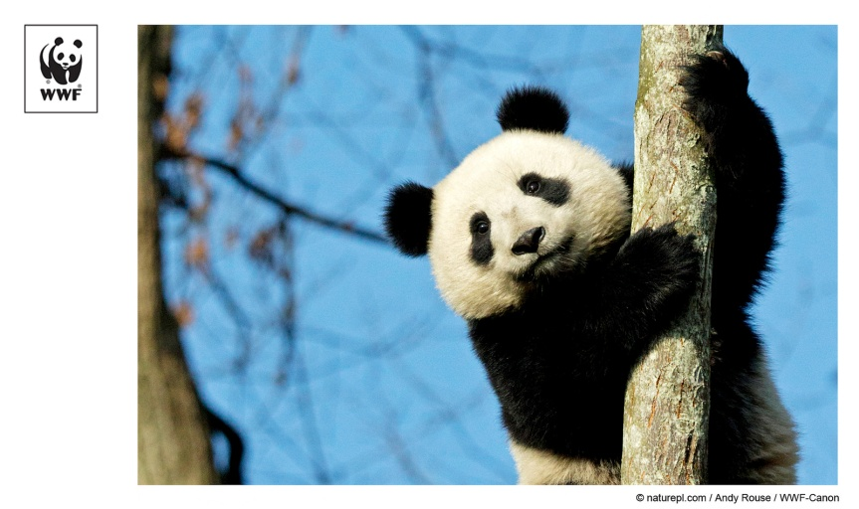
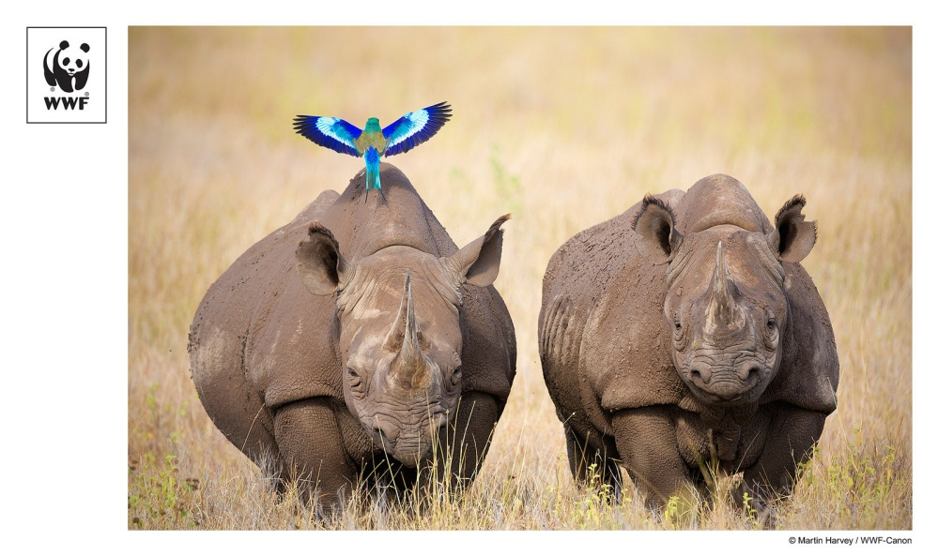
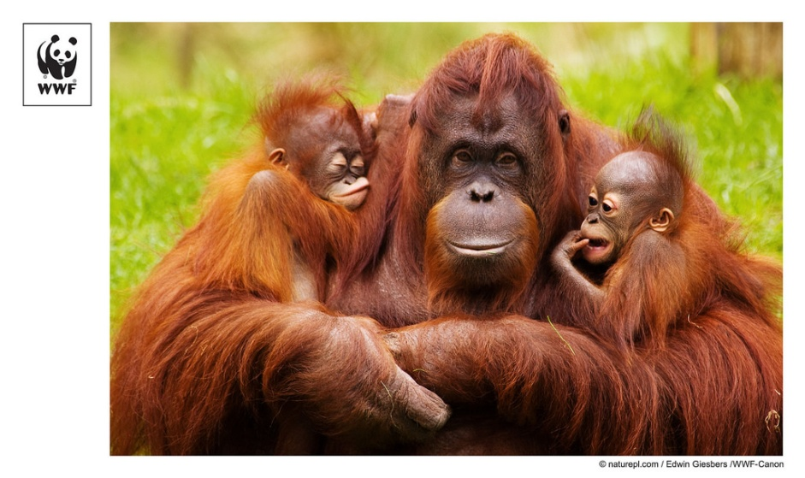
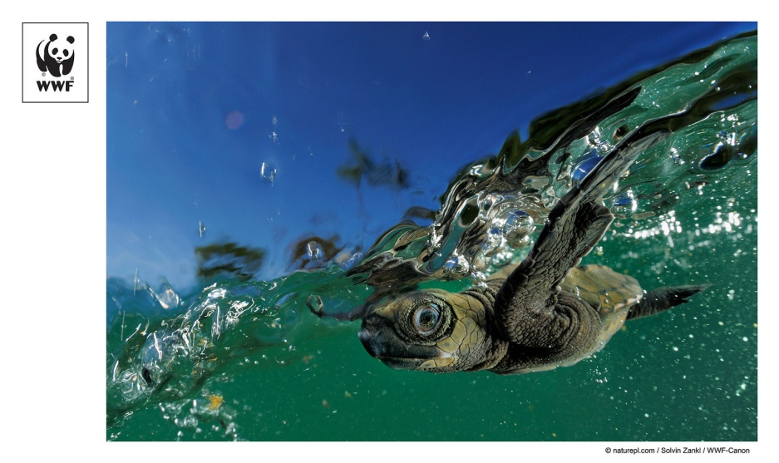
A BRIGHTER FUTURE
We seek to be the voice for those creatures who have no voice.

Slide 5
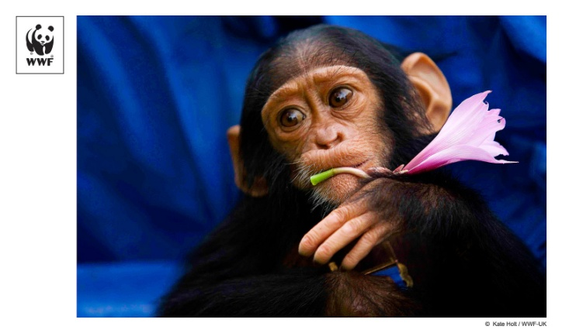
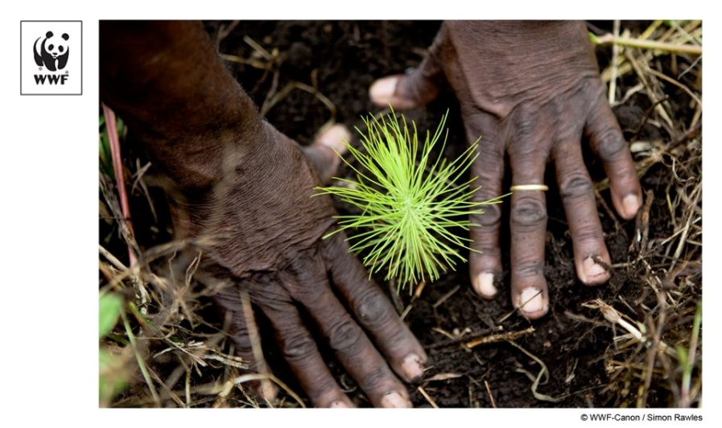
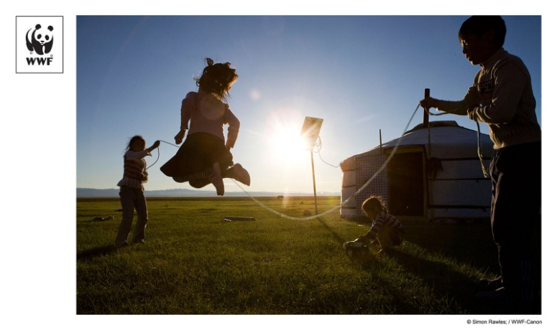
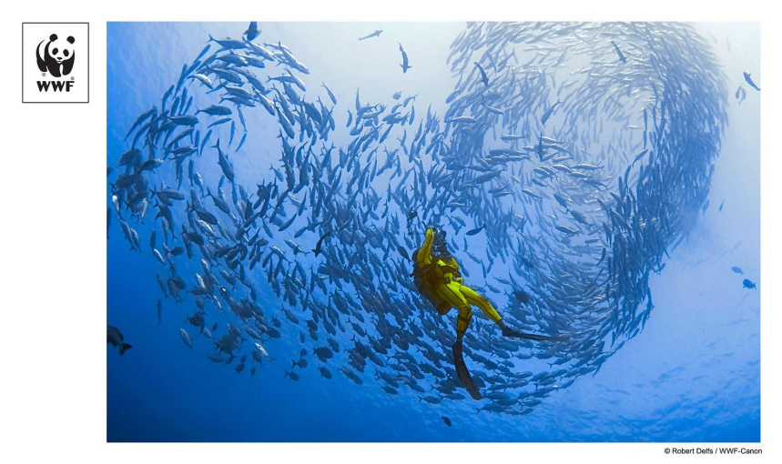
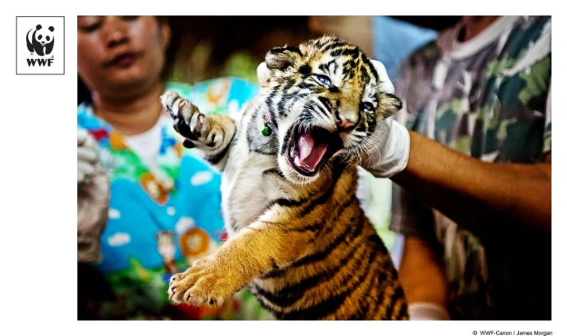
GOAL AND STRATEGIES
Protect and restore species and their habitats
Strengthen local communities' ability to conserve the natural resources they depend upon
Ensure that the value of nature is reflected in decisions made by individuals, communities, governments and businesses
Mobilize hundreds of millions of people to support conservation

