Slide 1
Education in England
Suharskaya Olga
10-v

Slide 2
Education in England
Education in England is overseen by the Department for Education and the Department for Business, Innovation and Skills. Local authorities take responsibility for implementing policy for public education and state schools at a local level.
The education system is divided into early years (ages 3–4), primary education (ages 4–11), secondary education (ages 11–18) and tertiary education (ages 18+).
Higher education often begins with a three-year bachelor's degree. Postgraduate degrees include master's degrees, either taught or by research, and the doctorate, a research degree that usually takes at least three years. Universities require a Royal Charter in order to issue degrees, and all but one are financed by the state via tuition fees, which cost up to £9,000 per academic year for English, Welshand EU students.

Slide 3
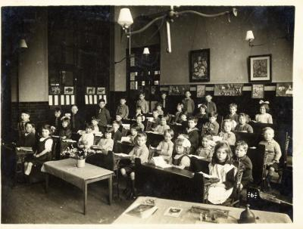
History of English education
Until 1870 all schools were charitable or private institutions, but in that year the Elementary Education Act 1870 permitted local governments to complement the existing elementary schools, to fill up any gaps. The Education Act 1902 allowed local authorities to create secondary schools. The Education Act 1918 abolished fees for elementary schools.

Slide 4
Primary and secondary education
The school year begins on 1 September (or 1 August if a term starts in August). Education is compulsory for all children from the next "prescribed day" which falls either on or after their fifth birthday to the last Friday in June of the school year in which they turn 16. This will be raised, in 2013, to the year in which they turn 17 and, in 2015, to their 18th birthday.The prescribed days are 31 August, 31 December and 31 March.
State-funded school system
State-run schools and colleges are financed through national taxation, and take pupils free of charge between the ages of 3 and 18. The schools may levy charges for activities such as swimming, theatre visits and field trips, provided the charges are voluntary, thus ensuring that those who cannot afford to pay are allowed to participate in such events. Approximately 93% of English schoolchildren attend such schools.
A significant minority of state-funded schools are faith schools, which are attached to religious groups, most often the Church of England or the Roman Catholic Church.
There is also a small number of state-funded boarding schools, which typically charge for board but not tuition. Boarding fees are limited to £12,000 per annum.
Nearly 90% of state-funded secondary schools are specialist schools, receiving extra funding to develop one or more subjects in which the school specialices.

Slide 5
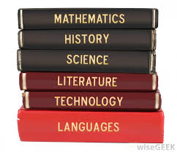
Curriculum
All maintained schools in England are required to follow the National Curriculum, which is made up of twelve subjects. The core subjects—English ,Mathematic and Science—are compulsory for all students aged 5 to 16. A range of other subjects, known as foundation subjects, are compulsory at one or more Key Stages:
Art & Design
Citizenship
Design & Technology
Geography
History
Information & Communication Technology
Modern Foreign Languages
Music
Physical Education
In addition, other subjects with a non-statutory programm of study in the National Curriculum are also taught, including Religious education in all Key Stages, and Career education and Work-related learning in Key Stages 3 and 4. Religious education within community schools may be withdrawn for individual pupils with parental consent. Similarly, parents of children in community schools may choose to opt their child out of some or all sex education lessons.

Slide 6
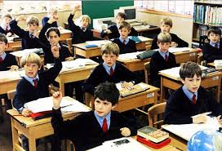
Independent schools
Approximately 7% of school children in England attend privately run fee-paying independent schools rising to 18% for sixth form students. Some independent schools for 13-18 year olds are known for historical reasons as 'public schools' and for 8-13 year olds as 'prep schools'. Some schools offer scholarships for those with particular skills or aptitudes, or bursaries to allow students from less financially well-off families to attend. Independent schools do not have to follow the National Curriculum, and their teachers are not required or regulated by law to have official teaching qualifications. ".

Slide 7
Specialist qualifications
The University of Birmingham, a 'Red Brick university'.
Education: Postgraduate Certificate in Education Certificate in Education , City and Guilds of London Institute, or Bachelor of Education most of which also incorporate Qualified Teacher Status
Law: Bachelor of Laws.
Medicine: Bachelor of Medicine, Bachelor of Surgery, studied at medical school
Business: Master of Business Administration
Psychology: Doctor of Educational Psychology or Clinical Psychology

