Slide 1
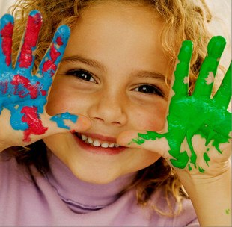
art world in the eyes of the young people
Made by Maryna Zimenko

Slide 2
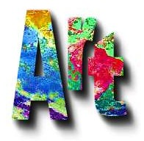
Here is information about:
Art and we: beauty will save the world
My visit to the Art Gallery
Creation of picture
national art treasures
My favorite picture

Slide 3
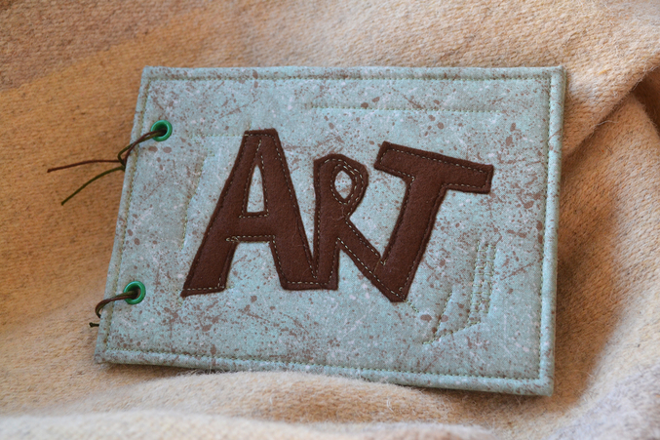

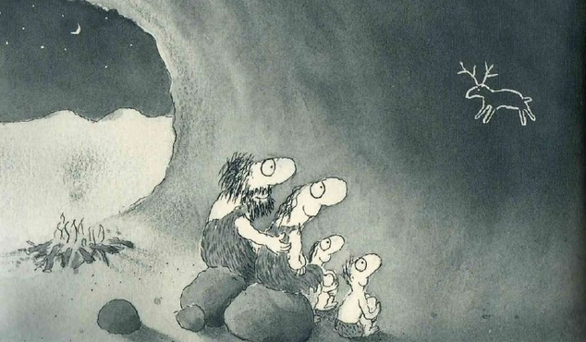
and
are very linked since ancient times.

Slide 4
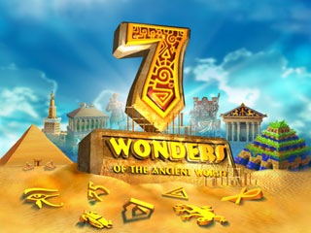
and
Agree with me that the world would not be as exciting and interesting without these wonders.

Slide 5
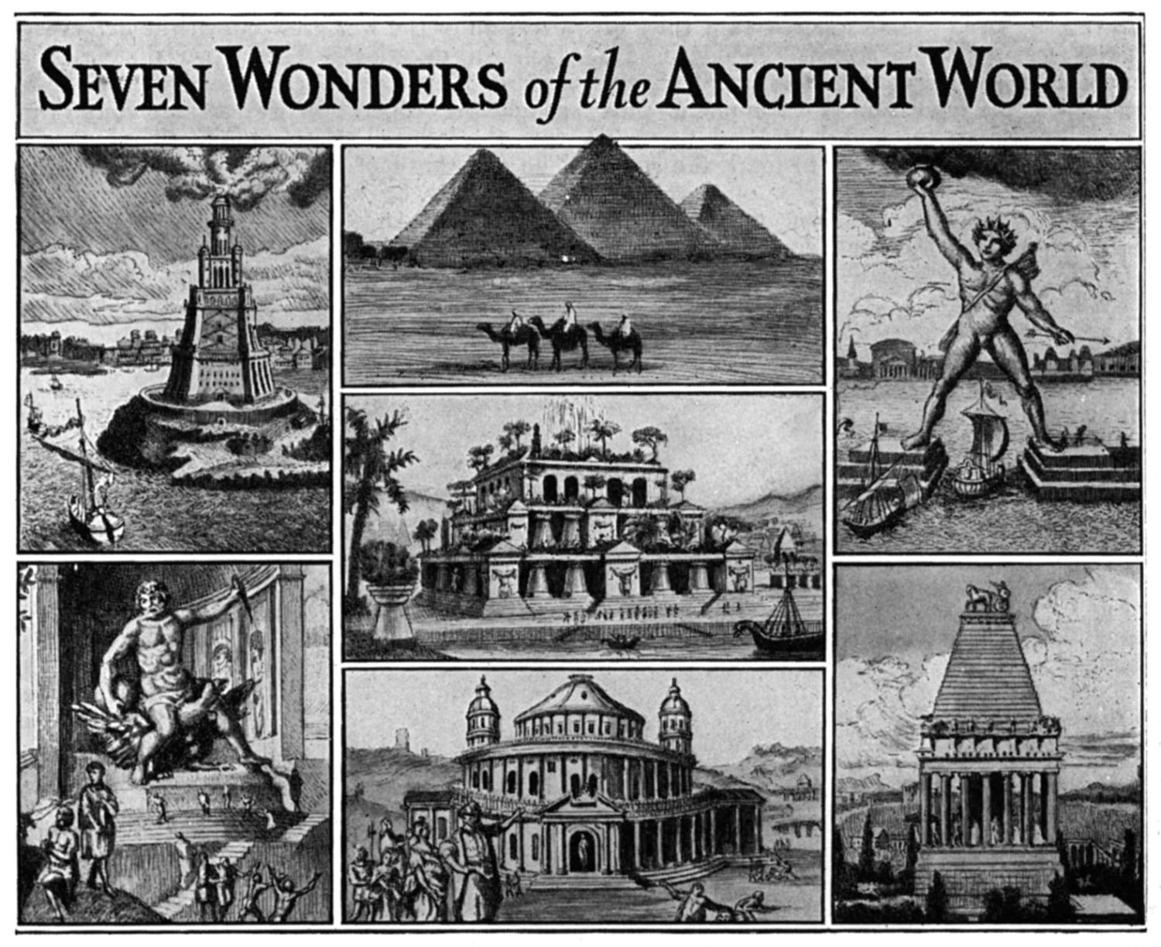
The Great Pyramid of Cheops
The Lighthouse of Alexandria
The Colossus of Rhodes
The Hanging Gardens of Babylon
The Statue of Zeus at Olympia
The Mausoleum at Halicarnassus
the Temple of Artemis at Ephesus

Slide 6
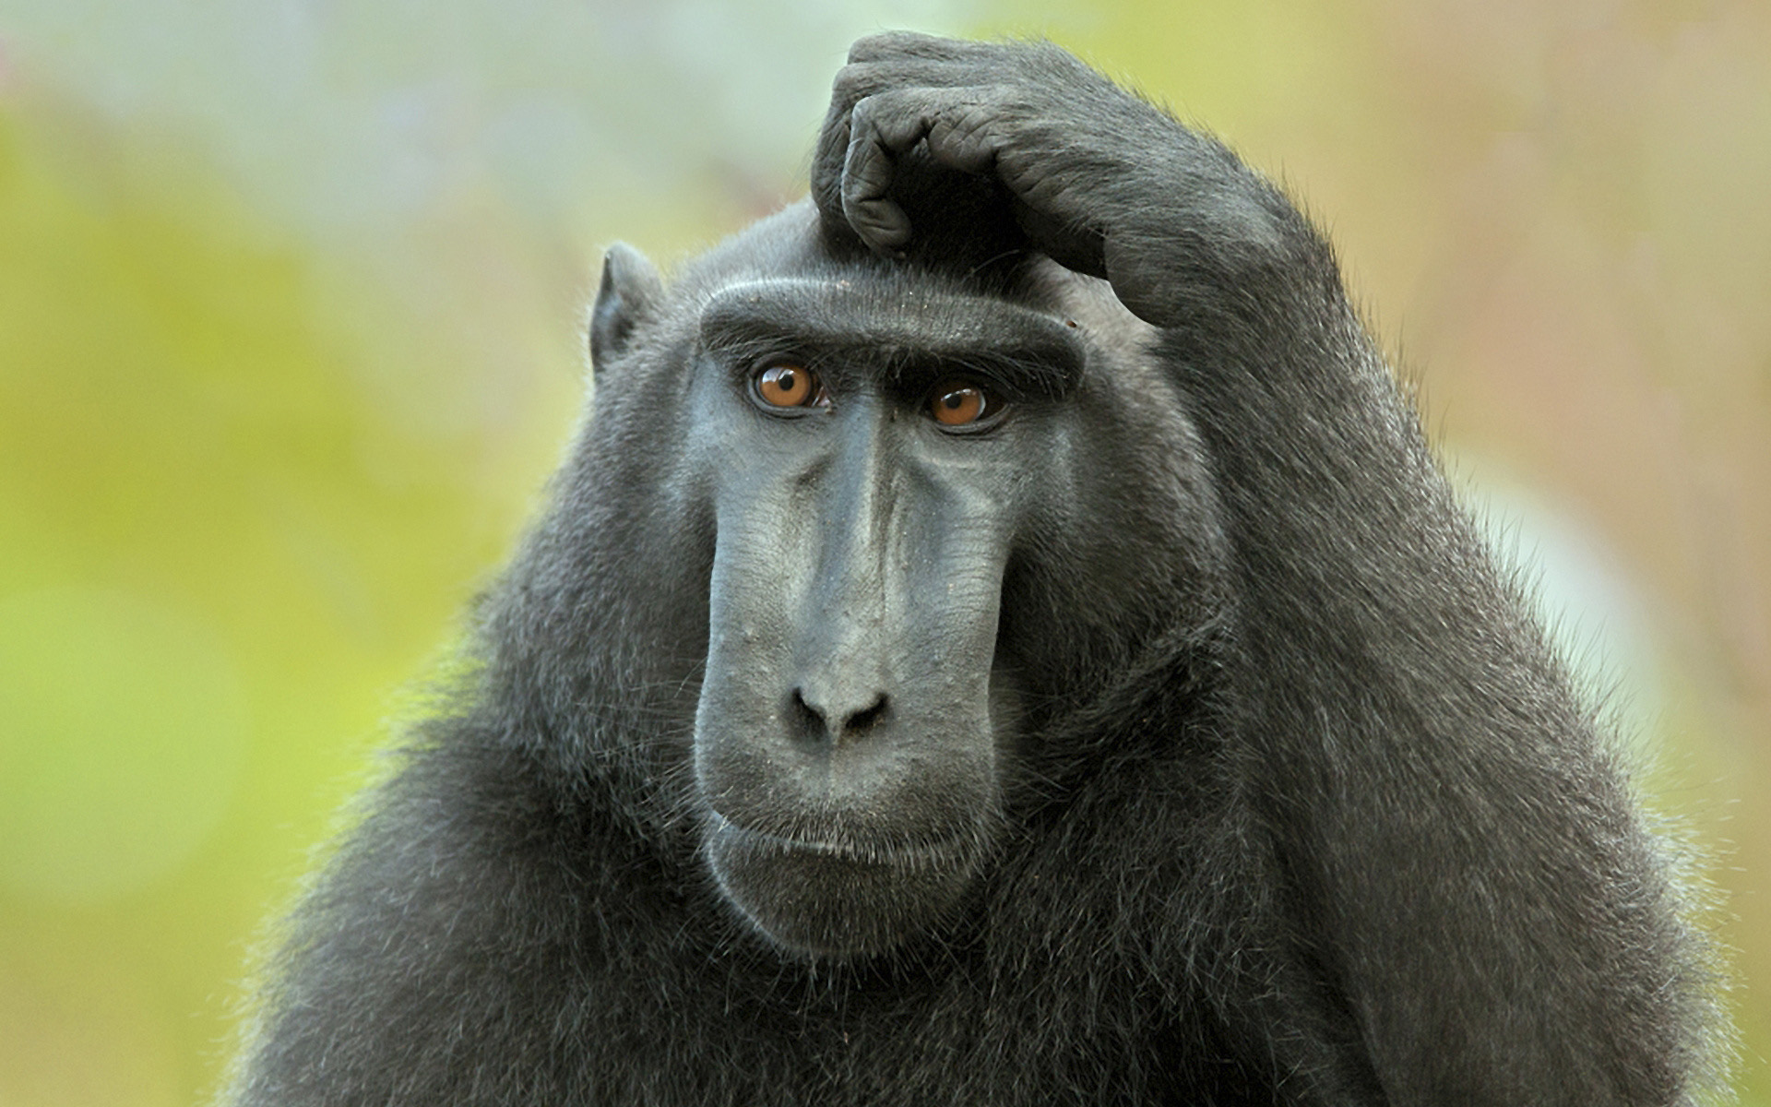
Will beauty save the world?

Slide 7
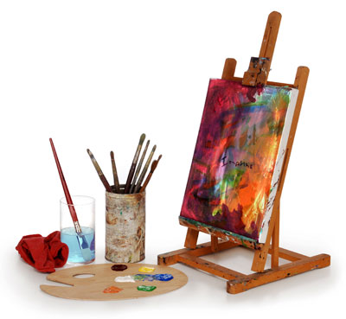
Many people ask themselves this question. But anyone can`t give an exact answer. Of course, in some sense, they may be right. Everyone has their own opinion on this question.
“Beauty will save the world” – Dostoevsky.

Slide 8
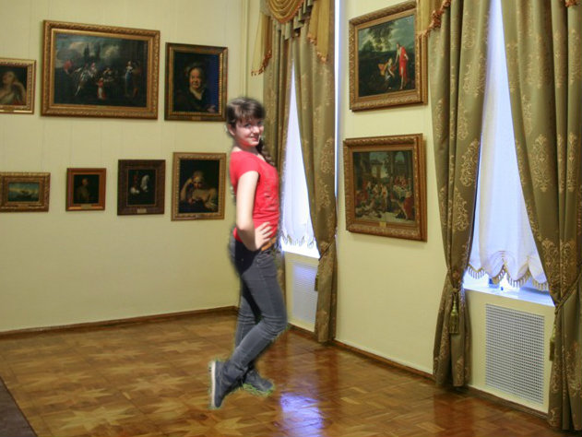
My visit to Art Gallery

Slide 9
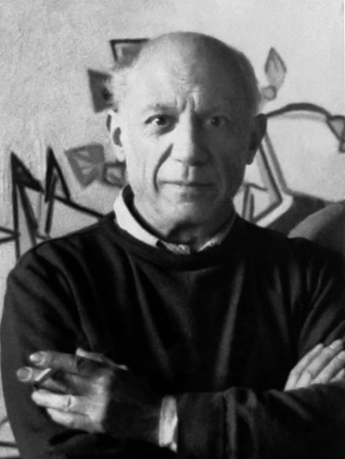
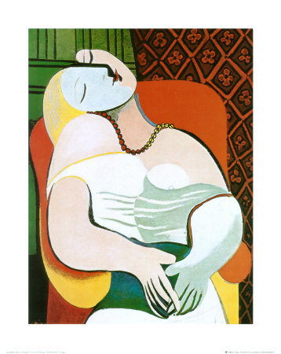
I visited art gallery of Pablo Picasso. He was a very wonderful and talented artist. His pictures are world famous. I was interested his art.
Each picture affects its originality.
“There are painters who transform the sun to a yellow spot, but there are others who with the help of their art and their intelligence, transform a yellow spot into the sun”
– Pablo Picasso

Slide 10
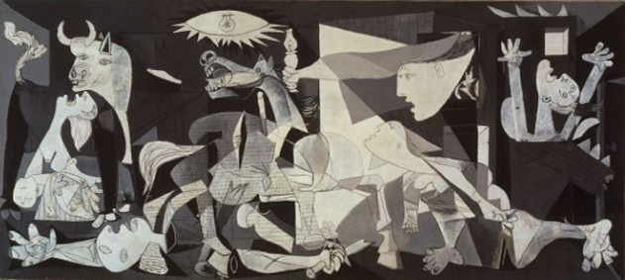
In his collection I like picture Guernica.

Slide 11
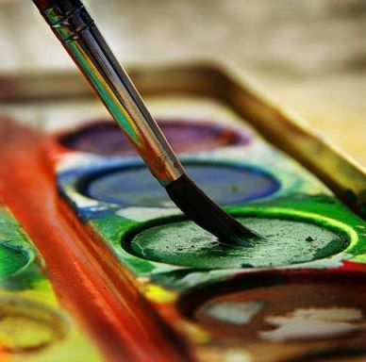
Creation of picture Guernica
One of Picasso’s most famous pictures represents the German bombing of Guernica during the Spanish Civil War. He created this picture to show the brutality and hopelessness of war.

Slide 12

national art treasures of Ukraine

Slide 13
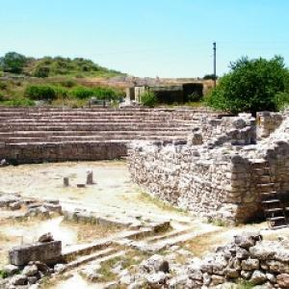
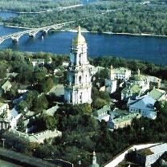
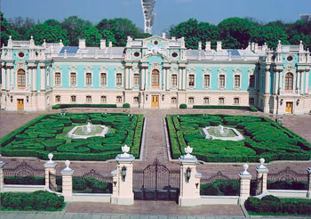
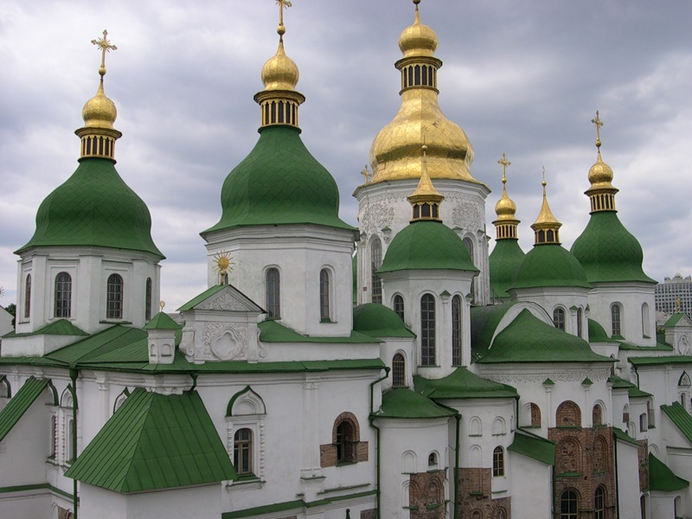
Architectural monuments occupy a special place among the rich cultural heritage of the Ukrainian people.
Chersoneses
Kiev-Pechersk Lavra
Mariinsk Palace
St. Sophia Cathedral

Slide 14

My favorite picture
I drew a picture that I liked. I think it is nice and can elevate mood.

Slide 15
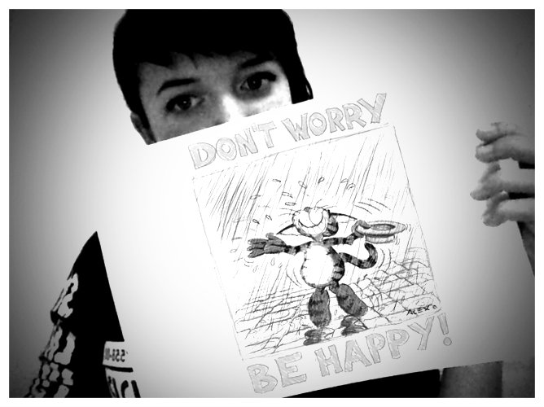


Slide 16

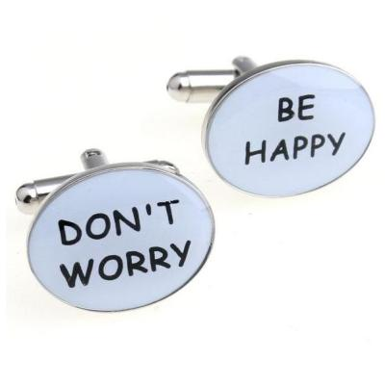
I painted these words because it is my life motto. I think that in these words are sense. We need to worry less and enjoy life more.
Don`t worry! Be happy! –
Bob Marley

Slide 17
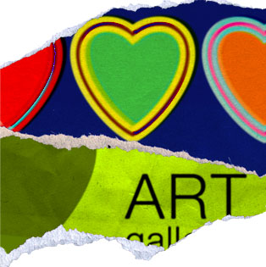
I think that art is interesting for many people.
Everyone wants to go to the world of art and learn more for yourself.
And we must to develop the art.
I want to advise everyone that they are interested in art, because it's beautiful.

Slide 18



This is how I see the world of art.

