Slide 1

Presentation:
ENGLISH PAINTERS
Prepared by
Oleksandra Pekhno
Form 11-A
School of Chynadiievo
February 2014

Slide 2
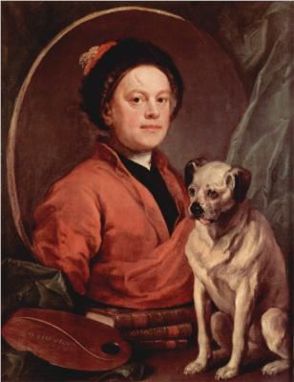
William Hogarth
William Hogarth (1697-1764) was the first great English painter who raised English pictorial art to a high level of importance.
He was a man of remarkably individual character and thought. W. Hogarth had friends among famous English writers J. Swift, H. Filding.

Slide 3
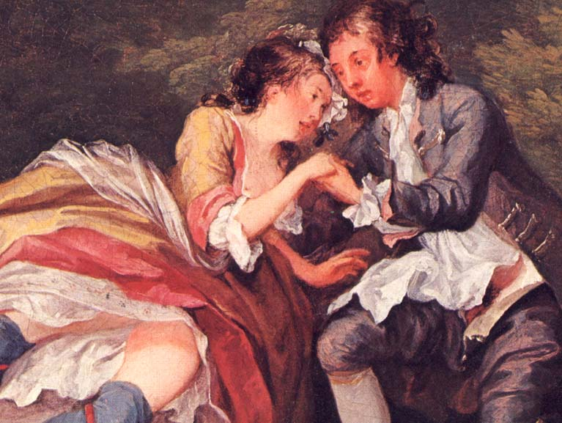
He was the first English painter who brought painting closer to literature and theatre.
His engravings of modern morality subjects were aimed at a wide public, and their outstanding success established his financial independence.

Slide 4
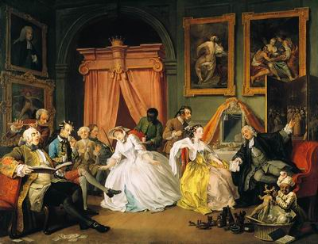
Marriage la Mode

Slide 5
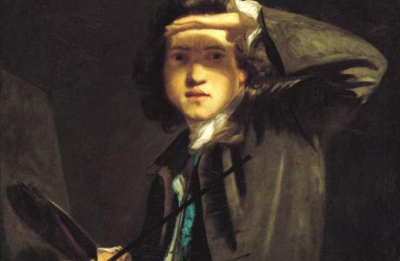
Reynolds Sir Joshua
Sir Joshua Reynolds (1723—1792), the first President of the Royal Academy of Arts, was not only a painter but the founder of the academic principles of the "British school".
Reynolds was the most outstanding portraitist of the 18th century.

Slide 6
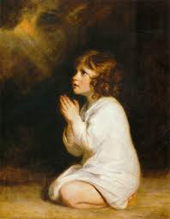
In his pictures he did not only paint portraits but produced characters.

Slide 7
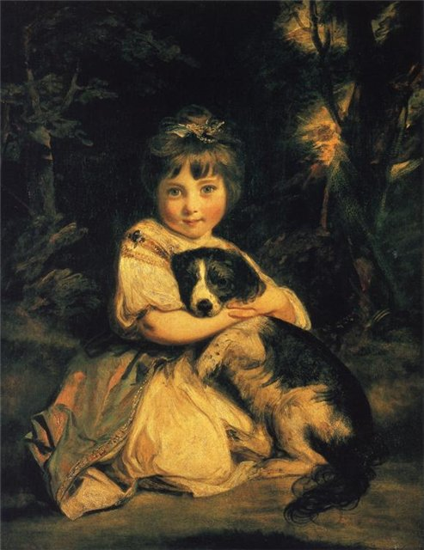
Love Me,
Love My Dog

Slide 8
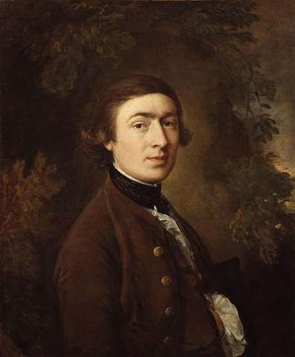
Thomas Gainsborough
Thomas Gainsborough (1727— 1788) was a brilliant portrait painter.
A good amateur violinist and a lover of the drama, he was an artistic person.
T. Gainsborough is the creator of the great English school of landscape painting.
His great love for the English country and his delicate understanding of nature are felt in his pictures.

Slide 9
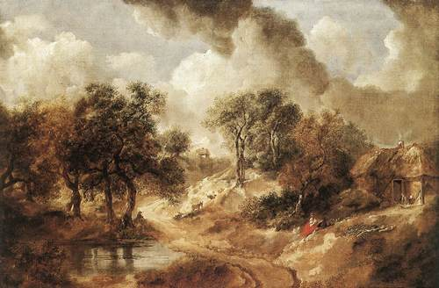
Landscape

Slide 10
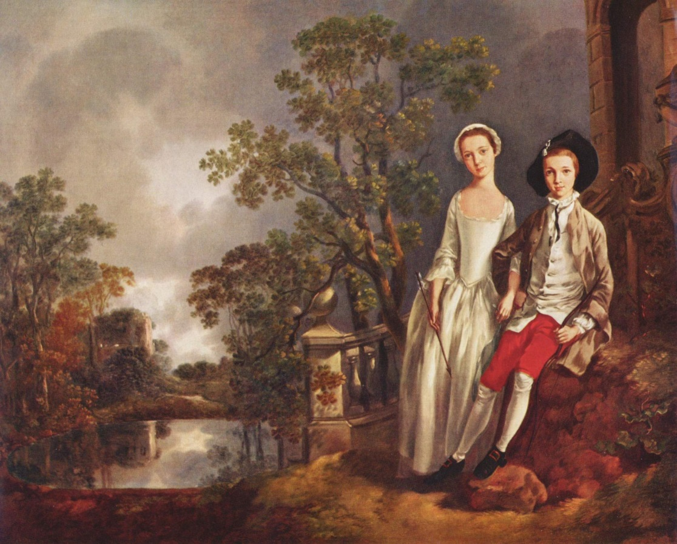
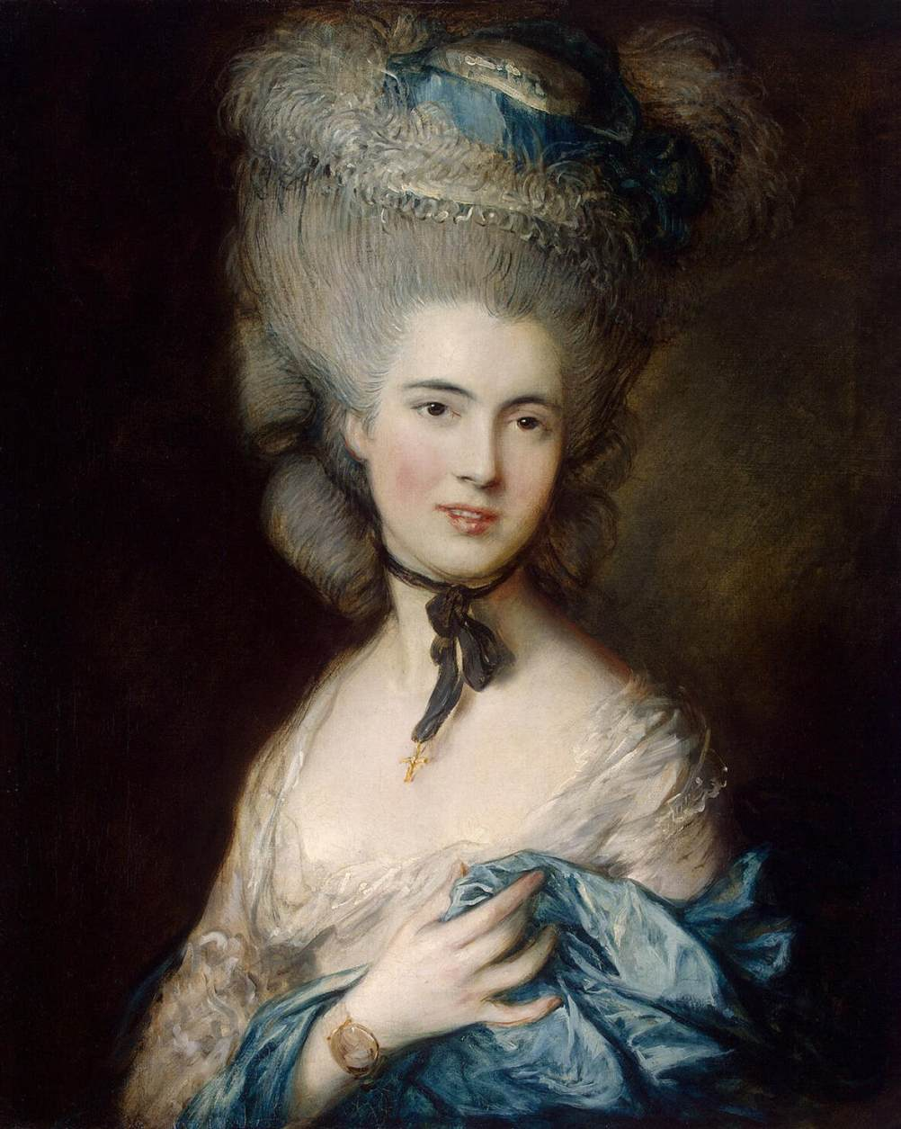
Lloyd and Lucy
Lady In blue

Slide 11
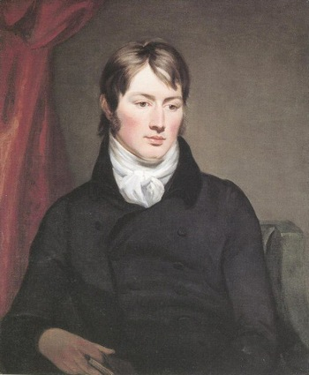
John Constable
John Constable is one of the greatest landscape painters.
He was the first landscape painter who considered that every painter should make his sketches direct from nature, which is working in the open air.
Constable was a realist.

Slide 12
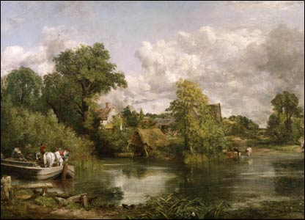
Constable may truly be considered the father of modern landscape painting.

Slide 13
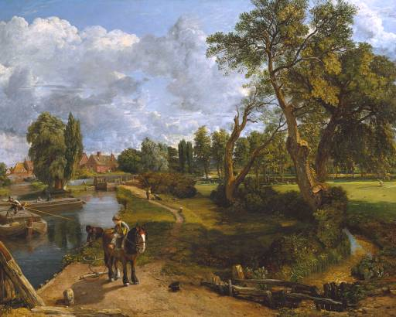
Flatford Mill

Slide 14
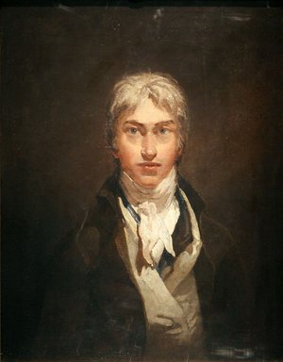
Joseph Turner
Another famous English painter was Joseph Turner (1775—1851), whose business was to paint the light.
He proved that with the help of light it is, possible to show qualities of any subject.
We know practically nothing about Turner's life.

Slide 15
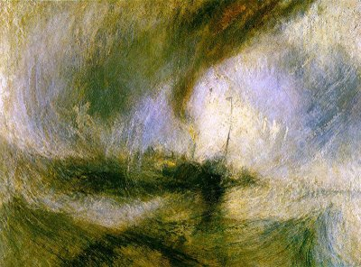
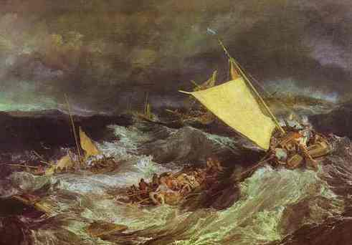
The Shipwreck
Snow Storm

Slide 16
THE END

