Slide 1
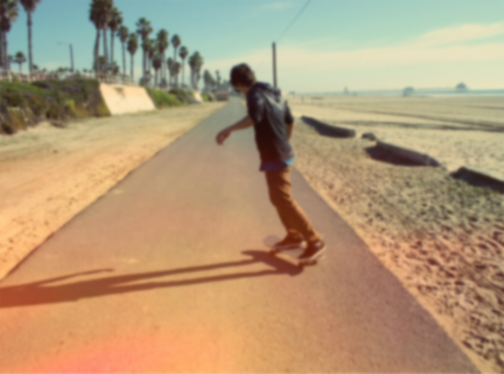

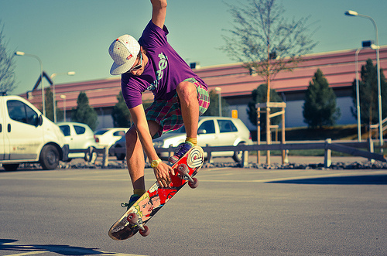
Skateboarding

Slide 2
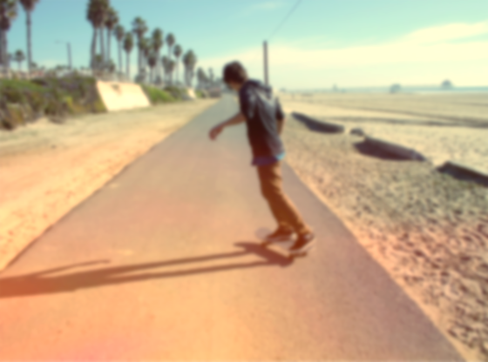
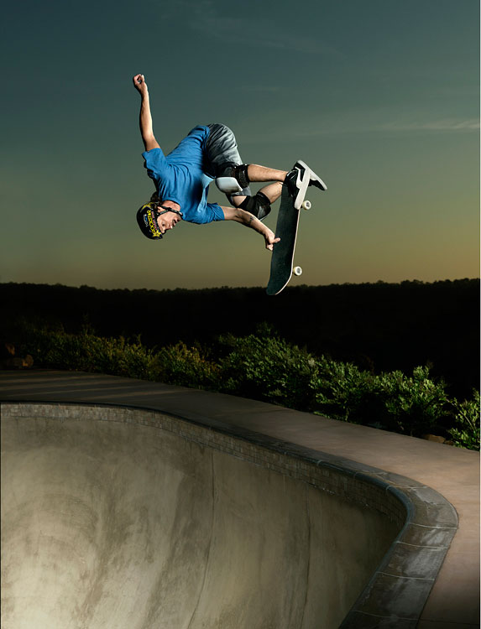
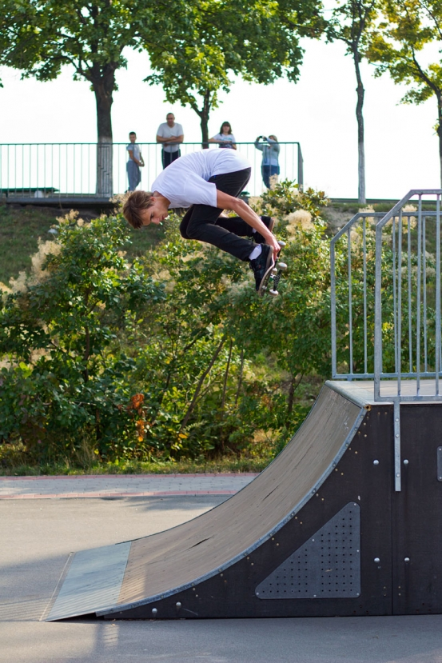
Skateboarding – is an action sport which involves riding and performing tricks using a skateboard
Skateboarding styles :
Transportation
Military
Trampboarding
Swing boarding
Controversy

Slide 3
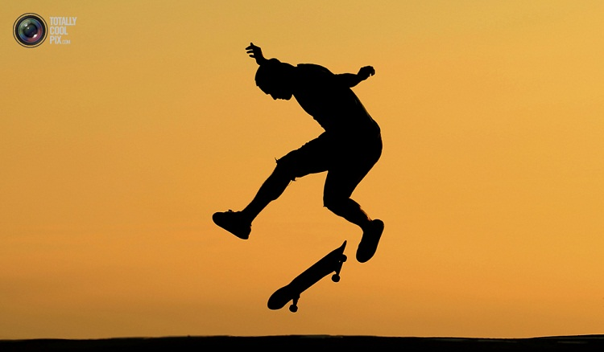
Skateboarding has been shaped and influenced by many skateboarders throughout the years. A 2002 report found that there were 18.5 million skateboarders in the world.
Since the 1970s, skateparks have been constructed specifically for use by skateboarders.

Slide 4
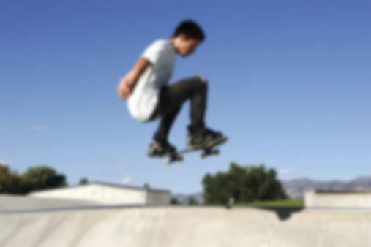
Skateboarding was probably born sometime in the late 1940s or early 1950s when surfers in California wanted something to surf when the waves were flat. No one knows who made the first board; it seems that several people came up with similar ideas at around the same time. These first skateboarders started with wooden boxes or boards with roller skate wheels attached to the bottom.
During this time, skateboarding was seen as something to do for fun besides surfing, and was therefore often called «sidewalk surfing»
The first manufactured skateboards were ordered by a Los Angeles, California surf shop.

Slide 5
