Slide 1
BRITISH FOOD

Slide 2
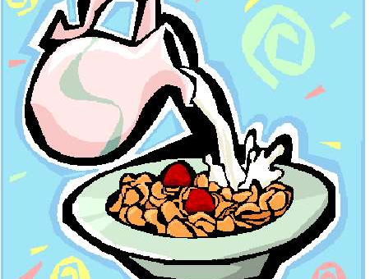
BREAKFAST
between 7:00 and 9:00

Slide 3
BREAKFAST
What is a typical English Breakfast? It is a typical English breakfast is more likely to be a bowl of cereals, a slice of toast, orange juice and a cup of coffee. In the winter many people will eat "porridge". The traditional English breakfast consists of eggs, bacon, sausages, fried bread, baked beans and mushrooms.

Slide 4
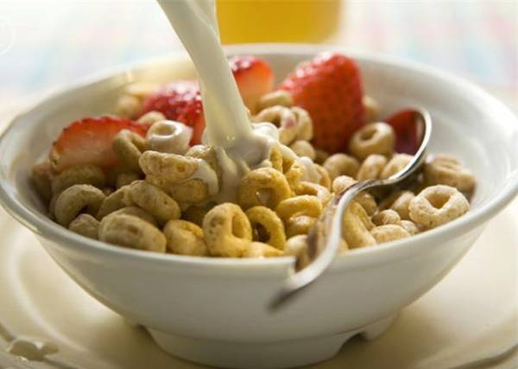
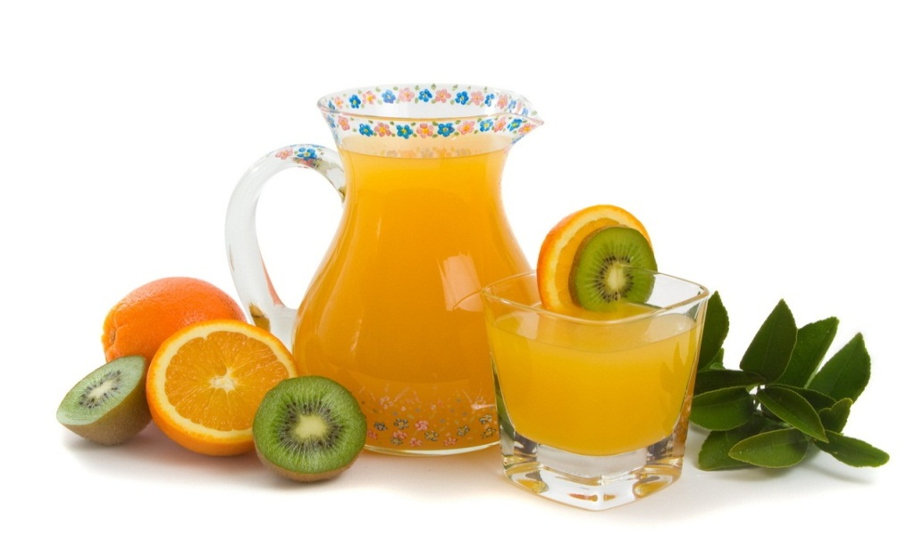
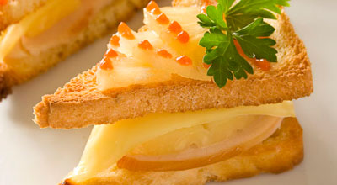

Bowl of porridge.
Orange juice.
Slice of toast.
Cup of coffee.

Slide 5
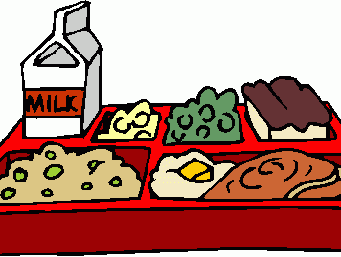
LUNCH
between 12:00 and 1:00 p.m.

Slide 6
LUNCH
Many children at school and adults at work will have a lunch. This typically consists of a sandwich, a packet of crisps, a piece of fruit and a drink. The lunch is kept in a plastic container. Favourite sandwich is prawn and mayonnaise.

Slide 7
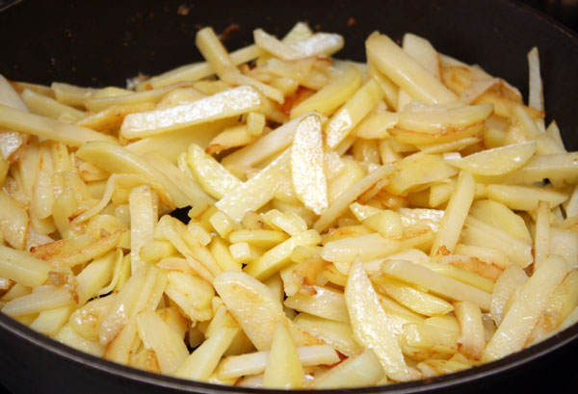
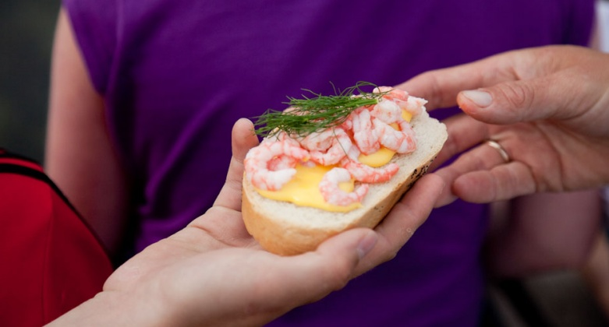
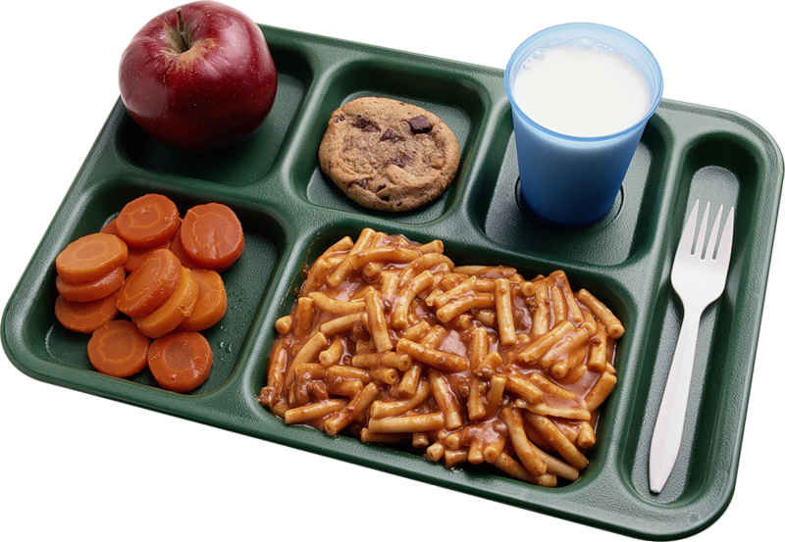
Favourite sandwich is prawn and mayonnaise.
Crisps.
The lunch is kept in a plastic container.

Slide 8
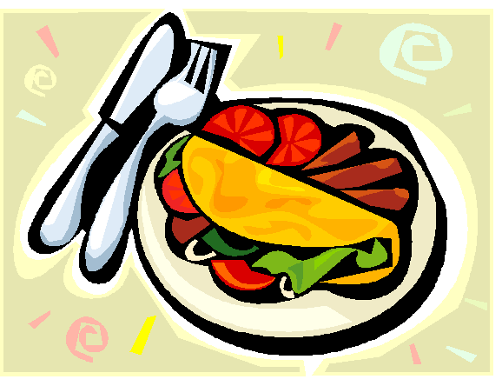
DINNER (SUPPER)
the main meal between 6:30 and 8:00 p.m. (Evening meal)

Slide 9
DINNER
A typical British meal for dinner is "meat and two vegetables. We put hot brown gravy on the meat and usually the vegetables. Vegetables grown in England, like potatoes, carrots, peas, cabbages and onions, are still very popular.

Slide 10
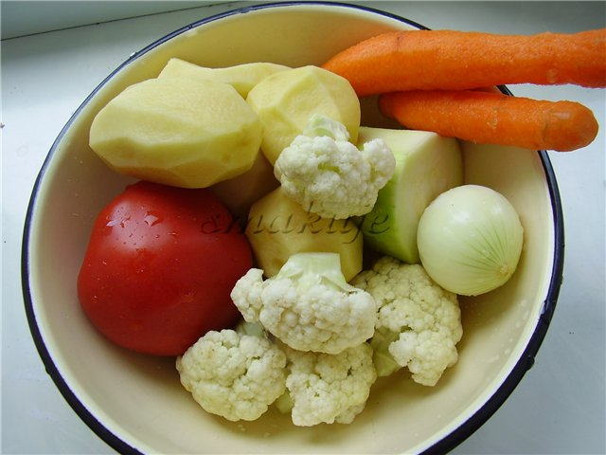
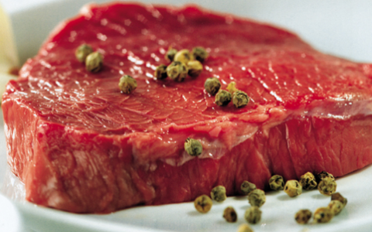
Potatoes, carrots, tomatoes, cabbages and onions.
Meat.

