Slide 1
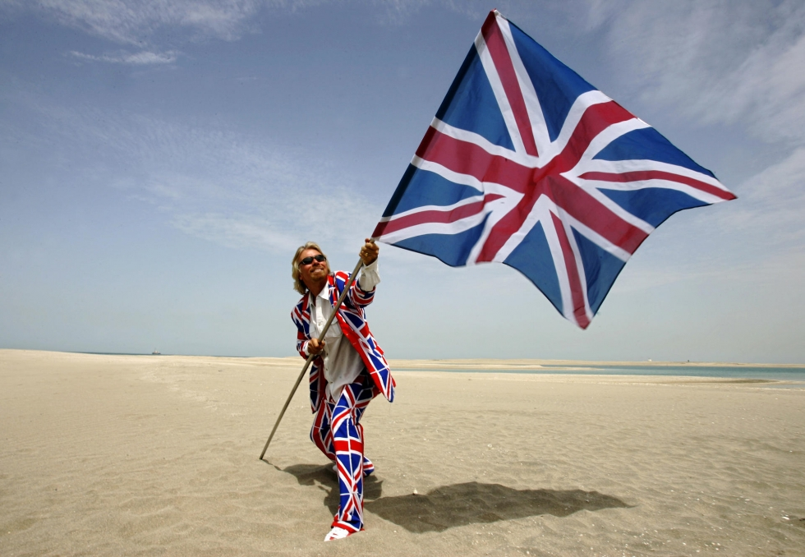
Richard Branson

Slide 2
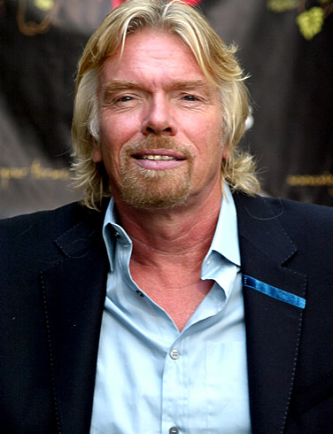
Richard Branson is an entrepreneur and businessman, who founded the Virgin group of more than 400 companies. The Virgin group grew from a small record shop he founded in 1972, to become a major multinational company including interests in transport, media, and entertainment. Richard Branson is also a flamboyant character and has taken part in a number of gruelling adventure challenges, such as sailing across the Atlantic and taking part in round the world hot air balloon journeys.

Slide 3
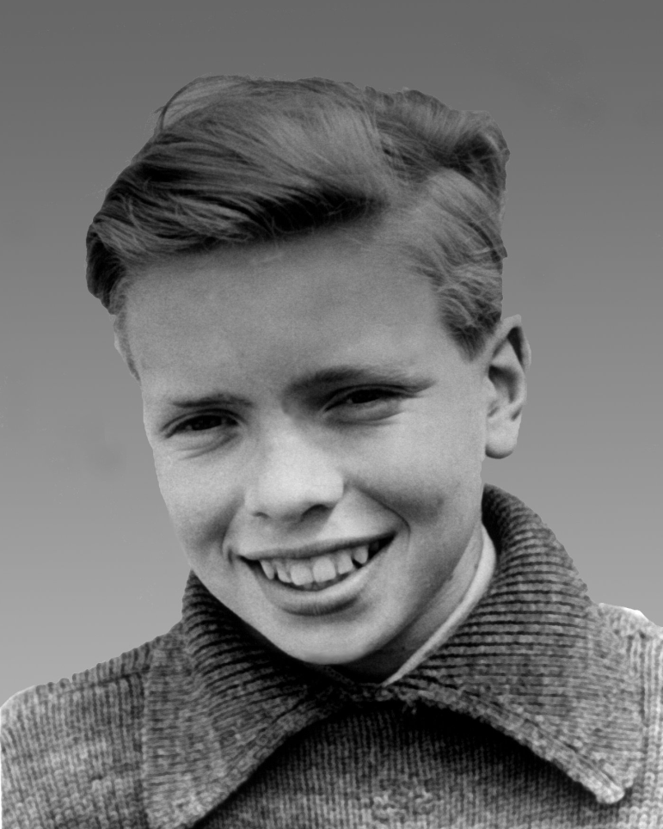
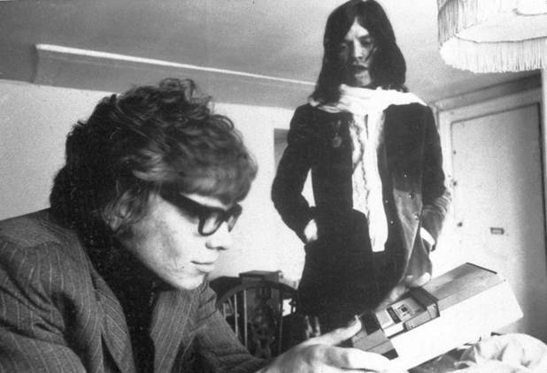
Short Biography Richard Branson
Richard Branson was born in Blackheath, London 18 July 1950. His father was a barrister. Branson attended Scaitcliffe School and later Stowe school. Suffering from dyslexia, Branson did not excel at studies; he was more interested in extra curricular activities, such as football and cricket. At the age of 15, he had started to try his first business ventures, which included trying to grow trees and another raising budgerigars.
On one occasion, he was caught leaving the bedroom of the headmaster's daughter, and Branson was expelled from school. This left him devastated and he wrote a suicide note, suggesting he couldn't cope. When the note was discovered, he was forgiven, but failing at his studies, Branson left school at 16 - an early high school drop out.

Slide 4
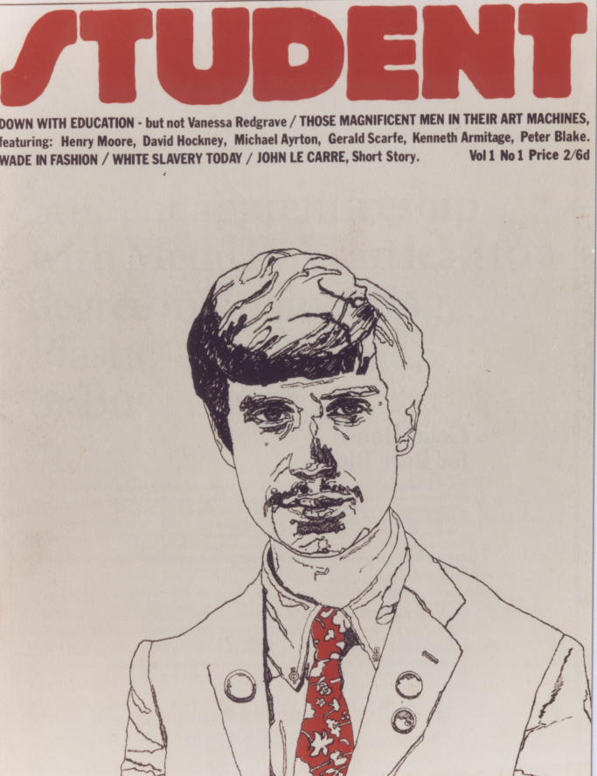
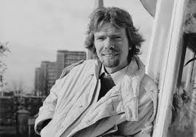
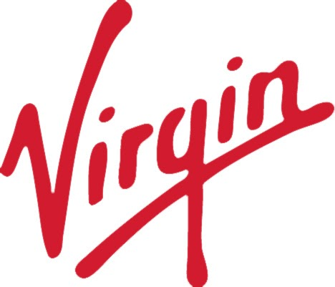
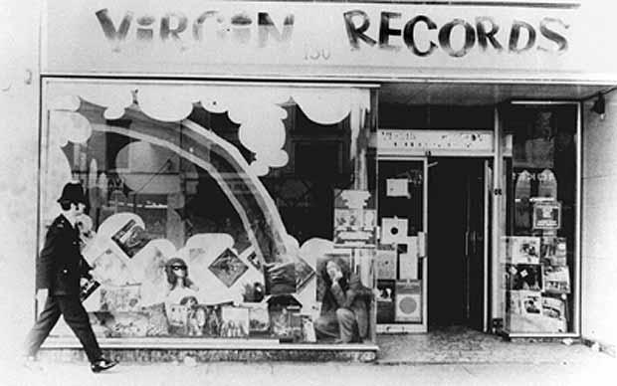
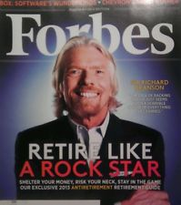
After quitting school, he moved back to London, where he began his first successful business. He started a magazine about youth culture, called The Student. It was produced by students, for students and was launched in 1966. Branson was able to attract significant advertisement from firms wishing to tap the student market; this enabled him to distribute the first 50,000 copies for free.

Slide 5
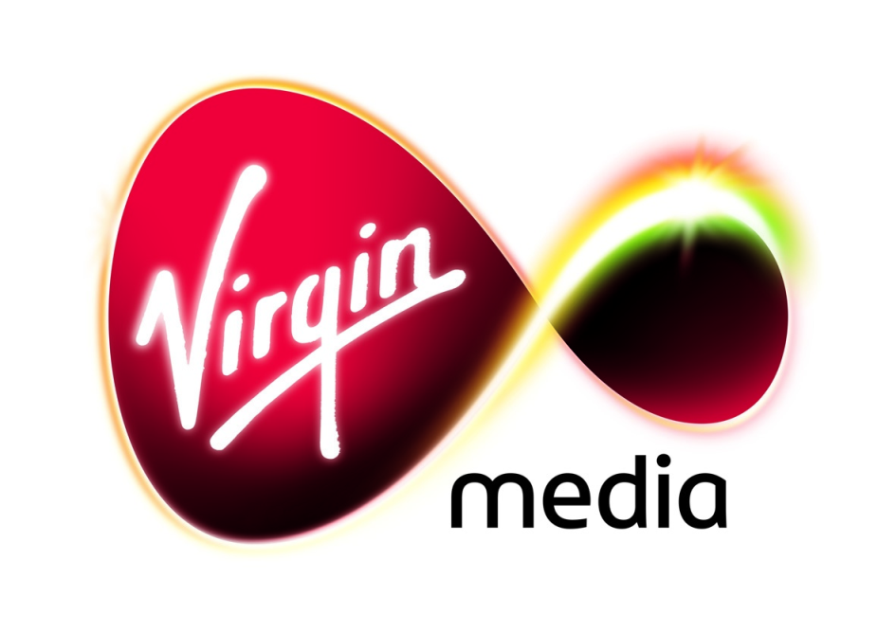
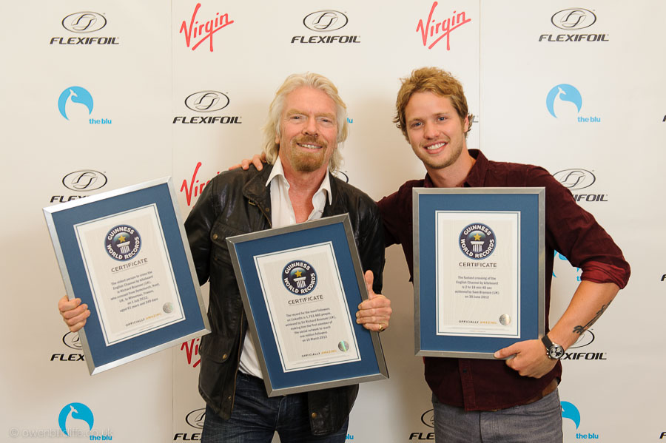

Virgin Music
As the record business expanded, Branson created his own record label, with Nik Powell - Virgin Music in 1972. Within a year, Branson had a great stroke of luck. His first artist, Mike Oldfield, recorded the album 'Tubular Bells' and this proved a smash hit, staying in the charts for over four years. This high profile and earnings, helped Branson to sign up some of the top bands of the era, including Culture Club, the Rolling Stones, Genesis, and controversial bands such as the Sex Pistols.

Slide 6
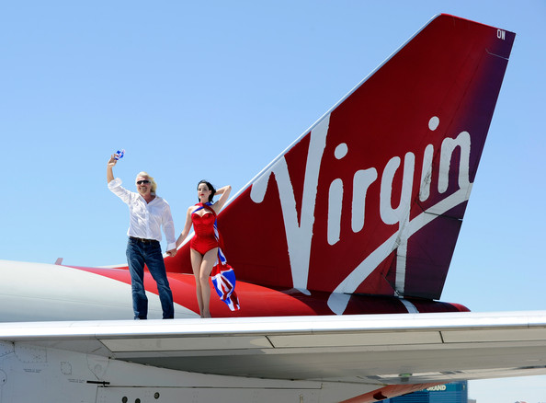
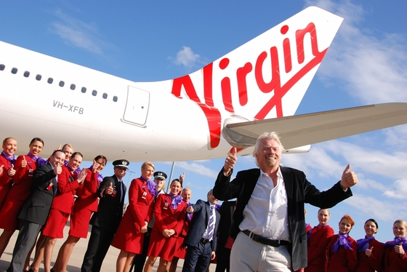
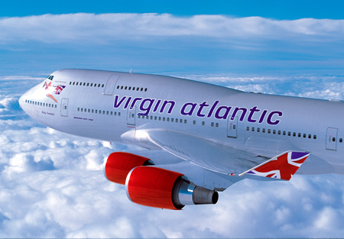
In 1984, Branson branched out into his biggest business venture - forming Virgin Atlantic Airways, and started competing in a market dominated by big national carriers, such as British Airways. At times this rivalry was intense, with Virgin accusing British Airways of dirty tricks in poaching customers. British Airways eventually settled out of court. However, in 1992, Branson had to sell Virgin records to EMI for £500m to help keep a struggling Virgin Atlantic afloat.

Slide 7
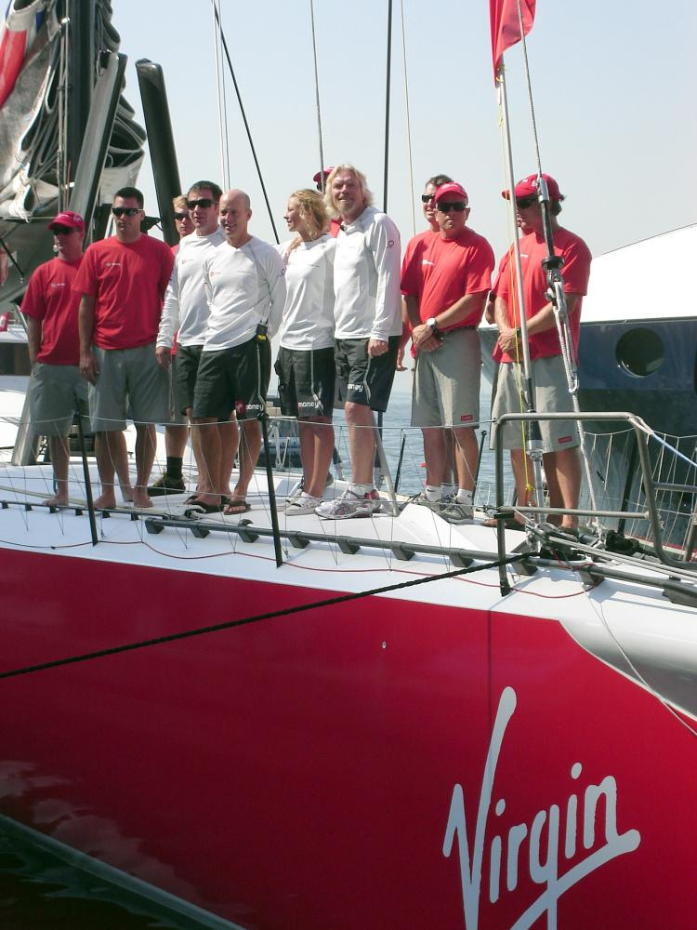
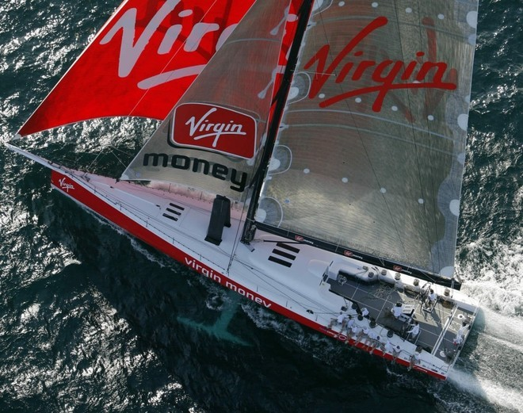
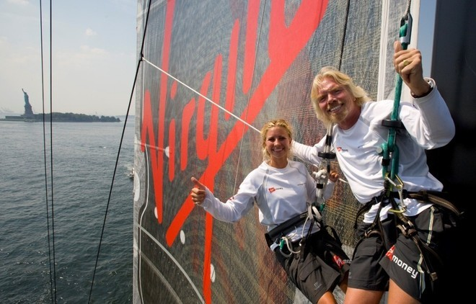
World Record Attempts
Richard Branson has undertook many endurance world record attempts. He set the fastest transatlantic sailing record in 1986. He also made several record attempts in hot air balloons. In 1998, he failed in a bid to make a global flight in a hot air balloon.

Slide 8
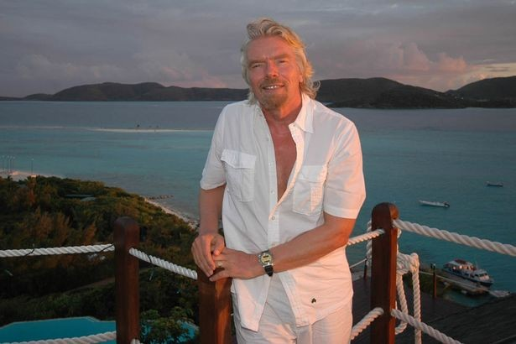
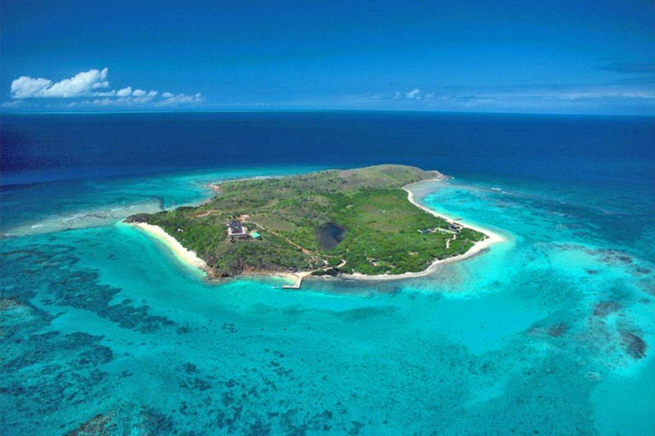
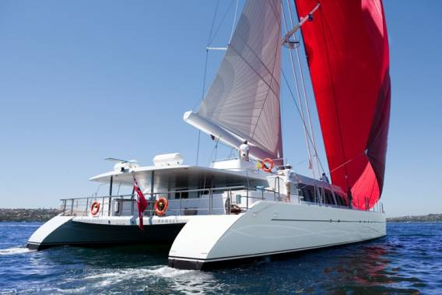
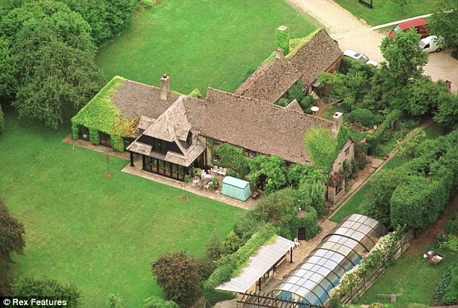
Wealth
The Sunday Times estimate the wealth of Richard Branson at £3,065 billion, making him the fourth richest person in the UK. Much of this is invested in off-shore havens.

Slide 9
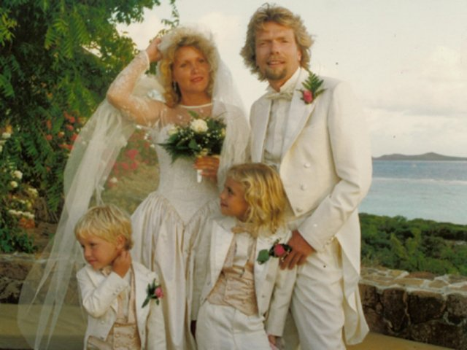
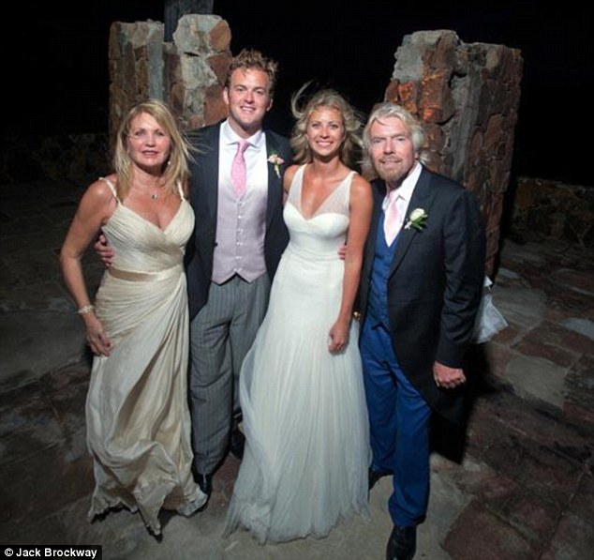
Personal Life
Branson is married to his second wife, Joan Templeman, with whom he has two children: Holly and Sam. He currently lives in London, England.
The couple wed—at their daughter Holly's suggestion when she was eight years old—in 1989 at Necker Island, a 74-acre (30 ha) island owned by Branson in the British Virgin Islands.

