Slide 1
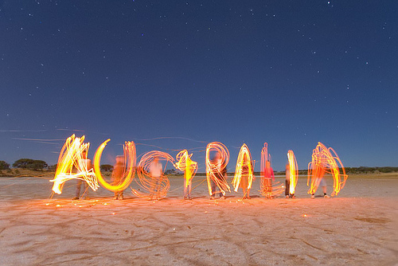

Slide 2
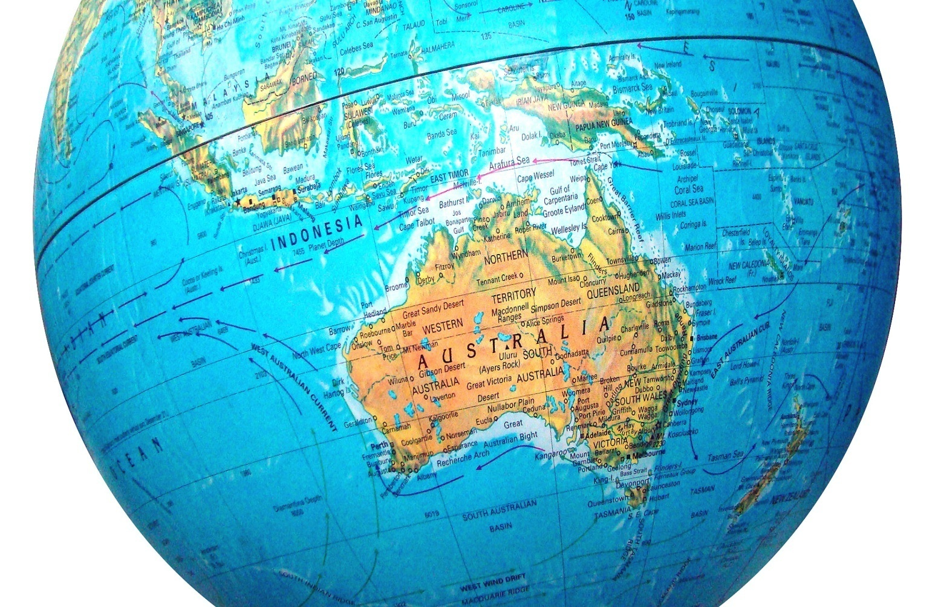
Location
Australia is a country comprising the mainland of the Australian continent

Slide 3
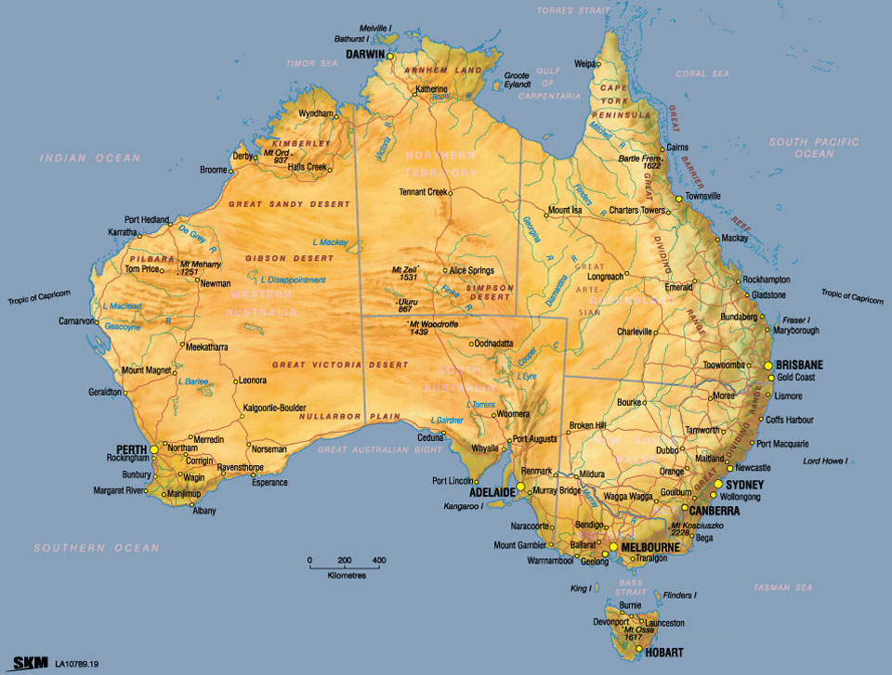
It is the world's sixth-largest country by total area.
It`s an island, surrounded by water.
It`s the smallest continent in the world.

Slide 4
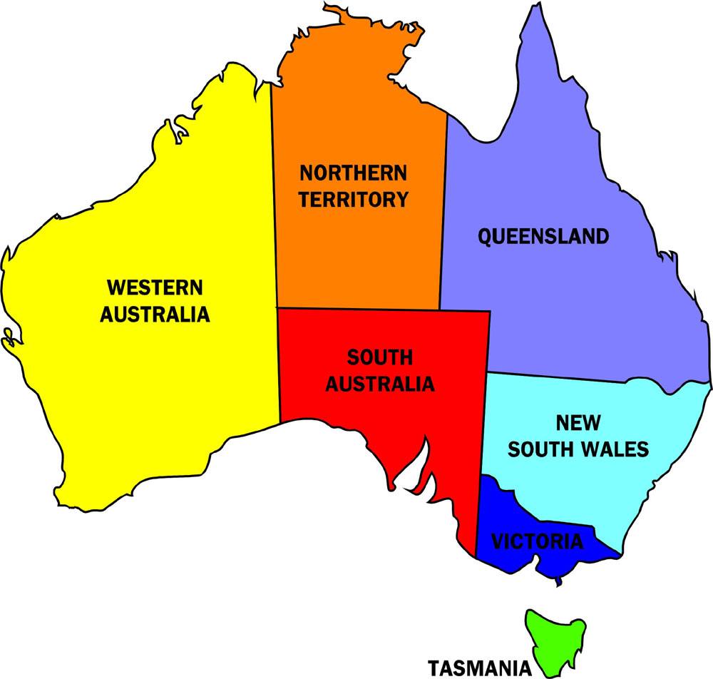
Australia is composed of 7 territories:
Western Australia, Northern Territory, Queensland,
South Australia, New South Wales, Tasmania,
Victoria.

Slide 5
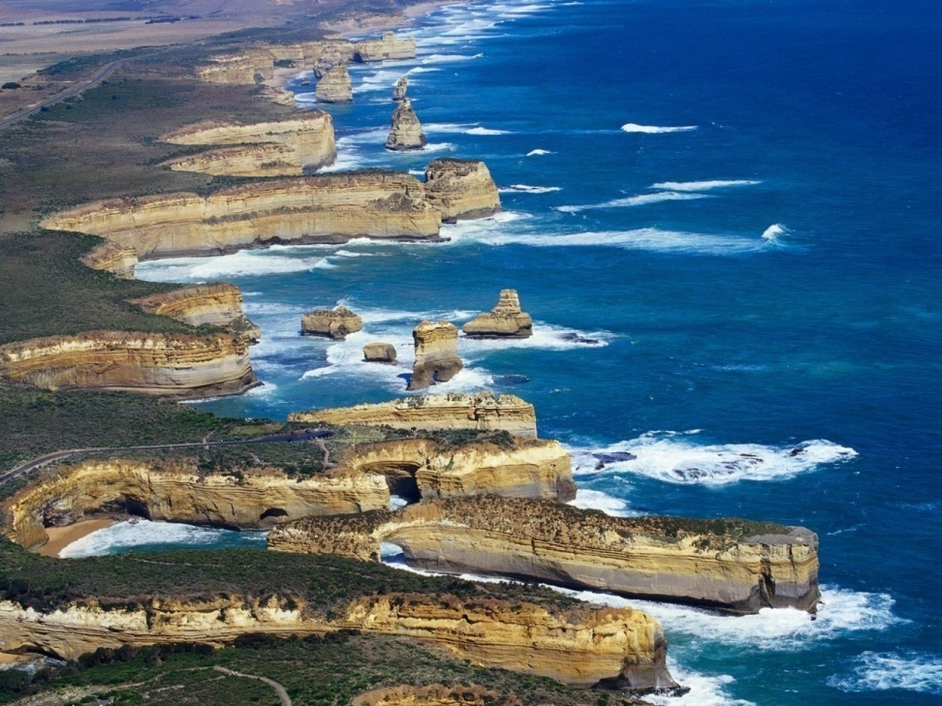
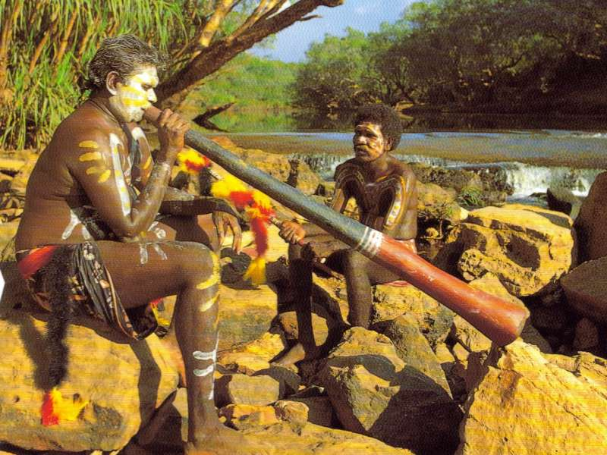
History
James Cook discovered Australia in 1770
The Aborigines have lived in Australia for over 40,000 years.

Slide 6
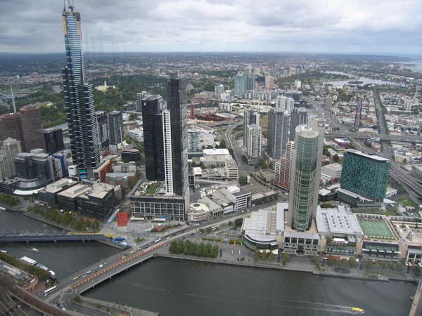
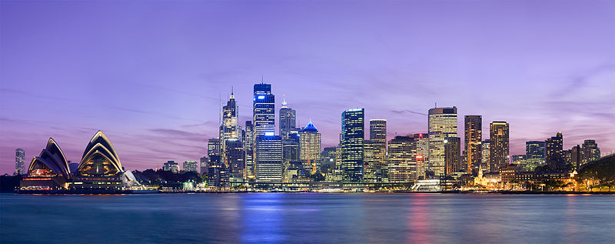
Cities
Canberra is the capital city of Australia. With a population of 374,245
Sydney is the state capital of New South Wales and the most populous city in Australia.

Slide 7
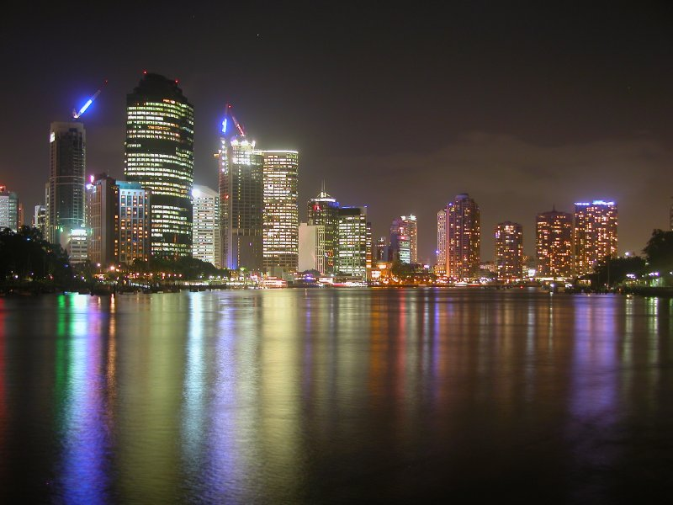
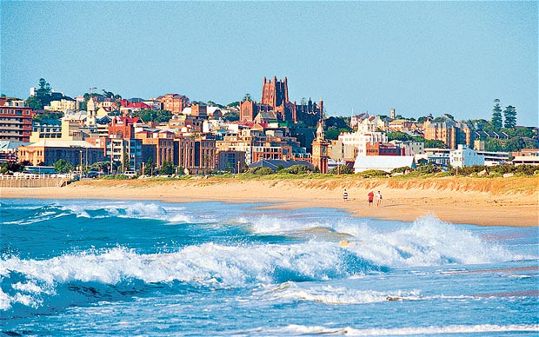
Melbourne is the capital and most populous city in the state of Victoria, and the second most populous city inAustralia.
Brisbane is the capital and most populous city in the Australian state of Queensland, and the third most populous city in Australia.

Slide 8
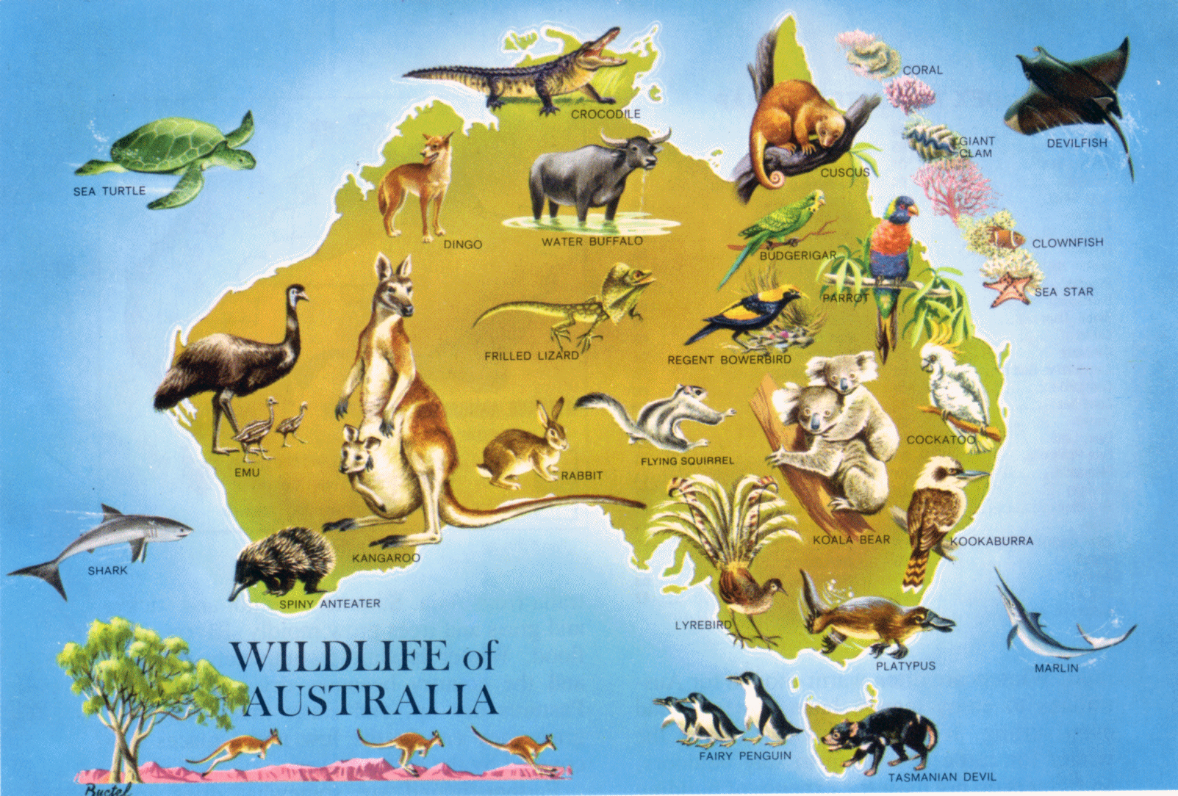
Animals

Slide 9
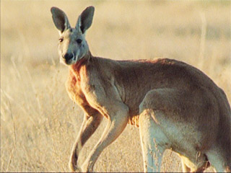
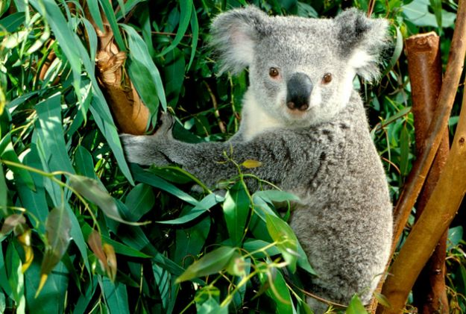
Kangaroo
Koala

Slide 10
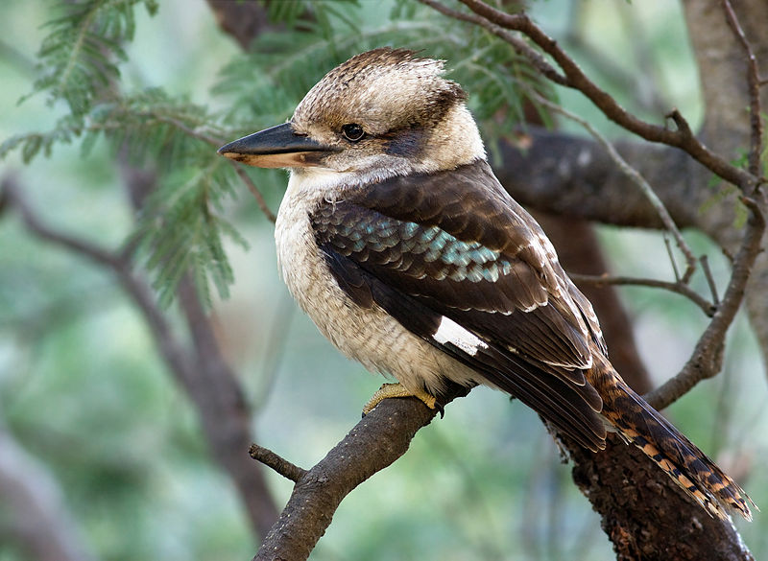
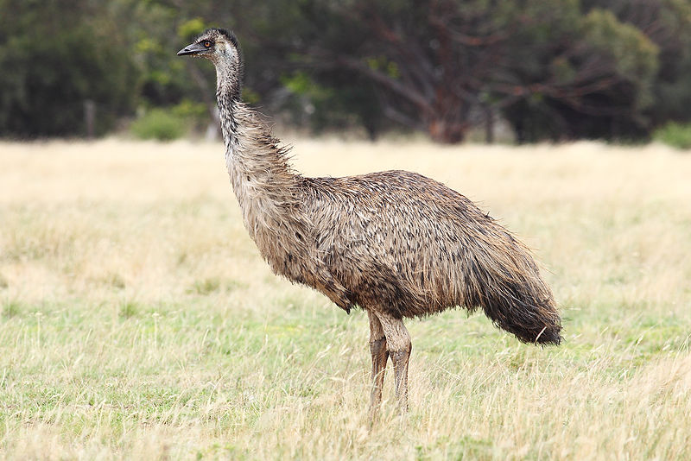
Emu
Kookaburra

Slide 11
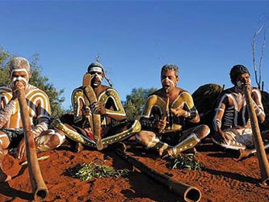
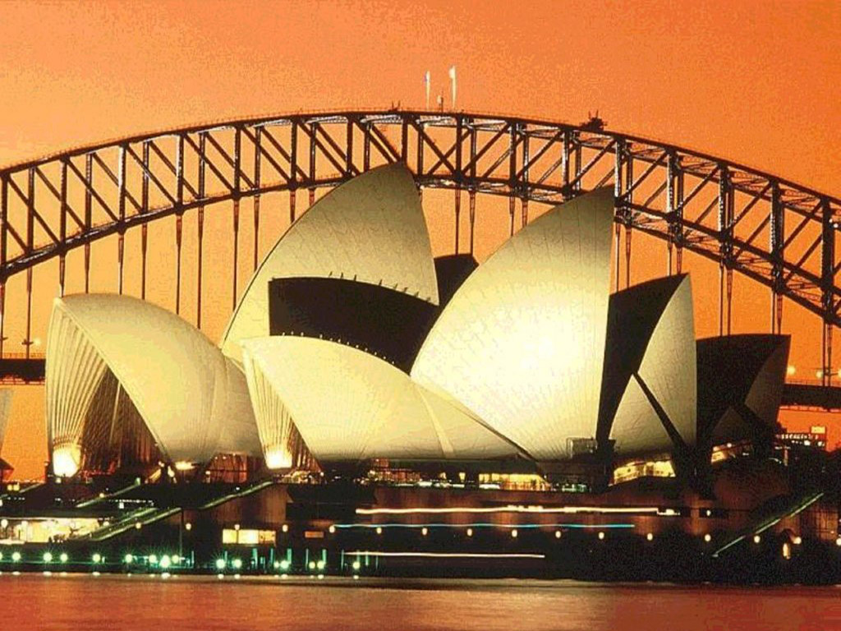
Some Australian synbols
An Aborigine
Sydney Opera House

Slide 12
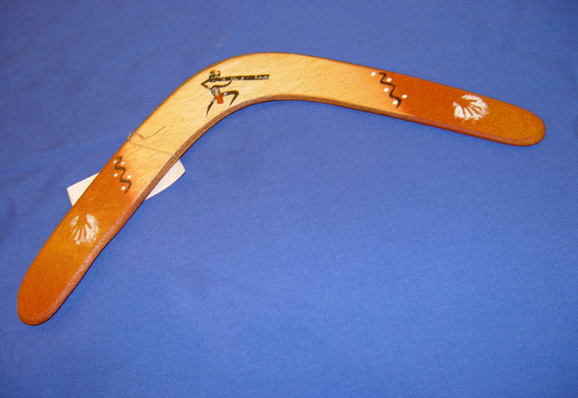
A boomerang

Slide 13
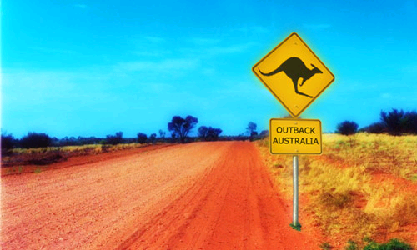
Kangaroos in the Outback

Slide 14
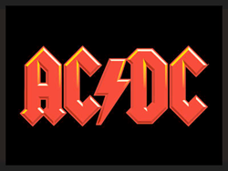
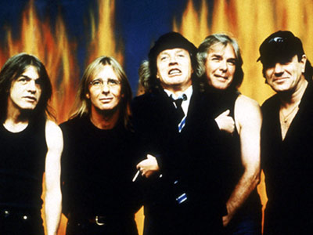
AC/DC, music band

Slide 15
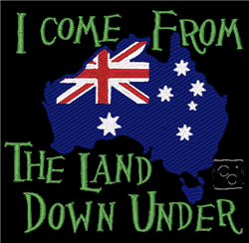
Other names for Australia
Oz
Down Under

