Slide 1
Joseph William Turner

Slide 2
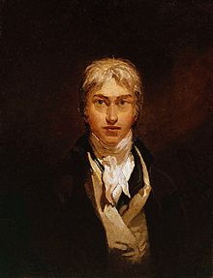
Biography
Joseph Mallord William “J. M. W.” Turner (14
May 1775 – 19 December 1851) was a British
Romantic landscape painter, water-colourist, and
printmaker. He was baptised on 14 May 1775,
but his date of birth is unknown. It is generally
believed he was born between late April and early
May. He was born in Maiden Lane, Covent
Garden, London, England. His father, William
Turner, was a barber and wig maker. His mother,
Mary Marshall, came from a family of butchers.
A younger sister, Mary Ann, was born in
September 1778 but died aged four in August 1783.
In 1785, as a result of a "fit of illness" in the family the young Turner was sent to stay with his maternal uncle, Joseph Mallord William Marshall, in Brentford. There he first showed interest in the visual arts. He entered the Royal Academy of Art in 1789, when he was 14 years old, and was accepted into the academy a year later.

Slide 3
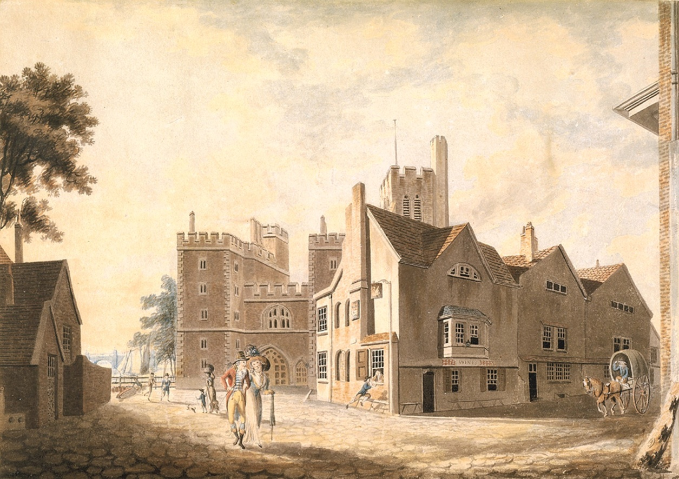
Biography
Sir Joshua Reynolds, president of the Royal Academy, chaired the panel that
admitted him. At first Turner showed a keen interest in architecture but was
advised to continue painting by the architect Thomas Hardwick. His first water-
colour painting ’A View of the Archbishop's Palace’, Lambeth was accepted for
the Royal Academy summer exhibition of 1790 when Turner was 15.

Slide 4
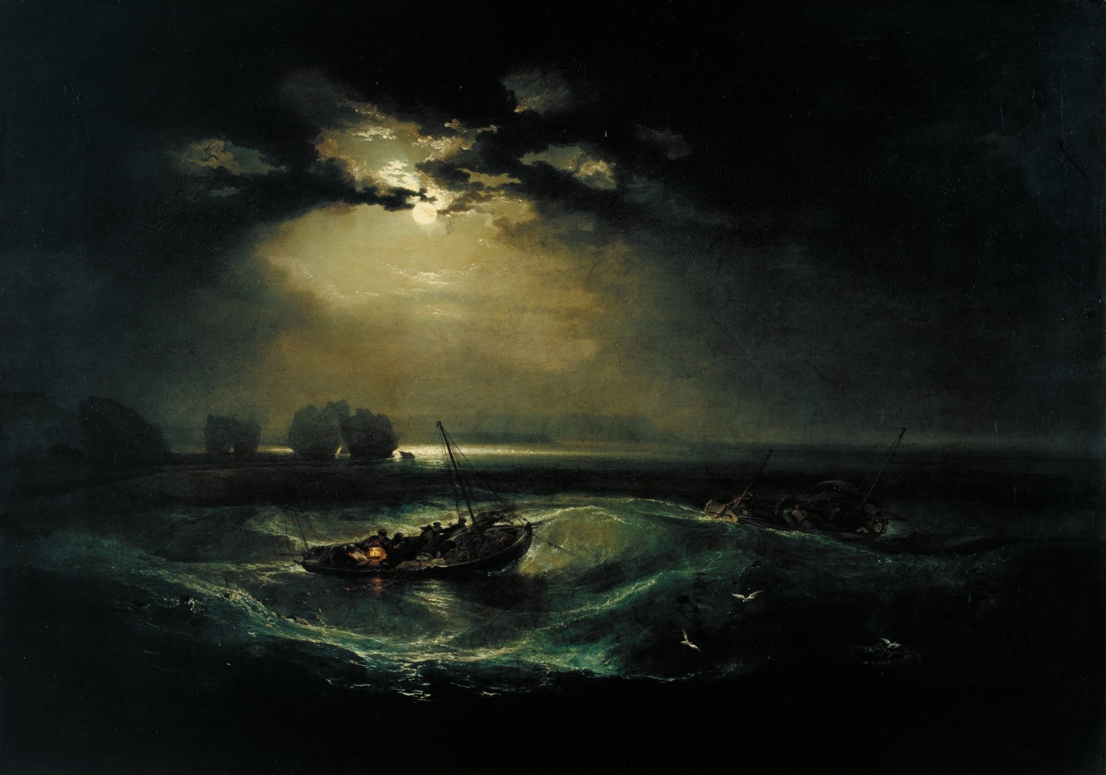
Biography
Turner exhibited his first oil painting at the academy in 1796, ’Fishermen at Sea’.
Wilton said that the image: “Is a summary of all that had been said about the sea by
the artists of the eighteenth century” and shows strong influence by artists such
as Horace Vernet, Philip James de Loutherbourg, Peter Monamy and Francis
Swaine, who was admired for his moonlight marine paintings.

Slide 5
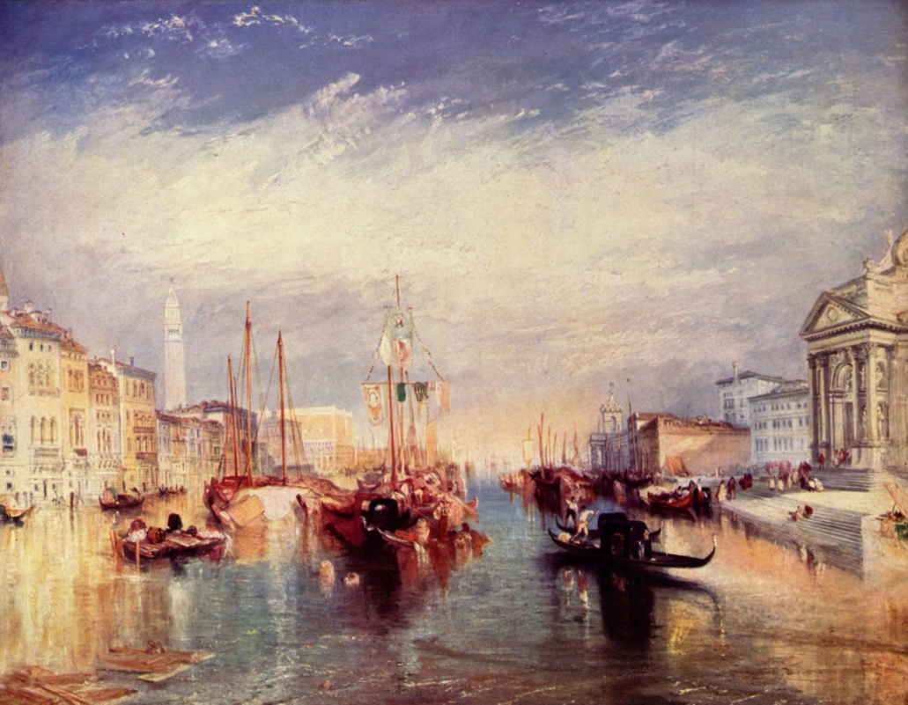
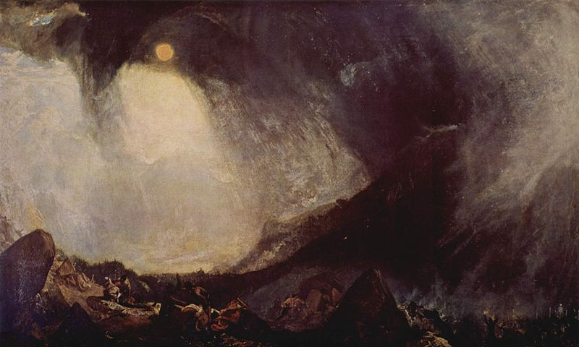
Biography
Turner travelled widely in Europe, starting with France and Switzerland in 1802
and studying in the Louvre in Paris in the same year. Also he made many visits to
Venice. His first trip in Europe Turner made ​​in 1791. After that, he had been there
many times and painted many beautiful pictures like ‘Canal Venecia’ or ‘Snow
Storm: Hannibal and his Army Crossing the Alps’.

Slide 6
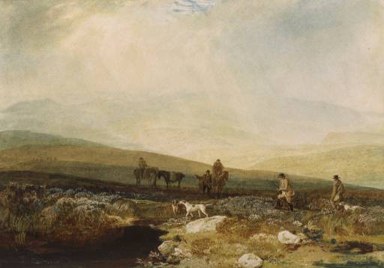
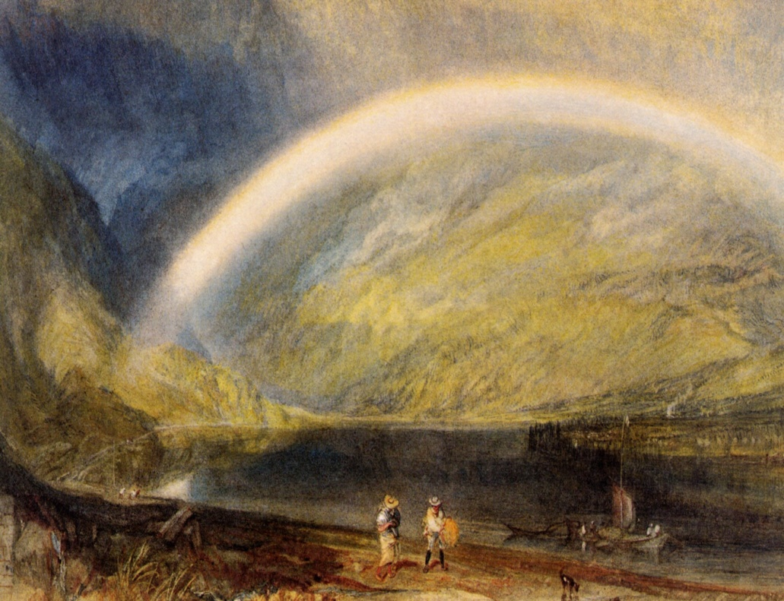
Biography
Important support for Turner’s work came from Walter Ramsden Fawkes,
of Farnley Hall, near Otley in Yorkshire, who became a close friend of the
artist. Turner first visited Otley in 1797, aged 22, when commissioned to
paint watercolours of the area. There, in Yorkshire, the artist drew a lot of great
new pictures such as ‘Grouse Shooting on Beamsley Beacon’ and ‘Rainbow’.

Slide 7
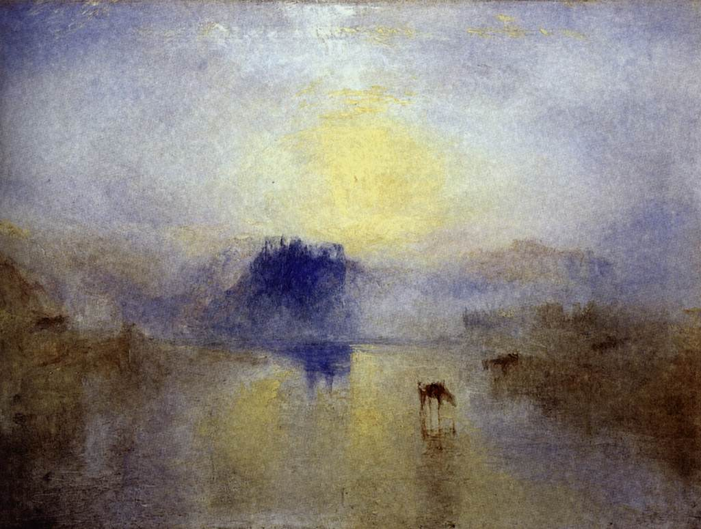
Biography
Turner died in the house of his mistress Sophia Caroline Booth in Cheyne
Walk in Chelsea on 19 December 1851.
At his request he was buried in St Paul's Cathedral, where he lies next to Sir
Joshua Reynolds. His last exhibition at the Royal Academy was in 1850. Turner
left behind a lot of remarkable works, which people admire today.
Norham Castle, Sunrise.

Slide 8
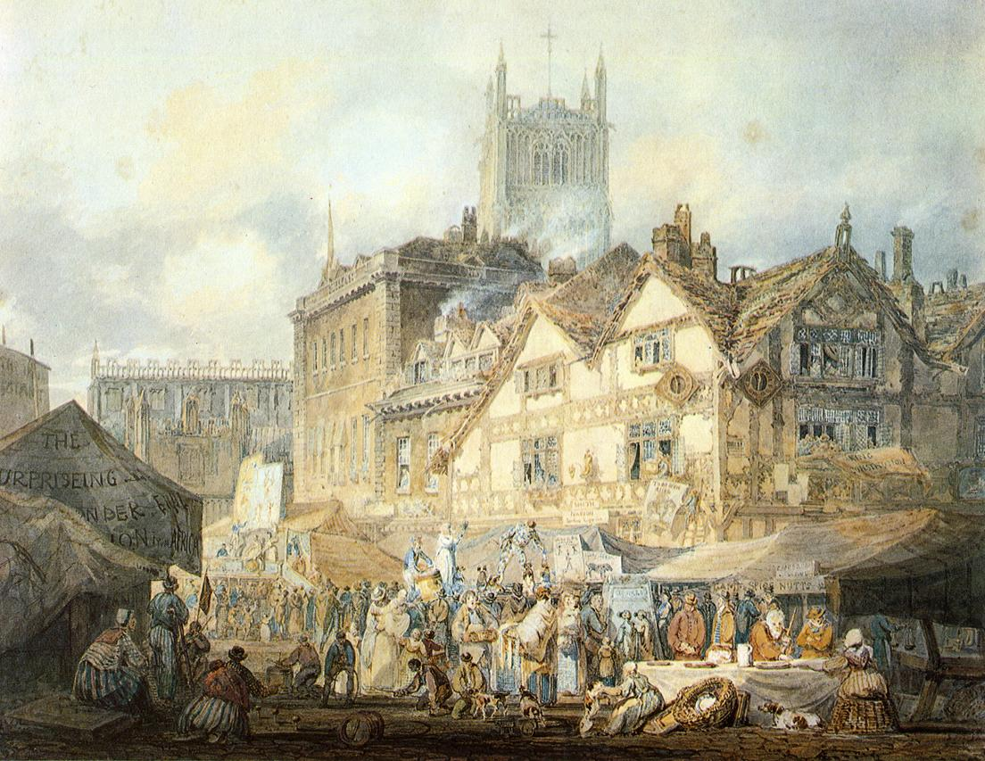
The most amazing works
Wolverhampton, Staffordshire.

Slide 9
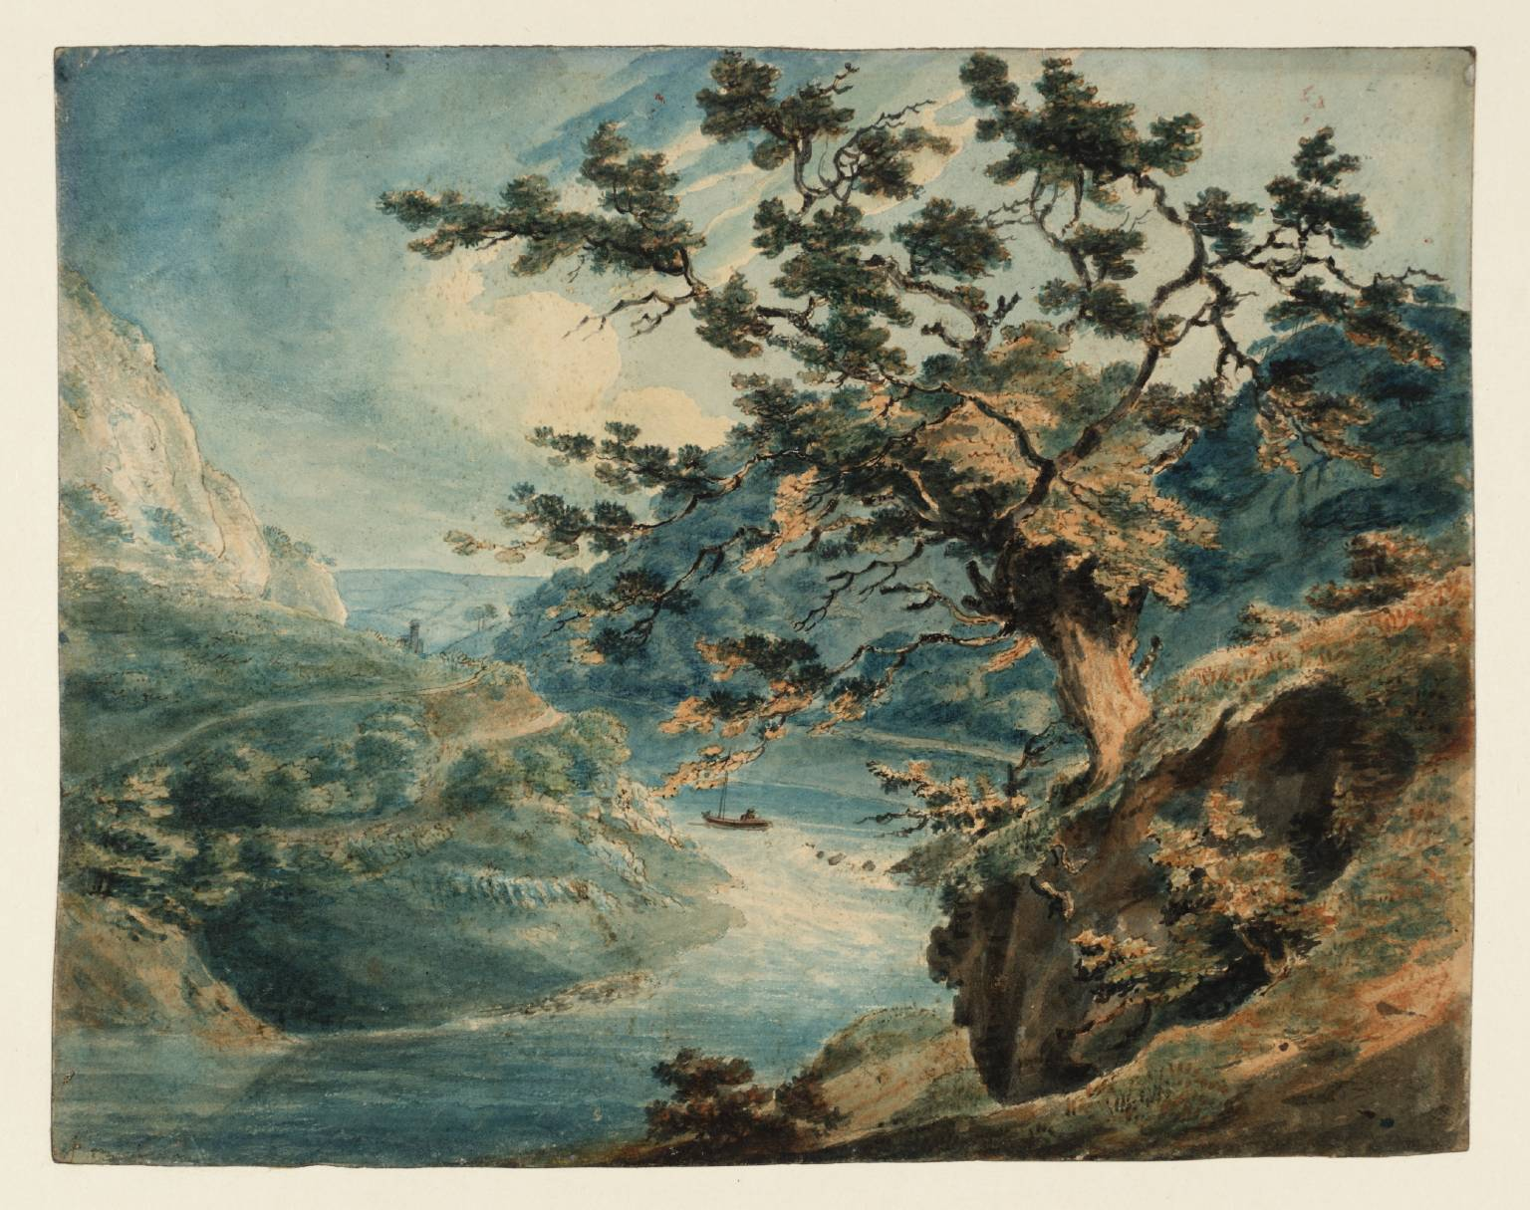
The most amazing works
View in the Avon George.

Slide 10
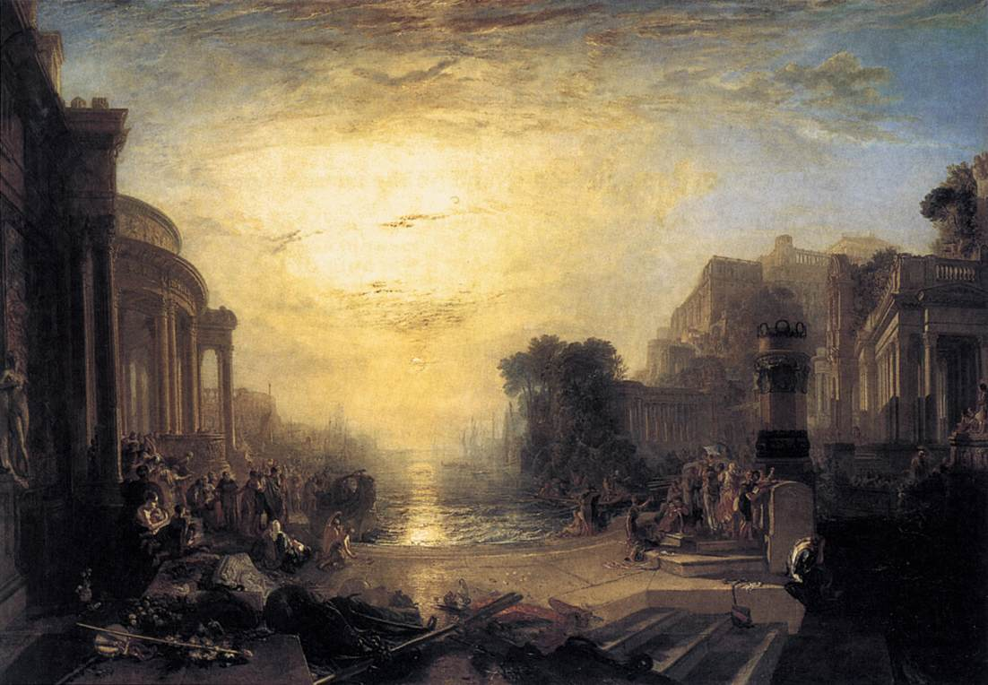
The most amazing works
The Decline of the Carthaginian Empire.

Slide 11
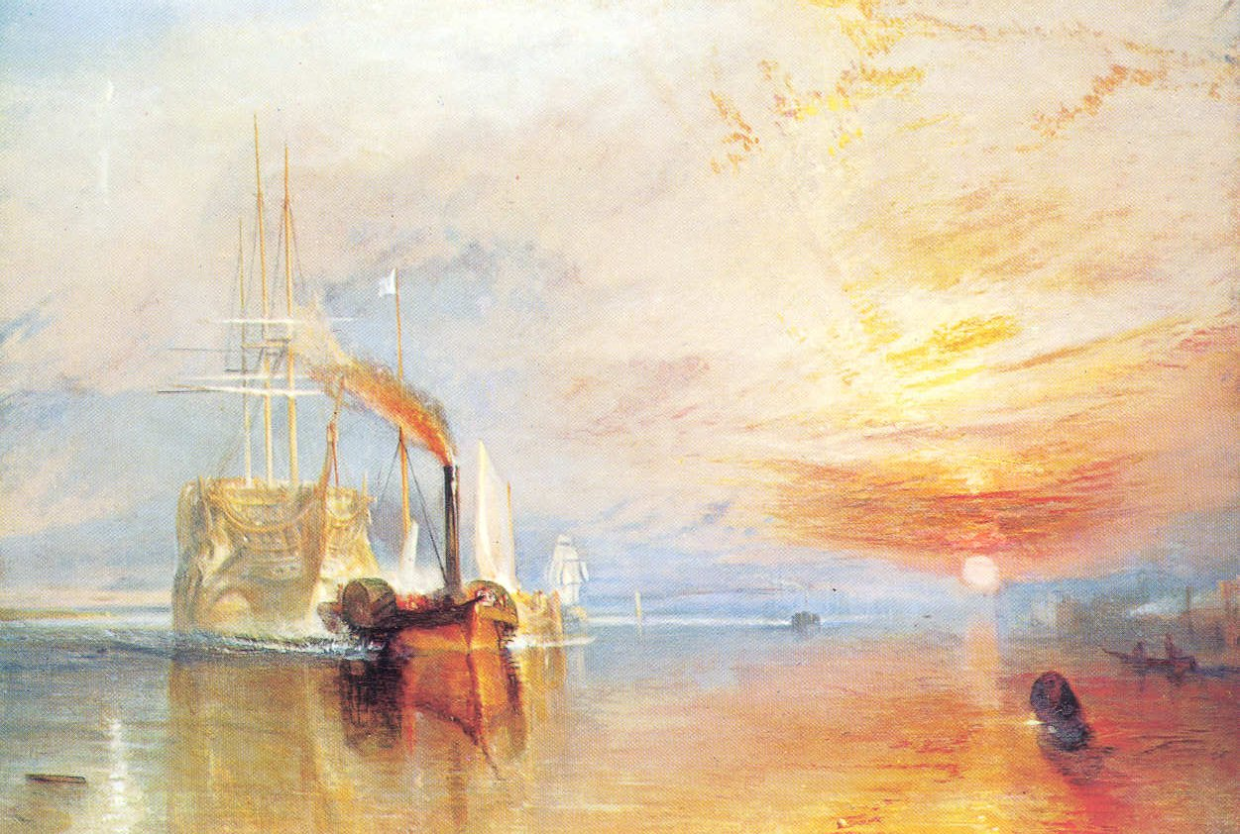
The most amazing works
El Temerario remolcado al dique sec.

Slide 12
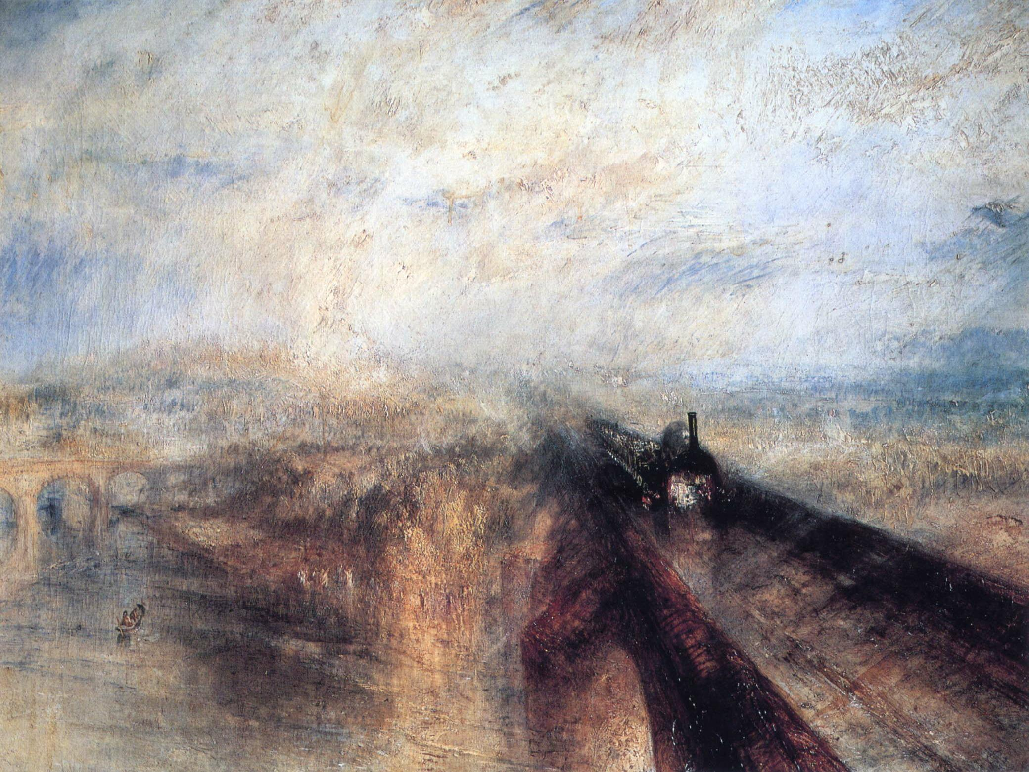
The most amazing works
Early 19th Century Romanticism.

Slide 13
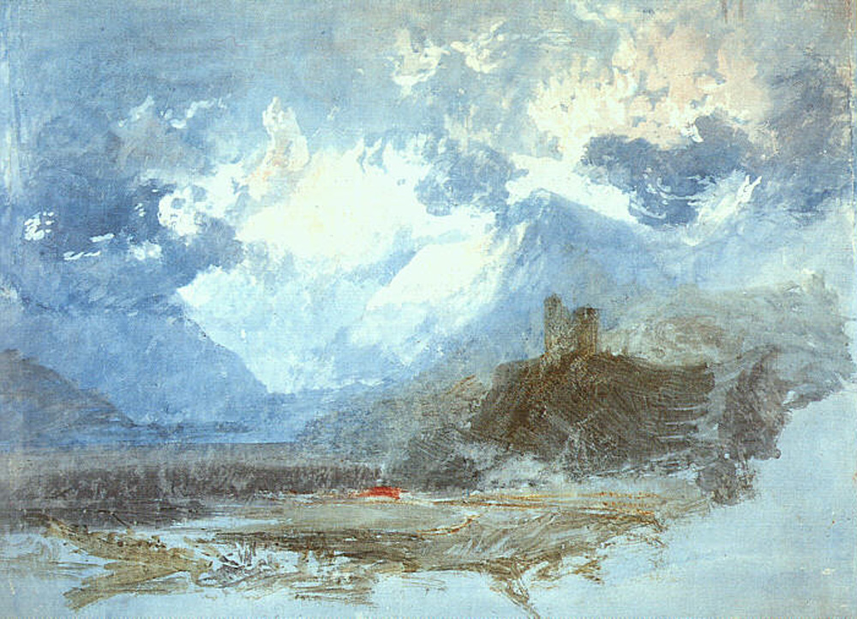
The most amazing works
Dolbadern Castle.

Slide 14
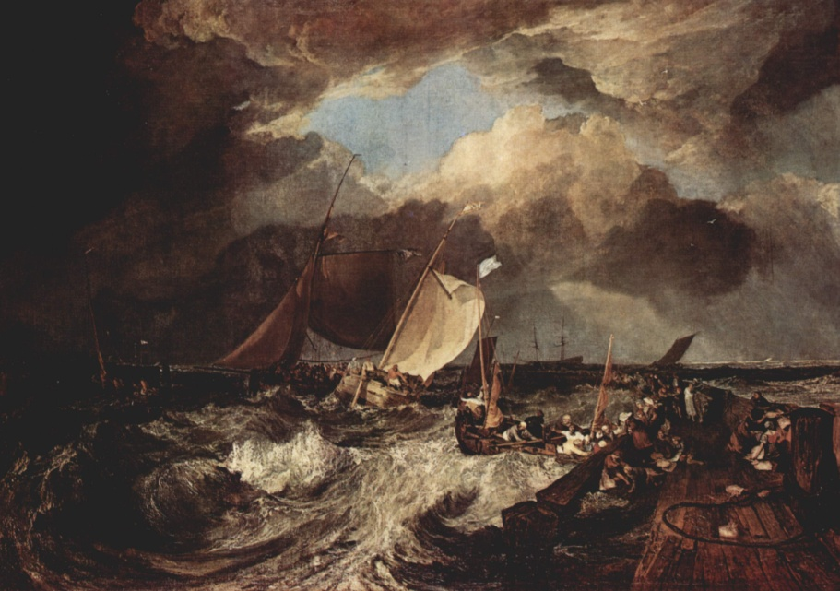
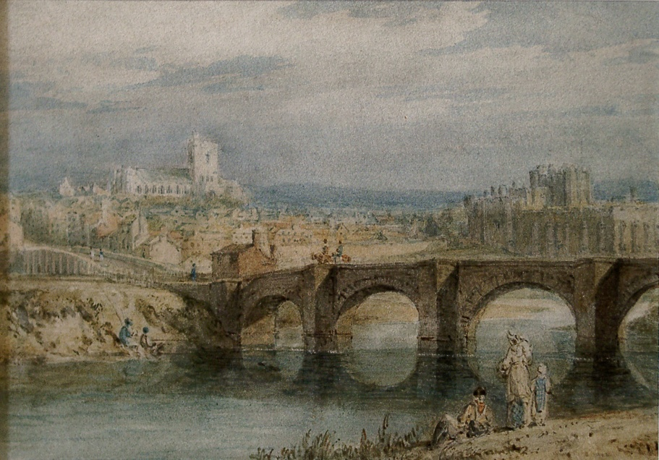
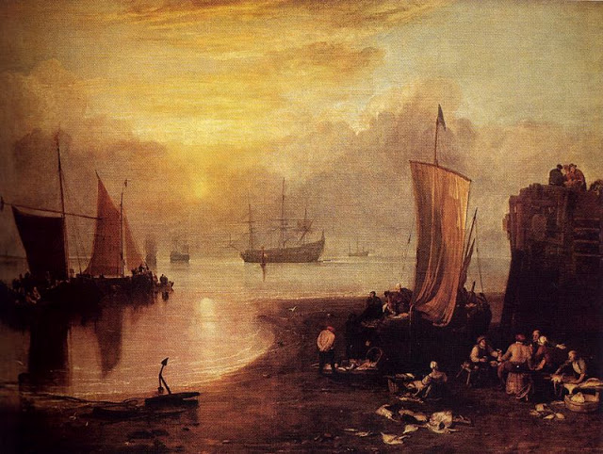
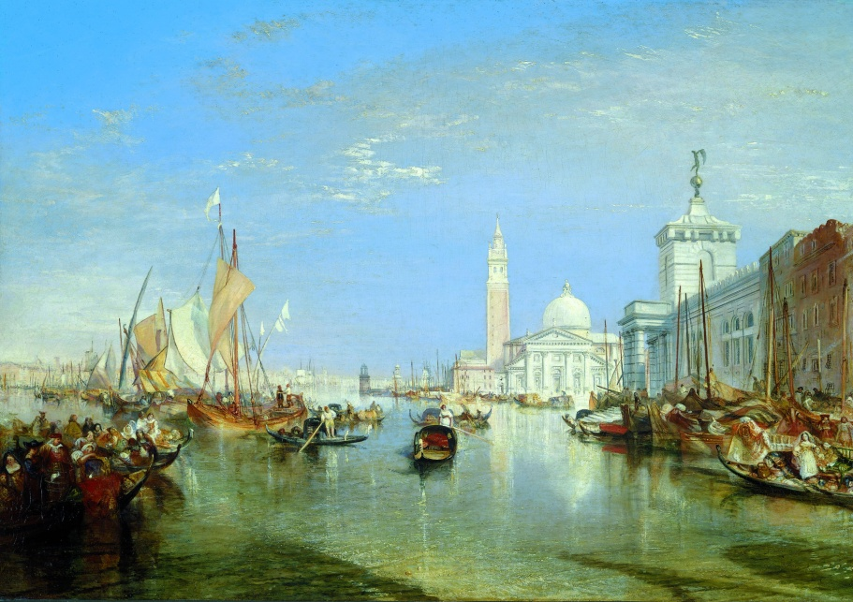
Thank you for your attention! ☺

