Slide 1
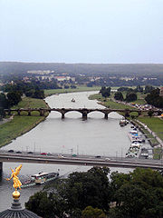
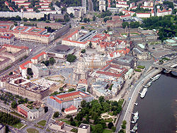
Dresden – one of the most beautiful towns in the world…
… in our opinion. =)))))

Slide 2
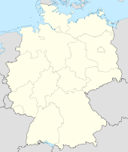
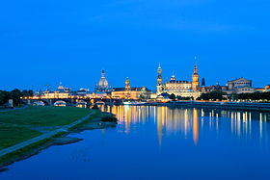
General information
Dresden is located in the east Germany, to the west of Ukraine. It is situated in a valley on the River Elbe, near the Czech border. In 2011 Dresden celebrate its 805th birthday.
The population consist of just over 512 400 inhabitants.
Dresden is an attractive, amazing city – culture capital of Germany. It’s the largest industrial center in the country, too. It has very beautiful landscapes and picturesque location. Also it is well-known as “Florence on the Elbe“.
The territory of city occupy almost 330 square km.

Slide 3
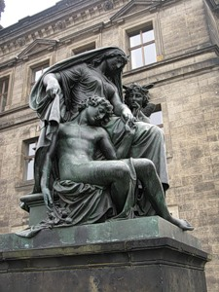
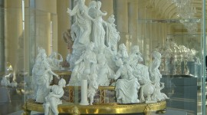
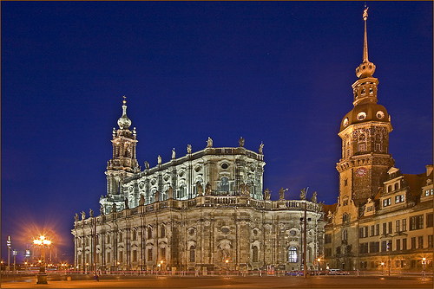
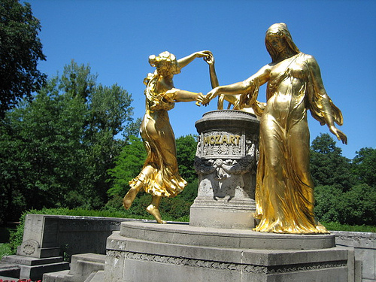
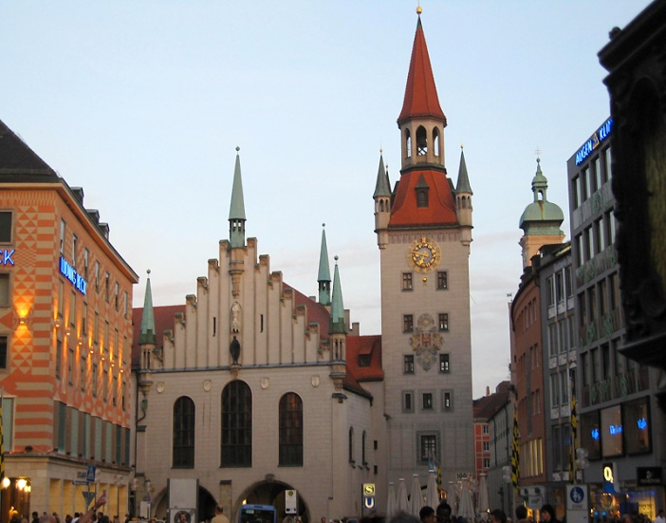
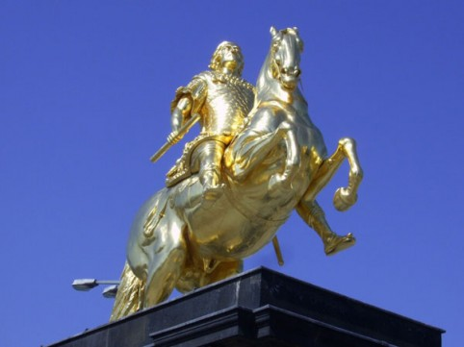
Sights and interesting places to visit

Slide 4
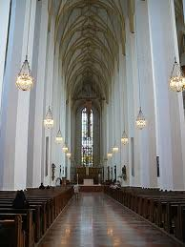
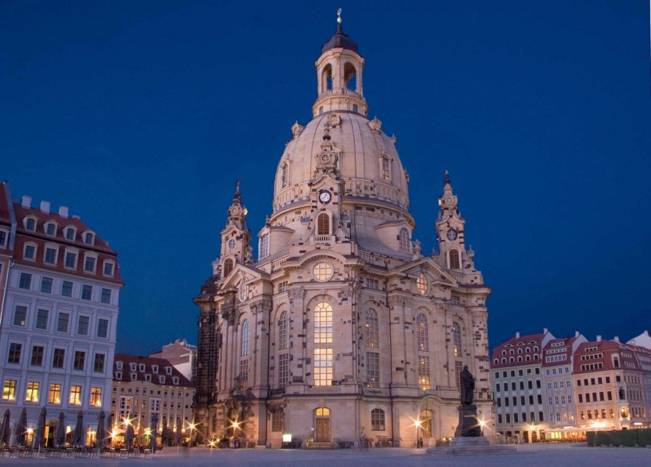
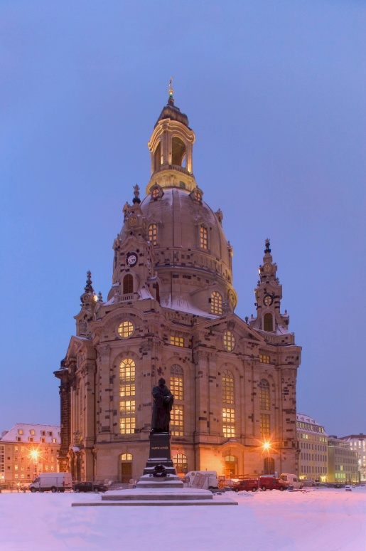
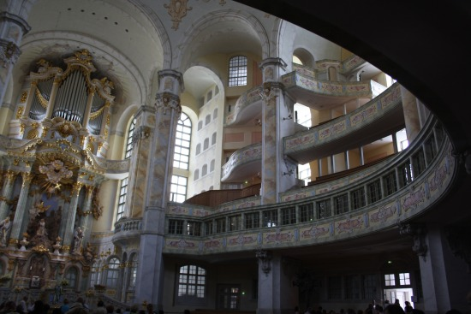
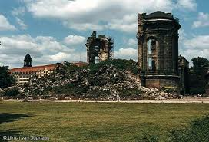
Frauenkirche Church
Also known as “The Church of Our Lady”, the Frauenkirche is one of the most important sights of Dresden. During World War II the church was badly damaged and many people thought that it could not be repaired. But, with much effort and talent it was rebuilt years later. Since its reopening, the Frauenkirche is considered as an impressive symbol of reconciliation and hope.

Slide 5
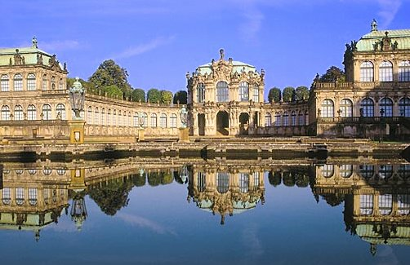
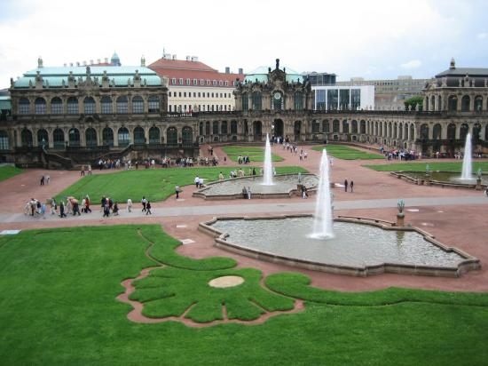
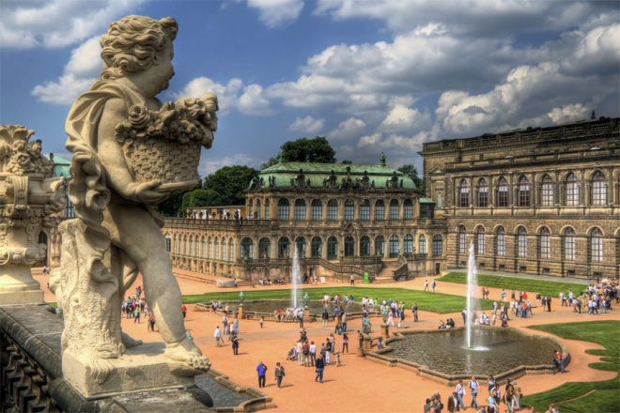
Zwinger
This famous complex was building from 1710 to 1728. In this epoch, Augustus the Strong used the palace as a home for his concubines and for exhibitions or athletic tournaments. Now, Zwinger is home for many sculptures, pavilions and art collections like the famous Madonna Sistina of Rafael. There is also the “Crown Gate” that with its golden dome has become an important and wide visited sight.

Slide 6
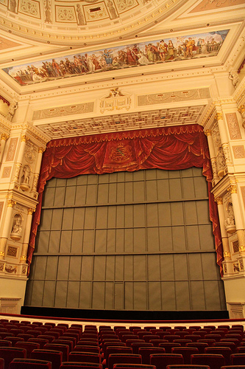
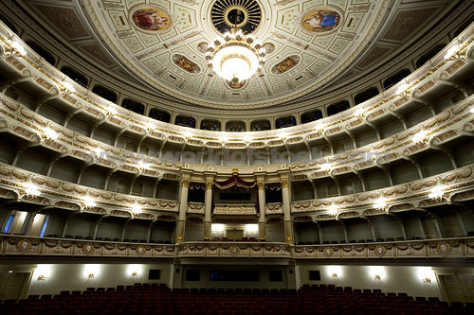
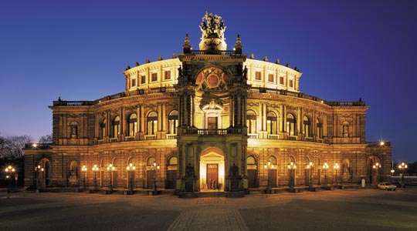
The Semper Opera House
The Semper Opera House is a famous historic building and for many people the most representative in Dresden. The name of this Opera House is in honour of the architect Gottfried Semper, who designed and built it, using an Italian Renaissance style. As many historic buildings in Dresden it was destroyed in the World War II. Nowadays, in the Semper Opera House many famous opera performances are shown.

Slide 7
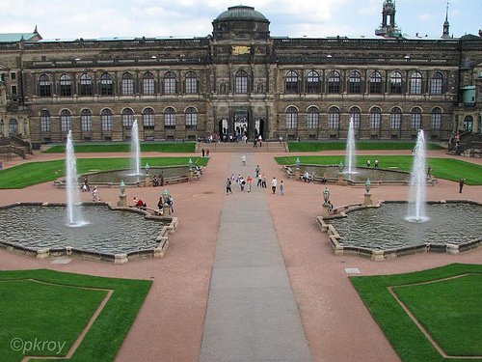
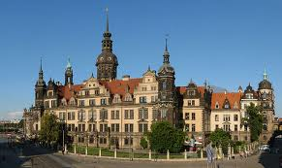
The Dresden Castle
This famous castle was built in the 15th century with a renaissance style and was the royal residence of Saxon leaders, especially of August the Strong. Through the years the castle suffered many changes which are expressing in the mix of the Renaissance, Baroque and Classicist styles. After the World War II, it was reconstructed as a museum complex.

Slide 8
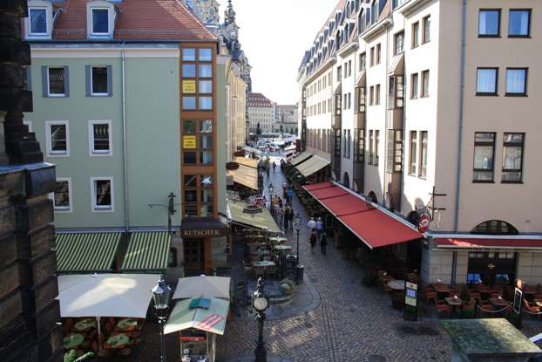
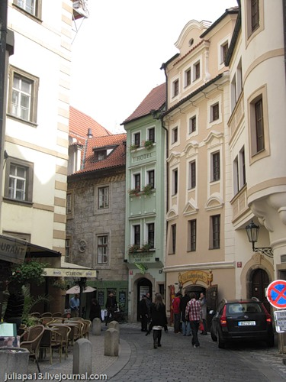
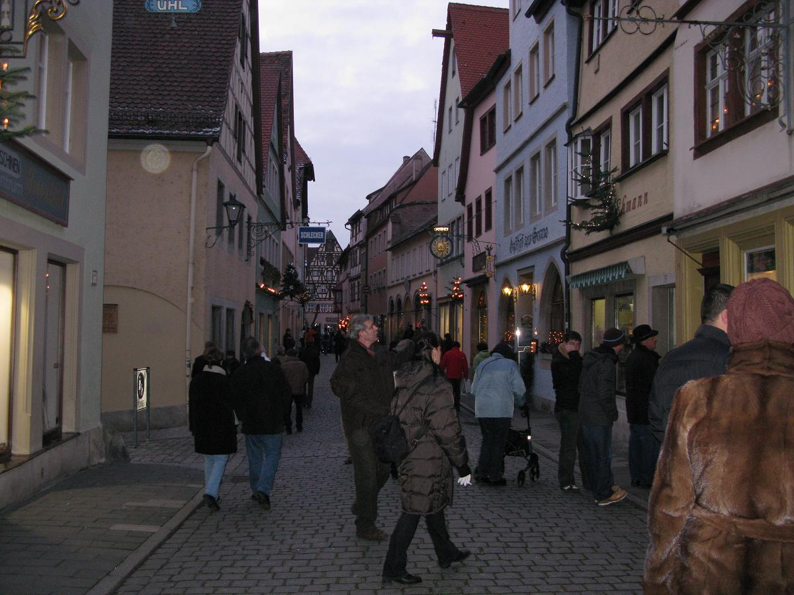
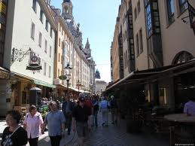
Small streets of Dresden with its cozy cafes on roadsides…

Slide 9
Interesting activities and exciting things to do in Dresden
Many various kinds of sports
Tourism
Weihnachten (Christmas) in Dresden
Places to going out

Slide 10
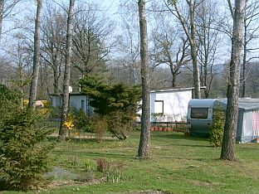
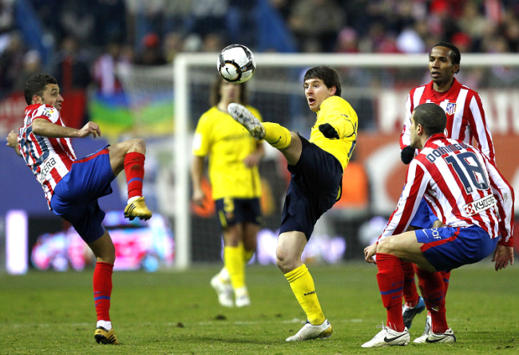
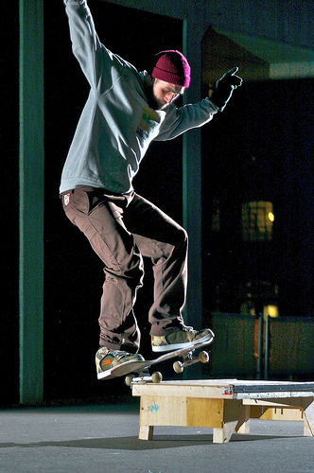
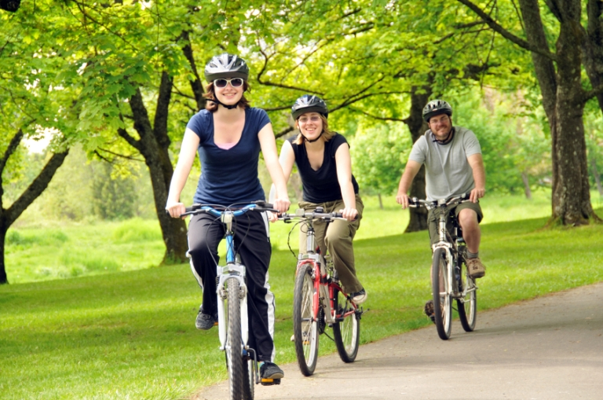
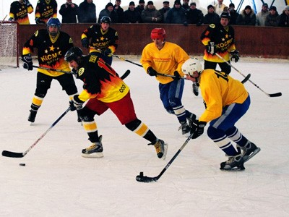
Sport in Dresden
Dresden is not very sport city, but there’re many famous kinds of sport such as: football, ice hockey, boxing. There are also special kinds of sport such as: night skating, bicycle, swimming, sauna and camping.

Slide 11
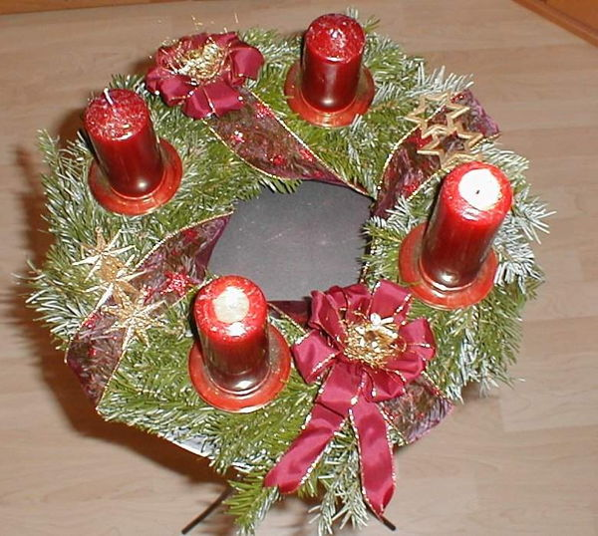
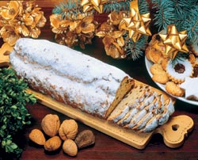
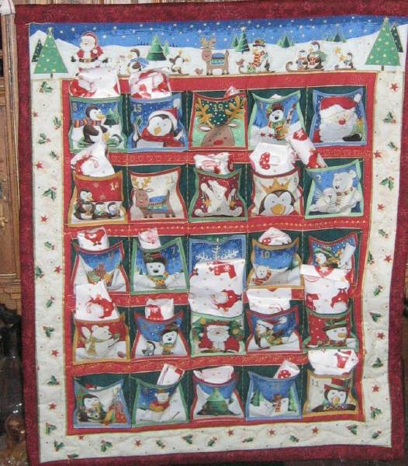
Christmas in Dresden
“Adventszeit” it is the time, which begin on 1st December, last 24 days and on 25th December people celebrate Christmas – “Weihnachten” in German.
It is national Christmas pie “Stollen”. There is even festival, which call “Stollenfest”
People put such wreath with candles on their windowsills and every Sunday in “Adventszeit” family gather together and burn the candle. In wreath there are four candles for one week in “Adventszeit.”
“Adventskalendar”- it is an poster with 24 pockets. Children get it in the first day of “Adventszeit”. Then they can open a little door and get a small present.

Slide 12
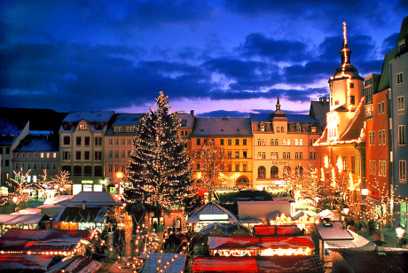
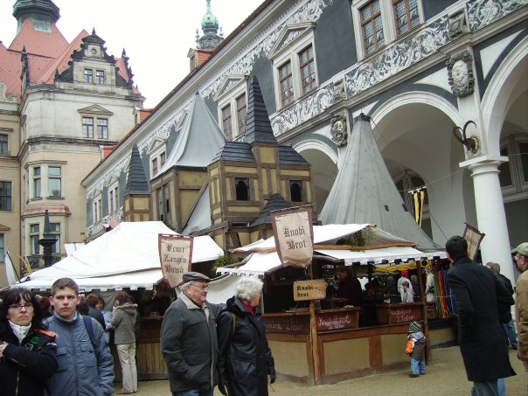
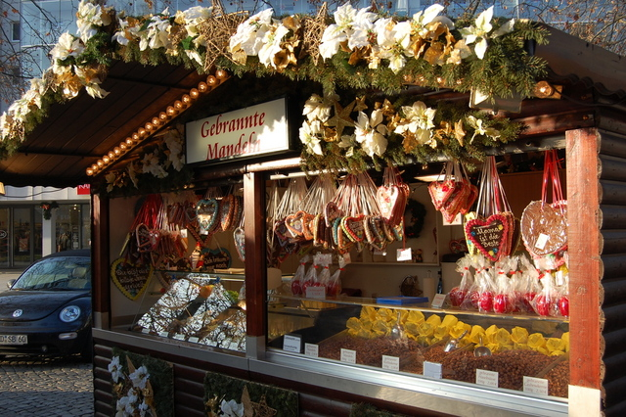
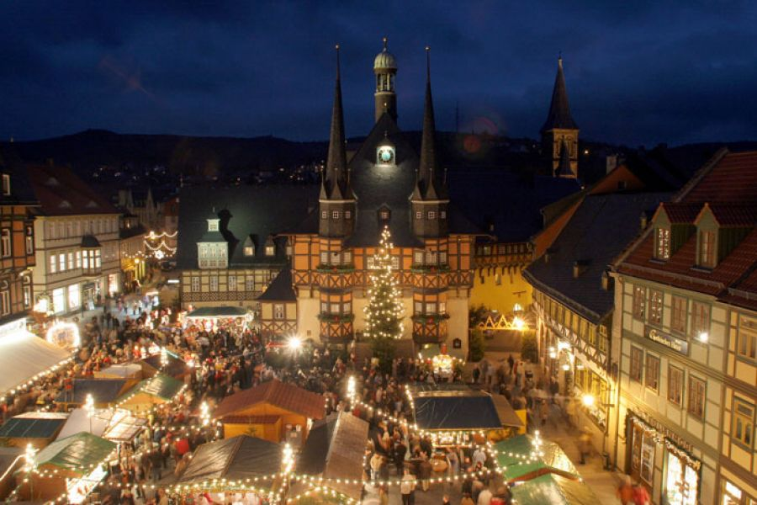
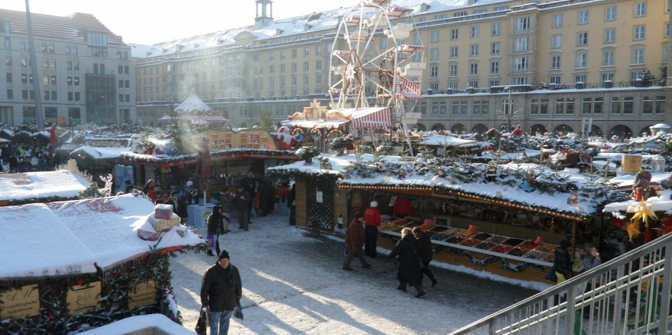
Christmas Fairs in Dresden
During all “Adventszeit” in Dresden are opened many Christmas fairs with various candies, cookies, biscuits, pies and other sweets. You can also find hear many presents for your friends and relatives. “Mulled wine” (the heat, warm wine) – it is very common alcohol beverage between adult people in winter.

Slide 13
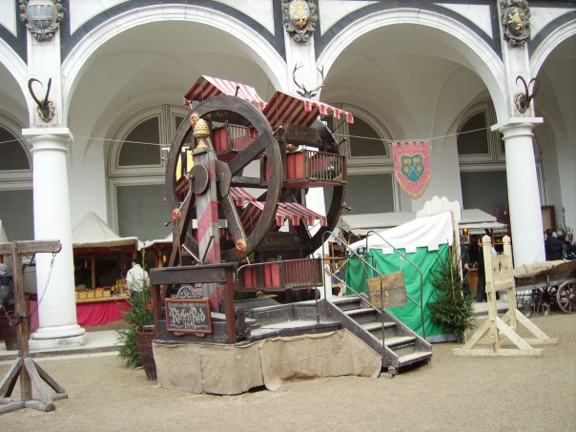
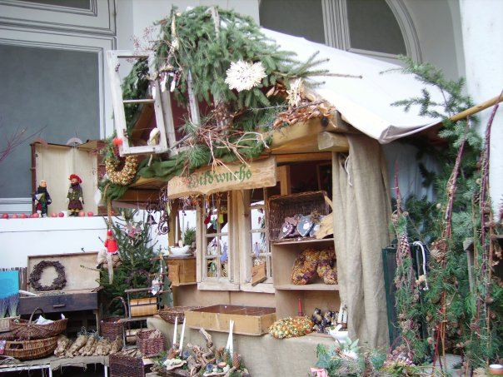
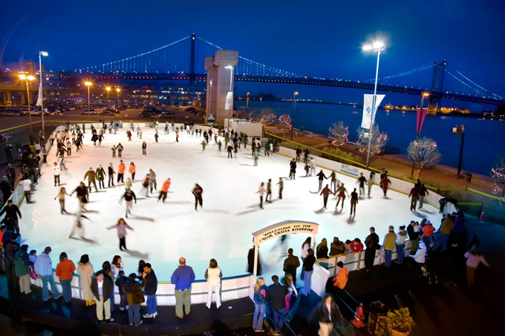
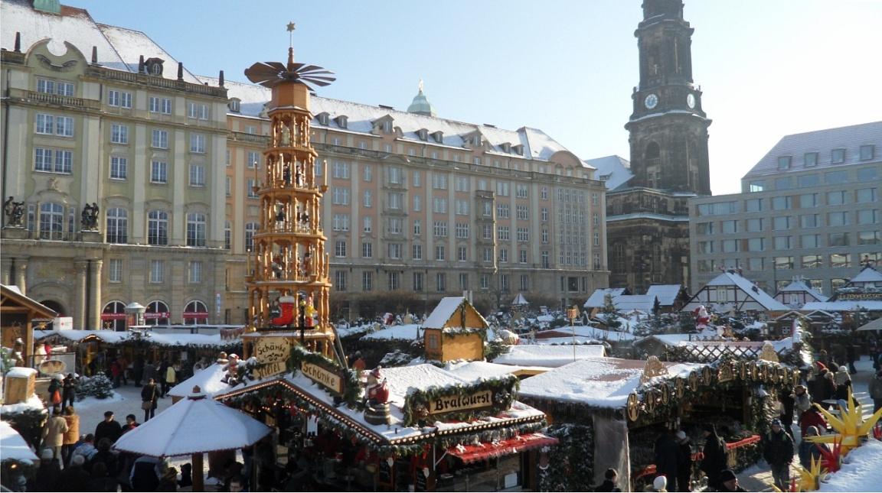
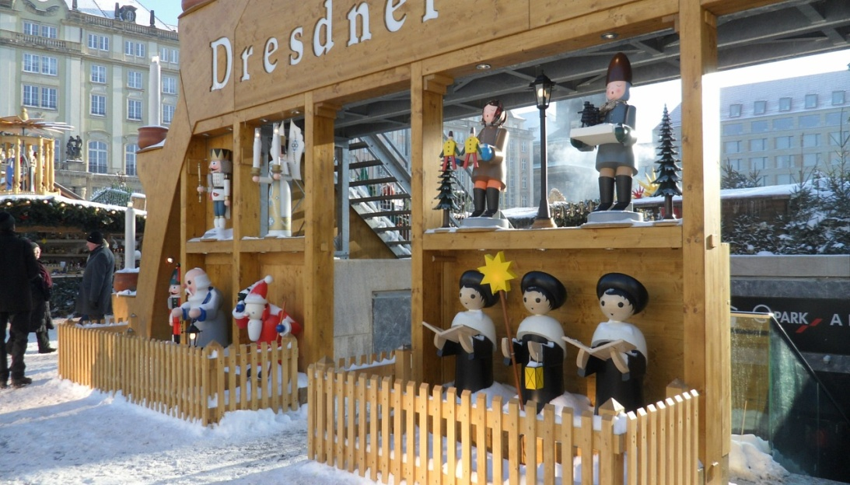
Different shops and stores suggest you various interesting things, sweets and presents. There are also many amazing decorations and showcases, so, as a result, it attracts plenty visitors, customers and shoppers.

Slide 14
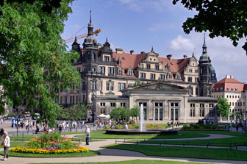
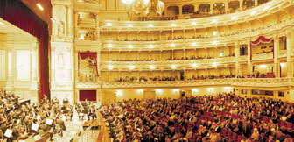
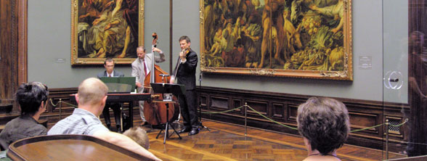
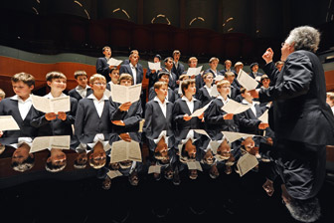
Places to going out
In Dresden there are 56 galleries, 44 museums and 36 theatres and stages.
A well-known person is the conductor of the Dresden Philharmonic orchestra. Rafael Fruehbeck de Burgos gives with his orchestra concerts almost every weekend – major symphonies, choral works, chamber music and concerts specially for children.
You can visit concerts in Semper Opera House or Old Masters Picture Gallery with Raphael's “Sistine Madonna”.

Slide 15
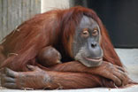
Dresden Zoo
The fourth-oldest zoo in Germany is a magnet for visitors. It is situated in the southern part of the Great Garden. There live nearly 2,000 animals of 334 species. Its special attractions include the Africa House with elephants, mandrills and some tropical birds, in the cage like savannah live lions and caracals, and the new Giraffe House, where a viewing gallery allows visitors to see “eyes to eyes” the giraffes.
The zoo isn’t only entertaining place, and the largest scientific educational institute in the city. The Zoo School, established in 1969, shows students of all ages many various animals, pays attention to environmental-protection problems and global problems of ecology.

Slide 16
Botanical Garden
The Botanical Garden contains approximately 10,000 species of plants from every climate zone and from different of geographical regions worldwide. Three different demonstration greenhouses give you opportunities to watch the flora of tropical and subtropical regions.

Slide 17
Glass Manufacture
"Glass Manufacture” - it is the factory and museum where visitors or costumers can watch how their cars are making. Here are making Volkswagens cars. There is tower 40 meters height, where stay cars and wait for their masters. Here is also sophisticated computer system, which equipped in the floor. The special machines move on this floor (how on the map) and bring needed details for cars and then man put it in the correct place. Everybody who want, can put some details in certain place.

Slide 18
The project was made by:
Dima
Kristina
Alina

Slide 19
Thank you very much for virtual trip with us !!!

