Slide 1
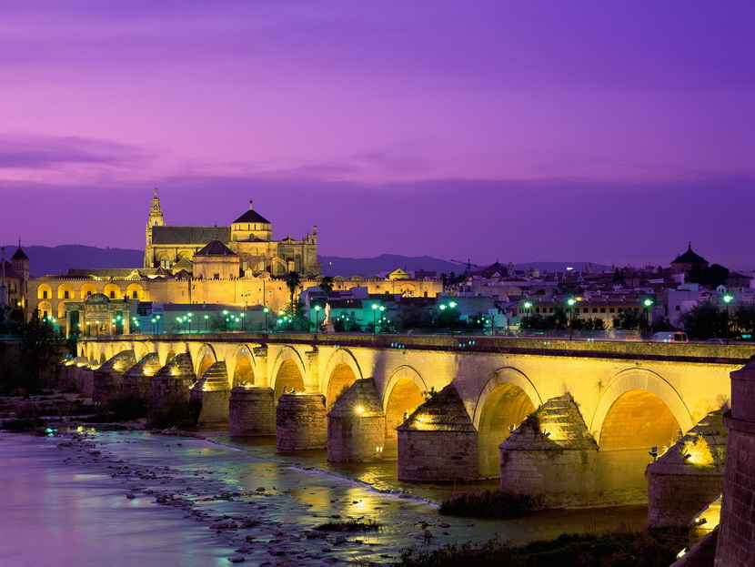
Welcome to Spain

Slide 2
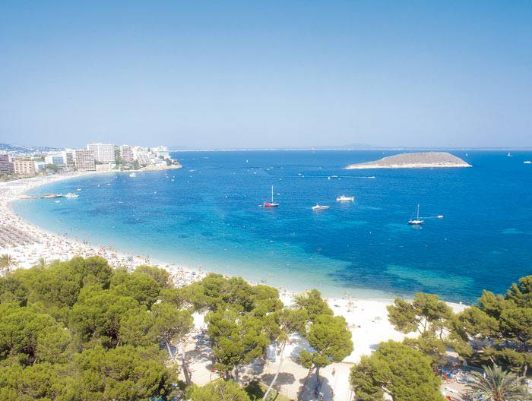
Tourist card
"Ukraine International Airlines" fly on the route Kiev-Barcelona from 400 €.
Documents required for a tourist visa to Spain for the citizens of Ukraine and Russia are identical. The documents must be translated into Spanish or English. Adults - 45 €. For children - 20 €.
Time difference between Ukraine and Spain is -1 hour.
Weather in Spain - one of the sunniest and warmest in Europe. The number of sunny days per year is about 280.
The most popular hotels are Royal Passeig de Gracia 3 * - 50 €, Sunway Playa Golf 4 * - 70 €, Eurostars Grand Marina GL 5 * - from 85 €.
Lunch in a restaurant costs about 20 €.

Slide 3
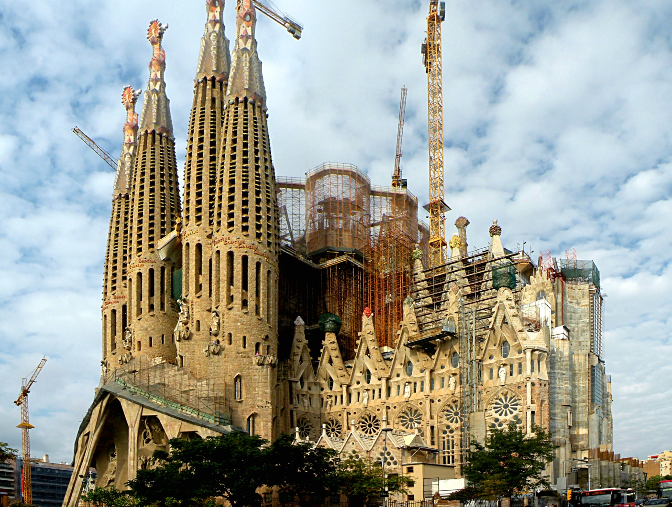
Sagrada Família
"Sagrada Familia" is the main attraction of Barcelona, a church built by the famous Antoni Gaudi. Its construction has not yet been completed: complex architectural forms each unit require individual treatment.

Slide 4
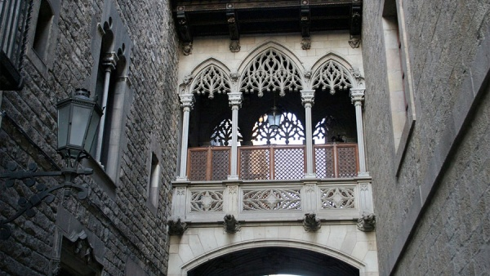
The Gothic Quarter
This is the oldest part of the capital city, famous for the beauty of medieval streets, houses, palaces and cathedrals, and the habitat of the authorities of Catalonia.

Slide 5
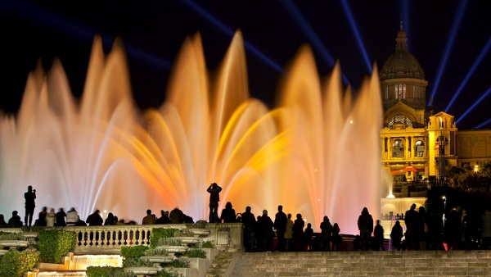
Singing Fountain
This is the most popular attraction of Barcelona's 2.5 million spectators each year. The water sings, dances and all colors of the rainbow. The show lasts 20 minutes. In summer, the fountain "acts" in 21.00, 21.30, 22.00, 22.30, and 23 hours. Winter - 19.00, 19.30, 20.00.

Slide 6
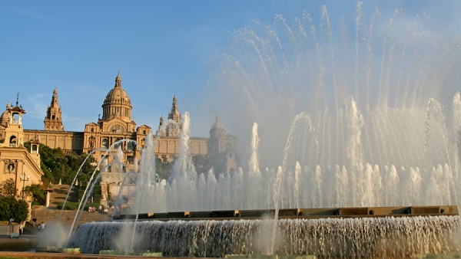
Montjuic Park
This is one of the largest urban parks in Europe with a magic fountain, old castle, a magnificent palace, gardens and museums.

Slide 7
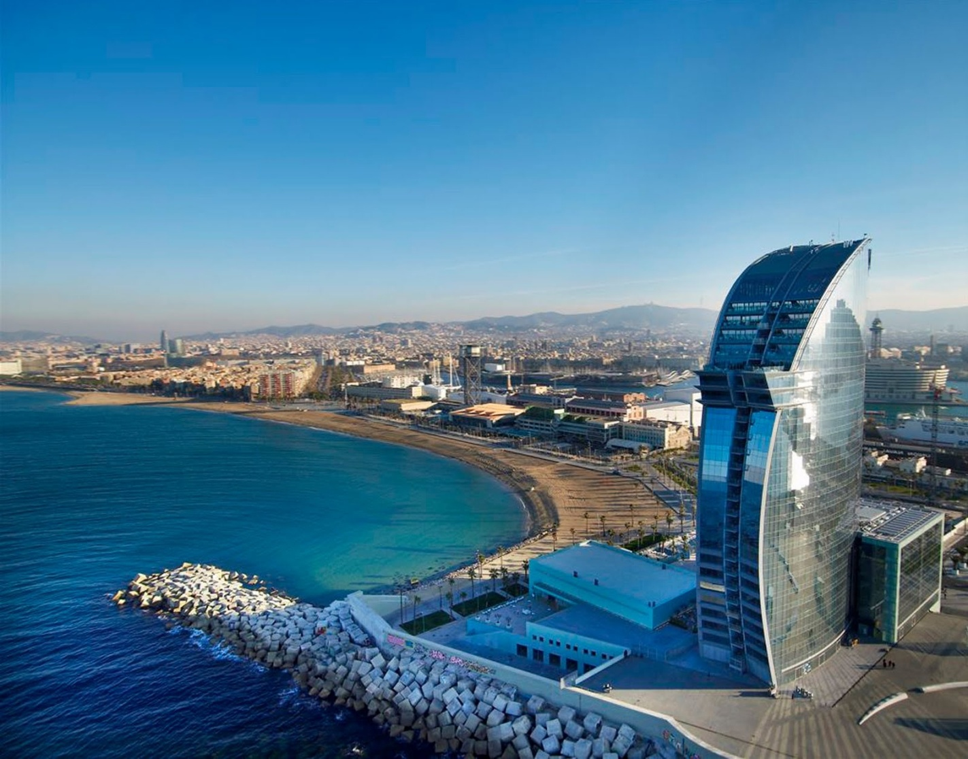
The beach of Saint Sebastia
It is the longest and the wide sandy beach of Barcelona, located closest to the city. Free, clean water and no jellyfish.

