Slide 1
Environmental problems

Slide 2
Today people strongly pollute environment without thinking of consequences

Slide 3
The major forms of pollution:
1. air pollution;
2. littering;
3. noise pollution;
4. soil pollution;
5. radioactive contamination;
6. water pollution;
7. destruction of animals and plants.

Slide 4
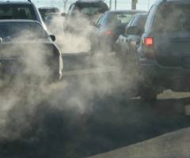
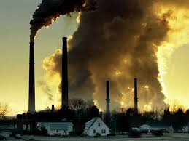
Air pollution
Air pollution is characterized the release of chemicals and particulates into the atmosphere.

Slide 5
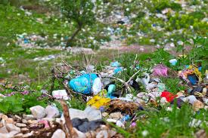
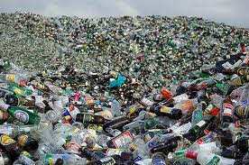
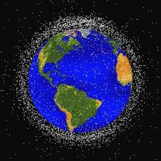
Littering
Littering is characterized by emission of waste of food, plastic, papers and metal products.

Slide 6
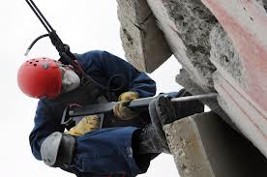
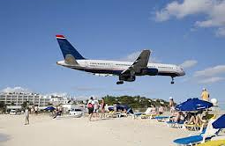
Noise pollution
It is noise of cars, trains, planes.

Slide 7
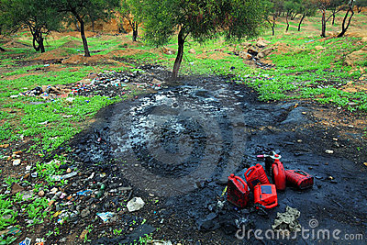
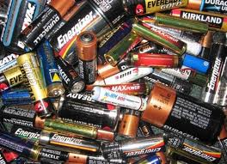
Soil pollution
Soil contamination occurs when chemicals are released by spill or underground leakage. Among the most significant soil heavy metals.

Slide 8
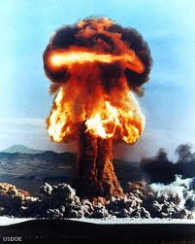
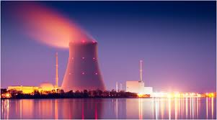
Radioactive contamination
Environment is polluted by nuclear power generally

Slide 9
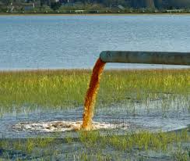
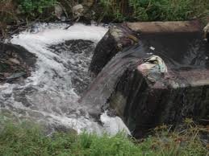
Water pollution
Water pollution happens unloading of sewage from commercial and industrial wastes (purposely or through pro-lithium) on a surface water.

Slide 10
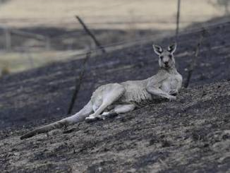
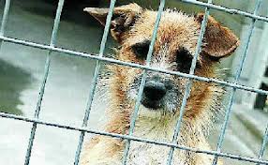
Destruction of animals and plants
Animals kill for meat and valuable skins, and plants destroy for the areas under constructions.

Slide 11
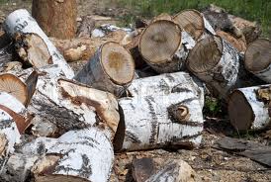
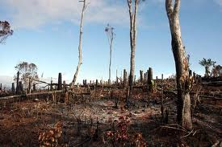
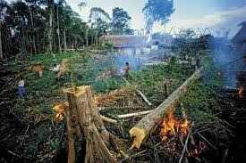

Slide 12
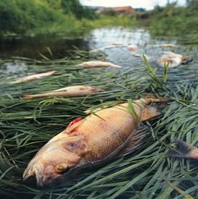
Environmental pollution consequences, reduction of stocks of drinking water, illness, global warming, reduction of an ozone sphere.

Slide 14
Save our planet!!!

