Slide 1
Robert Boyle

Slide 2
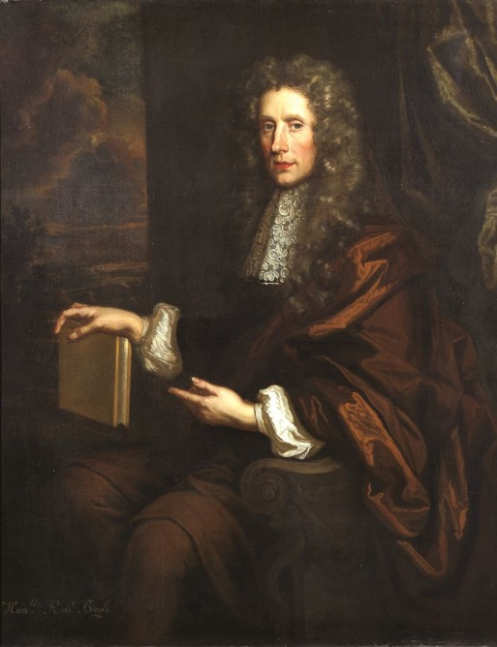
Biography
Born in Lismore, County Waterford, Ireland 25 January 1627.
As a child, Boyle was fostered to a local family, as were his elder brothers.
After spending over three years at Eton, Robert travelled abroad with a French tutor.
They visited Italy in 1641 and remained in Florence during the winter of that year studying the "paradoxes of the great star-gazer" Galileo Galilei, who was elderly but still living in 1641.

Slide 3
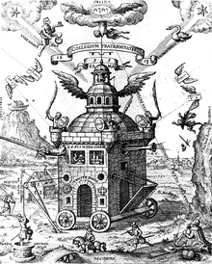
Returned to England from continental Europe in mid-1644 with a keen interest in scientific research.
Took a prominent place in the band of enquirers, known as the "Invisible College", who devoted themselves to the cultivation of the "new philosophy".
In 1652 Robert moved to Ireland
In 1654, Boyle left Ireland for Oxford to pursue his work more successfully.
Emblematic image of a Invisible College

Slide 4
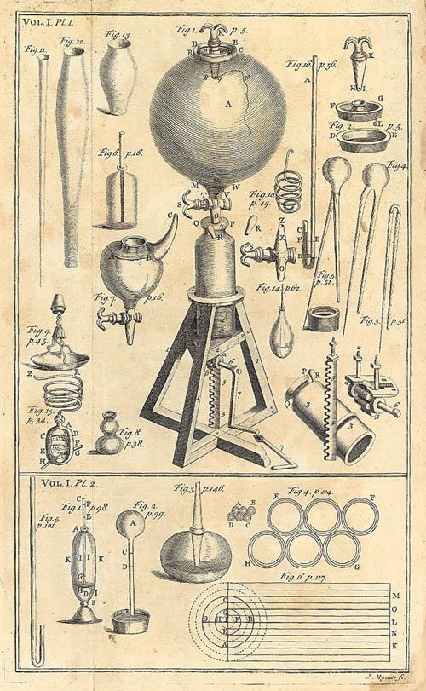
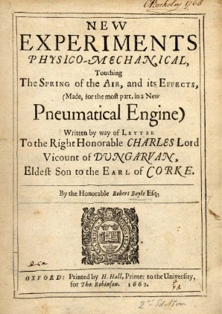
In 1659 he constructed the "Pneumatic Engine", which was Otto von Guericke's air pump with improvements.

Slide 5
Boyle's law
PV=k
P – the pressure of the gas
V – the volume of the gas
k-constant
«The absolute pressure exerted by a given mass of an ideal gas is inversely proportional to the volume it occupies if the temperature and amount of gas remain unchanged within a closed system»

Slide 6
“The Sceptical Chymist”
In the book Boyle attacks the Aristotelian theory of the four elements (earth, air, fire, and water) and also the three principles (salt, sulfur, and mercury) proposed by Paracelsus.
He represents hypothesis that matter consisted of atoms and clusters of atoms in motion and that every phenomenon was the result of collisions of particles in motion.

Slide 7
Boyle's major discoveries and theories:
He designated the technique of detecting mixture's and compound's ingredients, by the term "analysis"
Elements are the indecomposable constituents of material bodies.
Elements are ultimately composed of particles of various sorts and sizes
There is a distinction between mixtures and compounds.

Slide 8
Theological interests
promoted the spread of Christianity in the East
contributed liberally to missionary societies
supported translating the Bible or portions of it into various languages
believed that all human beings, no matter how diverse their physical differences, came from the same source: Adam and Eve
Boyle's writings mentioned that for Europeans beauty was not measured so much in color of skin, but in "stature, comely symmetry of the parts of the body, and good features in the face".

Slide 9
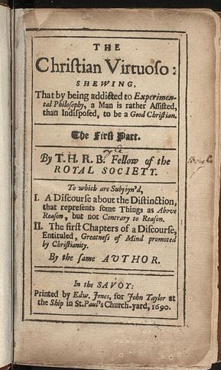
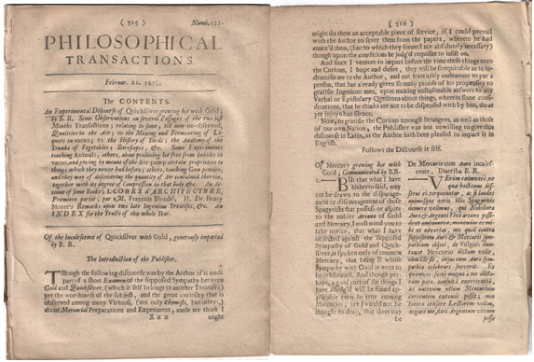
His religious and philosophical writings

