Slide 1

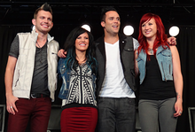
Skillet

Slide 2
Skillet (band)
Skillet is a Christian rock band formed in Memphis, Tennessee in 1996 and based in the United States. The band currently consists of husband and wife John (lead vocals, bass) and Korey Cooper (rhythm guitar, keyboards, backing vocals), along with Jen Ledger(drums, vocals) and Seth Morrison (lead guitar). The band has released nine albums, two receiving Grammy nominations: Collide andComatose. Awake has been certified Platinum and debuted on No. 2 on the Billboard 200, with Comatose certified Gold by RIAA.
Skillet went through several line-up changes early in their career, leaving founder John Cooper as the only original member remaining in the band. They have sold over 2 million albums in the U.S. alone and are known for a relentless touring schedule, which garnered them a top five ranking in the Hardest Working Bands of 2011 by Songkick.com.

Slide 3
Musical style
The band's style has been described as rock, Christian rock, Christian metal, alternative rock, hard rock, nu metal, and symphonic metal. The band's eponymous debut album characterized by its grunge influences, while their follow-up album, Hey You, I Love Your Soul was noted for "its electronic elements and industrialfeel."
Allmusic reviewer James Christopher Monger described the band's musical style as a fusion of "alt-metal, hard rock, post-grunge, and soaring alternative rock," in his review for the band's 2013 album, Rise.

Slide 4
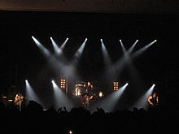
Skillet performing live on April 12, 2008 at Anderson University, Anderson, Indiana.

Slide 5
Touring
Starting on August 13, 2013 Skillet toured with Shinedown, Papa Roach and In This Moment on the Carnival of Madness tour. In October and November the band arrives Europe supporting Nickleback's tour in twenty one shows. The band closed the year headlining their own tour in Russia and a show in Ukraine.
Skillet started 2014 coheadlining the Roadshow 2014 with Third Day during January and February. Upon completion, the band continued coheadlining alongside Third Day in a Spring tour. Later in May, toured with TobyMac and Lecrae in the Summer Shed Tour. Starting in the end of May, the band traveled to be part of European festivals during six weeks. In August and September they joined Godsmack, Seether, and Buckcherry in the Rockstar Uproar Festival in twenty one American cities. In October and November the band had its own tour in Europe and Russia, offering twenty-two shows.
Starting in January, Skillet will headline the Winter Jam Tour 2015.

Slide 6
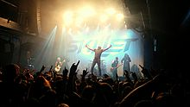
Skillet performing in the Komplex457 in Zurich in October 20, 2014

Slide 7
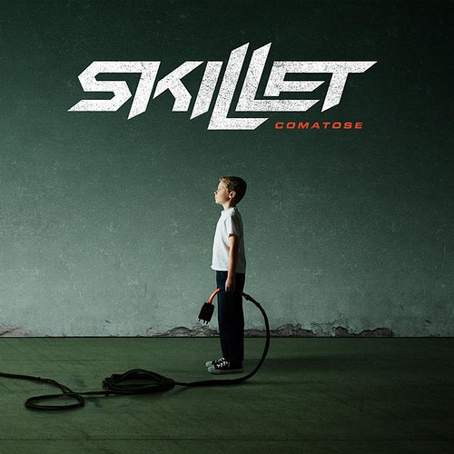
My favourite song
Skillet - comatose

