Slide 1
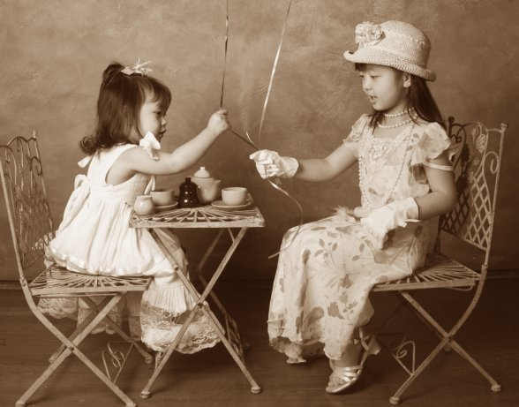
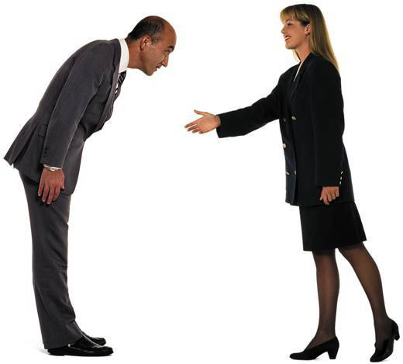
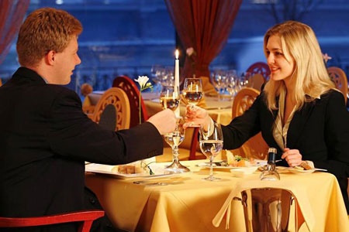
Good manners
lera Osadchuk and Tania Grigor

Slide 2

Each country has its own idea about good manners. Every day we meet different people and communicate with them, get new experience and communication skills. Any communication starts with the greeting.

Slide 3

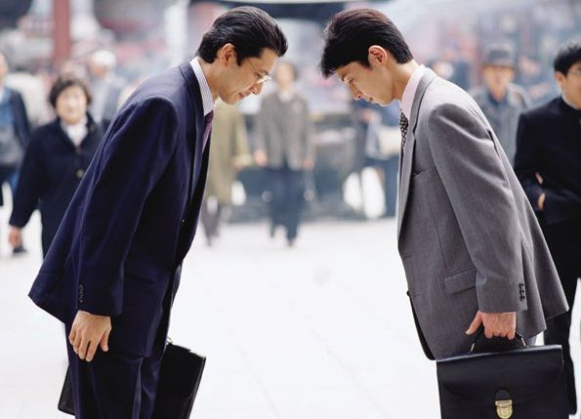
Greeting
In different countries people greet each other in different ways.
The Russians, Europeans, Americans shake hands.
In Japan you should bow . The tradition of bowing to come from the depth of centuries.
In France in the informal atmosphere of even unfamiliar people kiss each other .
Lapp are rubbing against each other's noses.
Arab people crossed his arms on his chest.
Tibetans take off the hat of the right hand and left hand lay behind his ear, and stick out his tongue.
Latin Americans embrace each other .
In each country - its traditions, its own way of conversation, wishes of prosperity and rules of politeness. It is clear that there is not universal, general rule for all nations, but a single common rule is that you should be polite.

Slide 4
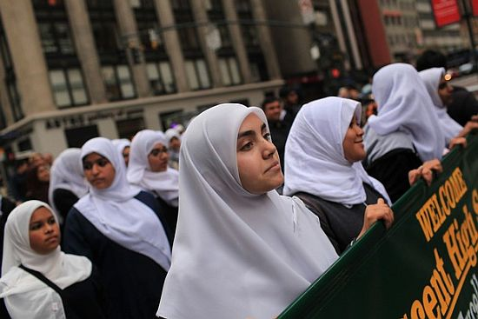
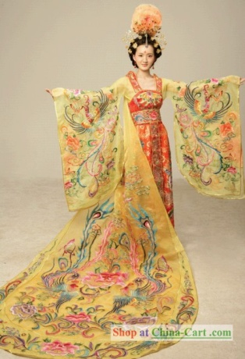
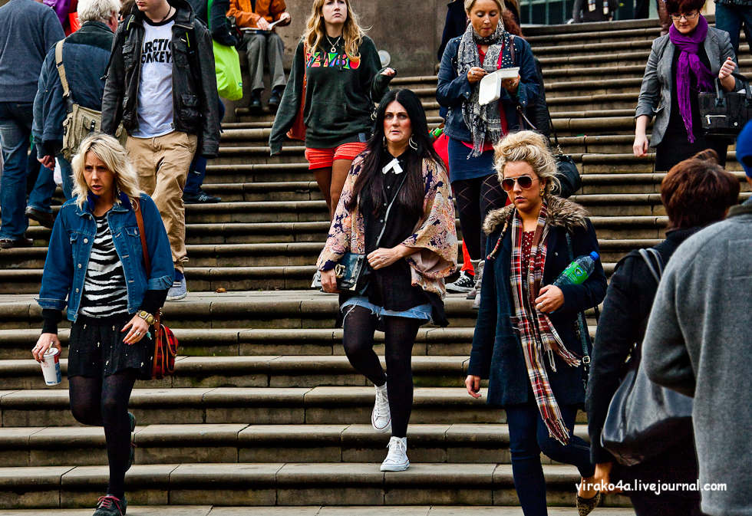
Clothes
People in different countries dress up in different ways. Thanks to the variety and individual preferences in clothes all people look unique. There is not any general rules on choice of clothes, but the clothes should always be appropriate for a site that you visit. Going to the theater men should dress suits and women should dress evening dresses. In Muslim countries
Women shouldn’t reveal their body. In North-Karolinska Mobile women aren’t allowed wear shoes with heels higher than 3.8 cm. In Alabama there are restrictions on the wearing of jeans.

Slide 5
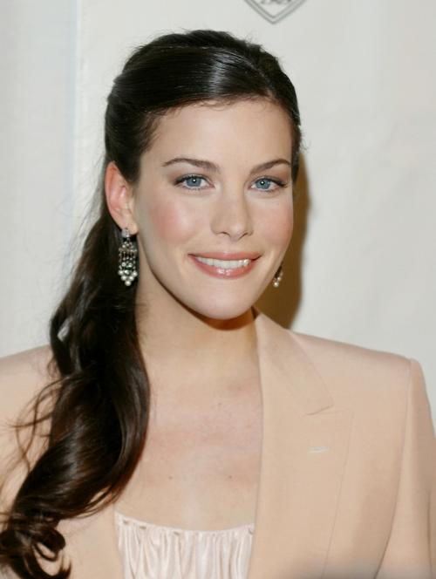
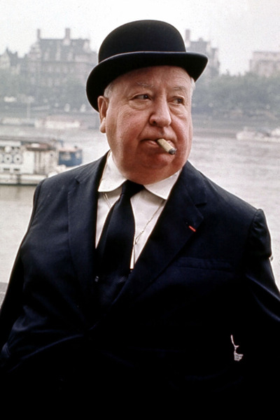
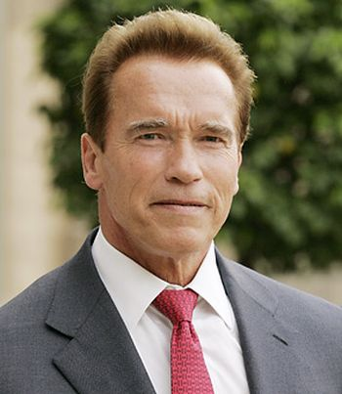

England
Your clothes should be low-key, well-tailored and high quality. The ideal would be a classic suit quiet tones. The most important item of clothing for the British - it's a tie. It is determined by social status and wealth of the entrepreneur. The British love the combination of black and white or pink. Women need to consider that make-up should be thorough, jewelry minimum hair arranged in a fashionable haircut or combed back.
German
As for appearance, if you appear in the office of German businessman without a jacket, it would be an unforgivable breach of etiquette on your part. B German conservative clothing - a classic suit calm colors. Women encouraged moderate makeup application, the use of jewelry, modest, strong hair.

Slide 6
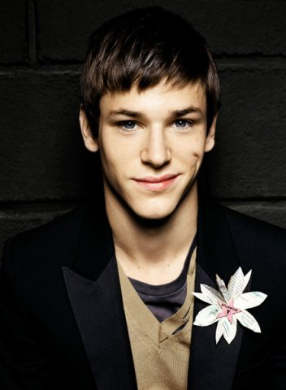
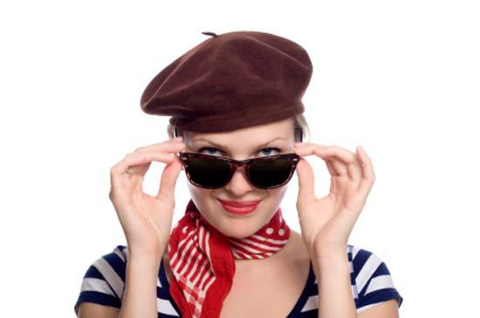

France
French are great connoisseurs of clothes and makeup. In dealing with them you can stick to the classic style. Assess if a woman light up very well suit scarf or a brooch, and a man tie clip.
Italy
Italians are very sensitive to color. The clothes should not use more than three colors (not counting semitones). Allowed various hairstyles.

Slide 7
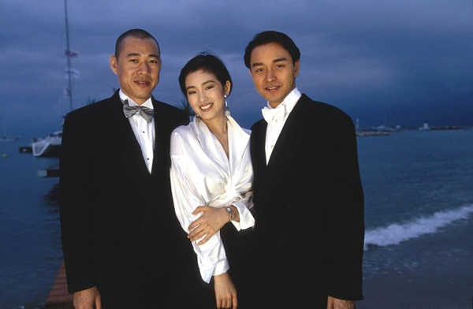
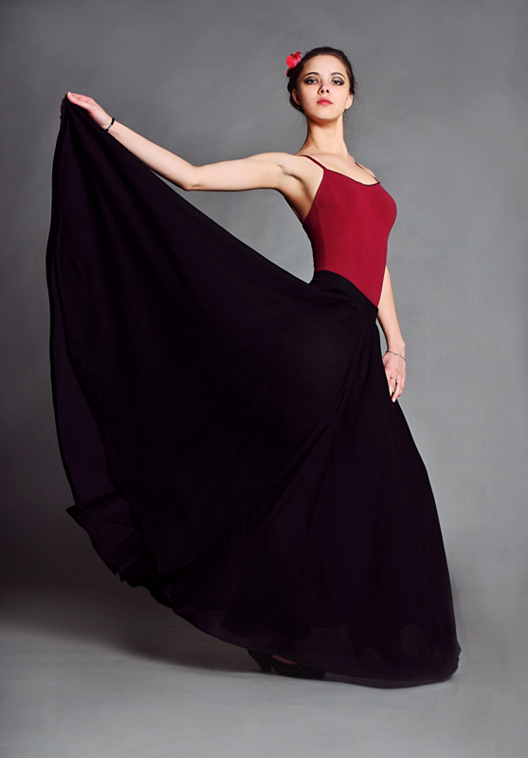
Spain
The clothes Spaniards love the combination of black and white or black and red with gold trim. Women's hair is best to remove a tight bun.
China
At a meeting with Chinese partners dress modestly. Prefer dark tones. Suit and tie are required only at official receptions.

Slide 8
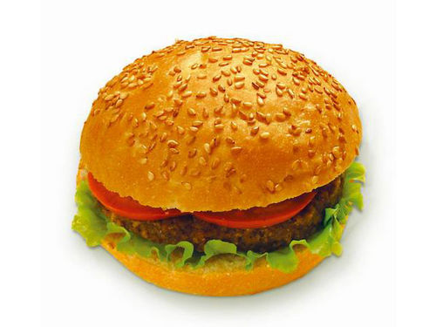
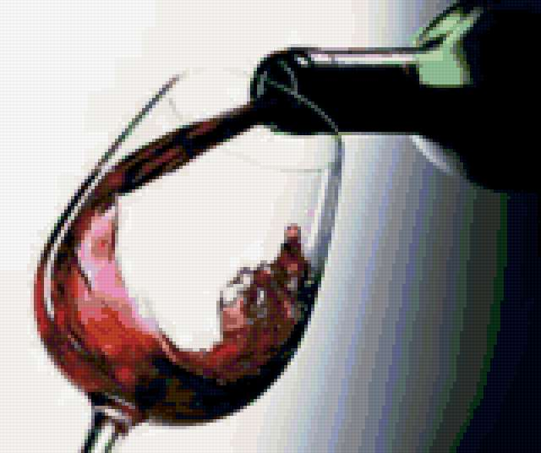
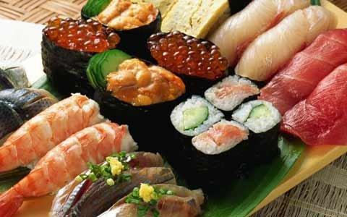
Food and drinks
In many Asian cultures, it is acceptable to smack lips during the meal.
In America you should eat your hamburger as fast as possible.
In Chine your host will keep refilling your dish unless you lay your chopsticks across.
In Japan, the chopsticks is not accepted vertically stuck into your plate with rice.
In Georgia, during the traditional feast is considered disrespectful to drink wine, slowly sipping a drink from the glass - only one gulp and to the bottom after each toast.
If you come to the middle East or in India you must not eat with your left hand.

Slide 9
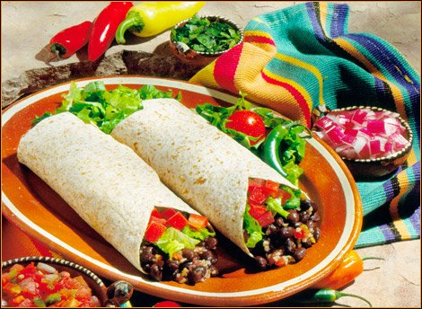
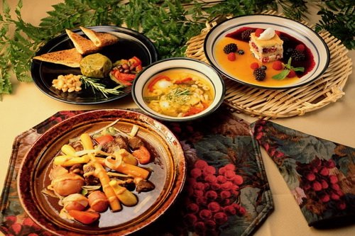
If you are China, it will never turn the fish on the plate back.
In Italy you should not order cappuccino in three hours to or after dinner.
Recommend you avoid a knife and fork to eat Mexican tacos.
In France should not eat bread as a snack. It is recommended to eat as a supplement to the main dish or with cheese, which is served in the end of the meal.
In Chile never eat with hands.

Slide 10
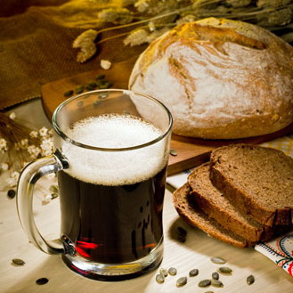
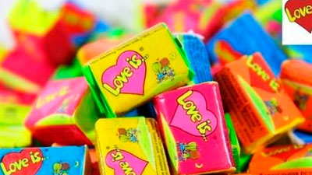
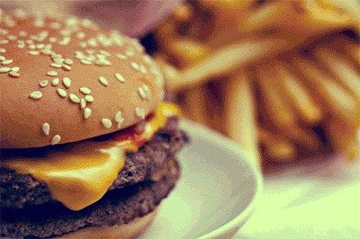

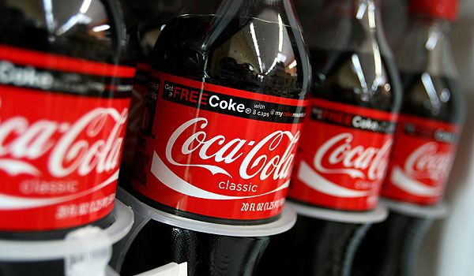
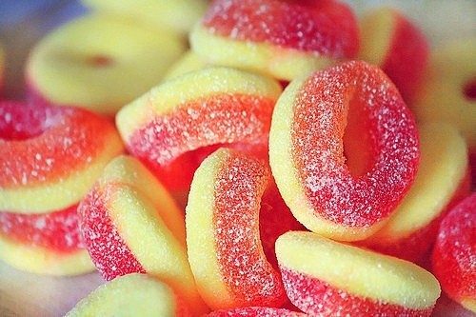
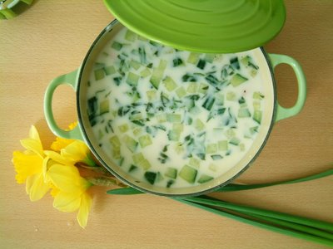
Every country is also know for its food.
England is noted for its pudding, bacon, marmalade, porridge and five-o'clock-tea.
America is the country of Coca-Cola, hamburgers and chewing gum.
Traditional Russian cooking is world-famous for such dishes as okroshka, shi, pelmeni and kvass.

Slide 11
5 Tips
1.Respect national traditions in food, holidays, religion, and leadership of the country where you are.
2.Do not compare to their country and do not criticize.
3.Always be punctual.
4. Coming not the first time in the country, make sure that on the back of your business card was information in the language of that country.
5. Names should be remembered. If the name is difficult, is not harmful to train in its pronunciation. Keep in mind that the name may indicate social status and marital status.

