Slide 1
Youth Organizations in Ukraine

Slide 2
The youth movement have become an important factor in the life of our state.

Slide 3
Youth are the future of each nation, of each country.

Slide 4
Unfortunately, some of young people prefer surfing the Internet or do nothing.

Slide 5
Different youth organizations unite young people of different towns in Ukraine.

Slide 6
There are some youth organizations. For example The Young Motherland, the Students Brotherhood, The independent Ukrainian Youth League, The Young Regions.

Slide 7
The most popular organizations is the Students Brotherhood. It unites students from all parts of Ukraine.

Slide 8
The Plast National Scout Organization of Ukraine is the largest Scouting organization in Ukraine. Their purpose is to promote patriotic education and self-developing of Ukrainian Youth.

Slide 9
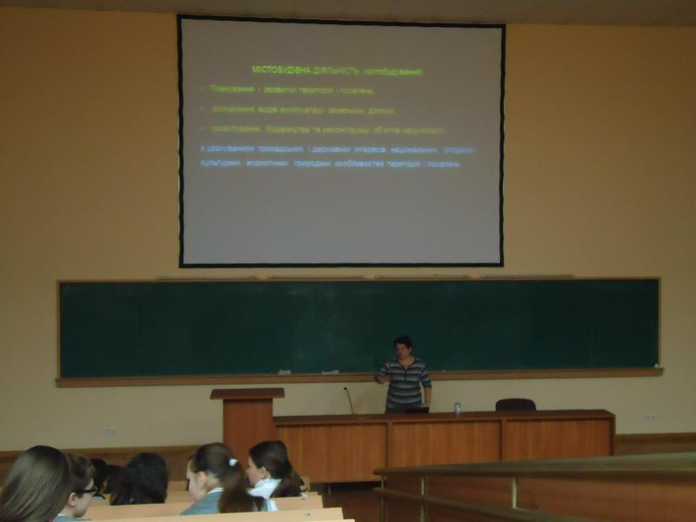
The School of Young Mayor
It is an organization in Kharkiv which learn our students how to be a leader everywhere, especially in the social life.

Slide 10
SIFE
SIFE - an international organization that brings together 57,000 students from 39 countries. For business support SIFE students create real projects in the community.

Slide 11
Thank you for attention!

